Slide 1
Analyzing the locations in Paris to open a restaurant
Capstone final project

Slide 2
Introduction
The primary objective of this project is to analyze the locations in Paris to choose a location that is ideal to open a restaurant.
The project is mainly targeted towards investors who are looking for ideal places with less competition to open a restaurant.
The task is accomplished using simple data analysis techniques in Python

Slide 3
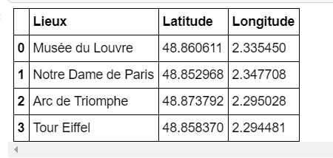
Data
(i) Paris location data accessible from “https://lvdesign.com.fr/coursera_data/paris.csv”
(ii) Further location data is accessed through FourSquare API.

Slide 4
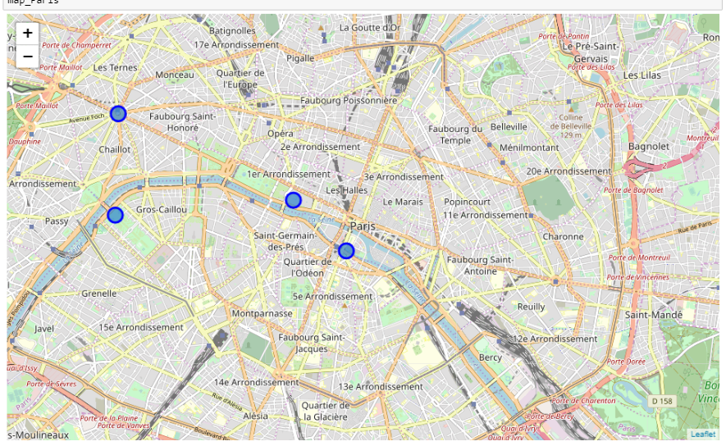
Folium map for the given data

Slide 5
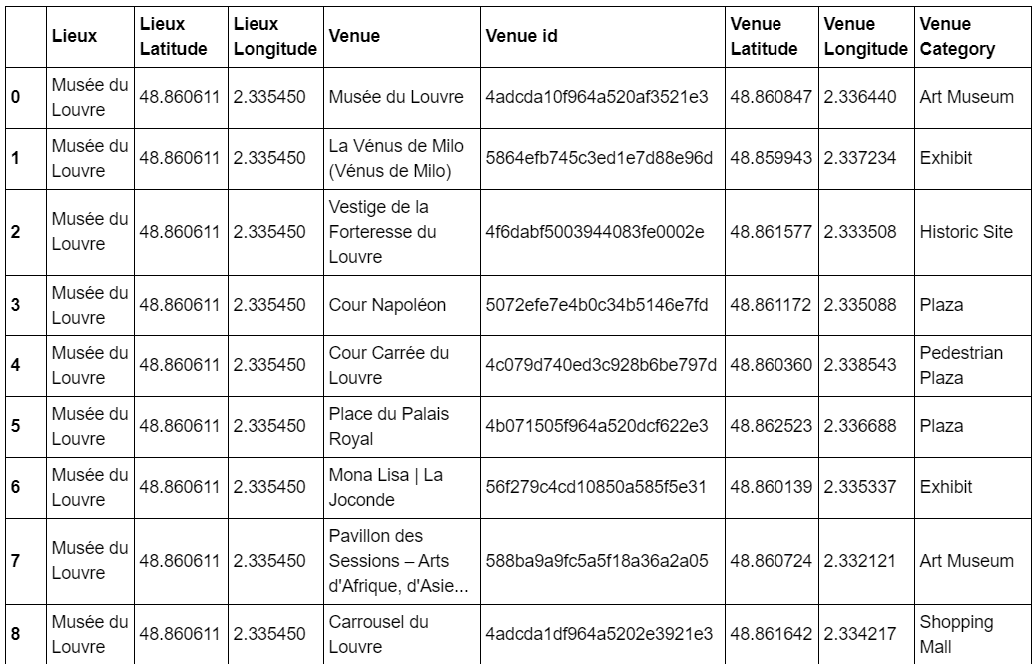
Getting the nearby venues

Slide 6
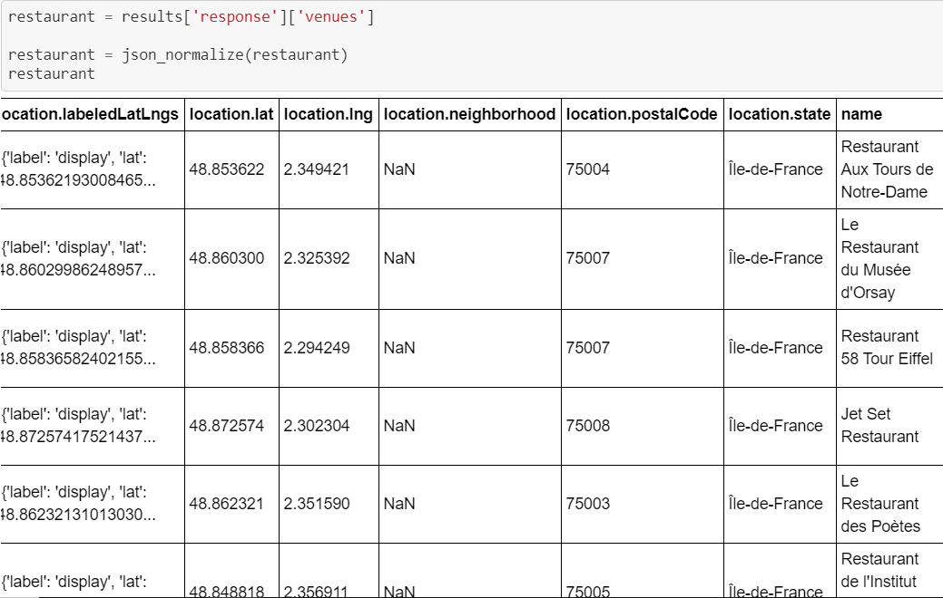
Searching for restaurants

Slide 7
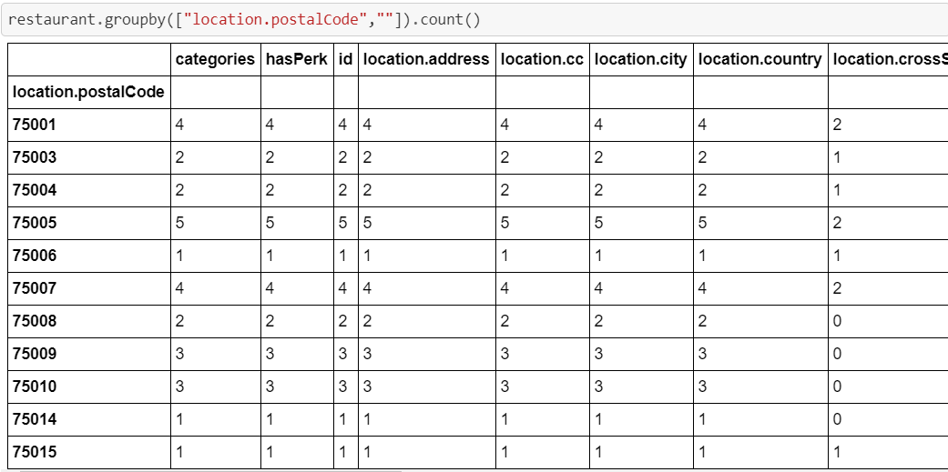
Result : To get the number of restaurants at each zip code

Slide 8
Thank you

