Slide 1




WARZONE SOEN 6441 (Advance Programming Practices)
Build 1
Kapil Soni(40290467)
Meet Boghani(40294571)
Tejasvi Tejasvi(40292854)
Nishith Soni(40289556)
Bharti Chhabra(40294202)
Yesha Shah(40290892)

Slide 2
Table of Contents
About Project
Phases of the game
MVC
Folder Structure
Class Diagram
Game Flow
Continuous Integration
Code Layout
Commenting Convention
Test Cases

Slide 3
About Project
In this project, we are developing Warzone using the Extreme Programming approach. The Warzone is produced by adhering to its features, which include continuous integration, pair programming, communal ownership, and testing.
Specifically, we are using the incremental development strategy here, releasing builds with fewer features at a time. Furthermore, the Model View Controller (MVC) architecture was used in the development of this game.

Slide 4

Phases
Map Loader Phase
StartUp Phase
Reinforcement Phase
Issue Order Phase
Execute Order Phase
Map Editor Phase

Slide 5
MVC Architecture
MVC stands for Model View Controller. It is design pattern and is used widely used in software development.
Model represents the data and business logic of application.
View is the user interface and the presentation part.
Controller handles the input from the user and then updates the model.

Slide 6
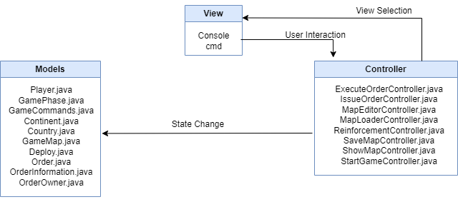
Model-View-Controller

Slide 7

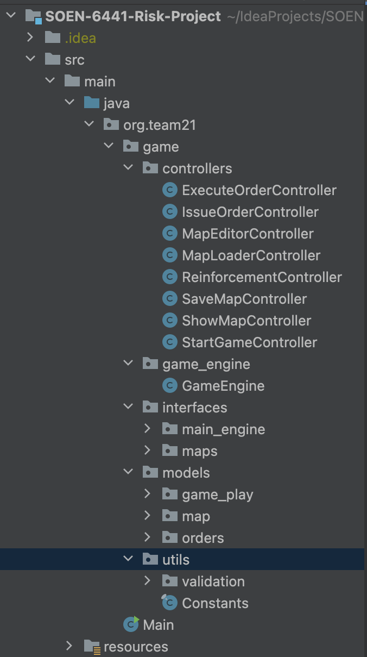

Folder Structure

Slide 8
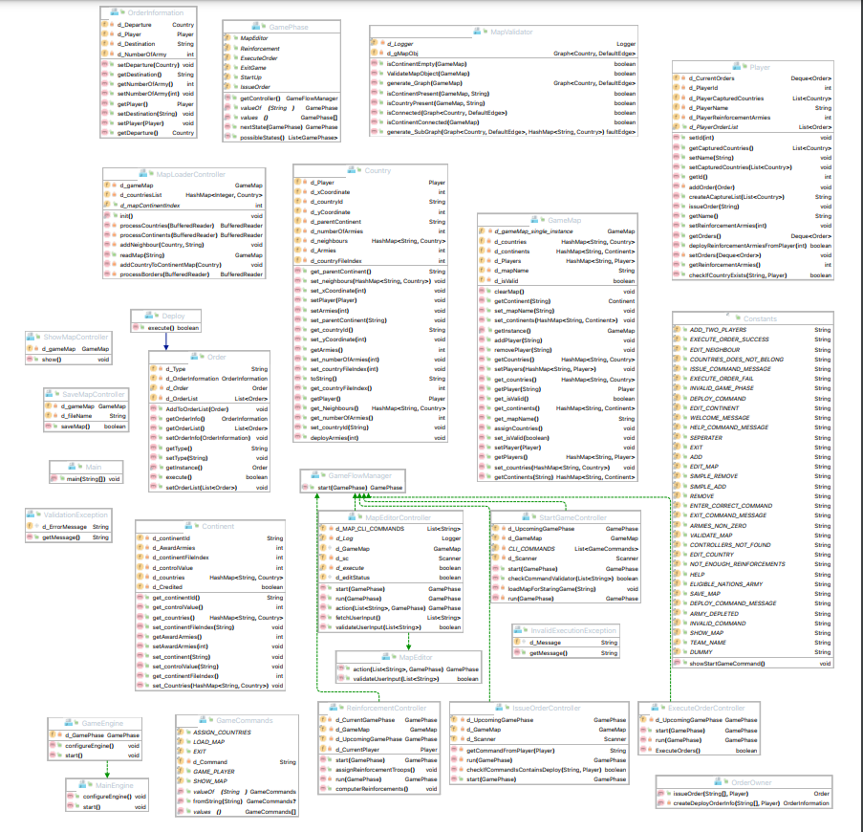
Class Diagram

Slide 9
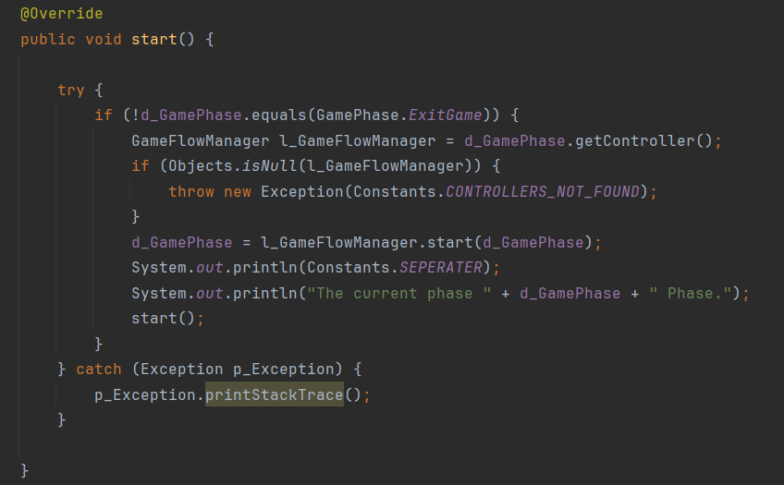
Game Flow
Here it checks for the condition until the Exit Phase and makes sure that all the phases of the game are implemented serially.

Slide 10
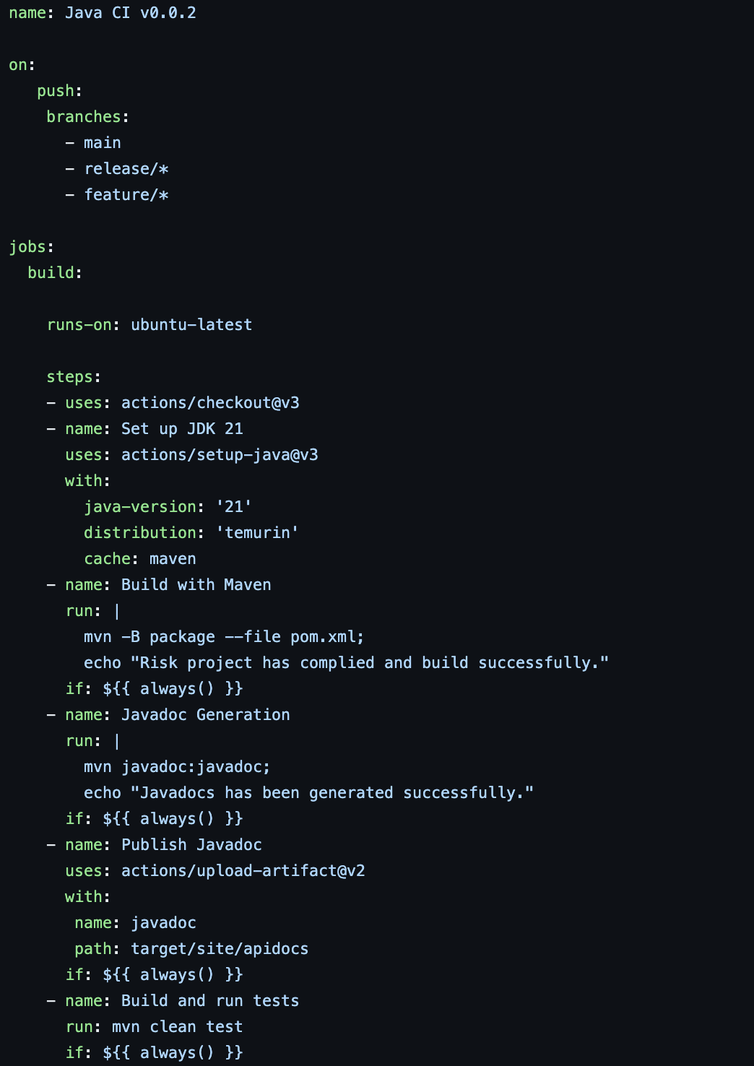
Continuous Integration
This consists of total Five steps:
Checkout
Build With Maven
Javadoc Generation
Publish Javadoc to artifacts
Build and run test

Slide 11
Code Layout
Indentation
Position of Curly Braces
Line Spacing
Spacing between Operators and Operands

Slide 12
Commenting Conventions
Javadocs
Javadocs for all the classes, data members and member functions will be mentioned above them.
/**
* mentioned above classes and methods.
*/
@return type description
@param parameter_name description
@throws exception description

Slide 13

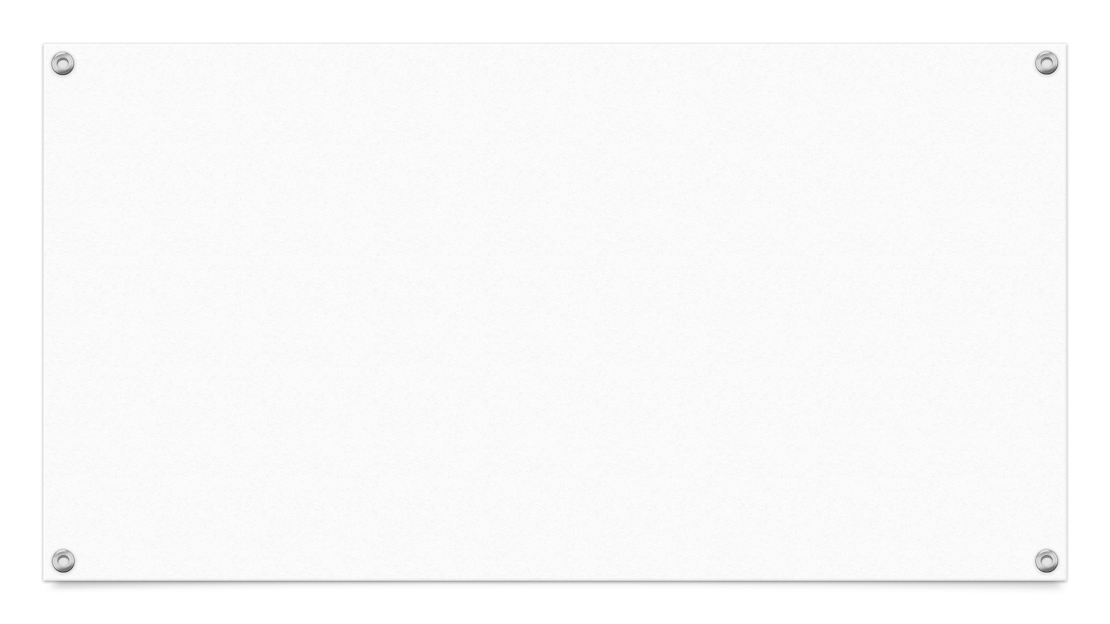
Testing
Here we are using JUnit version 4 for our testing purpose.
We have tested few models such as country, continent, game map, player.
On top of that, we have also tested controller such as reinforcement controller.
We have also validated map with help of map validator test.

Slide 14
THANK YOU

