Slide 1
Eternity – σ (Standard Deviation)
SOEN 6011
SOFTWARE ENGINEERING PROCESSES
SUMMER 2024
By – Tejasvi (40292852)
Wednesday –
24 July 2024

Slide 2
Introduction & Agenda
Standard deviation, denoted as σ, is a fundamental concept in statistics. It provides a measure of the amount of variation or dispersion in a set of values. A low standard deviation indicates that the values tend to be close to the mean, while a high standard deviation indicates that the values are spread out over a wider range. In this presentation, we will explore these questions by implementing a standard deviation function in Java from scratch, adhering to the ISO/IEC/IEEE 29148 Standard for software requirements.
Agenda –
Problem Statement
Functional and Non-Functional Requirements
What’s new in this build
Conclusion

Slide 3
Problem Statement
We're tasked with creating a standard deviation function in Java, built from scratch. This function must adhere to the ISO/IEC/IEEE 29148 Standard for software requirements. The challenge lies in ensuring accuracy, efficiency, and compliance with the standard, while also providing a user-friendly graphical interface.

Slide 4
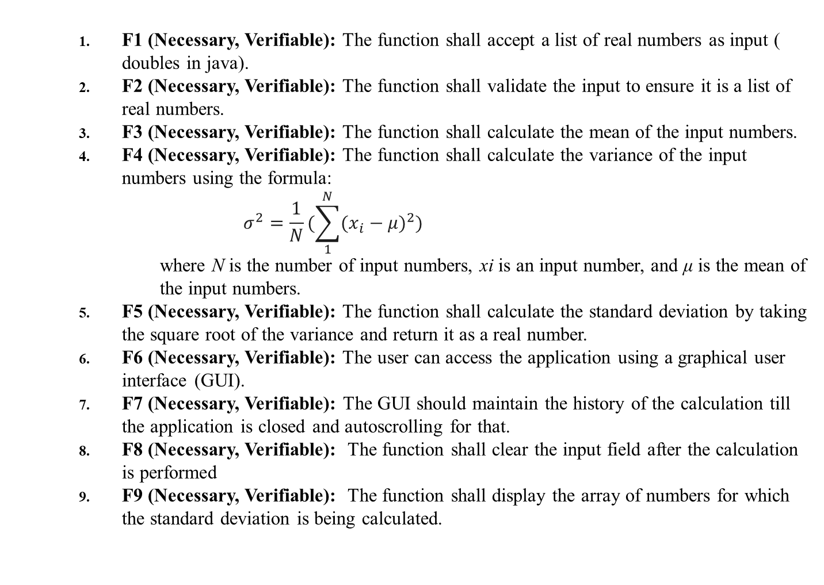
Functional Requirements
F1 (Necessary, Verifiable): The function shall accept a list of real numbers as input ( doubles in java).
F2 (Necessary, Verifiable): The function shall validate the input to ensure it is a list of real numbers.
F3 (Necessary, Verifiable): The function shall calculate the mean of the input numbers.
F4 (Necessary, Verifiable): The function shall calculate the variance of the input numbers using the formula:
$$σ^{2}=\frac{1}{N}(\sum_{1}^{N}{{(x_{i}−μ)}^{2}})$$
where N is the number of input numbers, xi​ is an input number, and μ is the mean of the input numbers.
F5 (Necessary, Verifiable): The function shall calculate the standard deviation by taking the square root of the variance and return it as a real number.
F6 (Necessary, Verifiable): The user can access the application using a graphical user interface (GUI).
F7 (Necessary, Verifiable): The GUI should maintain the history of the calculation till the application is closed and autoscrolling for that.
F8 (Necessary, Verifiable): The function shall clear the input field after the calculation is performed
F9 (Necessary, Verifiable): The function shall display the array of numbers for which the standard deviation is being calculated.

Slide 5
Non-Functional Requirements
Non - Functional Requirements :
NF1 (Necessary, Verifiable): The function shall handle large lists of numbers efficiently.
NF2 (Necessary, Verifiable): The function shall return accurate results up to a reasonable precision.
NF3 (Necessary, Verifiable): The function shall provide error messages for invalid inputs.
NF4 (Necessary, Verifiable): Use of modular functions and classes for maintainability.
NF5 (Necessary, Verifiable): The function shall have a visually appealing GUI.
NF6 (Necessary, Verifiable): The Code should be independent of specific tools and IDE for builds.
Assumptions :
A1 (Necessary): It is assumed that the input list is not empty.
A2 (Necessary): It is assumed that the input numbers are real numbers.
A3 (Necessary): It is assumed that JRE is installed on the user’s PC.
F, NF, A are the prefixes for the ids of the requirements whose meaning is self explanatory.
The changes from the previous requirements are:
FR6 has been updated to reflect the use of a GUI instead of a textual user interface.
FR7, FR8 and FR9 are new functional requirements based on this latest build.
NFR5 and NFR6 is a new non-functional requirements.

Slide 6
What’s New
In the previous version of this project we had a textual user interface but our requirements changed and we have to convert that to a Visual Graphical UI. Below are the key changes to the project from previous build
Creation of JFrame – Created a Jframe which acts as a main window to the application
Component Addition - Added several components to the JFrame, including a JLabel to display text to the user, a JTextField for the user to input their numbers, a JButton that the user can click to calculate the standard deviation, and a JTextArea to display the results.
Event Handling - You've added an ActionListener to the button, which gets triggered when the user clicks the button. In the event handler, you parse the user's input, calculate the standard deviation, and display the result in the text area.
Exception Handling - Added exception handling to the event handler. If the user's input is invalid (i.e., not a list of real numbers), an exception is thrown, caught, and a helpful error message is displayed to the user.
Separation of Concerns - Separated the standard deviation calculation into its own Standard Deviation class, keeping the GUI code separate from the mathematical logic. This makes the code more maintainable and easier to understand.
Visual Enhancements - Made some visual enhancements to the GUI, such as setting a background color and a title for the JFrame.

Slide 7
Conclusion
In conclusion, we have walked through the process of implementing a standard deviation function in Java from scratch and a GUI to access the function, adhering to the ISO/IEC/IEEE 29148 Standard for software requirements. We've seen how well-defined requirements can guide the implementation process and ensure the function is robust, accurate, and user-friendly. This exercise underscores the importance of standard deviation in statistical analysis and scientific computing, and the value of implementing mathematical functions from scratch while adhering to software requirements standards.

Slide 8
References
References:
ISO/IEC/IEEE 29148:2018(E) - Systems and software engineering -- Life cycle processes -- Requirements engineering.
Standard deviation (2024) Wikipedia. Available at: https://en.wikipedia.org/wiki/Standard_deviation (Accessed: 04 July 2024).
Estimating Square Roots - https://gregorygundersen.com/blog/2023/02/01/estimating-square-roots/
Java Swing - https://www.javatpoint.com/java-swing

