Slide 1



BookTown.com: An Online E-commerce Web Application
Presented by
Tejasvi Khandait(229226)
Amruta Varade(229230)
Under the guidance of :
Mr. Narendra Pawar

Slide 2
Content
Introduction
Objectives
Technologies Used
System Design
UML Diagrams
Snapshots
Advantages and Disadvantages
Future Work

Slide 3
Introduction
Online shopping is the process whereby consumers directly buy goods, services etc. from a seller interactively in real-time without an intermediary service over the internet.
BookTown.com is an online website based e-commerce where the customer can purchase books online in a secure and efficient manner. This website provides an interactive interface through which a user can interact with different areas of application easily by maintaining the product’s as well as customer’s information.
It includes smooth functionality and efficiency that adds to buyer’s confidence. BookTown.com keeps a constant focus on new category creation and expansion of products.

Slide 4
Objective
Our objective is to design such an application using which one can say 'goodbye' to the days when you stood in line waiting, and waiting some more for a store clerk to finally check out your items.
Our main aim is to design such a bookstore where customers can visit our site anytime of the day from anywhere to view the available books, choose any of them and can order by paying online.
The administrator will regularly add any new books available to them for sale. The administrator will take books from the reputed vendors only. More specifically, this designed system will allow registered users to search for specific books and order online.

Slide 5
Technologies Used
Front End: React Js
Back End: Java Spring Boot
Database: MySQL

Slide 6
System design
Admin
Login/Logout
Manage Suppliers
Manage Books
Manage Categories
View Users
View Order Details
Customer
Register, Login, Logout
Browse Books
View/ Update Profile
Update Delivery Address
Add To Cart
Place Orders
View Order History

Slide 7
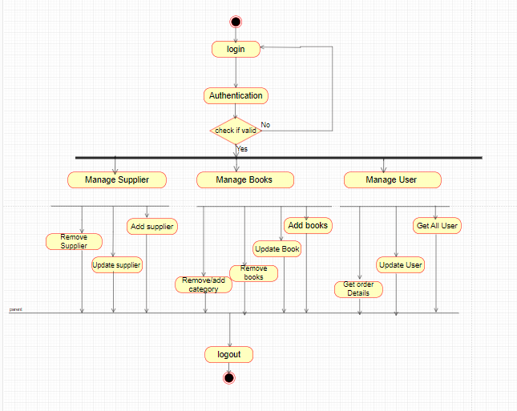
Activity Diagram: Admin

Slide 8
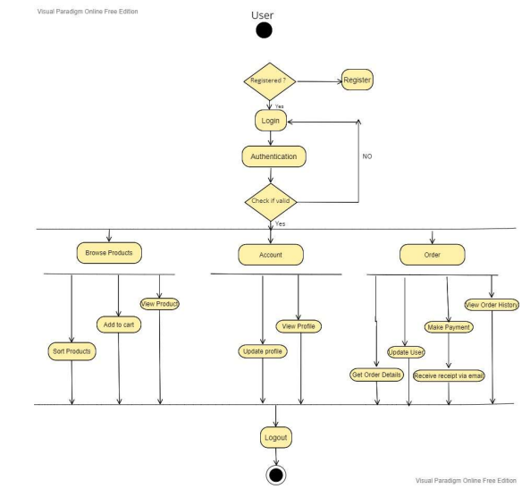
Activity Diagram: User

Slide 9
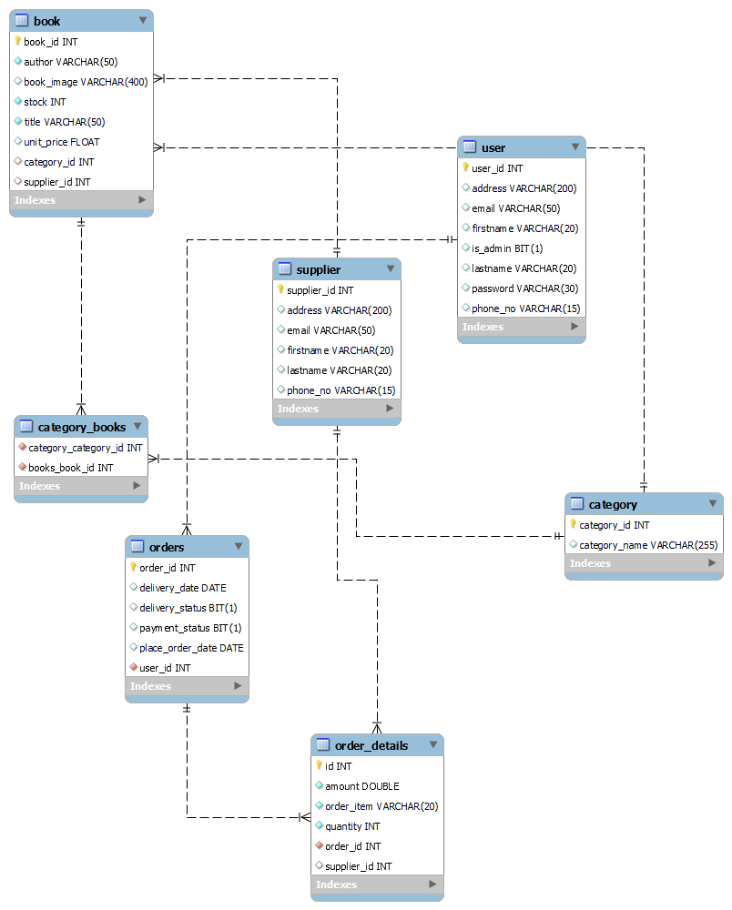
Fig. ER Diagram

Slide 10
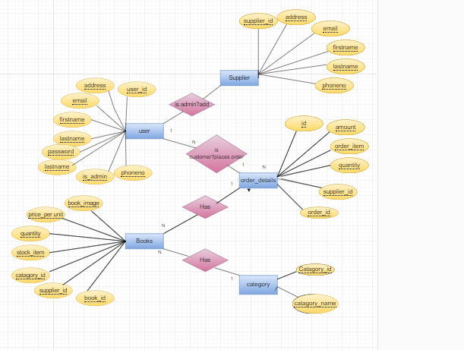
Fig. ER Diagram

Slide 11
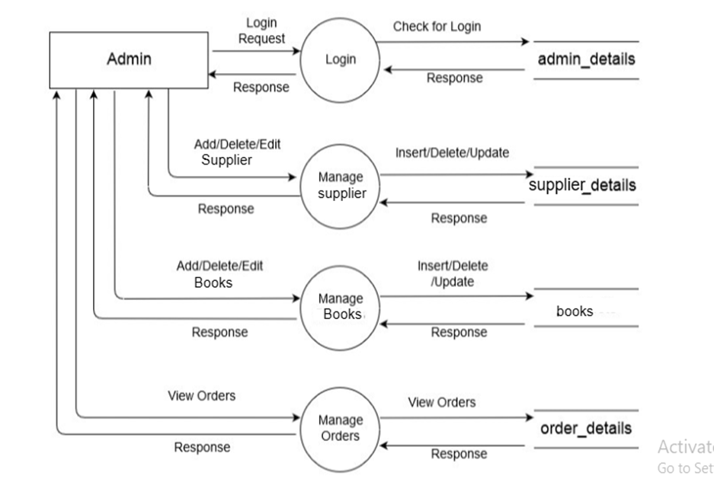
Admin DFD

Slide 12
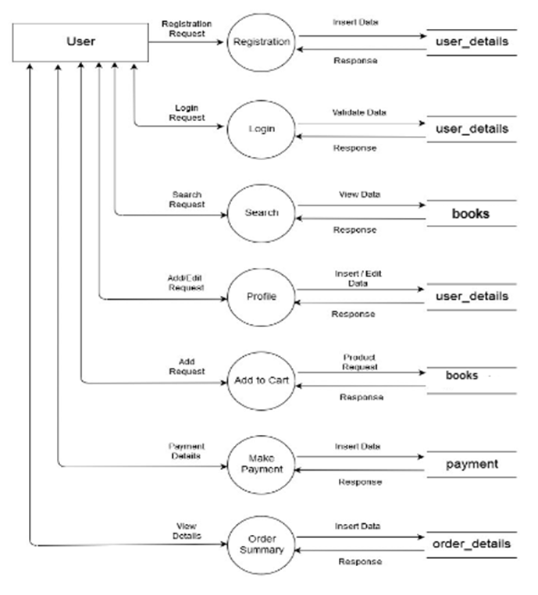
Customer DFD

Slide 13
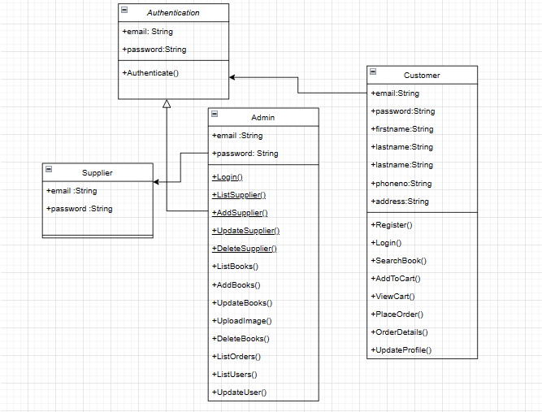
Customer DFD
Class Diagram

Slide 14
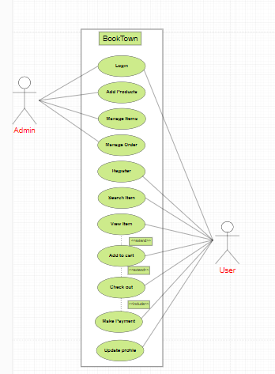
Use Case Diagram

Slide 15
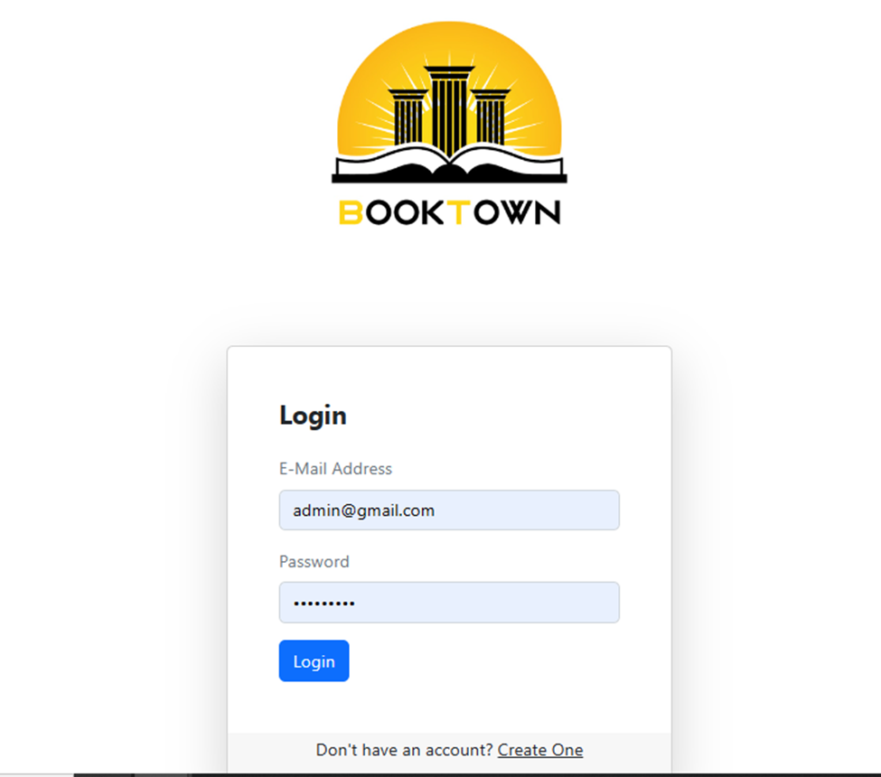
Project Screenshots
Login Page

Slide 16
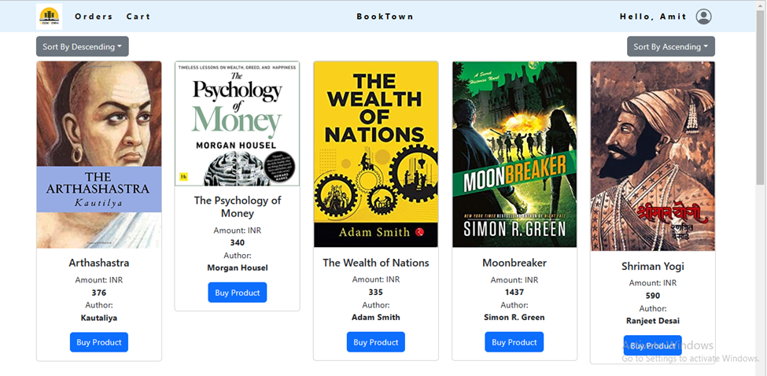
Home Page

Slide 17
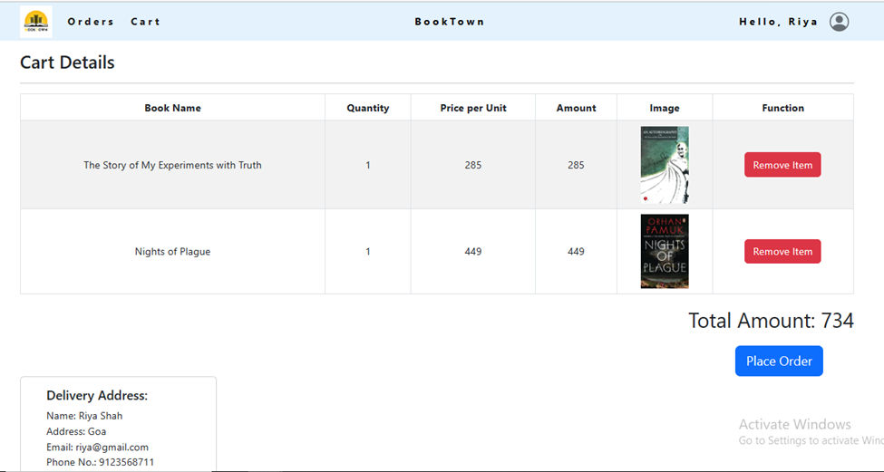
Cart Detailss

Slide 18
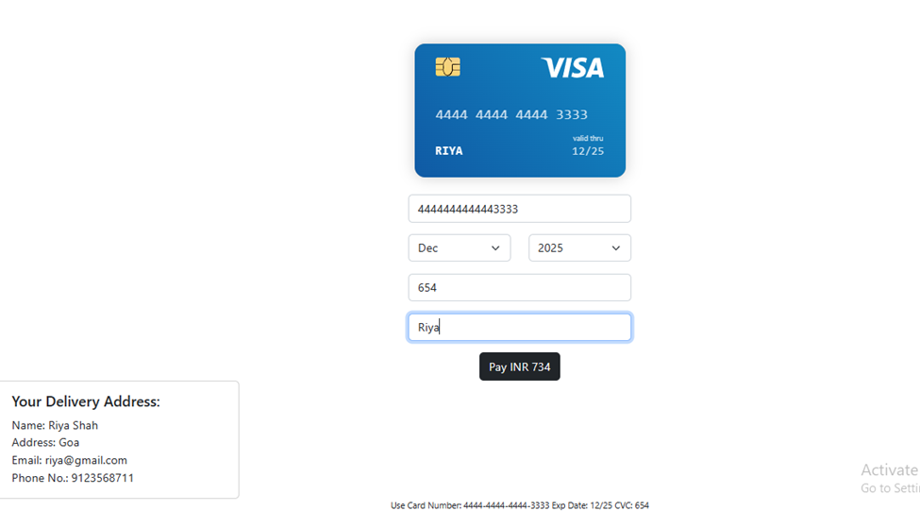
Payment Gateway

Slide 19
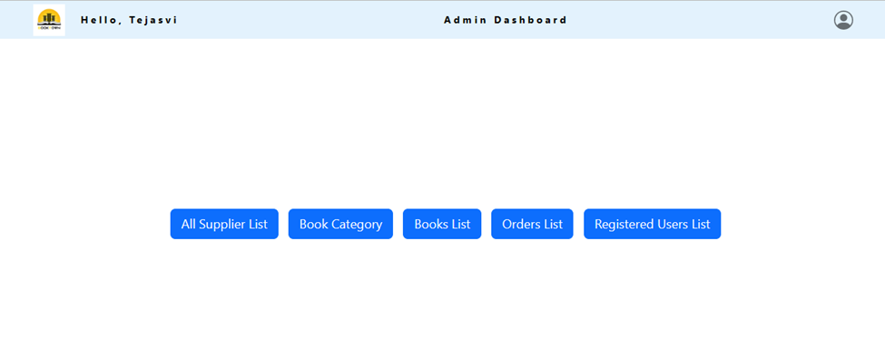
Admin Dashboards

Slide 20
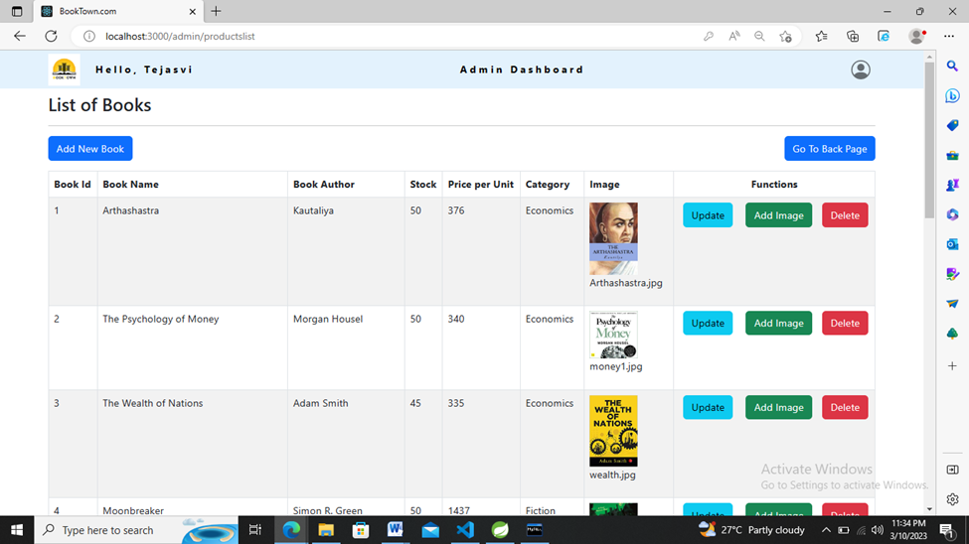
Admin :List of Bookss

Slide 21
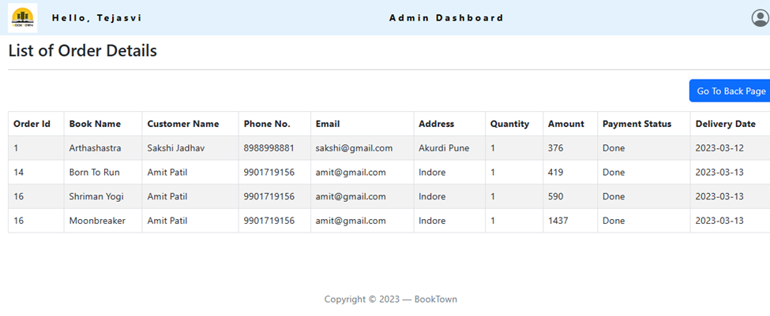
Admin :List of Order Details

Slide 22
Advantages
BookTown.com is an online website based e-commerce where the customer can purchase books online in a secure and efficient manner.
It includes smooth functionality and efficiency that adds to buyer’s confidence.
Effortless Communication
Lesser time requirement to maintain and manage records of books, users, suppliers, orders, etc.
BookTown.com keeps a constant focus on new category creation and expansion of products.
Paper work is reduced

Slide 23
Disadvantages
Rating and reviews facility not included
Payment gateways can be provided additional features
Password resetting not included.

Slide 24
Further work
Rating chart for Supplier and Books.
Customers can upvote/downvote/report feedback.
Additional payment means can be added other than cards.
In case the user forgets the password, a ‘reset password’ functionality can be added.

Slide 25
Conclusion
In conclusion, “BookTown.com” is an application that would definitely be a good choice for any book merchandise trading Supplier that wishes to enter the online market.
At the same time, it provides a one-stop platform for Customers to purchase their daily needs of merchandise directly from authenticated Suppliers. We are confident that the numerous features and visually appealing look of application will certainly give a big boost to the Supplier.

Slide 26
References
https://reactjs.org/docs/getting-started.html
https://www.baeldung.com/
https://www.w3schools.com/
https://docs.spring.io/springdata/jpa/docs/current/reference/html/#reference
https://javaee.github.io/javaee-spec/javadocs/

Slide 27
Thank You

