Slide 1
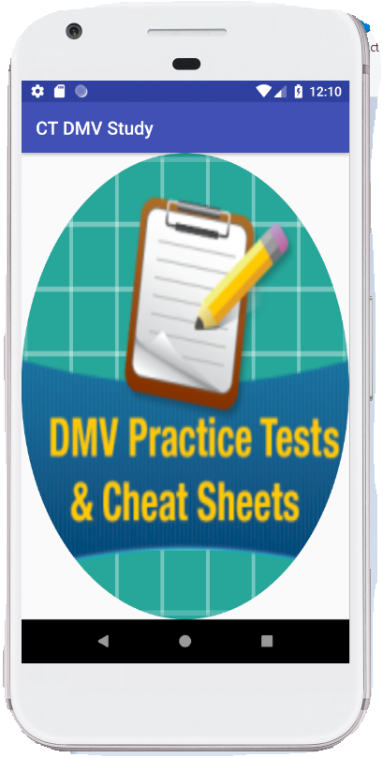
CT DMV Study
Developed By:
SADIDA SIDDIQUI,
TEJASVINI SHELAR,
COMPUTER SCIENCE
PACE UNIVERSITY
Guided By:
Prof.CHRISTELLE SCHARFF
CS Dept Chairperson
Pace University

Slide 2
PURPOSE:
It is a mandatory requirement for every person above 18 years to first pass Connecticut DMV learners permit test before the dmv can issue him/her permanent license to independently drive on road. For this test, CT DMV has provided 60-page driving rules manual which includes rules, procedures, traffic regulations and related study details.
It is difficult for an individual to read the entire 60-page manual and remember all the rules and regulations . Recapitulating the same 60-page manual to the user through MCQs and a mobile application will make user’s life easy and will help the user to prepare for the test in minimal amount of time. Also, it will give a real life exam experience to the user which will increase his chances of passing the examination.

Slide 3
Research & DEVElopment:
After gathering reviews from several people, I observed that most of the CT DMV applications are not in sync with the recent DMV official manual. The questions and quiz in these present applications are not exactly covering all the points from the CT DMV Manual. Our App will majorly focus on creating the quiz questions and solutions directly from the official manual which will make it more realistic and dynamic for the users to give them a real test experience. MCQ preparation is the easiest preparation technique instead of reading the entire DMV manual, so we will try to create maximum number of MCQ questions which will cover the maximum important points from the manual so that just referring the application will be enough and studying will be fun.

Slide 4
existing applications:
1. Permit Test Connecticut CT DMV
https://play.google.com/store/apps/details?id=com.spotterlook.driverstartct
2. Connecticut DMV Practice Test
https://play.google.com/store/apps/details?id=connecticutDMVconnecticut.DMVtestQUIZct.CTtestDMVroadSIGNsignsROADsignSIGNS
3. Connecticut DMV Permit Practice Test
https://play.google.com/store/apps/details?id=ga.spartaner.www.drivingtestct
Connecticut Driving Test
https://play.google.com/store/apps/details?id=com.rjconlinemarketing.applications.app56fc19c8dc29c
5. DMV Driving Test
https://play.google.com/store/apps/details?id=com.itkakaam.ctdriversdmvtest

Slide 5
Introduction:
CT DMV Study is an android application that prepares you for driving and takes you through the experience of taking electronic examination at DMV office.
It provides a set of tests that takes you through questions that enhances your knowledge about dmv road, traffic and safety regulations and violations related to sign boards, signals, speed limits, hazard conditions, drunk driving, work and construction zones etc.
It also provides you an official dmv manual and booklet that contains in depth information regarding driving techniques and safety ways to promote safe and defensive driving.

Slide 6
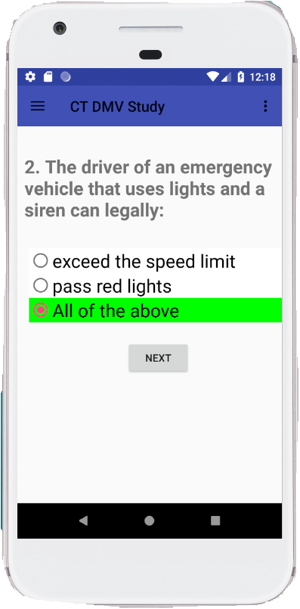
AdVANTAGES:
User Friendly Look And Feel
Easy Experience of Electronic Examination Conduct.
Fast And Light Application
A Quiz Experience that provides Self Evaluation

Slide 7
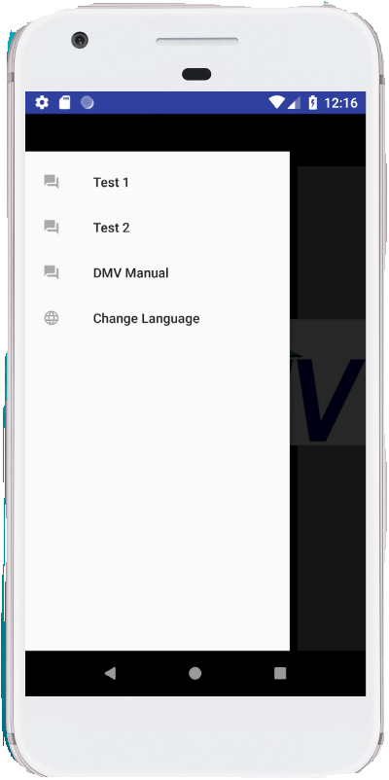
VISUAL Features:
A Navigation Drawer that contains
TEST SETS
DMV MANUAL VIEW
LANGAUGE CHANGE SETTINGS
An Option Menu that provides
SETTINGS
HELP

Slide 8
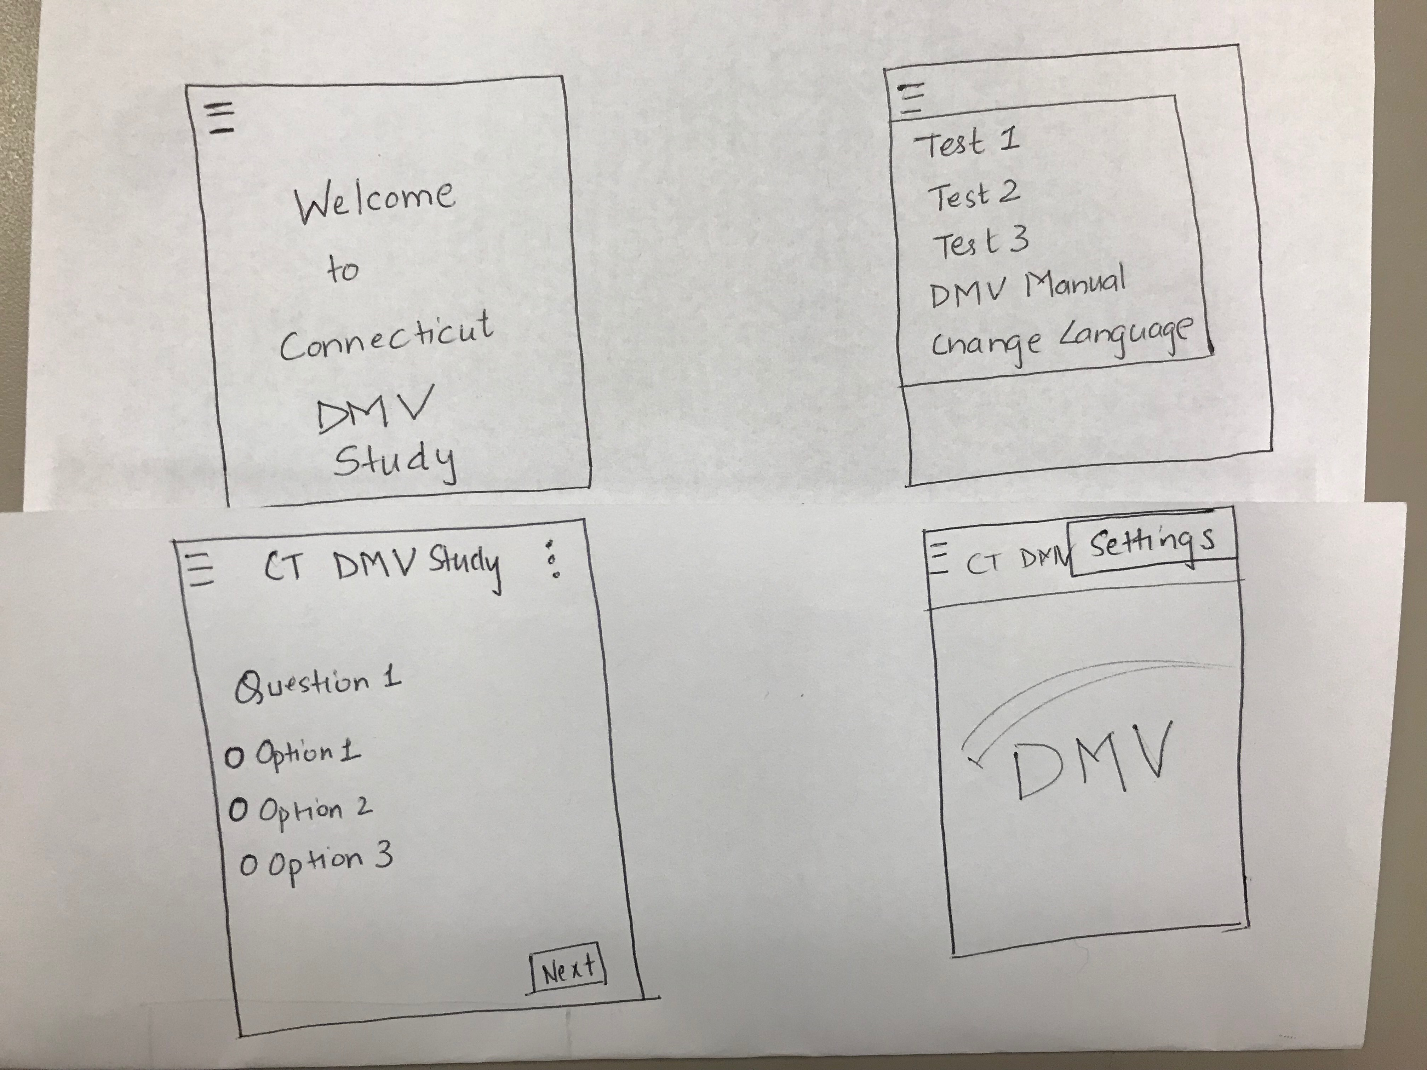
DESIGN

Slide 9
Users
This application will be used by Connecticut local residence who don’t have a driving license or person who has just become eligible for applying for the driving license.
The other users of this app will be international students or eligible non-immigrants like H1B, H4, L1, L2 visa holders who come to USA, Connecticut for education and temporary job perspective. Finally, this is a driving education app so anyone who wants to go through the rules and regulations of driving can utilize this application.

Slide 10
Technology
COMPATIBILITY VERSION
MIN SDK:19 ( KITKAT4.4)
TARGET SDK:27 (Oreo 8.1)
TOOLS
IDE: Android Studio
Database:Firebase
LANGAUGE

Slide 11
Current status OF App
Test 1 uses data from firebase using internet.
Test 11 uses data from json files.
DMV manual is programmed to be viewed inside of this app
The development of language module is still is in process.

Slide 12
VIDEO: APP PRESENTATION
LINK
https://www.youtube.com/watch?v=fuapt6B_Wws

Slide 13
ThANK YOU Happy Driving!

