Slide 1
Transactions_Reporting
File created on: 5/7/2019 4:42:15 PM

Slide 2
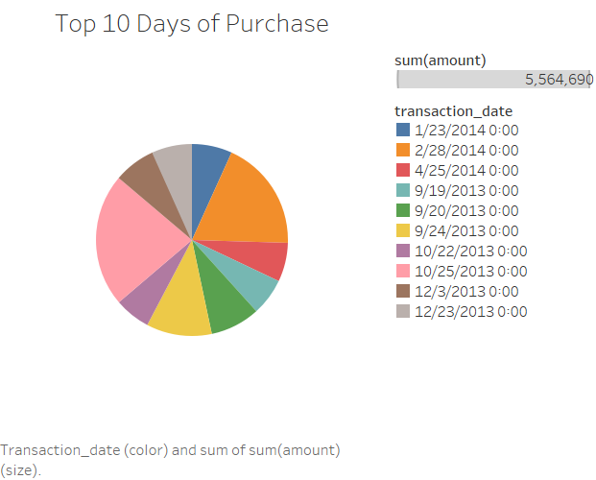

Slide 3
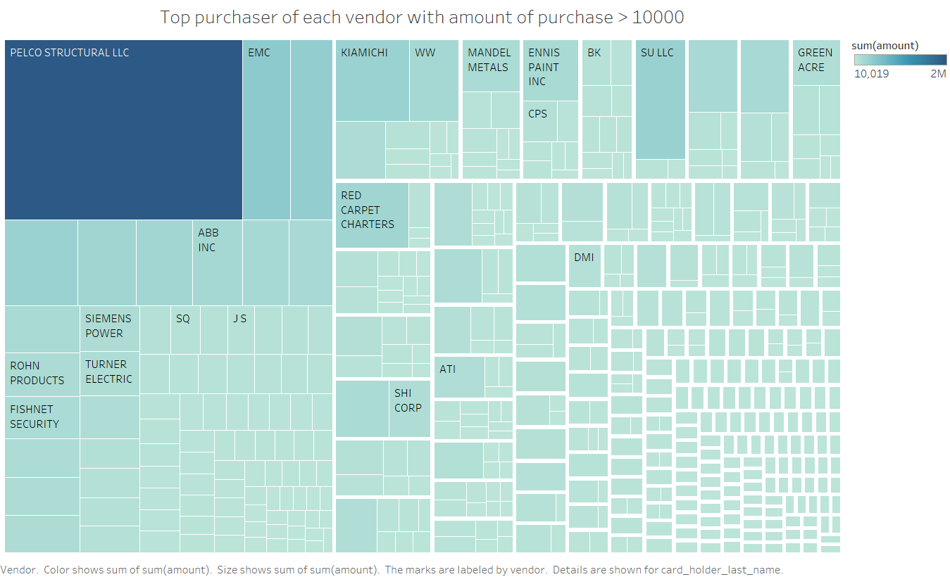

Slide 4
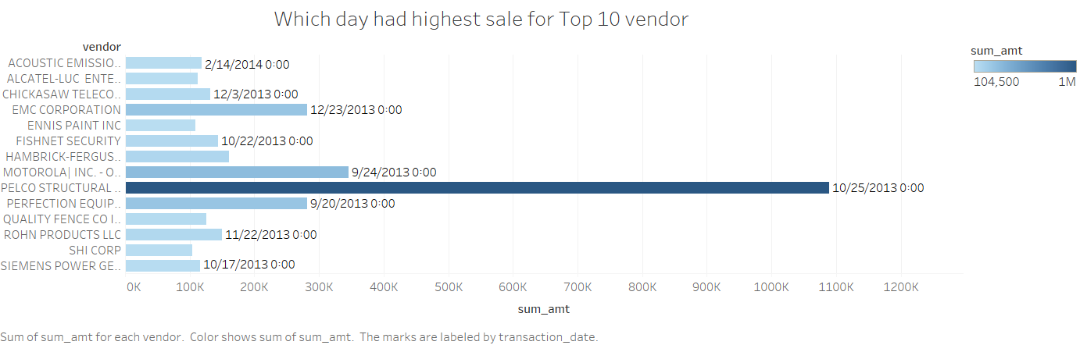

Slide 5
