Slide 1
transaction_per_vendor
File created on: 5/7/2019 3:49:58 PM

Slide 2
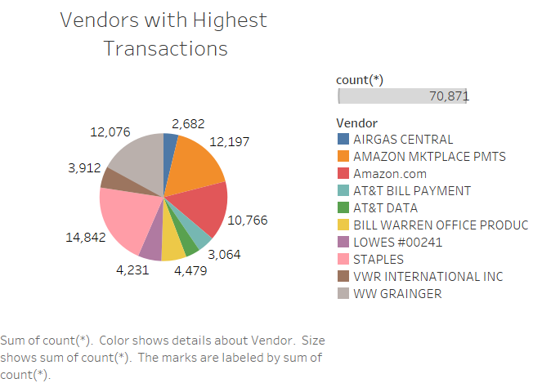

Slide 3
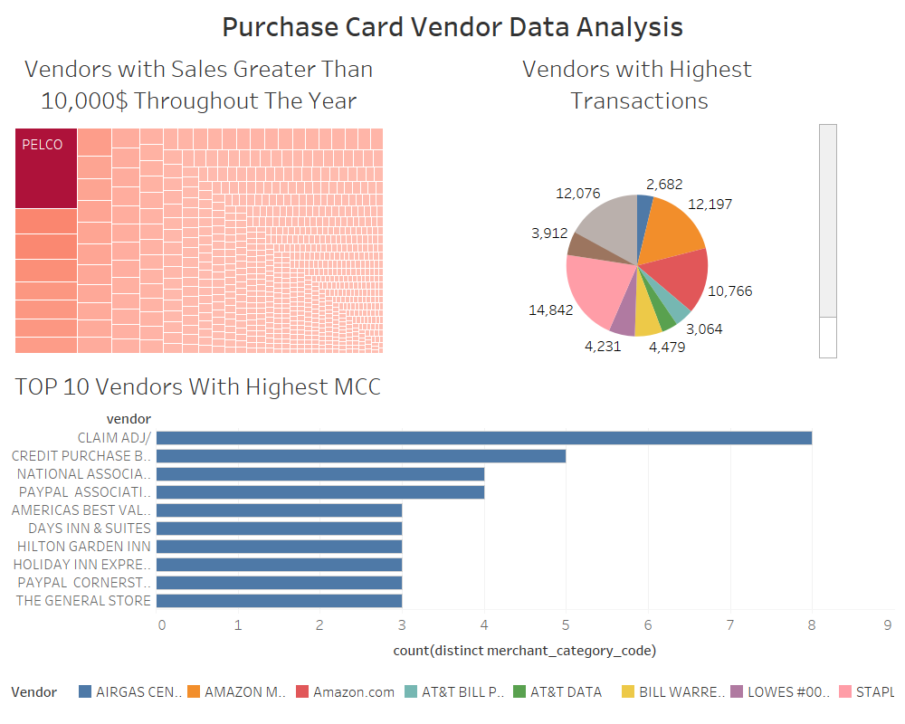

Slide 4
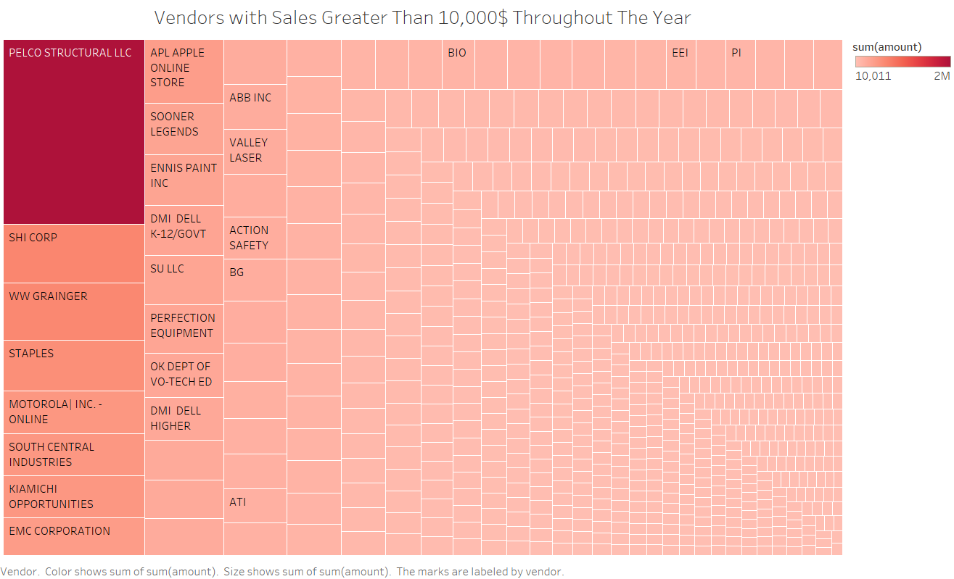

Slide 5
