Slide 1
Graph Clustering Algorithms
Presented By:
Kishore Kumar Kalathur Chenchu (M21CS058)
Prabhala Sandhya Gayatri (M21CS060)
Tejaswee A (M21CS064)
Instructor:
Dr. Anand Mishra

Slide 2
Objective
There exist many universally accepted graph clustering algorithms with the best strategies
but usage of each algorithm depends on the use case. Given the constraints, optimizing these
graph clustering algorithms is an NP-hard problem. Therefore, among the available best
strategic graph clustering algorithms, our task is to explore a few of them that have a wider
range of applications.

Slide 3
Graph Clustering Measures
The quality measures of a clustered graph is identified as follows:
1. Combination of less inter-cluster edges and more intra-cluster edges gives better and
higher quality
2. Inseparable Cliques
3. Connected Clusters
4. Disjoint Cliques approaching maximum quality

Slide 4
Graph Clustering Approaches
The Graph Clustering Approaches are majorly classified as:
Top-down: In this approach starting with one-cluster, we split to form smaller
clusters in iterative manner.
Bottom-up: It starts with singleton set of individual data points and merge them to
form clusters.
Local Optimization: Starting with random clustering, we migrate towards the nodes.

Slide 5
Graph Clustering Algorithms
Top down:
k-means - minimizing the distance squared
k-center - minimizing the maximum distance
k-median - minimizing the average distance
Bottom up:
Greedy Agglomeration
Markov Clustering and Random Walks
Local Optimization :
Local Moving and Multilevel algorithm
Others:
Clique Percolation

Slide 6
TOP-DOWN APPROACH

Slide 7
k-Means Clustering
k-Means stores the k-centroids that are useful to define the clusters.
k-Means works for a set of samples having features with no labels mentioned. Hence, grouping the samples into clusters is used to find the related sample data.
For finding centroids using k-Means, we iteratively choose the nearest data points by calculating Euclidean distance with the centroid and assigning such data points to a cluster by calculating the mean.
Clustering the data points terminate when either the number of centroids are not changing further or it has reached the maximum number of iterations.

Slide 8
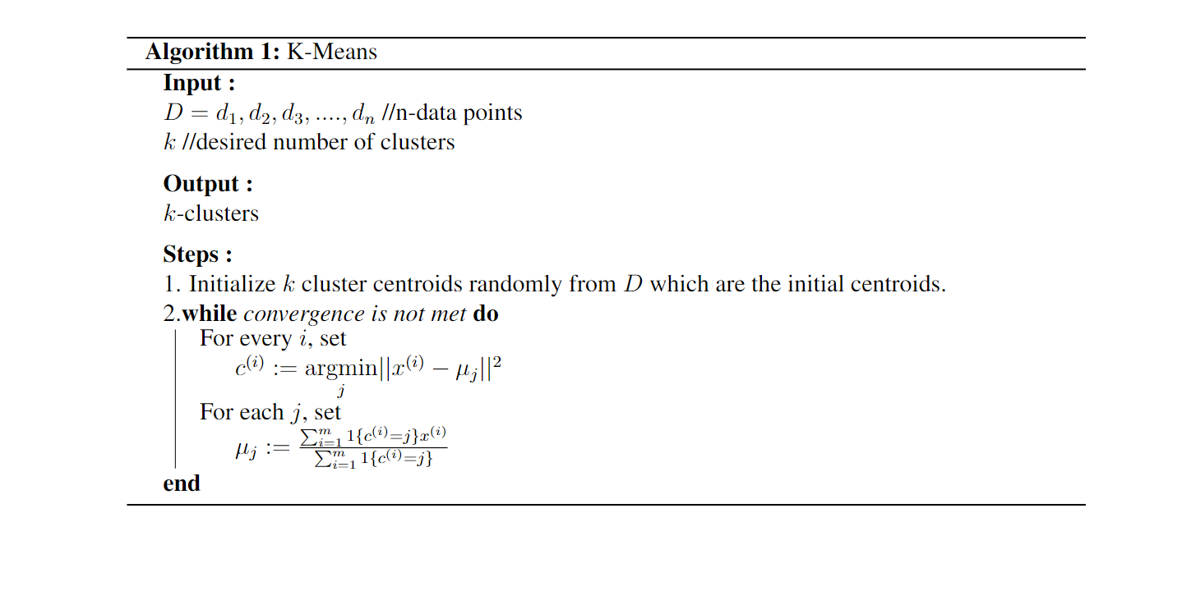
k-Means Algorithm

Slide 9
Example
K = 4

Slide 10
k-Center Clustering
k-Center Clustering, for each cluster, considers the farthest sample data from the centroid.
On the clusters level, it takes into consideration of the worst cluster whose data point has the maximum distance from the centroid in comparison to other clusters.
k-Center clustering is NP-Hard problem and solving them in polynomial time is highly unlikely to achieve.
Therefore, approximation algorithms such Greedy algorithms, Local search are preferred.

Slide 11
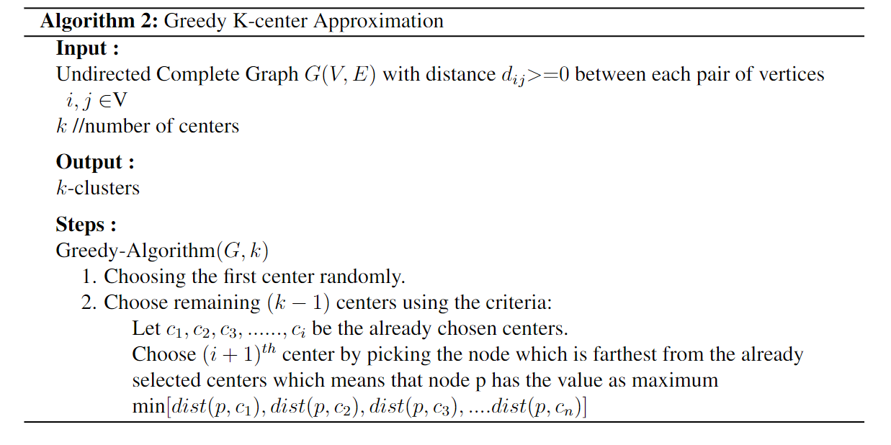
Greedy k center Algorithm

Slide 12
Example
Given k = 2, the most optimal solution is to place the routers near rooms C and D where the maximum distance becomes 6.
Let us consider a hostel block where the rooms are distance (in meters) apart as shown in the graph below. The authorities decide to establish Wi-Fi connection with routers placed at specific distances so that every occupant is equally benefited. Our aim is to find minimum numbers of routers to be installed.
10
A
B
3
4
8
5
C
D
6

Slide 13
k- Median Clustering
Generally Medians are less sensitive to the outliers when compared to the Means.
K-medians approach aims at minimizing the 1-norm distances (Manhattan-distance) of every data point and its closest center to the cluster.
Using median as the statistic to determine the clusters’ centers, it minimizes the distance between the data points to the center to form appropriate clusters.
Mean is highly vulnerable to outliers, even a single outlier can change the value of mean making it distant from other data points whereas median is highly resistant to outliers. This may require more than 50% of the data points to be differed in order to change the value of median.

Slide 14
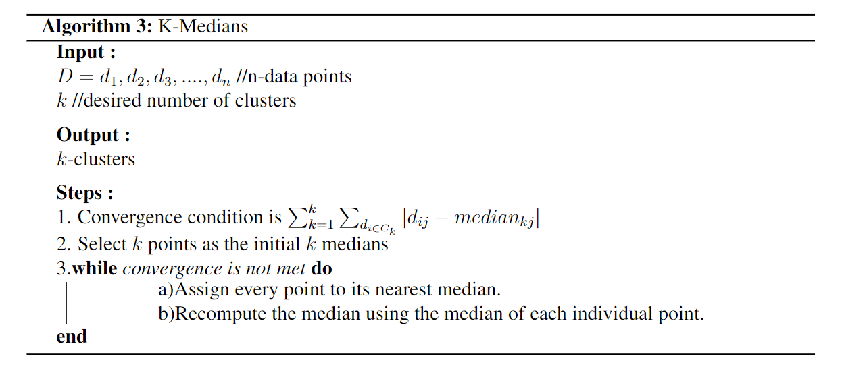
k-Median Clustering

Slide 15
Example
(6,7)
(2,6)
(6,7)
(2,6)
(6,6)
(6,6)
(3,5)
(4,5)
(3,5)
(4,5)
(1,4)
(5,4)
(1,4)
(5,4)
(3,3)
(5,3)
(3,3)
(5,3)
(4,2)
(4,2)
Randomly choosing c₁ as (3,5) and c₂ as (6,6)

Slide 16
Points | Dissimilarity from c1 | Dissimilarity from c2
(1,4) | 3 | 7
(2,6) | 2 | 4
(3,3) | 2 | 6
(3,5) | - | -
(4,2) | 4 | 6
(4,5) | 1 | 3
(5,3) | 4 | 4
(5,4) | 3 | 3
(6,6) | - | -
(6,7) | 5 | 1
(6,7)
(2,6)
(6,6)
(3,5)
(4,5)
Total Cost = 20
(1,4)
(5,4)
(3,3)
(5,3)
(4,2)

Slide 17
Points | Dissimilarity from c1 | Dissimilarity from c2
(1,4) | 3 | 4
(2,6) | 4 | 5
(3,3) | - | -
(3,5) | 2 | 3
(4,2) | 2 | 3
(4,5) | 3 | 2
(5,3) | 2 | 1
(5,4) | - | -
(6,6) | 6 | 3
(6,7) | 7 | 4
Swap Cost = New cost - Prev Cost
= 21 - 20
= 1
(6,7)
(2,6)
(6,6)
(3,5)
(4,5)
(1,4)
(5,4)
Total Cost = 21
(3,3)
(5,3)
Randomly choosing c₁ as (3,3) and c₂ as (5,4)
(4,2)
New calculated cost is more than what we had with the medians as (3,5) and (6,6) hence, we terminate the process and the clusters obtained are shown in the graph otherwise the process would continue with the new means..

Slide 18
BOTTOM-UP APPROACH

Slide 19
Greedy Agglomeration
There is no requirement to specify the number of clusters required in advance.
Algorithms under bottom-up approach consider each data point as a singleton cluster and iteratively agglomerates to form a single cluster containing all the sample points.
Similar pair of clusters are grouped together as they go up in hierarchy.
Based on the distance measurement generated, we use linkage function to group the clusters.

Slide 20
Characteristics of Greedy Agglomeration
No prior information about the number of clusters is requited.
With n number of data points, time complexity shoots up to having atleast O(n²logn).
Operations cannot be undone once performed.
Results in best output in some cases and easier to implement.
It is sensitive to outliers, noise and having different sized clusters becomes unmanageable at times.

Slide 21
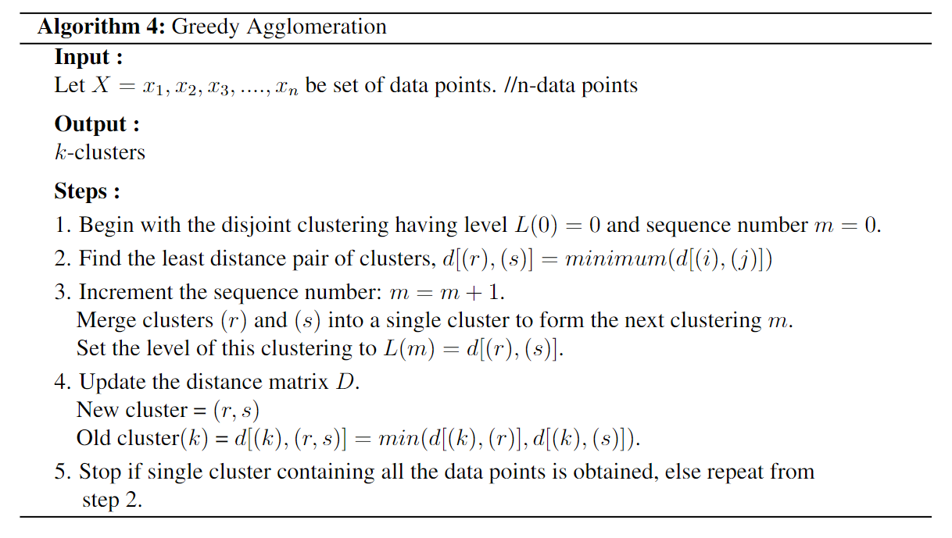
Greedy Agglomeration

Slide 22
Example
Bottom-Up
ABCDEFG
ABCD
EFG
BC
AD
FG
C
B
A
D
F
G
E
Figure: Bottom-Up Greedy Agglomeration to group a pair of clusters and form a single entity

Slide 23
Markov Clustering and Random Walks
Markov Clustering:
Markov Clustering Algorithm is based on Random Walks.
Random Walks:
Given a graph with clusters, we find more edges within a cluster, and less edges between clusters. This implies that, if we start our random walk at a node, then we are more likely to stay within a cluster to which the node belongs, than travelling between clusters. To know the where the flow trends gather, we use these random walks on graphs, which results in finding the clusters. These random walks are calculated using Markov Chains.

Slide 24
Markov Clustering and Random Walks
In MCL, the following two processes are alternated repeatedly:
Expansion (taking the Markov Chain transition matrix powers)
Inflation
The expansion operator is responsible for allowing flow to connect different regions of the graph.
Expansion is carried out by taking the Markov Chain powers.
The inflation operator is responsible for both strengthening and weakening of current, parameter r is used to control the same.
Inflation is re-normalizing a single column when expanded.
Edge weights connecting two vertices within clusters will be higher in the initial phase while having lower values connecting a pair of clusters.

Slide 25
Markov Clustering Algorithm
Input parameters: Undirected graph, power e and inflation parameter r .
Initialize a matrix with the corresponding edge weights and add self loops to each node.
Normalize the matrix column-wise.
Multiply the matrix by self for e times.
Inflate the matrix by r parameter.
Repeat above two steps (4 and 5) until we find two successive matrices the same (convergence is achieved).
Find for clusters so formed.

Slide 26
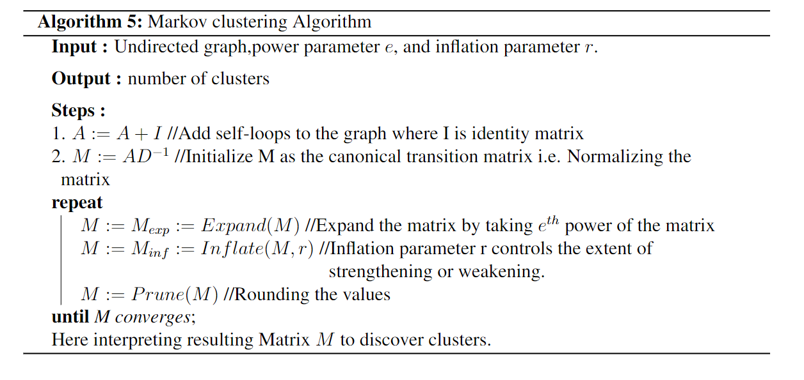
Markov Clustering Algorithm - Pseudocode

Slide 27
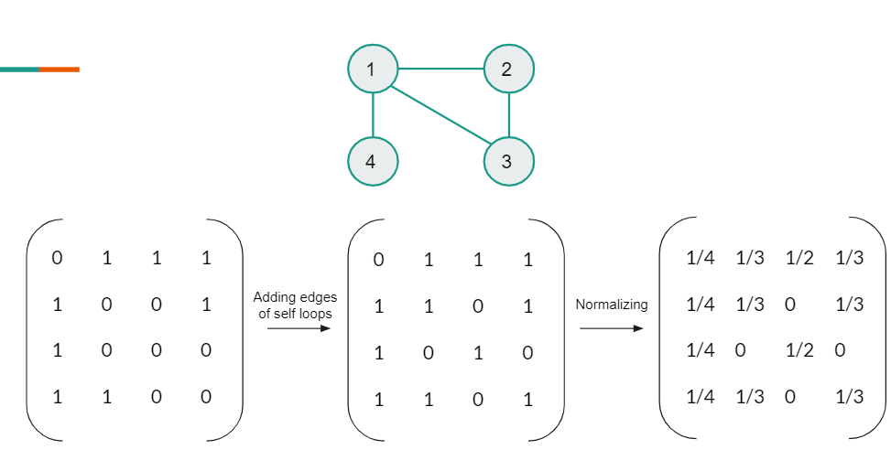
Example

Slide 28
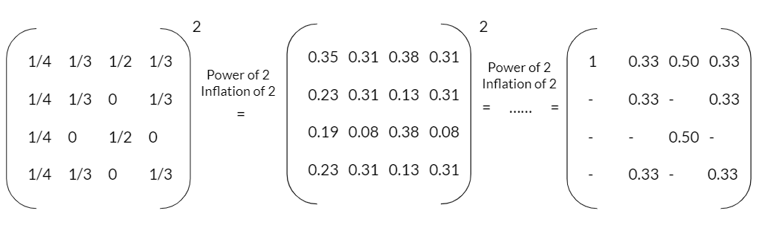
Example Contd.

Slide 29
LOCAL OPTIMIZATION APPROACH

Slide 30
Local Moving and Multilevel Algorithm
Given an input graph, coarsener, refiner and the reduction factor, the Multilevel Clustering Algorithm operates in 2 phases:
1. Coarsening Phase
2. Refinement Phase
In the Coarsening Phase, we may use any of the Cluster Joining (CJ) or Vertex Moving (VM) algorithms, which are known as Local Moving Approaches. These help to find the best move for each vertex by repeatedly iterating through all vertices in a randomized fashion.
In the Refinement Phase we stick to use VM approach, since CJ algorithms may not find joinable clusters resulting to an optimal clustering.

Slide 31
Local Moving and Multilevel Algorithm
Coarsening Phase:
A sequence of graphs called the coarsening levels are produced by the Coarsening Phase, in which the first coarsening level is the input graph.Initially each single vertex is a cluster for the coarsener and it starts clustering.
The coarsener runs until
It terminates
The number of clusters decrease by a certain percentage, as compared with the start, where the percentage is called reduction factor
The next coarsening level is formed where each cluster is contracted to result into a single vertex. When there are no further changes in clusters in 2 subsequent layers, the coarsening phase is known to reach a fixed point and it ends.

Slide 32
Local Moving and Multilevel Algorithm
Refinement Phase:
The algorithm then visits all the coarsening levels in a reverse order, from the coarsest graph to the original graph.
It computes clustering at each level. This phase is called the Refinement Phase.
The final clustering of a level is projected to its next subsequent level and this forms the initial clustering of the subsequent level, on which a refiner is applied to compute the final clustering.
Here the refiner is preferred to be a VM algorithm, since CJ algorithms may not find joinable clusters resulting to an optimal clustering.

Slide 33
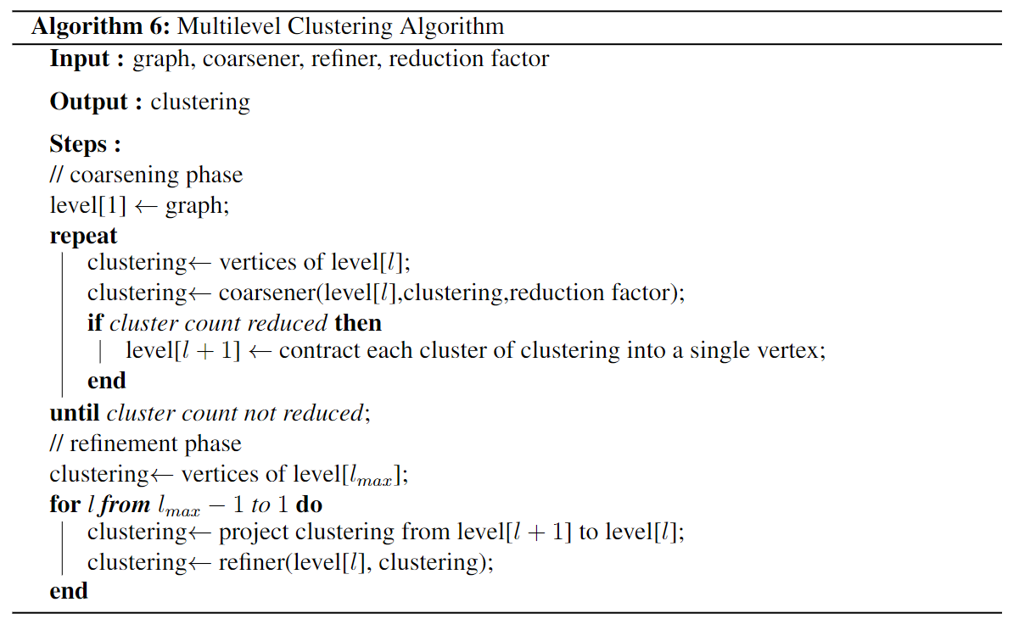
Multilevel Clustering Algorithm

Slide 34
Clique Percolation
In social networking graphs, it is important to find the communities which consist of similar type of people having similar though process. Hence, the key task become sto find the strongly connected subgraphs in a graph. These subgraphs are called cliques
It is so possible to have a single person belonging to multiple communities i.e a node in a community may be shared with certain other number of communities.
Therefore, clique percolation algorithms aims at identifying the overlapping communities.
It initiates with identifying k-cliques and maintaining the adjacent clique (having k-1 nodes) in a community.
Further in this process, k-cliques are considered to be different entities when it is not possible to group furthermore as a community.

Slide 35
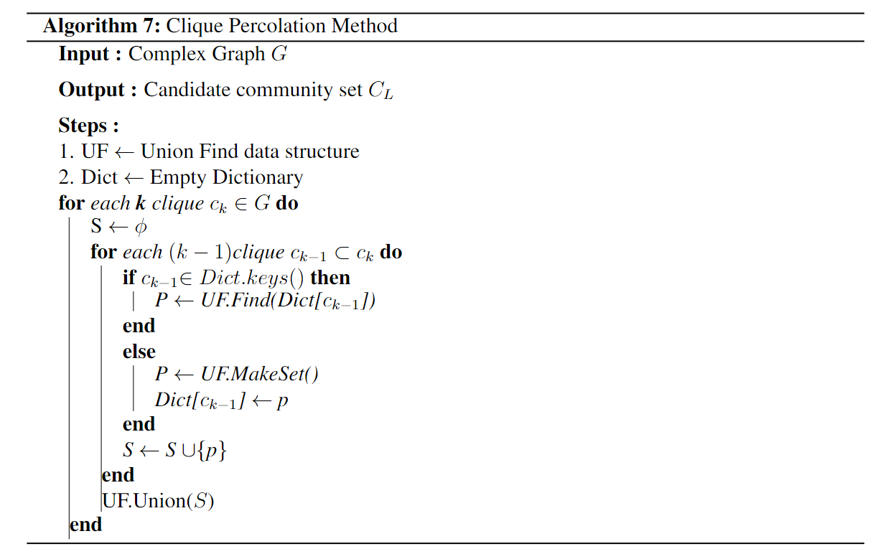
Clique Percolation

Slide 36
Example
6
8
Cliques of size k=3:
{1,2,4}
{1,2,3}
{4,5,10}
{5,6,7}
{5,7,9}
{5,7,10}
{5,9,10}
{7,9,10}
1
4
5
7
2
3
10
9

Slide 37
Example contd.
Cliques of size k=3:
{1,2,4}
{1,2,3}
{4,5,10}
{5,6,7}
{5,7,9}
{5,7,10}
{5,9,10}
{7,9,10}
1,2,4
5,6,7
5,7,9
1,2,3
5,9,10
5,7,10
7,9,10
4,5,10
K-Clique Communities:
{1,2,3,4}
{4,5,6,7,9,10}

