Slide 1
SENTIMENT ANALYSIS OF COVID-19 TWEETS

Slide 2
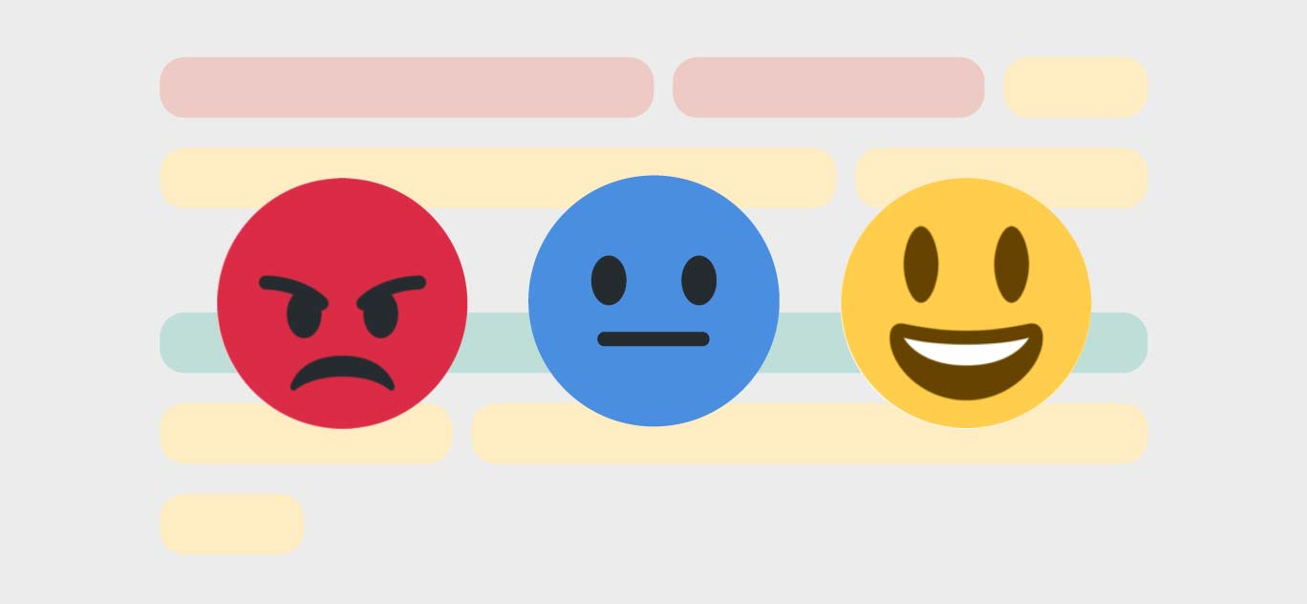
What is sentiment analysis?
It is simply the process of determining whether a given piece of text is positive, negative or neutral.
Usually, It helps data analysts from large business organizations to help understand public opinion, customer reviews, conduct market research etc.

Slide 3
A sentiment analysis system for text analysis combines natural language processing (NLP) and machine learning techniques to assign weighted sentiment scores to the entities, topics, themes and categories within a sentence or phrase.

Slide 4
Project analysis slide 2
NATURAL LANGUAGE
PROCESSING
TOPIC SEGMENTATION
TOKENISATION
NLP
SPEECH RECOGNITION
NAMED ENTITY
RECOGNITION
RELATIONSHIP
EXTRACTION
SUMMARISATION

Slide 5
CURRENT PROBLEM & SOLUTION
The main problem existing in the current techniques of most of the sentiment analysis solutions is that they only give the output as positive, negative, neutral or just the score
Also, most of the algorithms cannot deal with complex sentences that require more than sentiment words and simple analyzing.
The solution for analyzing the sentiments of the tweets in a better way is to use IBM Watson’s tone analyzer because it tries to understand the tone and emotion of the sentence.
There are currently 7 different tones: Joy, Fear, Anger, Confident, Sadness, Tentative, Analytical..

Slide 6
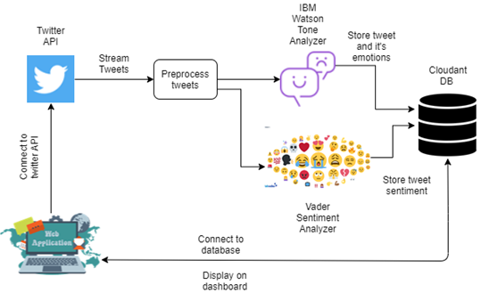

Slide 7
EXPERIMENTAL INVESTIGATIONS
A lot of people are actually happy with the lockdown because of the fact that they can better utilize their time to improve their skills so the emotion which was the highest is “Joy”.
The second most common emotion I noticed was “Sadness”. This pandemic has caused a lot number of troubles and deaths in families so far and yet to cause many till a cure is actually found. So, a lot of people’s tweets were about grievances.

Slide 8
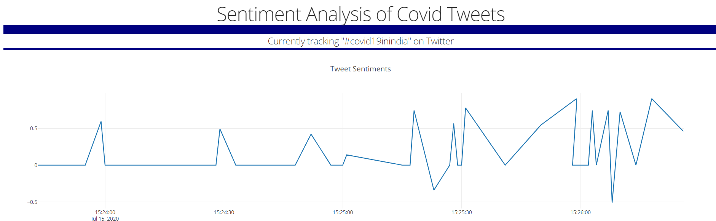
USER INTERFACE SCREENSHOTS

Slide 9
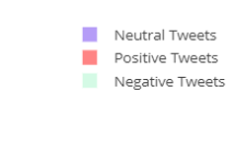
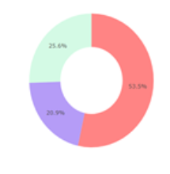
Usually without certain major situations like covid-19 happening the numbers of positive and negative tweets are relatively close and stay low compared with neutral tweets. And neutral tweets are about 20% every time, this shows a significant change in how people express their feelings.
About 45-50% of the tweets are positive which suggests that people are fighting this in a diligent way.
They are looking forward to making best use of their time and hoping for a speedy recovery which also indicates that they are agreeing on the decision taken by the government although it is very difficult to follow because its nearly not possible to completely stay at home but it is essential.
About 25-30% of the tweets are negative which includes sadness and anger showing the problems that has been caused.
Also there were a lot of tweets which showed criticizing China calling Covid-19 as Chinese virus this also contributed to the negative sentiment.

Slide 10
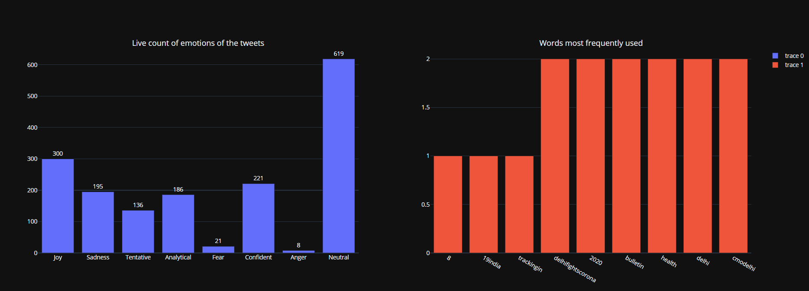

Slide 11
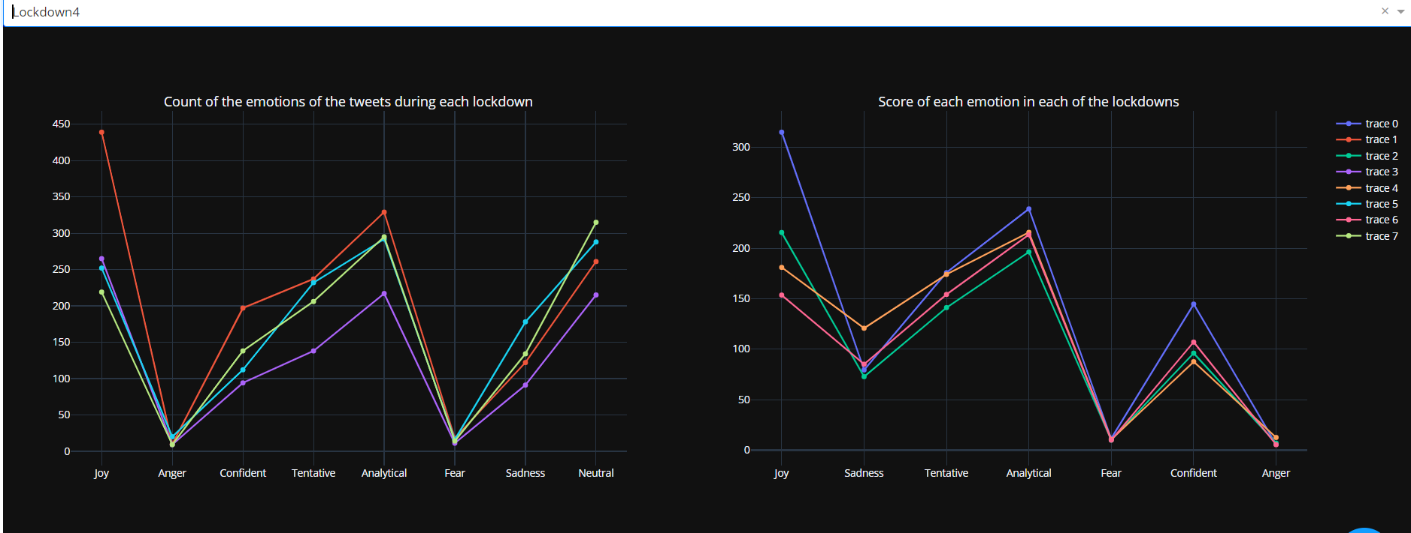

Slide 12
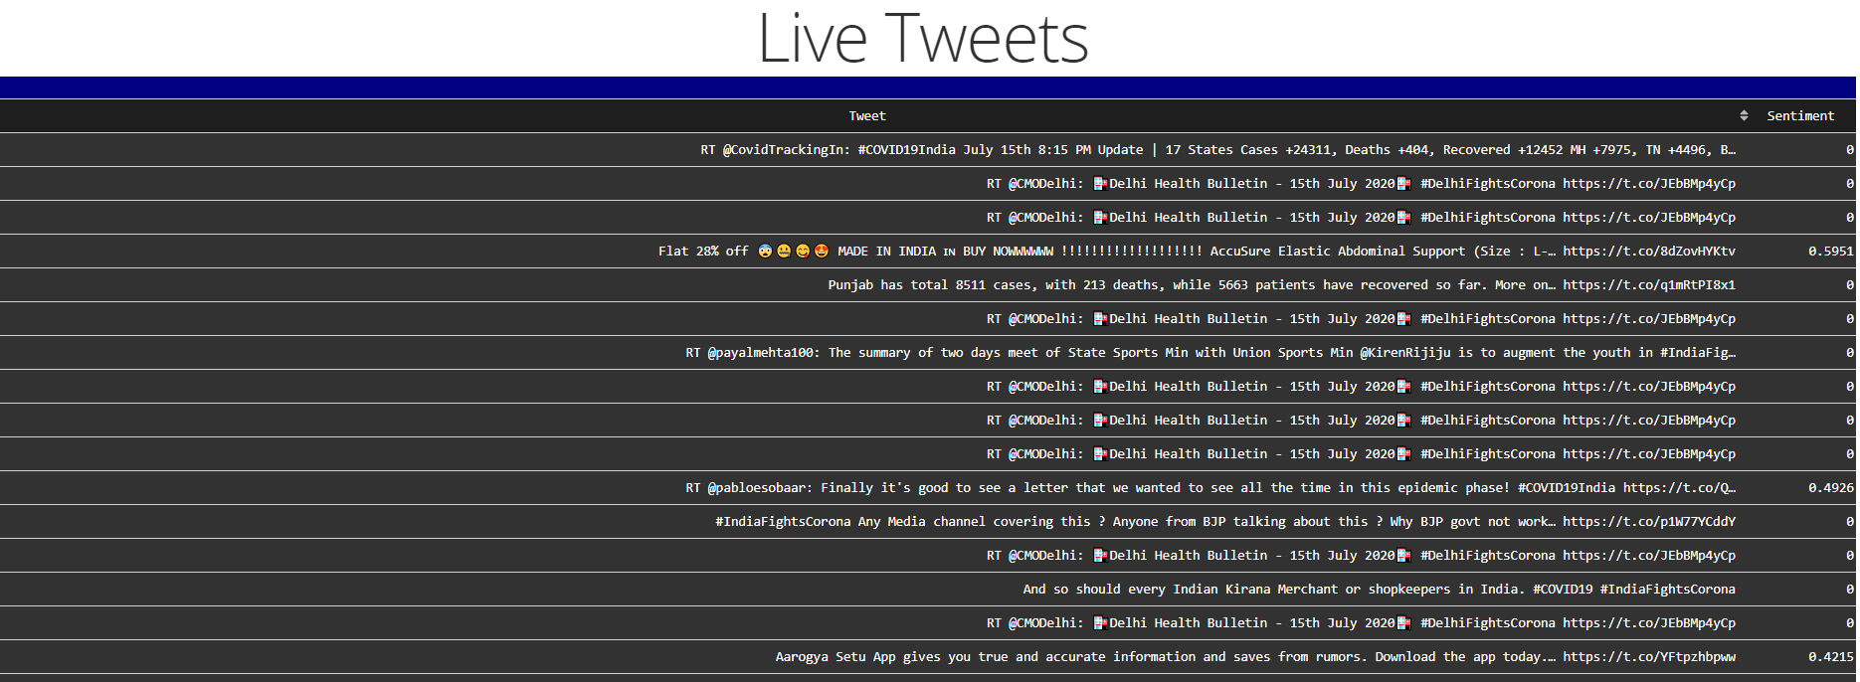

Slide 13
CONCLUSION
I enjoyed doing every bit of this project right from the start, setting up timelines and learning about the IBM services. This web app detects the sentiment of people in India and can be used sentiment worldwide. I thank, IBM and Smartbridge for its free services to help students in their projects.

Slide 14
Thank You
TEAM NAME: BOT-1
NAME: TEJASWI PALLAPOTHU
PROJECT ID: SPS_PRO_630
APPLICATION ID: SPS_CH_APL_20200002303

