Slide 1
Sensor Data Logging System using QNX Neutrino RTOS
IPC-based Real-Time Sensor Architecture
Presented by :
Bharath
Bharathi
Akhil Sai
Harshitha
Tejaswi
Devinath

Slide 2
Introduction
This project builds a real-time sensor data logging system that demonstrates reliable Inter-Process Communication (IPC) on a microkernel RTOS.
It connects real hardware with QNX Neutrino to show deterministic data reading, logging, and user interaction.
Runs on Raspberry Pi as the embedded target, enabling real GPIO interfacing with the DHT11 sensor and LED using QNX.
QNX is commonly used in automotive, medical, and industrial systems.

Slide 3
Tools & Technologies
Hardware: Raspberry Pi 4, DHT11 Sensor, GPIO, Breadboard,Jumper wires.
Software: QNX Neutrino RTOS, Momentics IDE, ARM qcc cross-compiler, C Programming language, SSH/SCP.
Protocols/Mechanisms: QNX IPC (MsgSend/MsgReceive), name-based service discovery, GPIO interfacing.

Slide 4
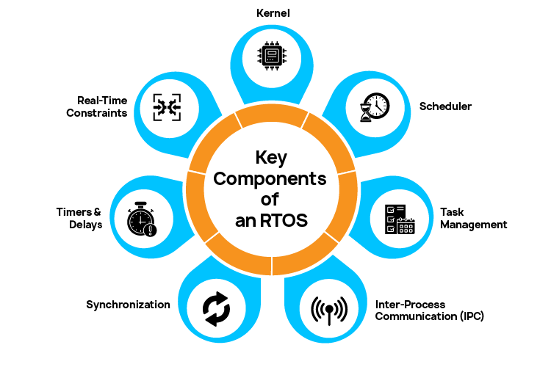
What is an RTOS?
Real-Time Operating System (RTOS)
An OS designed to handle tasks within strict timing constraints
Guarantees deterministic response
Used where missing a deadline = system failure

Slide 5
What is QNX Neutrino RTOS?
QNX Neutrino Architecture :
True microkernel RTOS.
Only core services run in kernel: Scheduler, IPC, Interrupt handling.
All other services run as user processes.
Advantages :
High reliability
Fault isolation
Easy debugging
Modular and scalable

Slide 6
Why QNX?
Real-Time Performance :
QNX is a hard real-time OS
Guarantees deterministic and predictable response time
Microkernel Architecture :
Minimal kernel (scheduler, IPC, interrupts only)
Drivers, networking, and applications run in user space
Fault Isolation :
Failure of one component does not crash the entire system
Faulty services can be restarted independently
Safety certifications:
It meets global functional safety standards including ISO 26262 (ASIL-D) and IEC 61508, making it suitable for high-reliability systems.

Slide 7
Why IPC is Important in QNX
Inter-Process Communication (IPC) :
Message-passing based communication
Uses synchronous message-passing between processes
Ensures deterministic timing behavior (RTOS requirement)
IPC Advantages :
No shared memory corruption
Priority inheritance
Deadlock prevention
Real-time safe communication

Slide 8
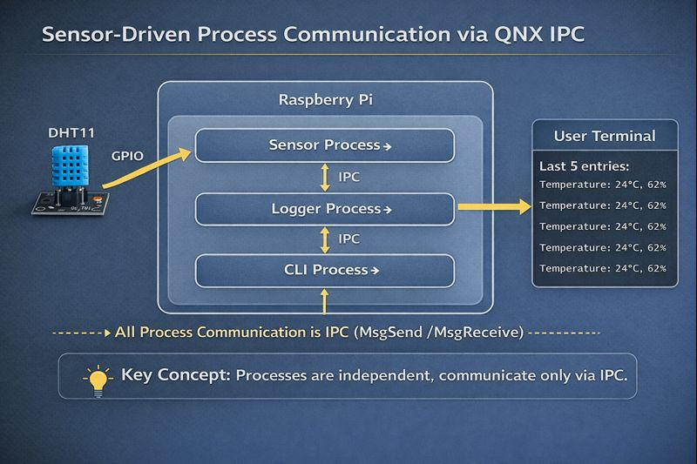
Project Architecture

Slide 9
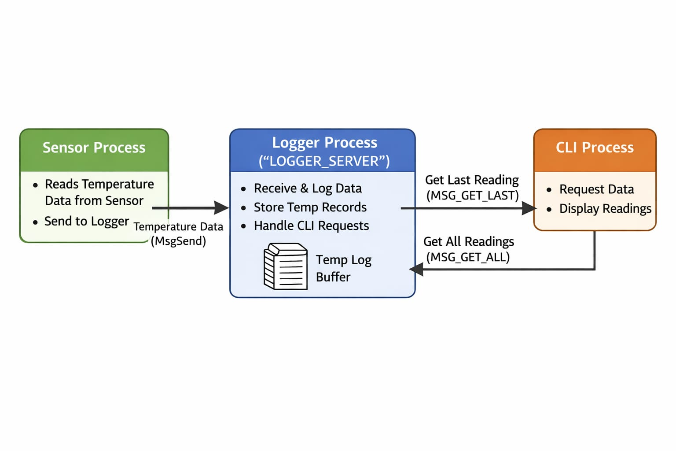
Project Block Diagram

Slide 10
Sensor Process
Functionality :
Reads temperature from DHT11 sensor
Controls LED based on threshold
Sends sensor data to logger using IPC
Key QNX Features Used :
ThreadCtl() for hardware access
mmap_device_io() for GPIO
MsgSend() for IPC

Slide 11
Logger Process
Functionality :
Acts as central IPC server
Stores temperature readings
Maintains data buffer
Why separate logger process :
Fault isolation
Scalability
Centralized data management

Slide 12
CLI Process
Functionality :
Provides user interface
Fetches last reading and all readings
Communicates using IPC
Benefits :
No direct hardware access
Safe user interaction
Decoupled from sensor logic

Slide 13
SCP (Secure Copy Protocol):
SCP uses SSH underneath to securely transfer files between machines.
It encrypts data during transfer.
Useful for pushing binaries, configs, logs, etc.
Example:
scp sensor_process logger_process cli_process qnxuser@172.16.0.44:/tmp/

Slide 14
SSH (Secure Shell):
SSH is a secure communication protocol used to remotely login into another machine.
It provides encrypted command-line access.
Typical usage: remote debugging, running executables, system administration.
Example:
ssh qnxuser@172.16.0.44

Slide 15
Why NOT Other OS?
FreeRTOS
No native multi-process model
No memory protection
Limited IPC
Suitable for microcontrollers, not complex systems
Linux
Not deterministic by default
Large kernel footprint
Weak fault isolation
Not ideal for safety-critical systems

Slide 16
Real-Time Behavior Demonstration
Deterministic IPC Behavior:
Message passing consistently meets real-time response requirements.
Reliable Sensor Logging:
Temperature readings are captured and stored without loss.
Non-Blocking CLI Queries:
User queries do not interfere with sensor read frequency or timing.

Slide 17
Challenges Faced
GPIO access permissions
IPC structure consistency
Timing accuracy for DHT11
Process synchronization
How they were solved :
Proper privilege handling
Unified IPC structures
Microsecond-level delays
Correct IPC design

Slide 18
Applications
Automotive sensor monitoring
Industrial data logging
Medical monitoring systems
Distributed embedded systems

Slide 19
Conclusion
This project successfully demonstrates a real-time sensor monitoring system on QNX Neutrino using deterministic message-passing IPC. Sensor data is reliably captured, logged, and queried without impacting timing behavior. The implementation validates QNX as an ideal RTOS for safety-critical and time-sensitive embedded applications due to its microkernel design, predictable execution, and robust IPC mechanisms.

