Slide 1
COVID Deaths Analysis
Tejaswi Tamarana

Slide 2
Time series Analysis
Formation of Problem Statement
Analysis of the data extracted from CDC.gov
Historical data analysis
Observe the trends or seasonality and stationarity

Slide 3
Problem Statement
Analysis of population depends on age group, ethnicity, race and gender and symptoms and considering some more aspects and clustering depends on Commonality

Slide 4
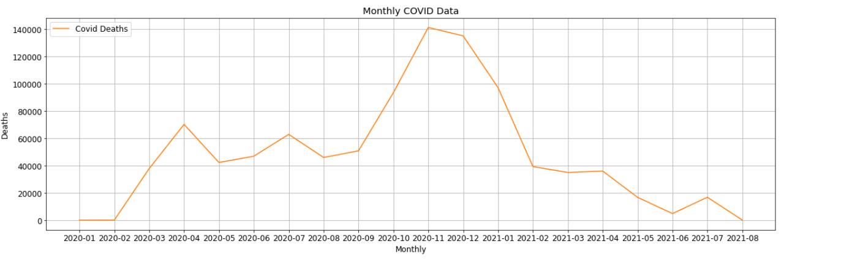
Understanding Monthly COVID data trends

Slide 5
COVID data manipulation
Using different modules in Python like pandas did wrangling of data and dropped some columns and replaced NA
Joined data frames for final data frame with all needful information
used couple of useful modules for visualizations in python

Slide 6
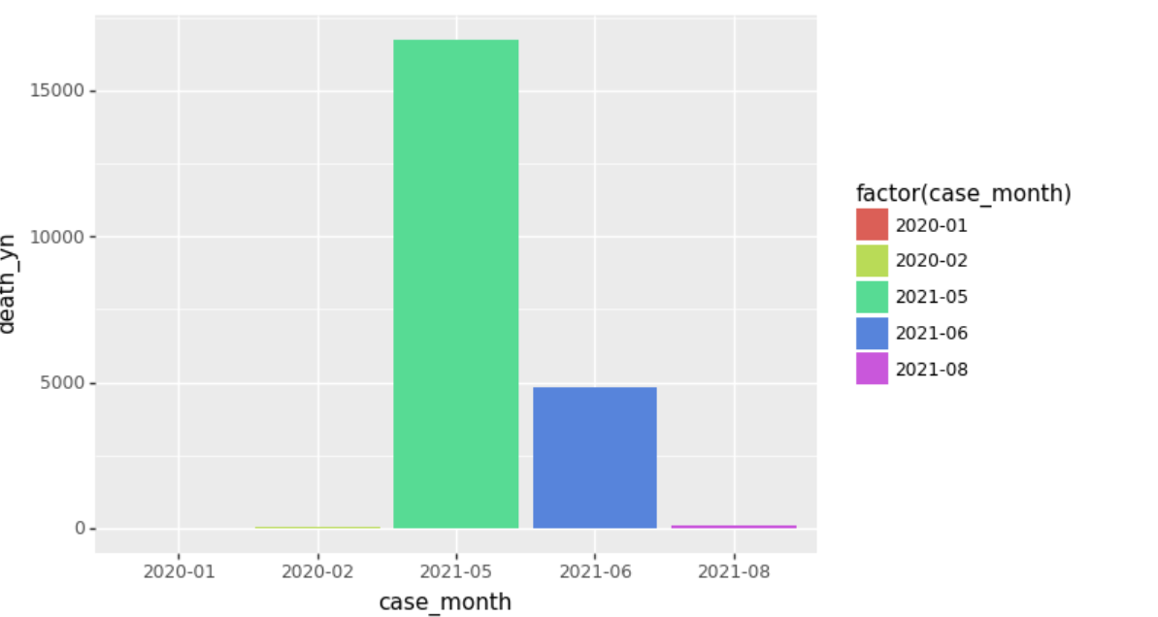
Exploratory Data Analysis

Slide 7
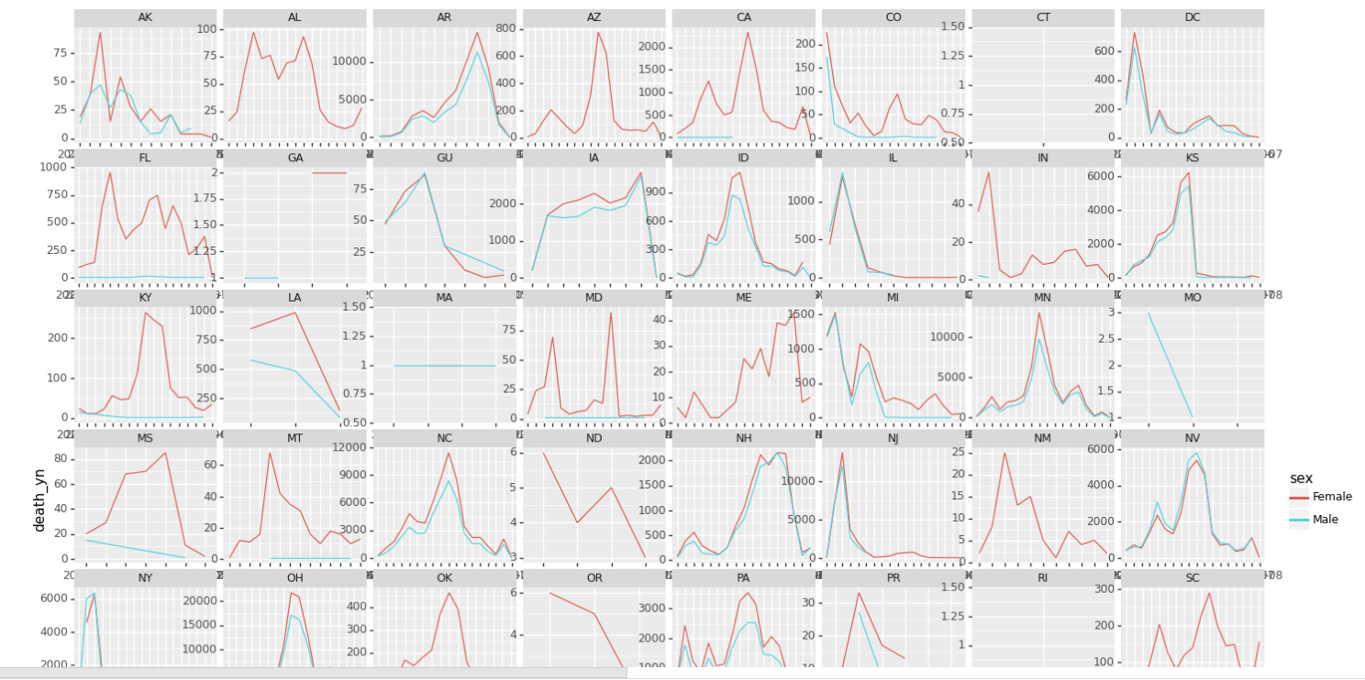
Male/Female deaths in different states

Slide 8
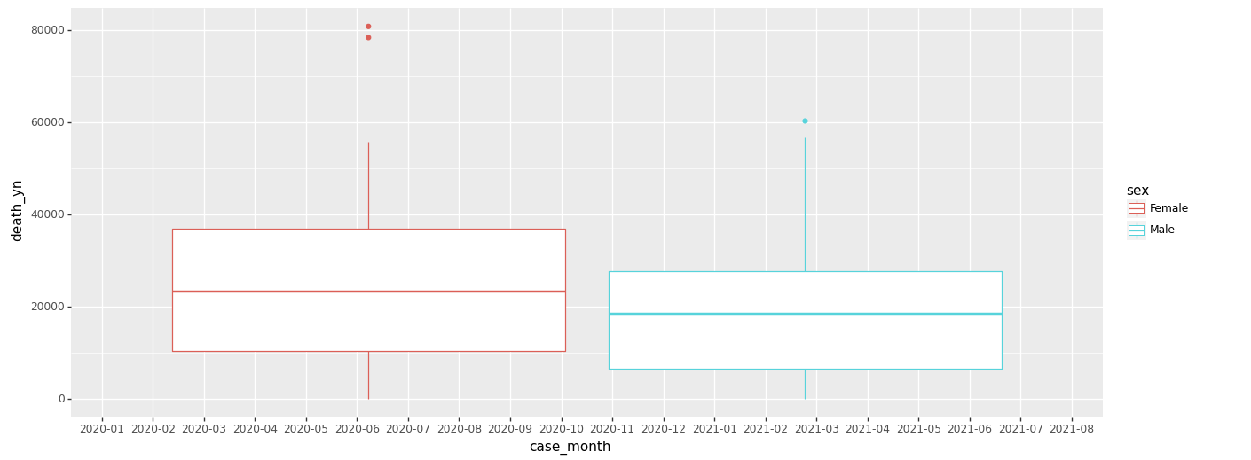
Monthly deaths in gender

Slide 9
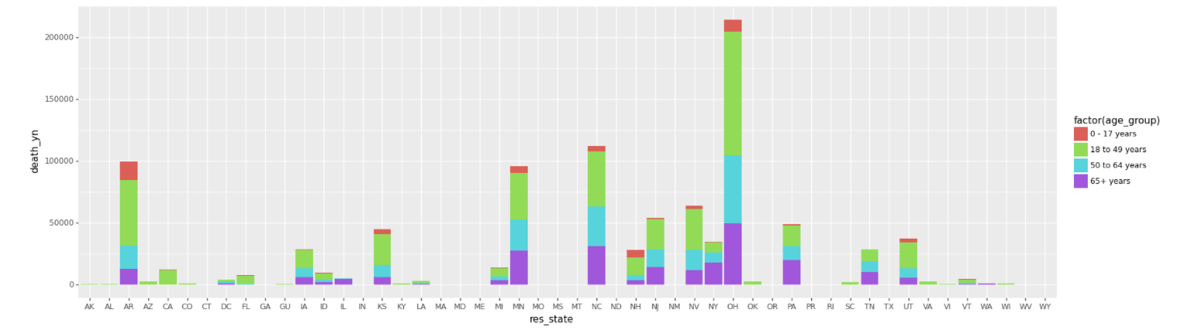
Effected age groups in all states

Slide 10
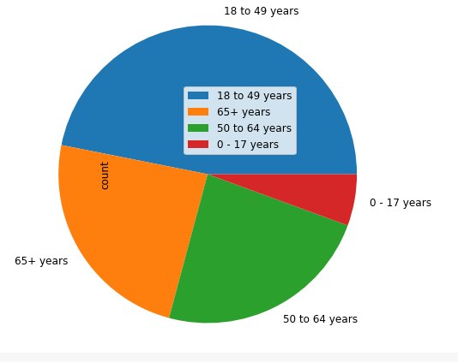
Pie chart

Slide 11
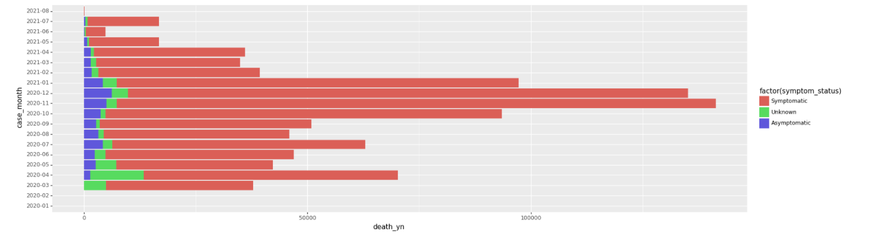
Deaths varied in symptomatic vs asymptomatic

Slide 12
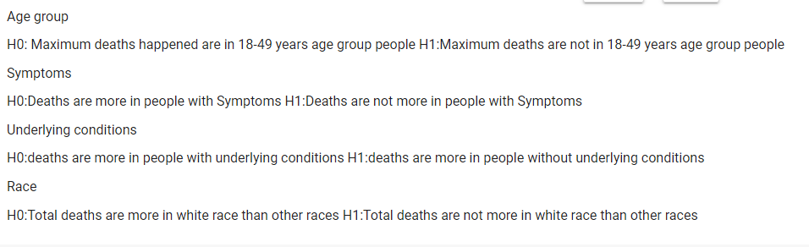
Hypothesis Testing to identify the significance

Slide 13
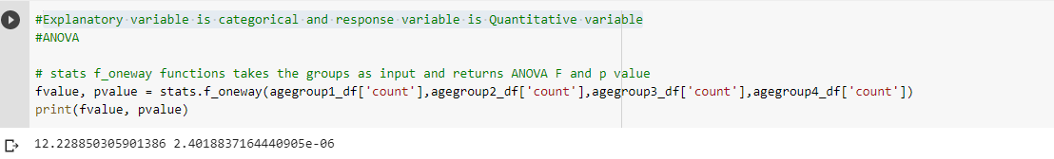
ANOVA testing
Performed ANOVA testing based on fact Explanatory variable is categorical and response variable is Quantitative variable

Slide 14
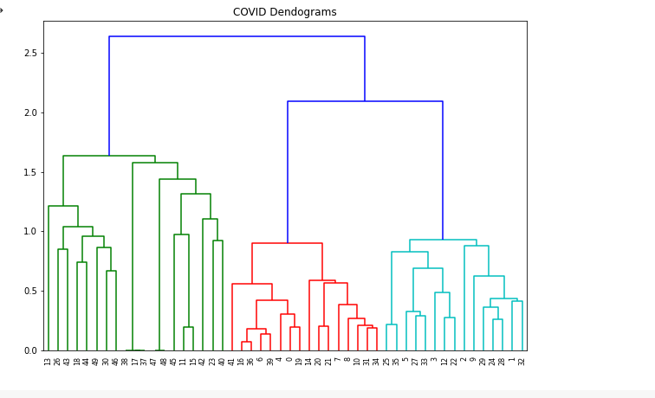
Hierarchical Clustering
Decided the best K value using Kmeans clustering and performed hierarchical Clustering

