Slide 1
Multiple choice Q&A using NLP

Slide 2
Data Collection
Collected data from https://mattr1.github.io/mctest/ here.

Slide 3
Data preprocessing
Import needful packages like nltk,Spacy,Pandas and scikit-learn
Grouping the columns paragraph and Question and answers.
Analyzing and understanding the data.
Data manipulation using Pandas.

Slide 4
Removing Stop words and Punctuation
Using nltk removed some stop words from the list
Using replace in string removed all punctuations
Each column tokenization and lemmatization

Slide 5
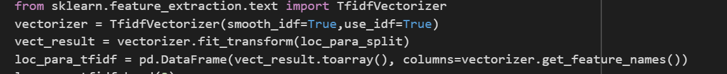
TFIDF Vectorization
Paragraph is split into sentences and vectors got created.
Find the TDIDF values of each sentence
Question TFIDF has calculated

Slide 6
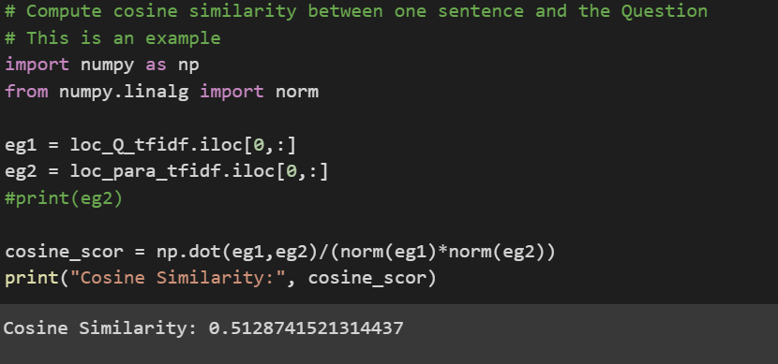
Cosine Similarity

Slide 7
Iterating the Cosine Similarity

Slide 8
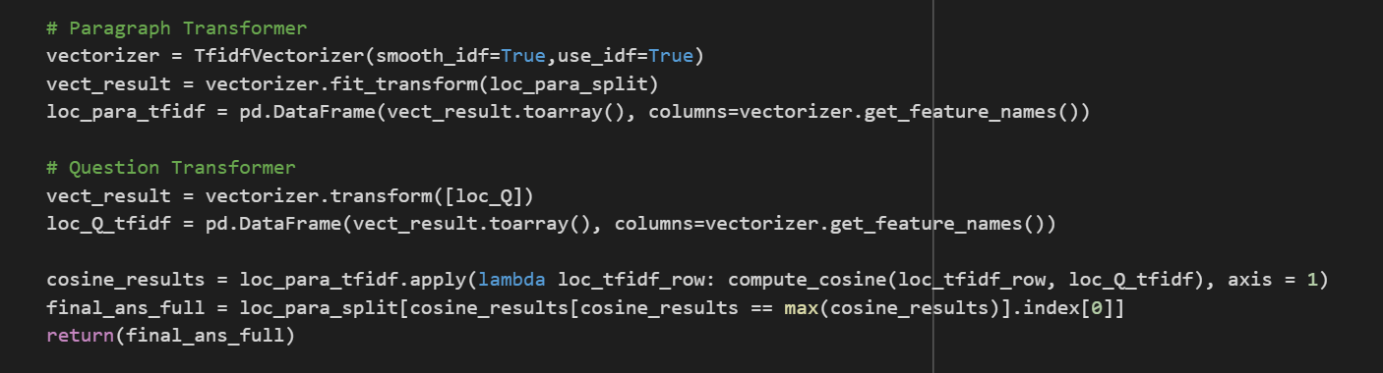
Final Answer
With maximum value of cosine similarity will be considered as an answer

Slide 9
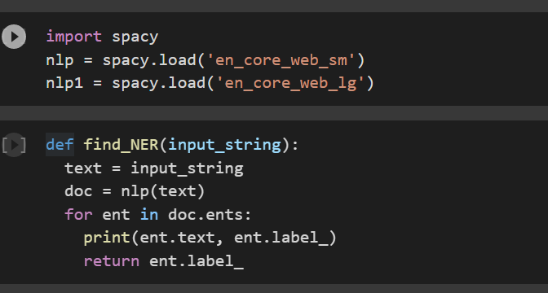
NER
Final answer and each option of the Question entities will be compared and depends on the match the answer will be identified.

