Slide 1
Resume Keyword
Extraction using NLP
Mini Project Presentation
An explainable pipeline for resume keywords and job-text matching
NLP Lab | Dataset: 962 resumes across 25 categories
01
Notes:
Source: project.ipynb and data/UpdatedResumeDataSet.csv. This presentation describes the implemented notebook and its recorded outputs.

Slide 2
Problem and project objective
•
Manual resume screening takes time when many applications arrive.
•
Relevant skills and qualifications may be missed in free-form text.
•
Extract and rank candidate keywords to make review more structured.
•
Compare a resume with a job description, while leaving decisions to a person.
02
Notes:
Problem statement from experiment 1; project objective implemented in project.ipynb.

Slide 3
Dataset and duplicate handling
The category chart uses all source rows; corpus analysis uses unique resume texts.
962
25
796
source rows
categories
exact duplicate rows removed
166 unique resumes remain. Category and Resume columns have no missing values.
Exact-text deduplication keeps the first copy for each resume.
03
Notes:
Notebook cells 4–7. Source: data/UpdatedResumeDataSet.csv.

Slide 4
Notebook workflow
•
Inspect, deduplicate, and clean text — experiments 1, 2, 10
•
Remove stopwords and lemmatize — experiment 3
•
Tag parts of speech and chunk noun phrases — experiments 4, 6, 7
•
Find named entities and listed skills — experiment 8
•
Rank terms, compare job text, and explore charts — experiments 5, 9, 10
04
Notes:
Method sequence and experiment links documented in project.ipynb.

Slide 5
Text normalization and phrase candidates
•
Normalize whitespace and selected encoding artifacts; preserve technical forms such as C++, C#, and .NET.
•
Remove English stopwords, then lemmatize tokens for downstream analysis.
•
Use NLTK POS tags to demonstrate morphology and simple adjective–noun phrase chunks.
•
Phrase chunks are candidates; fragmented resume lists can produce awkward results.
05
Notes:
Experiments 2, 3, 4, 6, and 7.

Slide 6
Entity and skill extraction
•
spaCy identifies general entities such as people, organizations, places, and dates.
•
A transparent skill list checks terms such as Python, SQL, machine learning, AWS, and Tableau.
•
In the sample resume, spaCy sometimes labels technical terms as PERSON, GPE, or ORG.
•
NER results are supporting clues; the skill list is more direct for listed technologies.
06
Notes:
Experiment 8. spaCy NER is supplemented by the notebook's editable common-skills list.

Slide 7
TF-IDF keywords and job matching
•
TF-IDF ranks unigrams, bigrams, and trigrams across 166 unique resumes.
•
Top terms are combined with noun-phrase candidates and skills found in the resume.
•
Cosine similarity compares the resume and job description; listed skills are split into matched and missing.
Recorded demo: 29.5% cosine similarity; 6 of 7 listed job skills matched.
The percentage depends on the wording and the two-document TF-IDF space. It is not a hiring score.
07
Notes:
Experiments 5 and 9.

Slide 8
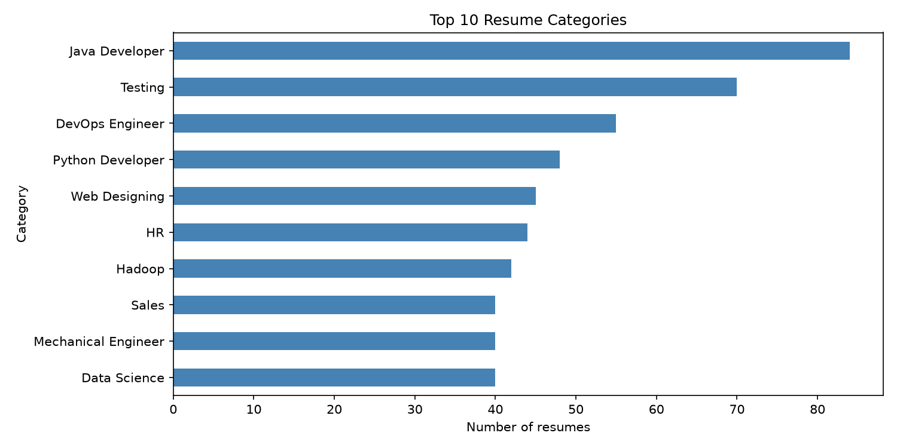
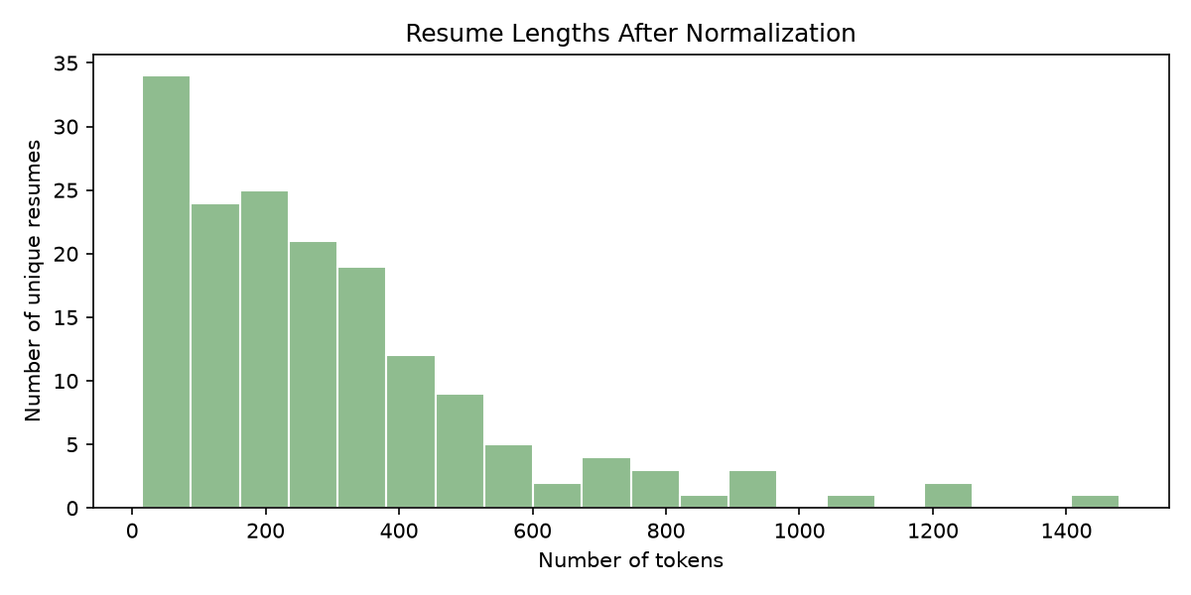
Dataset results and text lengths
Most common: Java Developer (84), Testing (70), DevOps Engineer (55).
08
Notes:
Experiment 10. The category bars count original rows; the histogram describes 166 unique resumes.

Slide 9
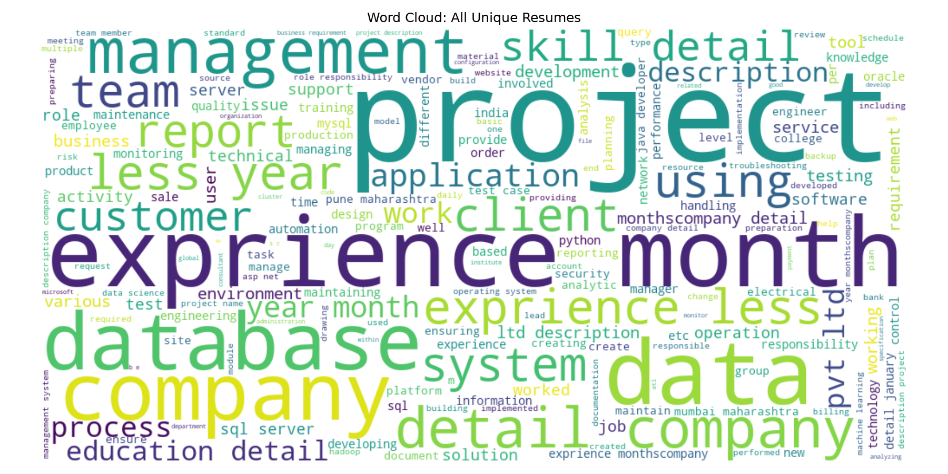
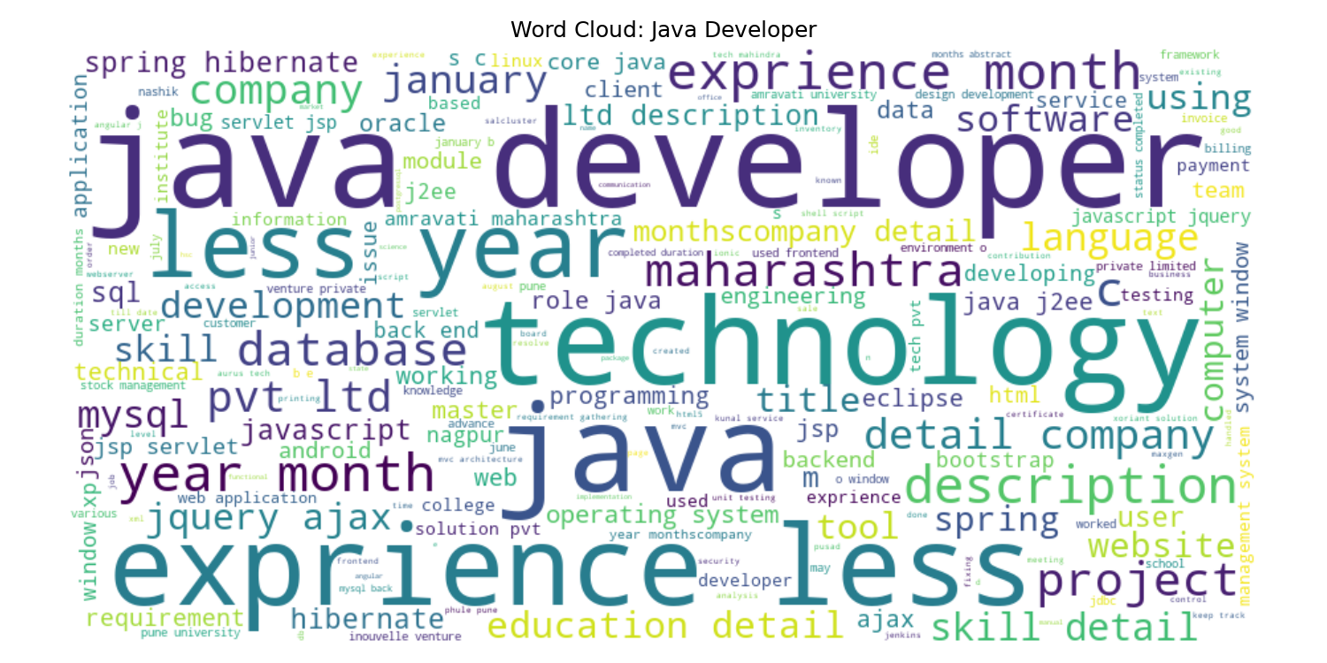
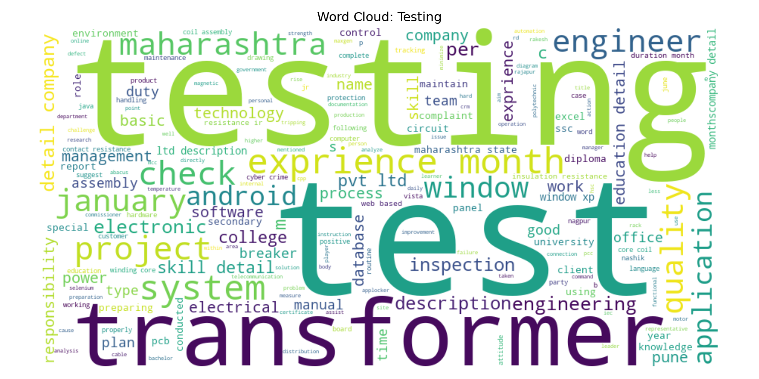
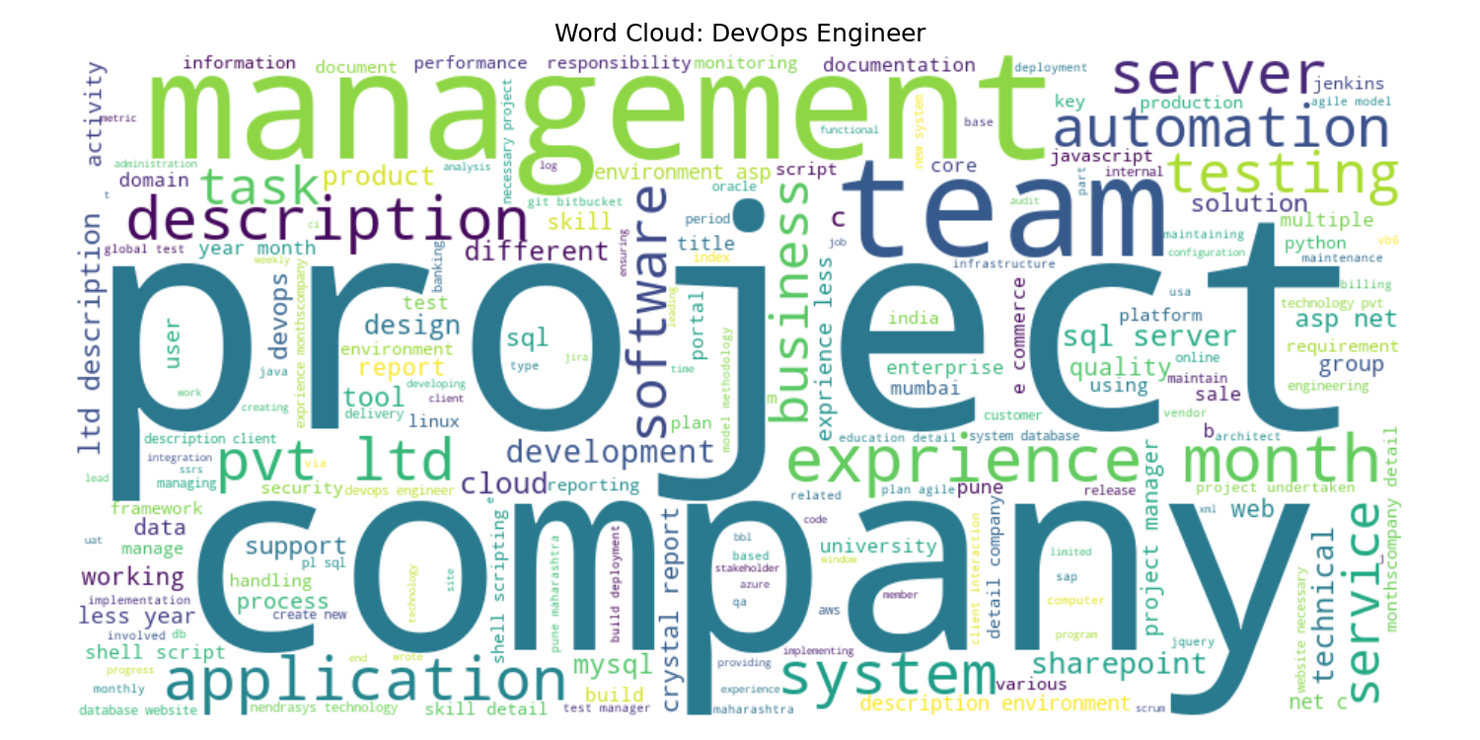
Word cloud exploration
09
Notes:
Experiment 10. These images summarize word frequency after stopword removal.

Slide 10
Conclusion and limitations
•
The notebook joins preprocessing, linguistic analysis, TF-IDF, similarity, and visual summaries.
•
The editable skill list is incomplete; POS chunks may be noisy; general spaCy NER can mislabel technologies.
•
Cosine similarity reflects shared wording, not experience quality or candidate suitability.
•
Use extracted terms to support human review, never as the sole hiring decision.
10
Notes:
Summary based on the implemented notebook and sample outputs.

