Slide 1
Resume Keyword
Extraction Using NLP
NLP Lab Mini Project
Extract useful terms from resumes and compare them with a job description.
962 source rows | 166 unique resumes | 25 categories
Notes:
Project context: data/UpdatedResumeDataSet.csv and the approved PROJECT_CONTEXT.md.

Slide 2
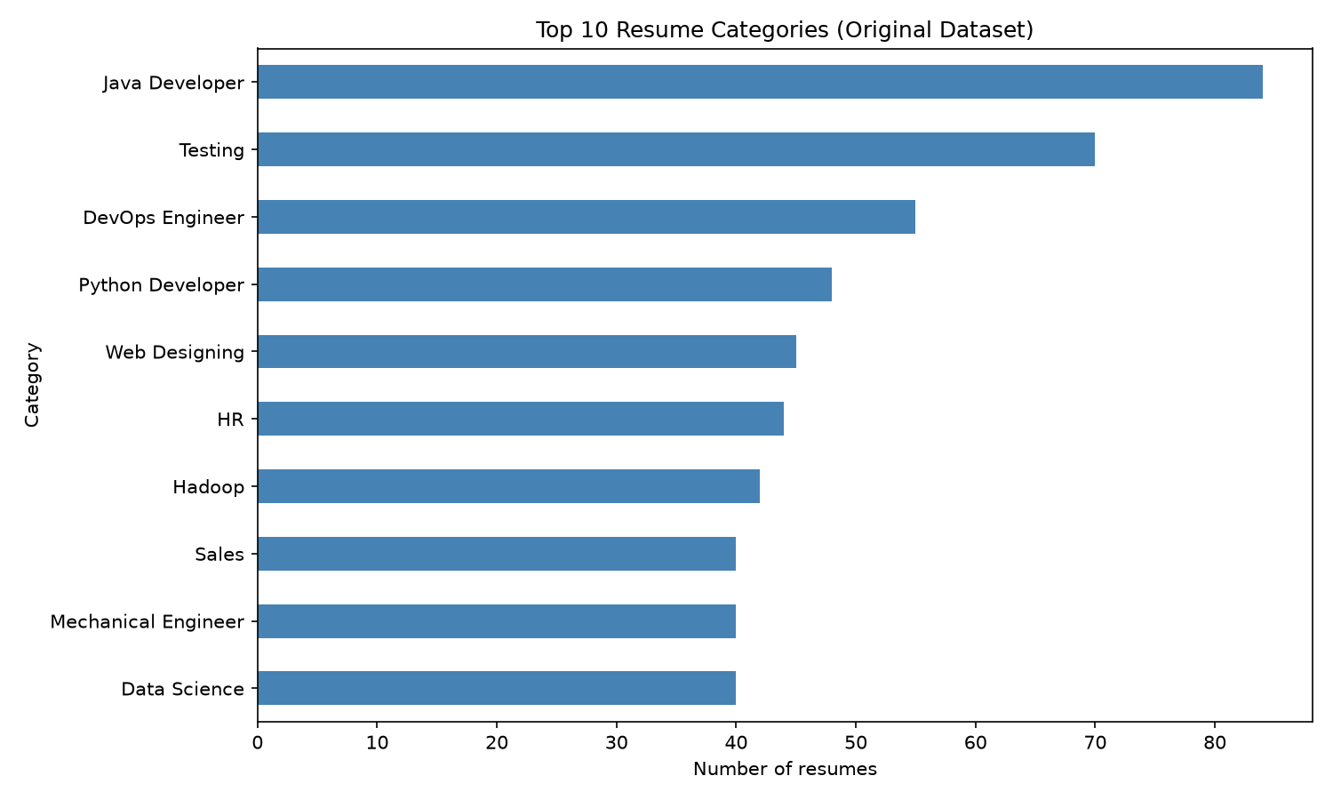
Dataset and duplicate removal
Exact repeated resume text was removed before corpus-level analysis.
962 source rows
796 repeated copies removed
166 unique resume texts
Largest groups
Java Developer 84
Testing 70
DevOps Engineer 55
Category counts use the original CSV; later text analysis uses unique resumes.
Notes:
Source: data/UpdatedResumeDataSet.csv; data/resumes_clean.csv; outputs/figures/top_categories.png.

Slide 3
NLP methodology
Each stage reuses techniques from experiments 2 through 10.
Experiments 2-3 Tokenize, clean, remove stopwords, and lemmatize
Experiments 4, 6, 7 POS-tag words and form noun-phrase candidates
Experiment 8 Add supporting entity labels with spaCy
Experiments 5, 9 Rank unigrams, bigrams, and trigrams with TF-IDF
Experiment 9 Compare resume and job text with cosine similarity
Experiment 10 Summarize categories, resume lengths, and common terms
Notes:
Methods are implemented in src/preprocess.py, linguistic.py, entities.py, keywords.py, matcher.py and eda.py.

Slide 4
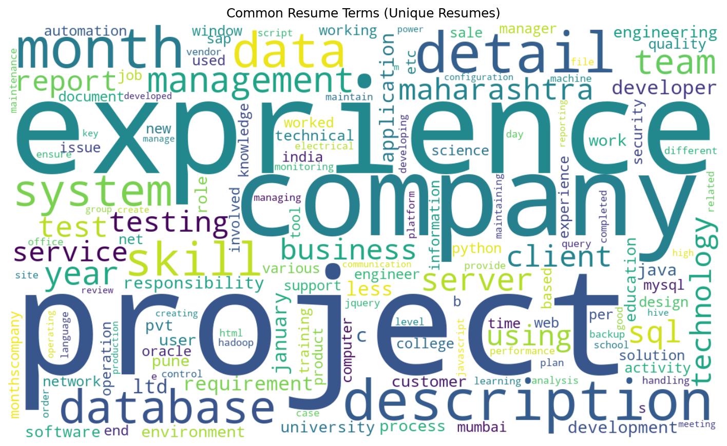
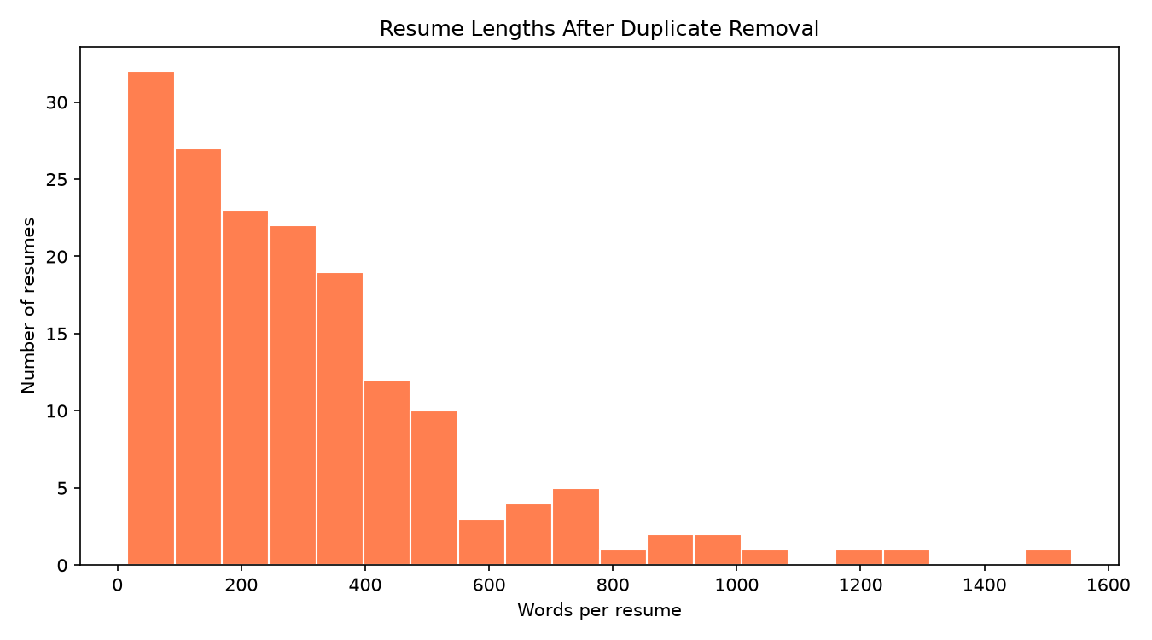
Results
The sample app found overlapping listed skills and returned a 57.6% cosine score.
Sample skills matched: Python, SQL, machine learning, AWS, Tableau
Top TF-IDF examples: python sql (0.253); data analyst (0.253); scikit-learn (0.234)
Notes:
Sources: outputs/figures/all_resumes_wordcloud.png; outputs/figures/resume_lengths.png; app.py sample run. The similarity percentage is not a hiring probability.

Slide 5
Conclusion and limitations
Conclusion
Limitations
The app turns unstructured resume text into ranked keywords and skill matches. It can support an initial review, while keeping the steps visible and explainable.
The skill list is limited. TF-IDF and cosine similarity depend on shared words, not meaning. spaCy may mislabel skills, and encoding artifacts remain in some resumes. Results need human review; no accuracy evaluation was performed.
Similarity is a text comparison, not a candidate-fit probability.
Notes:
Limitations are based on the implemented rule-based skill list, corpus-derived TF-IDF and cosine similarity, general spaCy NER, and the absence of labeled evaluation data.

