Slide 1




VIVEKANANDA EDUCATIONAL SOCIETY
INSTITUTE OF TECHNOLOGY
INFT DEPT
VESLUMNI
BY
TEJASWI KOUL
D15 B 31
UNDER THE GUIDANCE OF
-DR.RAVITA MISHRA

Slide 2

CONTENT
01
PROJECT INTRODUCTION
02
PROBLEM STATEMENT
03
PROJECT OBJECTIVES
04
ER DIAGRAM
05
IMPLEMENTATION
06
LITERATURE SURVEY
07
REFERENCES

Slide 3
INTRODUCTION
VESLUMNI IS YOUR DEDICATED HUB FOR CONNECTING WITH FELLOW VESIT ALUMNI, PROVIDING A VIRTUAL MEETING PLACE WHERE YOU CAN SHARE UPDATES, ENGAGE IN DISCUSSIONS, AND STAY CONNECTED WITH OUR VIBRANT COMMUNITY.
With features like posting updates, viewing news feeds, and staying informed about events and placements, VESlumni is your go-to for alumni connections and reliving college memories.

Slide 4
PROBLEM STATEMENT
VESIT alumni lack a centralized platform for effective communication and engagement.Existing methods, like scattered social media groups and email chains, hinder seamless interaction.
A dedicated mobile app, VESlumni, aims to address this gap by offering a user-friendly solution that promotes seamless interaction, update sharing, and community engagement.

Slide 5
PROJECT OBJECTIVES
FACILITATE ALUMNI CONNECTIONS, FOSTERING A VIBRANT COMMUNITY.
ENABLE SEAMLESS SHARING OF UPDATES AND ACHIEVEMENTS.
PERSONALIZE NEWS FEED FOR INFORMED COMMUNITY ENGAGEMENT.
IMPLEMENT EFFORTLESS CHATTING FUNCTIONALITY FOR COMMUNICATION.
PROVIDE TIMELY UPDATES ON COLLEGE EVENTS AND PLACEMENTS.
T

Slide 6
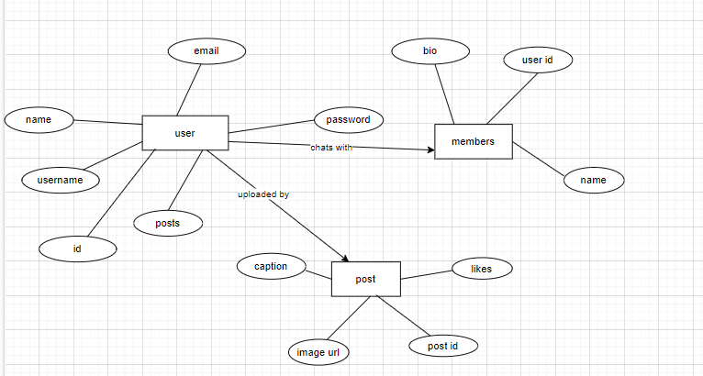
ER DIAGRAM

Slide 7
SOFTWARE REQUIREMENTS
FLUTTER SDK
DART PROGRAMMING LANGUAGE
ANDROID STUDIO IDE
FIREBASE FOR BACKEND SERVICES
GIT FOR VERSION CONTROL MANAGEMENT
Y

Slide 8
HARDWARE REQUIREMENTS
Processor: Intel Core i5
RAM: 8 GB
10GB Storage
Stable internet connection
Mobile Devices
Screen Resolution

Slide 9
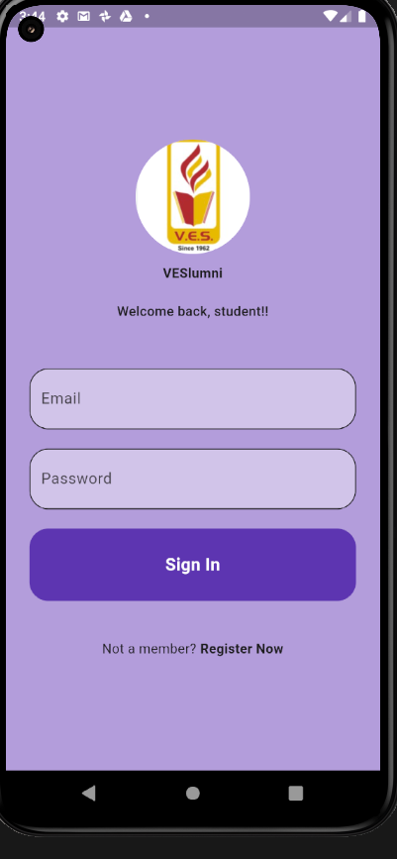
LOGIN PAGE
User-friendly interface with fields for email and password.
Efficient authentication mechanisms with error feedback using a snack bar.
Option to navigate to the signup page for new users.

Slide 10
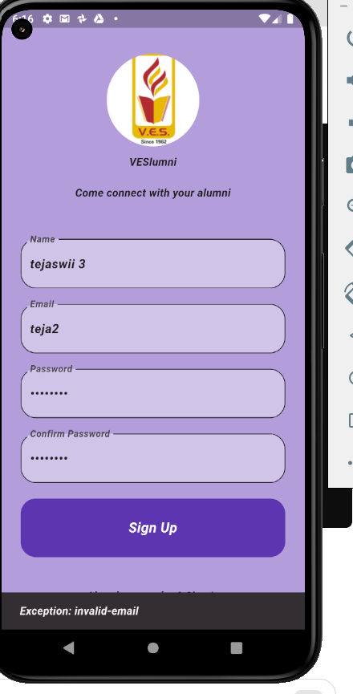
SIGN UP PAGE
Intuitive design with fields for name, username, email, and password.
Efficient authentication mechanisms with error feedback using a snack bar.
Option to navigate back to the login page for existing users.

Slide 11
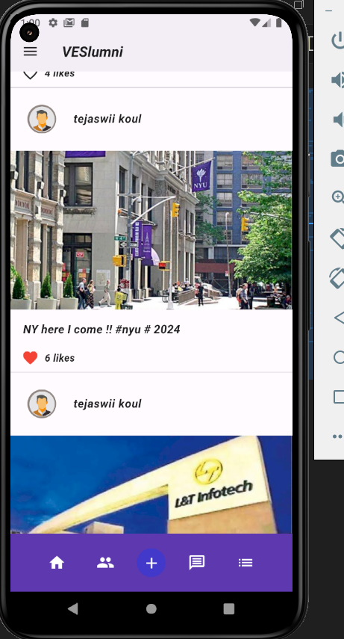
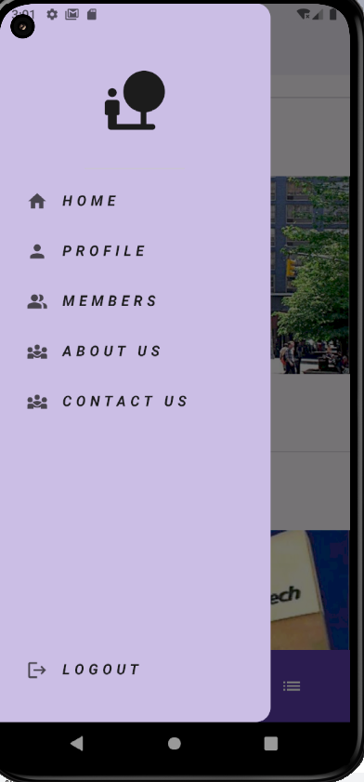
HOME PAGE
Displays posts with profile , usernames, captions, and likes.
Drawer bar with options: Home, Profile, Members, About Us, Contact Us, Logout.
Buttons for navigating to different sections: Home, Members List, Post Page, Chat, More.

Slide 12
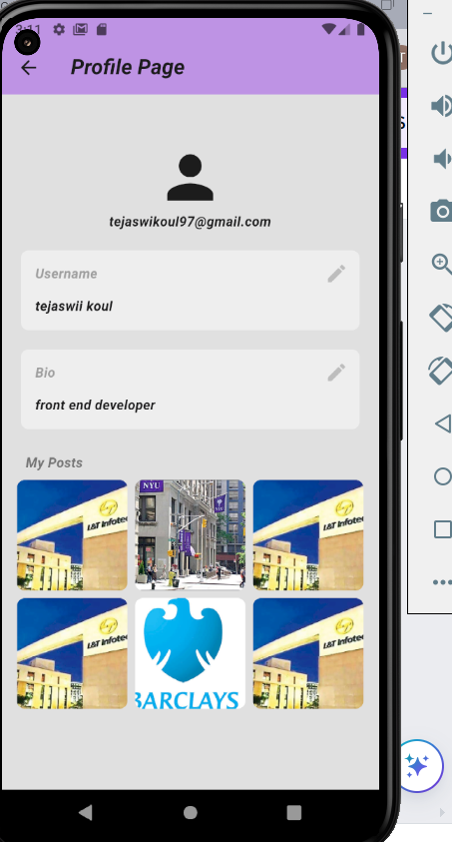
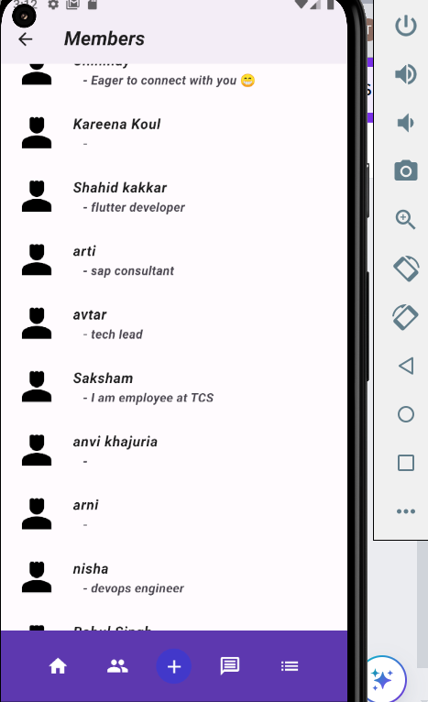
PROFILE PAGE & MEMBERS PAGE
Allows alumni to change their username and bio.
Displays all of the user's posted posts below.
Option to return to the home page.
Displays a list of signed-up alumni along with their bios.
Provides a platform for alumni to connect with each other.

Slide 13
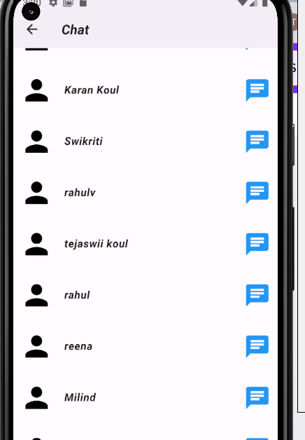
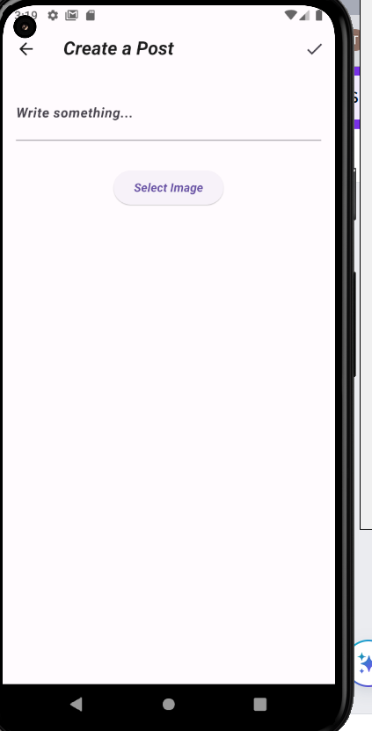
POST PAGE & CHATLIST PAGE
Post Page:
Allows users to create new posts by adding captions and selecting images from storage.
Provides options for posting and navigating back to the home page.
Chat Page:
Displays a list of members available for chat.
Enables users to send messages and engage in real-time conversations.

Slide 14
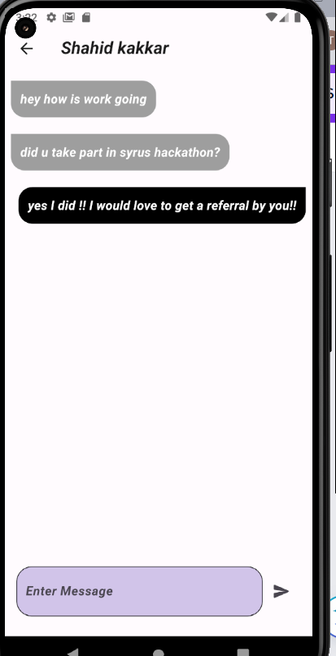
CHAT SCREEN PAGE
Provides a text input field for typing messages.
Allows users to send messages and engage in real-time conversations.
Supports message threading for organized communication.

Slide 15
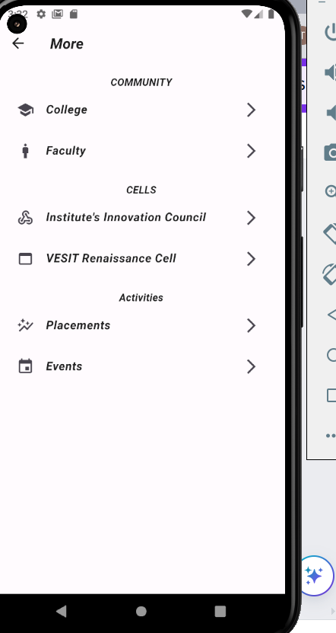
MORE PAGE
Offers additional options such as links to the college website, placement statistics, current events, and information about college cells/clubs.
Provides access to relevant resources and information for alumni.

Slide 16
LITERATURE SURVEY
Author | Title | link
Sonal Sawant , Pooja Jamdhade | App for alumni connect | https://www.irjet.net/archives/V8/i5/IRJET-V8I5435.pdf
Sanika Bhandare, Sonam Jeughale, Shivani More | Android app for alumni management | https://www.ijirmps.org/papers/2023/3/230140.pdf
P.Aruna, M.Sharmila Begum and D.Maghesh Kumar | Alumni Smart Connect | https://www.ijtrd.com/papers/IJTRD4230.pdf

Slide 17

CONCLUSION
The creation of the VESlumni app marks a remarkable milestone in harnessing modern technology to tackle alumni networking challenges effectively. Through the utilization of Flutter and integration with Firebase services, this project showcases the feasibility of developing a versatile and feature-rich networking platform.

Slide 18
REFERENCES
Singh, Shrestha. (2016). "Revolutionizing Alumni Engagement through Innovative Technology." Alumnus Quarterly Review.
Vyangar, Anagha. (2018). "Navigating Alumni Networks: Strategies for Effective Networking." Alumni Insights Journal.
kansana,keshav. (2021). "The Evolution of Alumni Platforms: Trends and Future Directions
CUSTOMERS

