Slide 1
Insurance Claim Analysis
MDSA Capstone Project | Mathematics for Data Science and Analytics
Coverage: Course Outcomes CO1 - CO6 | Dataset: Kaggle Insurance Dataset (1,338 records)

Slide 2
Introduction
Objectives & Problem Statement:
• Analyze medical charges and identify key risk factors driving insurance claims.
• Insurance companies must understand drivers of medical costs to price premiums accurately.
Approach & Tools:
• Systematic application of statistical and machine learning methodologies across 6 Course Outcomes (CO1-CO6).
• Tools Used: Python, Pandas, NumPy, SciPy, Scikit-learn, Matplotlib, Seaborn.

Slide 3
Dataset Description
Feature Description:
• age: Age of primary beneficiary (18-64 years)
• sex: Gender of beneficiary (male, female)
• bmi: Body Mass Index (15.96 to 53.13)
• children: Number of dependents/children (0-5)
• smoker: Smoking status (yes, no)
• region: Beneficiary's residential region in the US (4 regions)
• charges: Individual medical costs billed by health insurance ($1,121.87 to $63,770.43)
Summary:
• 1,338 rows, 7 columns. 0 missing values. 1 duplicate record removed.

Slide 4
Course Outcome Mapping Table
• CO1: Data Understanding & Preprocessing (Handling missing data, duplicate removal, IQR-based outlier detection)
• CO2: Descriptive Statistics (Measures of central tendency, dispersion, shape)
• CO3: Probability & Distributions (Conditional probability, Bayes' Theorem, Normal distributions)
• CO4: Statistical Inference (Central Limit Theorem, 95% CI, Two-Sample t-Test)
• CO5: Correlation & Regression (Covariance analysis, Pearson correlation coefficients, Simple Linear Regression)
• CO6: Evaluation, Visualization & Decision Making (Multiple Linear Regression, R², RMSE, business recommendations)

Slide 5
CO1
Data Understanding & Preprocessing

Slide 6
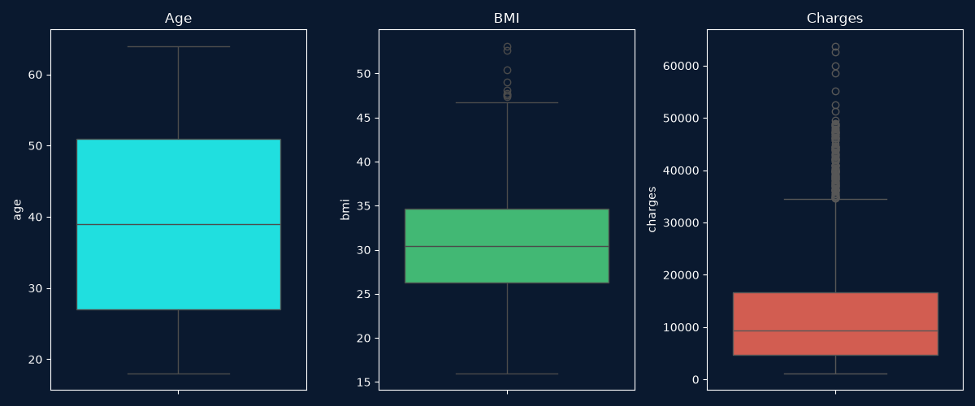
CO1: Data Understanding & Preprocessing
Key Preprocessing Steps:
• Loaded via pd.read_csv('insurance.csv'). Shape: 1,338 rows x 7 columns.
• 0 missing values. 1 duplicate record identified and dropped.
• Outlier Identification (IQR Method):
- age: 0 outliers
- bmi: 9 outliers (mildly high BMI values)
- charges: 139 outliers (reflecting extreme medical claims)
• Categorical Encoding: Applied mapping/dummy variables to sex, smoker, and region.

Slide 7
CO2
Descriptive Statistics

Slide 8
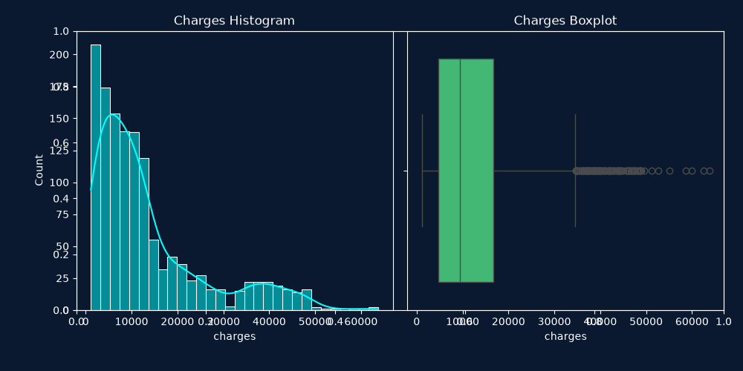
CO2: Descriptive Statistics for Charges
• Mean charges: $13,279.12 | Median charges: $9,386.16 | Mode: $1,121.87
• Range: $62,648.55
• Standard Deviation: $12,110.36 | Variance: $146,660,811.01
• Q1 (25%): $4,746.34 | Q2 (50%): $9,386.16 | Q3 (75%): $16,657.72
• IQR: $11,911.37
• Skewness = 1.5154 (strong right skew) | Kurtosis = 1.6042 (leptokurtic)
Key Insight:
Mean > Median confirms a right-skewed distribution driven by a subset of patients with high-cost medical claims.

Slide 9
CO3
Probability and Distributions

Slide 10
CO3: Probability Analysis
Event Definitions:
• High Charge = charges > Q3 ($16,658)
Basic Probabilities:
• P(High Charge) = 0.2498 | P(Smoker) = 0.2049
Conditional Probabilities:
• P(High Charge | Smoker) = 0.9270
• P(Smoker | High Charge) = 0.7605
Bayes' Theorem:
• P(Smoker|High) = [P(High|Smoker) x P(Smoker)] / P(High)
• = [0.9270 x 0.2049] / 0.2498 = 0.7605 (verified)

Slide 11
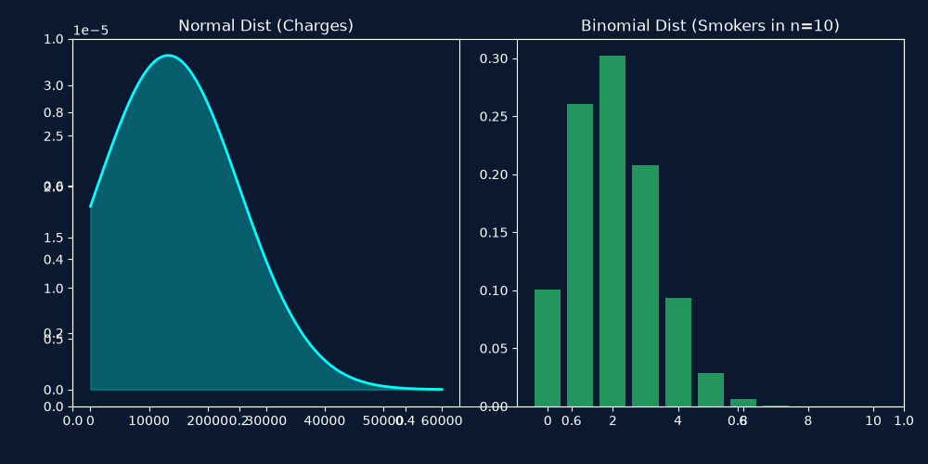
CO3: Bernoulli, Binomial & Normal Dist
Bernoulli (Smoker Status):
• p = 0.2049, q = 0.7951. Mean = 0.2049, Variance = 0.1629.
Binomial (Smoker count in a random sample of n=10):
• Expected smokers = 2.05. Most likely outcome is exactly 2 smokers (P(X=2) = 0.3018).
Normal Distribution (Charges Approximation):
• Approximating charges using mu = $13,279.12 and sigma = $12,110.36:
• P(Charges < $10,000) = 0.3933
• P(Charges < $20,000) = 0.7105
• P(Charges > $30,000) = 0.0837

Slide 12
CO4
Statistical Inference

Slide 13
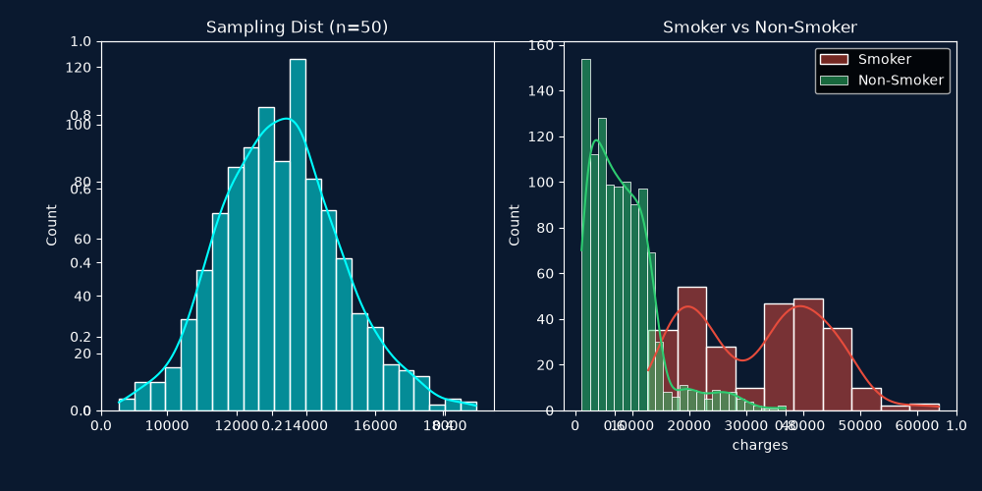
CO4: Confidence Intervals & Hypothesis Testing
Sampling Distribution (n=50):
• Mean of sample means = $13,275.03, Standard Error = $331.20.
95% Confidence Interval:
• CI = [$12,629.97, $13,928.27]
Two-Sample t-Test (Smokers vs Non-Smokers):
• H0: mu_smoker = mu_non-smoker | H1: mu_smoker != mu_non-smoker
• Smoker Mean = $32,050.23 | Non-Smoker Mean = $8,440.66
• t-statistic = 46.6448, p-value = 1.41e-282
• Decision: Strongly REJECT H0
Inference Errors:
• Type I Error (alpha) = 0.05, Type II Error (beta) = 0.20, Power of Test = 0.80

Slide 14
CO5
Correlation and Regression Analysis

Slide 15
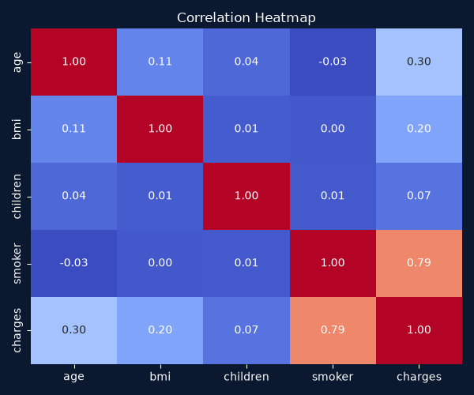
CO5: Correlation Analysis
Correlation with Charges:
• smoker: r = +0.7872 (Strong positive correlation)
• age: r = +0.2990 (Weak-to-moderate positive correlation)
• bmi: r = +0.1983 (Weak positive correlation)
• children: r = +0.0680 (Negligible correlation)
Key Finding:
• Smoking status is by far the most dominant linear predictor of insurance charges.

Slide 16
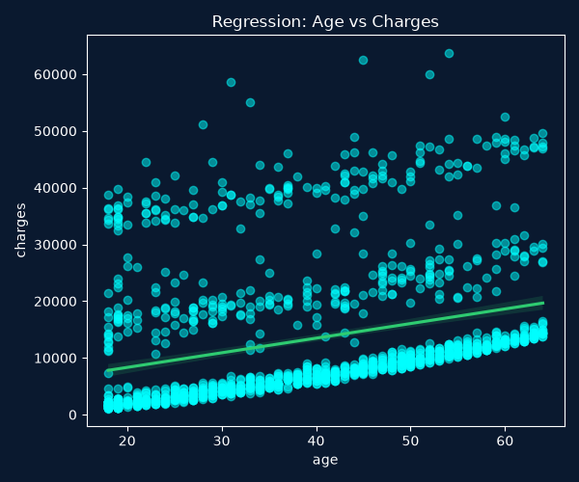
CO5: Simple Linear Regression (Age vs Charges)
Regression Details:
• Equation: Charges = 257.72 x Age + 3165.89
• Interpretation: For every 1-year increase in age, medical charges increase by an average of $257.72.
• R² = 0.0894 (Age alone explains only 8.9% of the variance in charges).
Residual Diagnostics:
• Mean of residuals is approximately 0.
• Residuals fail normality test, indicating non-linearity and missing factors (like smoking status).

Slide 17
CO6
Evaluation, Visualization & Decision Making

Slide 18
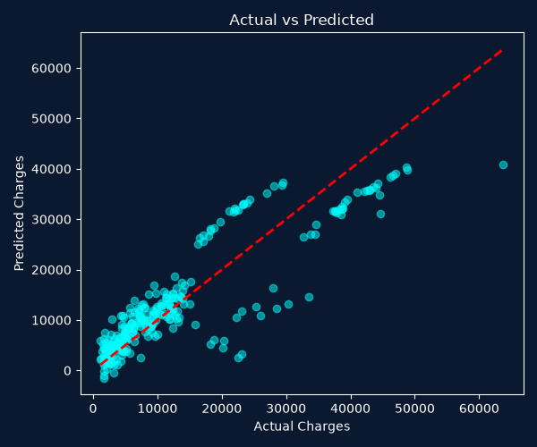
CO6: Multiple Linear Regression
Model Setup:
• Train/Test: 80/20 (1070 train / 268 test). Features: age, sex, bmi, children, smoker, region
Performance Metrics:
• MSE: 33,635,210.43 | RMSE: $5,800.00 | MAE: $4,186.51 | R²: 0.7827
• Model explains 78.3% of the variance in charges.
Feature Coefficients:
• smoker(yes): +$23,647.78 | children: +$425.23 | bmi: +$335.56 | age: +$256.86
Predictive Equation:
• Charges = -11,947 + 257xage + 336xbmi + 425xchildren + 23,648xsmoker

Slide 19
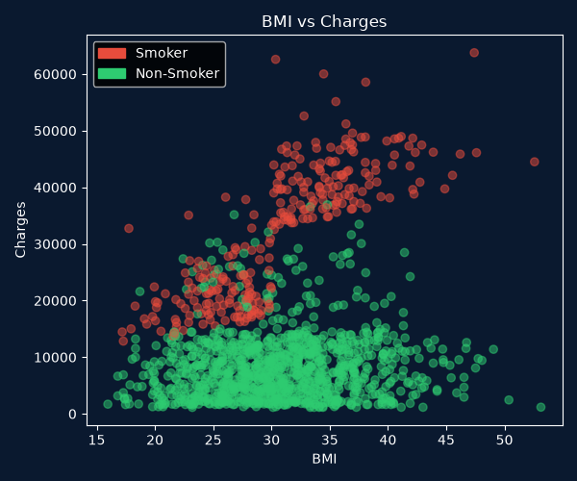
CO6: Key Visualizations & Clustering
BMI vs. Charges (3 Distinct Clusters):
1. Low-cost band: Non-smokers (under $15,000).
2. Medium-cost band: Smokers with BMI < 30 ($15,000 - $30,000).
3. High-cost/High-risk band: Smokers with BMI >= 30 (exceeding $30,000).
Age vs. Charges:
• Three distinct parallel linear bands corresponding to healthy habits, moderate risk, and extreme risk.
Smokers vs. Non-Smokers:
• Median charge for smokers is ~$34,000 compared to ~$7,500 for non-smokers (4.5x difference).

Slide 20
Conclusion & Recommendations
Key Conclusions:
• Smoking is the single greatest risk factor, followed by age and BMI.
• The multiple linear regression model is highly robust, explaining 78.3% of premium variance.
Recommendations for Insurance Underwriting:
• Implement tiered pricing surcharges specifically targeting smokers.
• Establish premium escalation pathways based on age-risk bands.
• Introduce wellness incentives for lowering BMI or smoking cessation.
Future Scope:
• Deploy Random Forest or XGBoost to capture interaction effects.
• Build a real-time web application for interactive premium pricing.

Slide 21
Thank You!
MDSA Capstone Project | Insurance Claim Analysis
All code scripts, statistical outputs, and visualization assets are available in the project repository.

