Slide 1
Interactive Teddy
Rawan Alharbi, Surabhi Ravishankar, Bhavita Jaiswal, Tejaswinee Sohoni

Slide 2
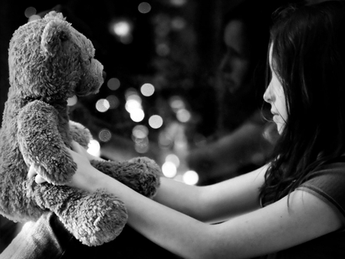

Slide 3
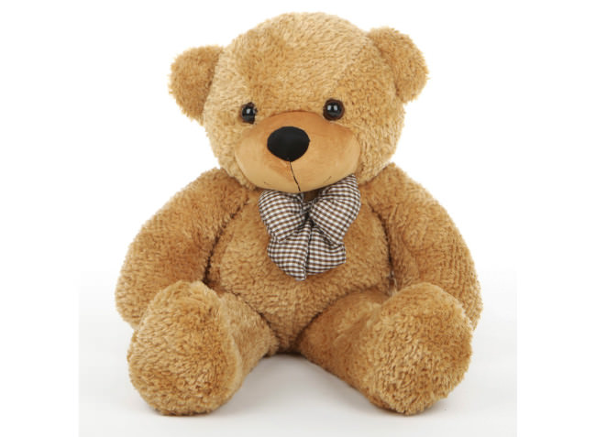
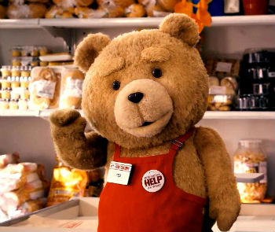

Hey there!
Machine Learning

Slide 4
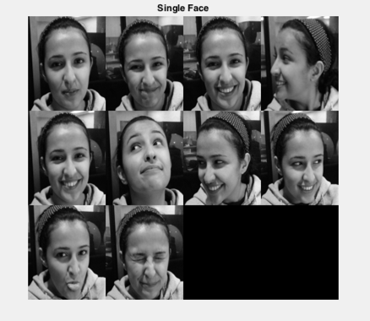
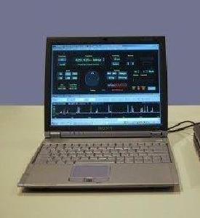
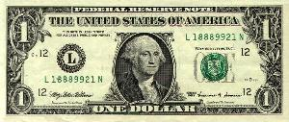
Data set

Slide 5
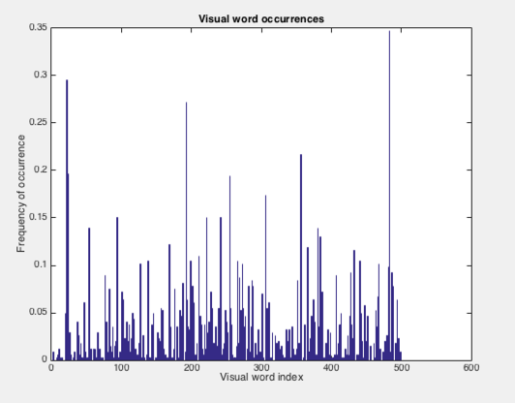
Feature Extraction for objects
Notes:
Construct the Vocabulary of SURF features representative of each image category.
Keep 80 percent of the strongest features from each Image Set. This is used for training.
Reducing features :
Balancing the number of features across all image sets to improve clustering
Using K-means Clustering to create a 500 word visual vocabulary.

Slide 6

Multi-Class SVM (One-Vs-All method)
SVM Model 3
SVM Model 1
SVM Model 2

Slide 7

Testing
SVM Model 1
1
SVM Model 2
-1
SVM Model 3
-1
SVM Model 1

Slide 8
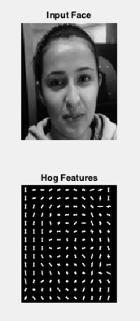
Feature extraction for faces then SVM again

Slide 9
Demo

