Slide 1
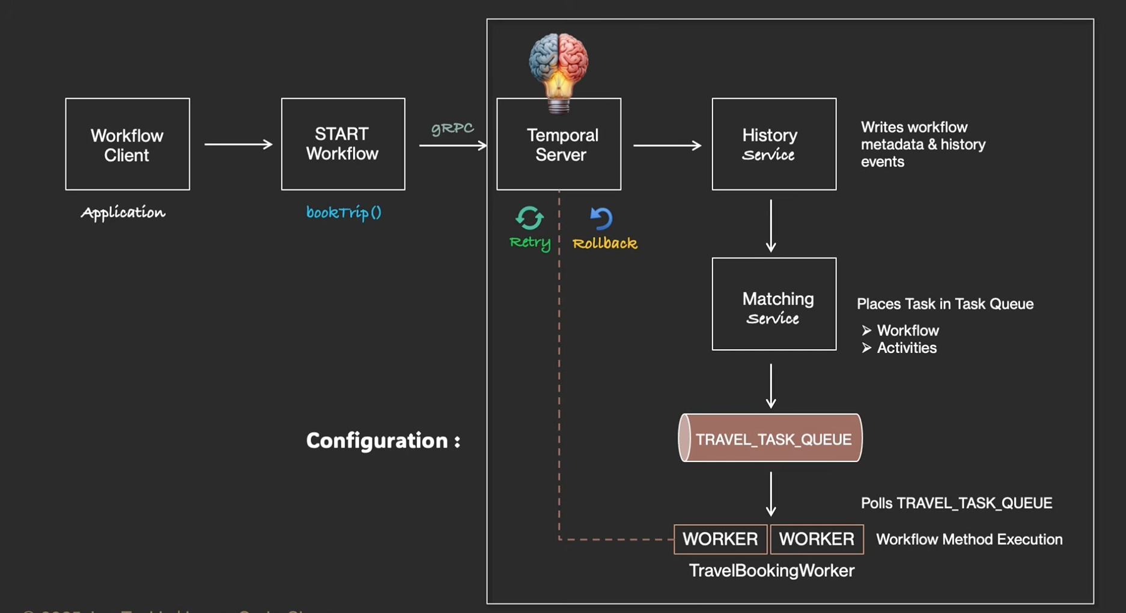
Spring Boot Microservice Orchestration with Temporal

Slide 2
Temporal Sync and Async Patterns
Channel | Flow type | Purpose
Branch | synchronous flow | return eligibility and estimated settlement immediately
Online | Signal + Wait | accept the online request and wait for the bank’s decision.
Online | Asynchronous Activity Completion | start a bank approval activity and complete it later using the saved Temporal task token.

Slide 3
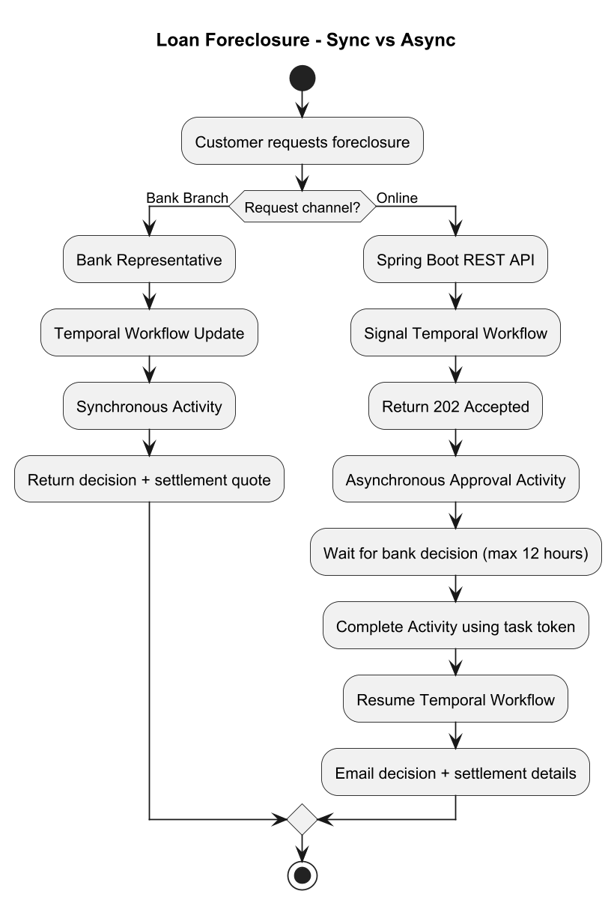

Slide 4
Flow diagram
diagram

Slide 5
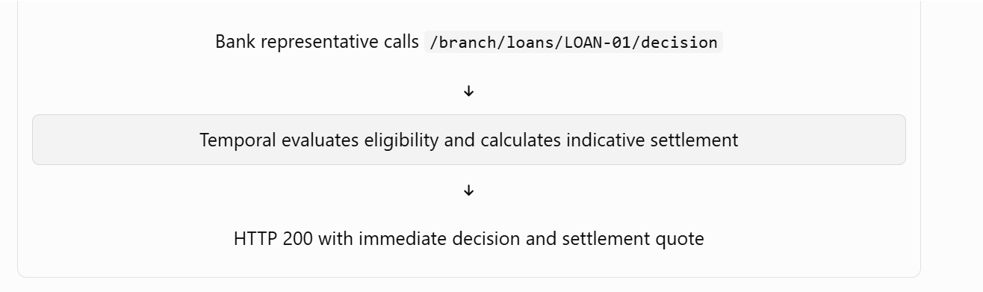
Branch synchronous flow
In Temporal, synchronous workflow interactions primarily happen through
Updates,
Queries,
Synchronous Child Workflows,
allowing external clients or parent flows to block and wait for a response or state change
Scenario :
a customer visits a bank branch and the bank representative needs to return a foreclosure decision and estimated settlement details immediately.

Slide 6
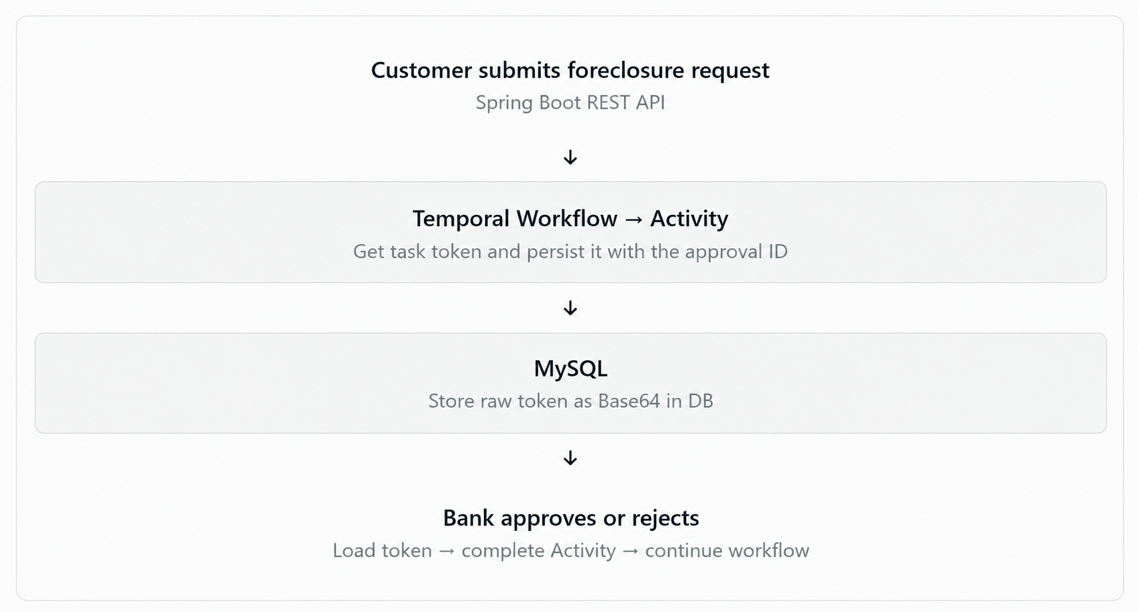
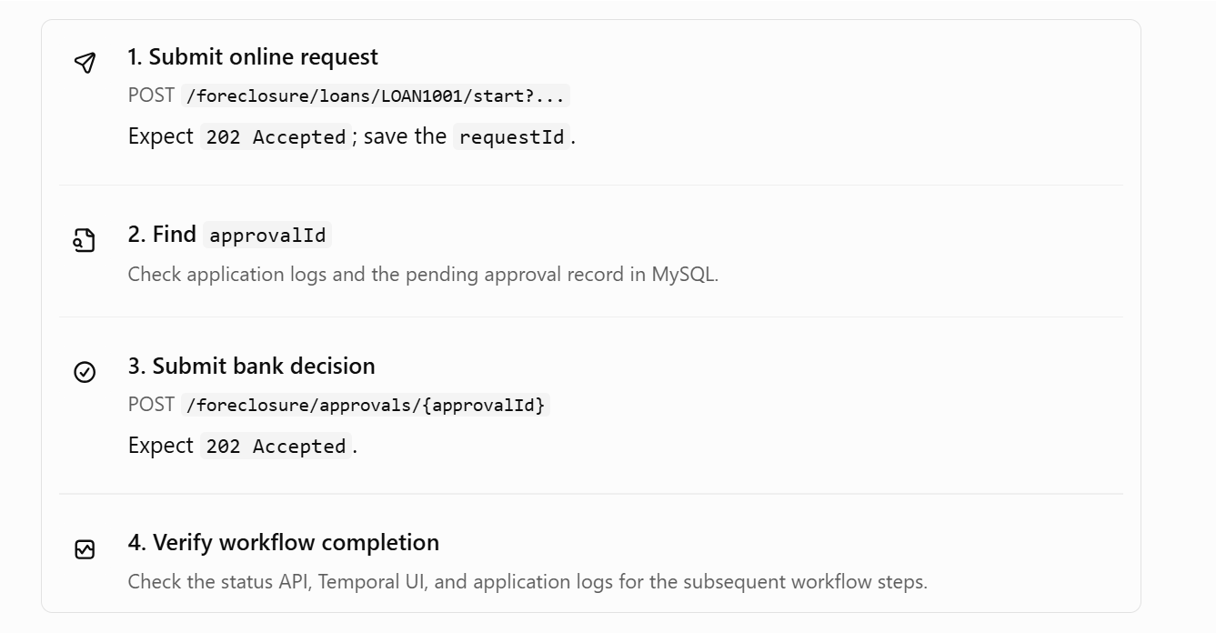
Asynchronous Activity Completion using Task Token

Slide 7
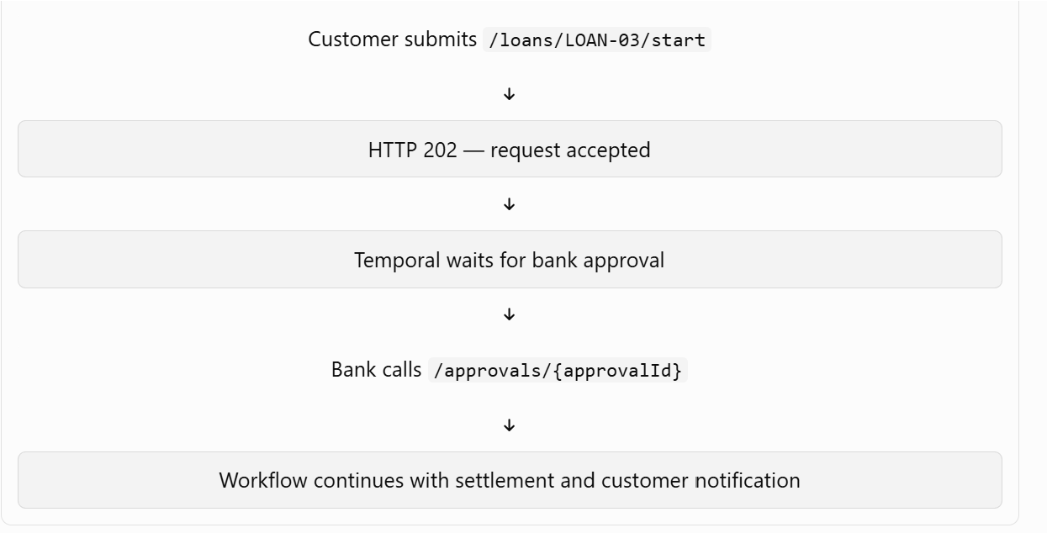
Online asynchronous flow using Signal & Wait

Slide 8
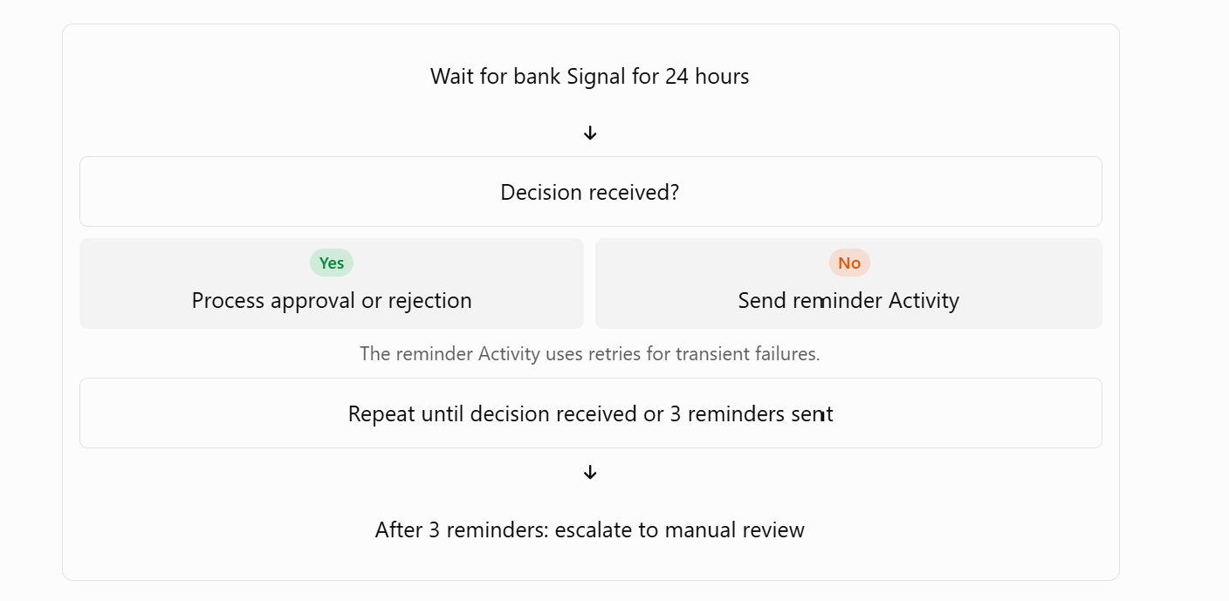
Scenario A — Bank officer responds within 24 hours
Scenario B — Bank officer does not respond within 24 hours

Slide 9
Key difference
Signal + Wait: the bank sends a decision to /foreclosure/signal; the workflow receives the Signal and resumes.
Asynchronous Activity Completion: the workflow schedules an Activity that starts a bank approval request and returns control without completing the Activity. Later, the bank sends its decision to /foreclosure/approvals/{approvalId}, and your application completes that Activity using its saved Temporal task token.
Signal | Customer submits an online foreclosure request. | Notify the workflow without waiting for the final business decision.
Workflow.await() | Workflow waits for bank approval or a condition to become true. | Wait for external events without continuously polling.
An Activity waits for an external bank decision and completes when the external system responds. | Handle long-running external or human approvals.

Slide 10
END

Slide 12
Foreclosure Signal
Record authoritative request timestamp
Check settlement feasibility
Can approval, calculation and settlement complete by the 25th?
YES
Process foreclosure
Reconcile EMI and settle by deadline
Disable auto-debit after confirmed completion
NO
Defer to next cycle
Keep auto-debit enabled
Re-evaluate in the next eligible month

Slide 13
Foreclosure arrives during an in-flight EMI debit
Now suppose the workflow has already started the EMI debit.
EMI debit in progress
Payment gateway is processing ₹10,000
EMI Activity
Debit already submitted
Foreclosure Signal
Request recorded
Reconcile payment status
Debit succeeded → account for the EMI in the foreclosure balance.
Debit failed → handle the failed debit.
Debit status unknown → reconcile with the payment provider before proceeding.
Calculate foreclosure settlement
Avoid duplicate debits and incorrect outstanding balances
Important: A Signal does not automatically cancel an Activity already executing. Do not simply terminate the debit because foreclosure arrived. First determine whether the payment was submitted or completed, and reconcile the result. Use idempotency keys and payment-status checks to prevent duplicate charges.
For this case, the best combination is:
Asynchronous Signal: Record the foreclosure request immediately.
Workflow logic: Finish or reconcile the in-flight debit safely.
Synchronous Update: Optionally validate the foreclosure request and return an accepted/rejected result.
Activity: Communicate with the payment provider and calculate settlement.

Slide 14
A. Branch visit — Workflow Update
Customer visits branch
Bank representative enters foreclosure request
Spring Boot API
Temporal Workflow Update
Validate loan, ownership and request eligibility
Return accepted or rejected result
The representative sees the result immediately. Acceptance means the request is accepted for processing, not that the loan has already been closed.

Slide 15
B. Online request — Workflow Signal
Customer submits request online
Spring Boot API
Temporal Workflow Signal
API acknowledges receipt
Workflow handles request
Cutoff → approval → settlement → notification
The customer gets a receipt acknowledgement first. The business decision and processing status arrive later

Slide 16
Asynchronous Signal: Record the foreclosure request immediately.
Workflow logic: Finish or reconcile the in-flight debit safely.
Synchronous Update: Optionally validate the foreclosure request and return an accepted/rejected result.
Activity: Communicate with the payment provider and calculate settlement.

Slide 17
Temporal Pattern | How it fits Loan EMI Collection
Entity Workflow | One long-lived parent workflow per loan to manage the repayment schedule and loan lifecycle.
Child Workflows | One child workflow per EMI to isolate collection, retries, and troubleshooting.
Saga | Compensate for partial failures, such as reversing a debit if a later step fails.
Non-Retryable Errors | Stop retries for permanent business errors like a closed account; retry transient network failures.
Request-Response via Updates | Process prepayment or foreclosure quote requests and return validated results.
Continue-As-New | Reset workflow history periodically for long-running loans while carrying forward essential state.
Updatable Timer | Adjust the next EMI due-date timer when a schedule changes due to restructuring or holidays.
Signal-With-Start | Start the loan workflow if needed and send a signal without a separate existence check.
Signals | Notify the workflow about events such as bank payment confirmation without waiting for a result.
Activity Retry | Automatically retry temporary failures in external operations, such as payment gateway calls.

Slide 18
Retry policy | Retries transient failures, such as network timeouts.
Saga | Runs compensating actions if a multi-step payment fails.compensate when a later payment step fails
Signals and Updates Results Signal-With-Start — start servicing without a separate existence check | Receive instructions and return validated Pattern: Signal-With-Start Purpose: Let an API send a message to a workflow whether it already exists or needs to be created.
Durable timers /Updatable Timer | Wait for due dates and react to schedule changes.change the next EMI due date dynamically Pattern: Durable timer with an updateable deadline Purpose: Adjust a workflow's wait when the repayment schedule changes. Suppose the next EMI is due on 5 November 2026. The parent workflow is waiting for that date.
Entity Workflow | one long-lived workflow per loan
Child Workflows | one workflow per EMI
Non-retryable errors | Retry temporary failures, not permanent ones Pattern: Activity retry policy
Request-response via Updates | prepayment with a synchronous result Pattern: Workflow Update Purpose: Let a caller request a business operation and receive its validated result. Suppose the customer wants to foreclose a loan by paying it off early. The caller needs the current foreclosure amount before confirming the transaction.

Slide 19
Continue-As-New — keep a years-long workflow manageable Pattern: Continue-As-New | Purpose: Start a fresh workflow run while preserving the business state needed for the next run. A loan may run for 15 or 20 years. Over time, the parent workflow could accumulate a large history of timer operations, signals, payment confirmations, and schedule changes. Large histories can make workflow replay and operations more expensive. Continue-As-New closes the current run and starts a new run of the same workflow execution, carrying forward selected state.

Slide 20
Retry policy
How to choose the retry pattern for each EMI scenario
Choose an EMI event to see the recommended Temporal pattern.
Loan disbursement completes
EMI reaches its due date
Payment gateway times out
Bank debit succeeds but ledger update fails
Customer requests a foreclosure quote
Loan due date changes
Workflow history becomes large
Bank confirms payment.
Activity retry policy : Retry transient failures with bounded backoff.

