Slide 1
Heat Wave Response, Recovery, Future Challenges and the Role of Technology
A Ground-Level Assessment and Preparedness Study
Project Presentation by Mandal Tejaswini | India Space Lab
Study Area: Hyderabad, Telangana
Project Duration: 17 June – 31 July 2026

Slide 2
Why Study Heat Waves?
Heat waves are becoming a serious urban disaster risk as high temperatures interact with rapid urban growth, loss of vegetation and dense built-up surfaces.
The impact is not limited to discomfort: extreme heat affects health, water demand, electricity use, outdoor work, agriculture and public infrastructure.
Hyderabad provides a useful urban setting to study how shade, traffic, vegetation and public preparedness influence heat exposure.
This project looks beyond the hazard itself and focuses on response, recovery, future challenges and practical use of technology.

Slide 3
Objectives of the Study
Understand the causes and major impacts of heat waves.
Study response measures used during periods of extreme heat and the recovery needs that follow.
Identify groups and locations that may face greater heat exposure.
Assess community awareness and basic preparedness.
Explore how GIS, remote sensing, AI, IoT, mobile alerts and other technologies can support heat-wave management.

Slide 4
Study Area and Methodology
Hyderabad, Telangana
The study uses a descriptive approach combining field-level observations with secondary information.
Primary components include a community questionnaire, temperature observations and comparison of different urban environments.
Secondary sources include IMD and NDMA material, government reports and published climate and health literature.
The study considers vulnerable groups such as outdoor workers, street vendors, construction workers, elderly people, children and sanitation workers.
Observed locations include a bus stand, public park, main road, residential area and market area.

Slide 5
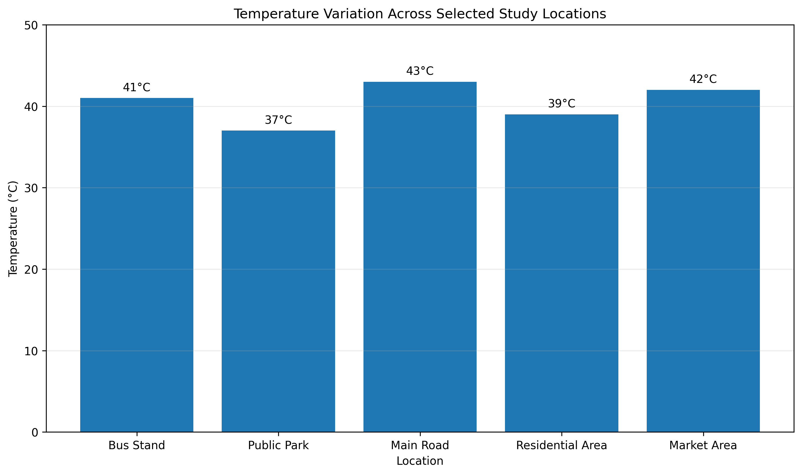
Field Temperature Observations
Highest observed temperature: Main Road — 43°C
Market Area — 42°C; Bus Stand — 41°C
Residential Area — 39°C
Lowest observed temperature: Public Park — 37°C
The 6°C difference between the Main Road and Public Park highlights the local importance of shade and vegetation.

Slide 6
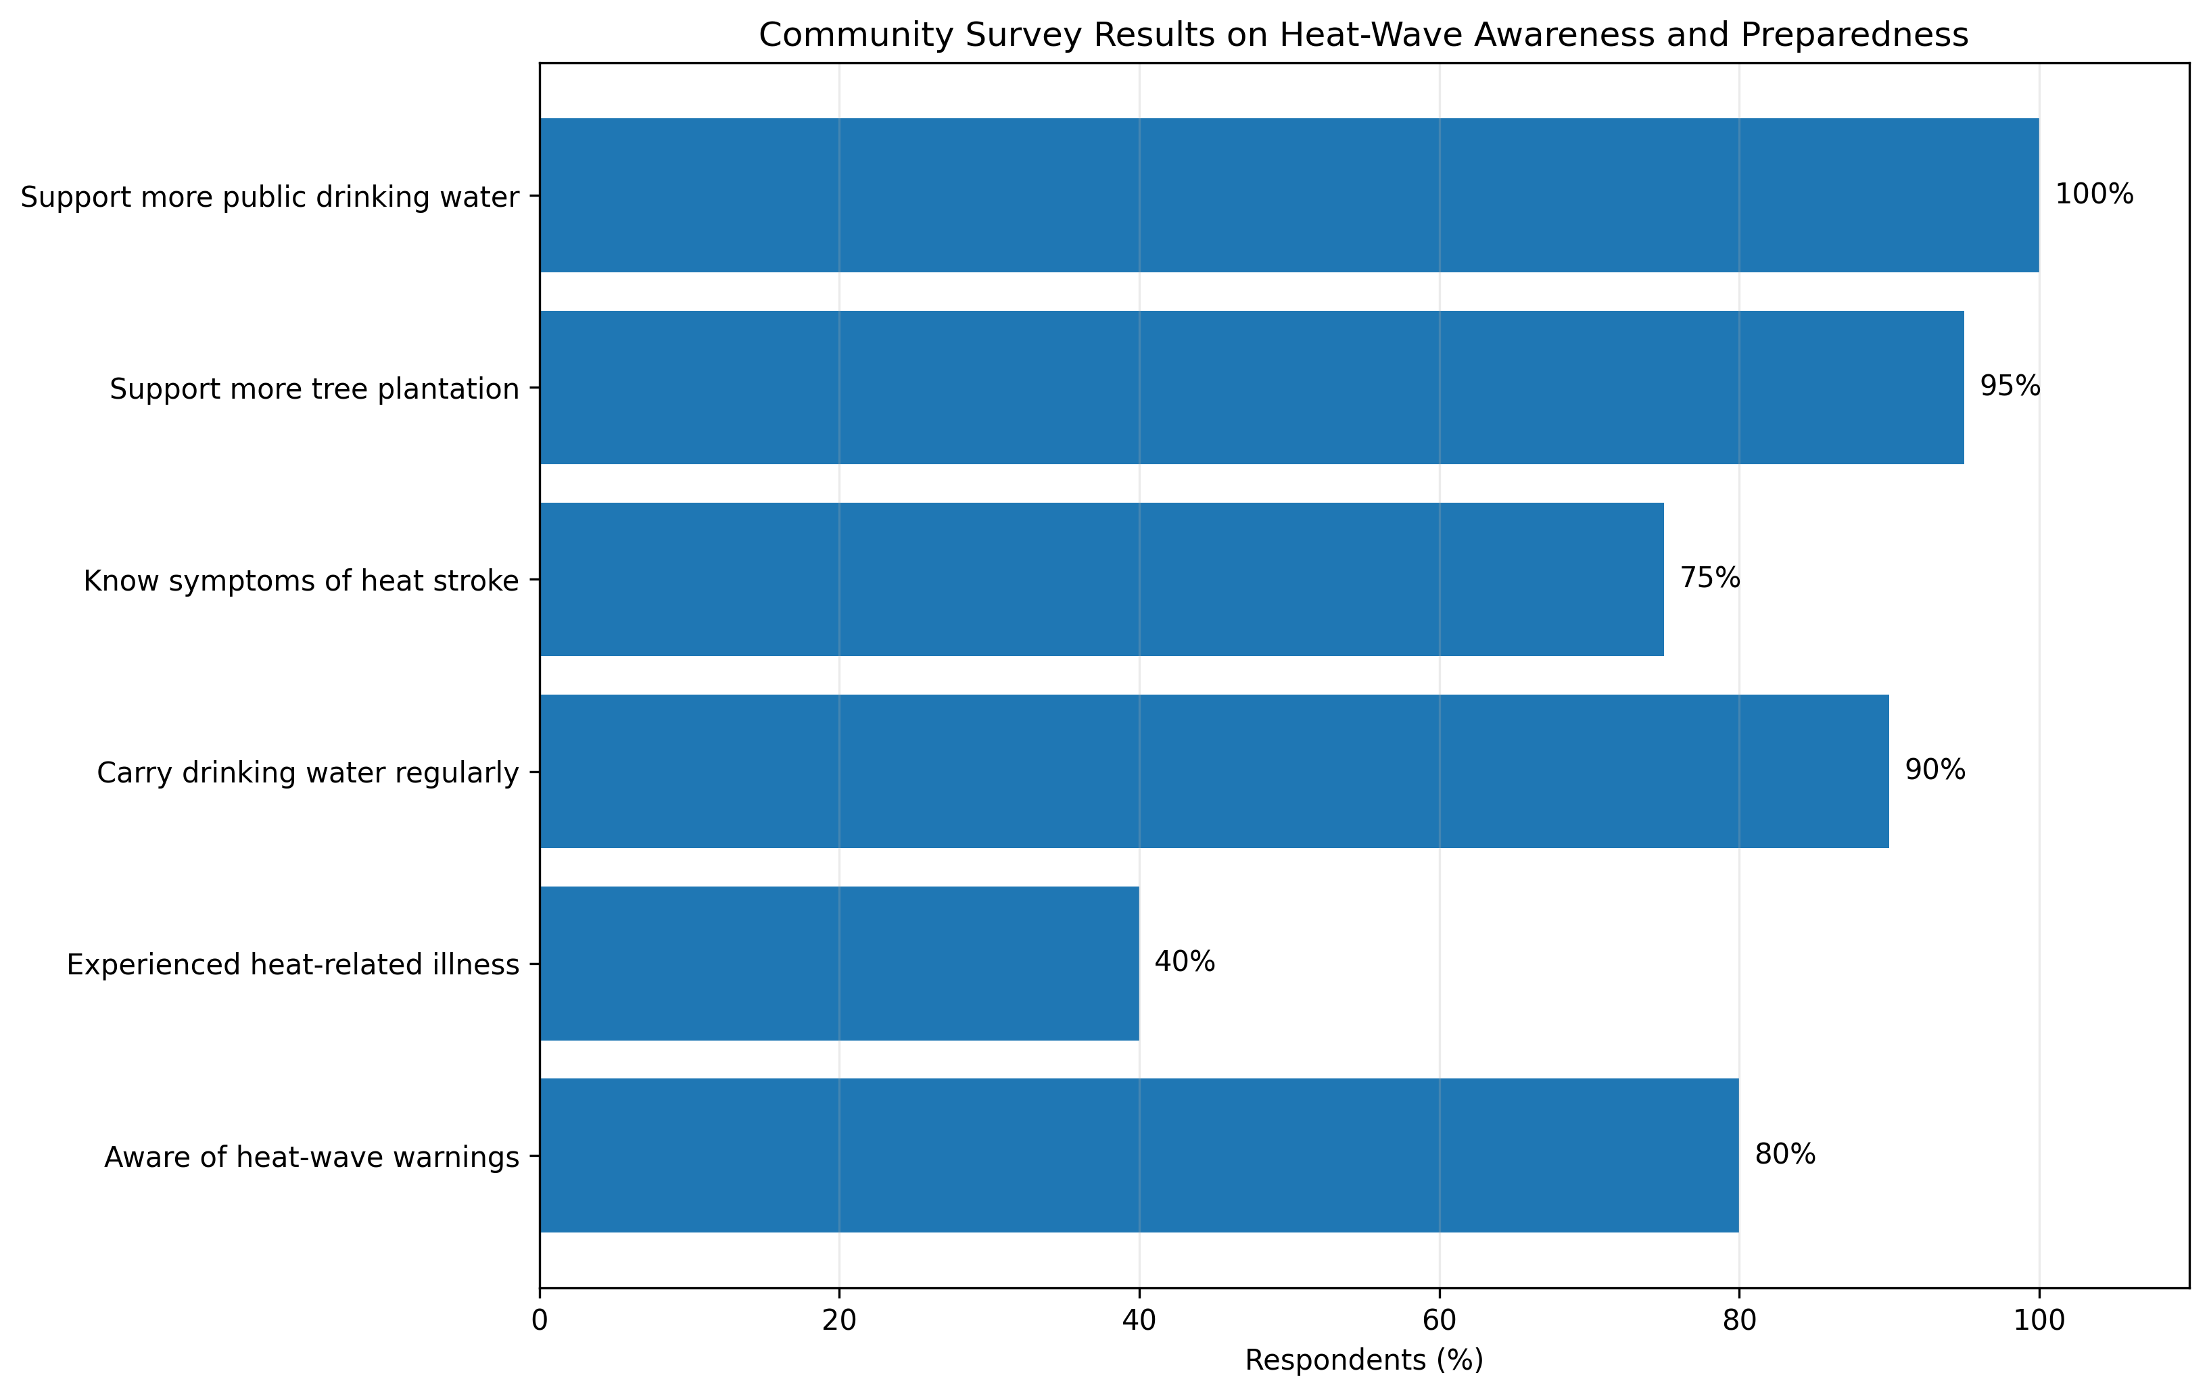
Community Survey: Awareness and Preparedness
Survey summary: 20 participants
80% were aware of heat-wave warnings.
40% reported experiencing a heat-related illness.
90% regularly carried drinking water.
75% knew the symptoms of heat stroke.
95% supported more tree plantation, while 100% supported additional public drinking-water facilities.

Slide 7
Relative Heat Vulnerability
Very High: Main Road (43°C) — heavy traffic and exposed built surfaces.
High: Market Area (42°C) and Bus Stand (41°C) — crowding, activity and limited shade can increase exposure.
Moderate: Residential Area (39°C).
Lower observed exposure: Public Park (37°C) — vegetation and shade were associated with a cooler local environment.
These observations are a small field comparison, not a city-wide temperature map, but they help identify practical factors that influence local heat stress.

Slide 8
Response and Recovery
Response: timely heat alerts, public communication, drinking-water access, shaded spaces, healthcare readiness and coordination among local agencies.
Priority groups include people who work outdoors, older adults, children and communities with limited access to cooling.
Recovery includes treatment of heat-related illness, restoration of livelihoods, reliable water and electricity supply, and support for agriculture where required.
Preparedness improves when response measures are planned before peak heat periods rather than introduced only after impacts occur.

Slide 9
How Technology Can Help
GIS and Remote Sensing: identify heat-prone areas and compare land-surface temperature patterns.
AI: analyze weather and historical data to support forecasting and risk assessment.
IoT sensors: provide continuous local temperature and environmental observations.
Mobile alerts: communicate warnings and safety guidance quickly to the public.
Drones and satellite imagery: support monitoring of vulnerable locations and changing urban conditions.
Smart infrastructure: cool roofs, reflective surfaces, green spaces and efficient irrigation can reduce heat stress.

Slide 10
Case Study: Heat-Wave Preparedness in Hyderabad
Hyderabad combines high summer temperatures with dense development, traffic and large numbers of people working or travelling outdoors.
The field comparison showed 43°C at the Main Road and 37°C at the Public Park, illustrating how local urban conditions can influence heat exposure.
Preparedness should combine early warnings with visible ground-level measures: drinking water, shade, healthcare readiness and targeted communication.
Technology can support this approach by identifying hotspots and helping authorities direct resources toward locations and populations with greater exposure.

Slide 11
Key Recommendations
Increase tree cover and shaded public spaces in high-exposure areas.
Maintain accessible drinking-water points at markets, bus stops and other busy locations.
Strengthen heat alerts and communicate them in simple, locally accessible formats.
Promote cool roofs, reflective surfaces and climate-sensitive urban planning.
Use GIS and temperature monitoring to identify local hotspots and prioritize interventions.
Continue public education on hydration, heat-stroke symptoms and safe outdoor activity during extreme heat.

Slide 12
Conclusion
Heat-wave risk is shaped by both climate and the local urban environment.
The field observations and survey indicate the value of shade, vegetation, drinking-water access and public awareness.
Effective management requires early warning, coordinated response, recovery planning and long-term adaptation.
Combining community-level action with technologies such as GIS, AI, remote sensing and IoT can strengthen heat resilience.
Thank You

