Slide 1

AI-Based Adaptive Interview Preparation System
AI PROJECT BASED LEARNING · B.TECH CSE (AI & ML)
Search, constraint satisfaction and logic working together to choose every next question.
PRESENTED BY
GUIDE
M. Tejaswini (24R11A6668)
Mr. Shaik Akbar
N. Shreya (24R11A6676)
Associate Professor, CSE (AI & ML)
Geethanjali College of Engineering and Technology · October 2026
Notes:
Welcome. This project applies classical AI (search, constraint satisfaction, propositional and first-order logic) to a practical problem: personalised technical interview preparation. Presented by M. Tejaswini and N. Shreya under the guidance of Mr. Shaik Akbar.

Slide 2
Static question lists ignore what the learner already knows and say nothing about the concepts they missed.
PROBLEM STATEMENT
01 · GENERATE
02 · ADAPT
03 · EVALUATE
Questions for any topic
The next question follows performance
Answers scored automatically
Built on demand for whatever topic the candidate enters.
Weak skills and the current level decide what is asked.
A final report lists mastery and areas to revise.
AI-Based Adaptive Interview Preparation System
02
Notes:
Problem: interview preparation usually uses static question lists. They ignore strengths and weaknesses and give no feedback about missed concepts. The goal is an application that generates questions for any topic, selects each next question adaptively, evaluates answers automatically, and presents a final report with revision areas.

Slide 3
Two-stage question selection
PROPOSED SYSTEM
STAGE 1 · FILTER
STAGE 2 · SELECT
AFTER EACH ANSWER · INFER
Constraint satisfaction
Search algorithms
Logical reasoning
Removes asked and too-difficult questions, and relaxes difficulty if the pool runs empty.
Uninformed, informed and local search choose the best remaining question.
Forward chaining derives facts such as Mastered_Skill to track the candidate.
The final report also demonstrates first-order logic unification and resolution.
AI-Based Adaptive Interview Preparation System
03
Notes:
Questions are first filtered as a constraint satisfaction problem. A search algorithm then picks the best candidate. After each answer, propositional forward chaining infers facts such as Mastered_Skill, and the final report demonstrates first-order logic unification and resolution.

Slide 4
Ten objectives, one adaptive interviewer
AIM AND OBJECTIVES
01
02
03
04
05
Dynamic question generation
Adaptive question selection
Uninformed search
Informed and local search
Constraint satisfaction
06
07
08
09
10
Logical reasoning
Automatic answer evaluation
Offline reliability
Interactive interface
Educational value
AI-Based Adaptive Interview Preparation System
04
Notes:
The aim is an interview preparation system that adapts to every candidate, and a demonstration of how the AI syllabus topics (search, heuristic and local search, constraint satisfaction, propositional and first-order logic) work together in one application built with only the Python standard library.

Slide 5
System architecture
IMPLEMENTATION
01
Candidate interface
Tkinter: topic, difficulty, number of questions, answers
02
Question generator
Google Gemini REST API, with an offline fallback generator
03
Search and reasoning engine
CSP filtering, then uninformed, informed and local search
04
Evaluation module
Keyword scoring, weakness profile, propositional inference
05
Feedback and final report
Score, mastery, revision areas, algorithm trace
AI-Based Adaptive Interview Preparation System
05
Notes:
Data flows from the Tkinter interface to the question generator, then through the search and reasoning engine, the evaluation module, and finally the feedback and report screens. Question generation runs in a background thread so the window never freezes.

Slide 6
Technologies used
IMPLEMENTATION
Technology | Role in the project
Python | Search, CSP and logic algorithms; evaluation
Tkinter | Dark-themed GUI with cards and a scrollable report
Gemini REST API | Topic-specific question bank via urllib.request
Search | BFS, DFS, UCS, IDS, Bidirectional, Greedy, A*, Hill Climbing, Simulated Annealing
CSP | Domain filtering, relaxation and backtracking
Logic | Propositional and first-order inference, unification, resolution
AI-Based Adaptive Interview Preparation System
06
Notes:
The whole application is pure Python using only the standard library: Tkinter, json, urllib.request, math, random, threading and collections. No third-party packages are needed.

Slide 7
Choosing which questions are eligible
CONSTRAINT SATISFACTION
Element | In this project
Variable | The next question to ask
Domain | Unasked questions generated for the topic
Constraints | Not asked, within allowed difficulty, relaxed if the domain is empty
Solution | One valid question chosen by a search strategy
Hard constraints
Question not already asked
Difficulty within allowed level
Relaxed if no question fits
Soft constraints
Prefer weak skills
Prefer difficulty near the target
Rotate search strategies
AI-Based Adaptive Interview Preparation System
07
Notes:
Hard constraints decide whether a question is eligible; soft constraints only guide the search toward a better choice. If no question satisfies the difficulty constraint, it is relaxed so the interview can continue, and backtracking is the final fallback.

Slide 8
Strategy rotation picks each question
SEARCH STRATEGIES
QUESTIONS 1–5
LATER QUESTIONS ROTATE
A* Search
Breadth-First Search
Uniform Cost Search
Bidirectional Search
Iterative Deepening Search
Greedy Best-First Search
A* Search
Hill Climbing
Simulated Annealing
f(n) = g(n) + h(n)
h(n) combines skill weakness and the gap from the target difficulty. Easier questions point to harder ones in a prerequisite graph.
AI-Based Adaptive Interview Preparation System
08
Notes:
The first five questions use A*, BFS, UCS, Bidirectional Search and Iterative Deepening; later questions rotate between Greedy Best-First, A*, Hill Climbing and Simulated Annealing. DFS also operates on the prerequisite graph. Hill Climbing and Simulated Annealing explore the neighbourhood of candidate questions and avoid local optima.

Slide 9
Difficulty and focus follow the candidate
ADAPTIVE LOGIC
DIFFICULTY UP
DIFFICULTY DOWN
WEAKNESS PROFILE
≥ 80
< 45
0–100
Average of the last three scores raises the target difficulty.
Average of the last three scores lowers the target difficulty.
Each skill keeps a moving-average score, so weak skills get priority later.
AI-Based Adaptive Interview Preparation System
09
Notes:
If the average of the last three scores is 80 or more, the target difficulty goes up; if it is below 45, it goes down. The score of each skill is updated as a moving average, so weak skills are prioritised later in the interview.

Slide 10
Every answer is scored out of 100
EVALUATION AND FEEDBACK
90
10
Keyword coverage · up to 90
Elaboration · +5 or +10
Marks follow how many expected concept keywords appear in the answer.
Bonus for answers of at least 15 or 30 words.
The feedback screen lists the concepts the candidate mentioned and the ones omitted.
AI-Based Adaptive Interview Preparation System
10
Notes:
The score is out of 100. Ninety marks come from keyword coverage, with an elaboration bonus of 5 or 10 marks for answers of at least 15 or 30 words. Limitation to mention if asked: keyword matching does not understand meaning, so a correct answer worded differently may score lower.

Slide 11
Inferring what the candidate knows
LOGICAL REASONING
Propositional logic
First-order logic
Forward chaining, backward chaining and resolution derive facts such as Mastered_Skill after each answer.
Unification with forward chaining matches patterns against facts in the final report.
IF Weak_Skill AND Knowledge_Base_Updated → Schedule_Remediation
Pattern: Mastered(?candidate, ?topic)
Fact: Mastered(Akhil, Context Switching)
AI-Based Adaptive Interview Preparation System
11
Notes:
Propositional forward chaining derives facts such as Mastered_Skill or Schedule_Remediation_Skill from rules. The final report demonstrates first-order logic unification and resolution; the example pattern and fact shown here come from the AI Algorithms Execution Showcase screen.

Slide 12
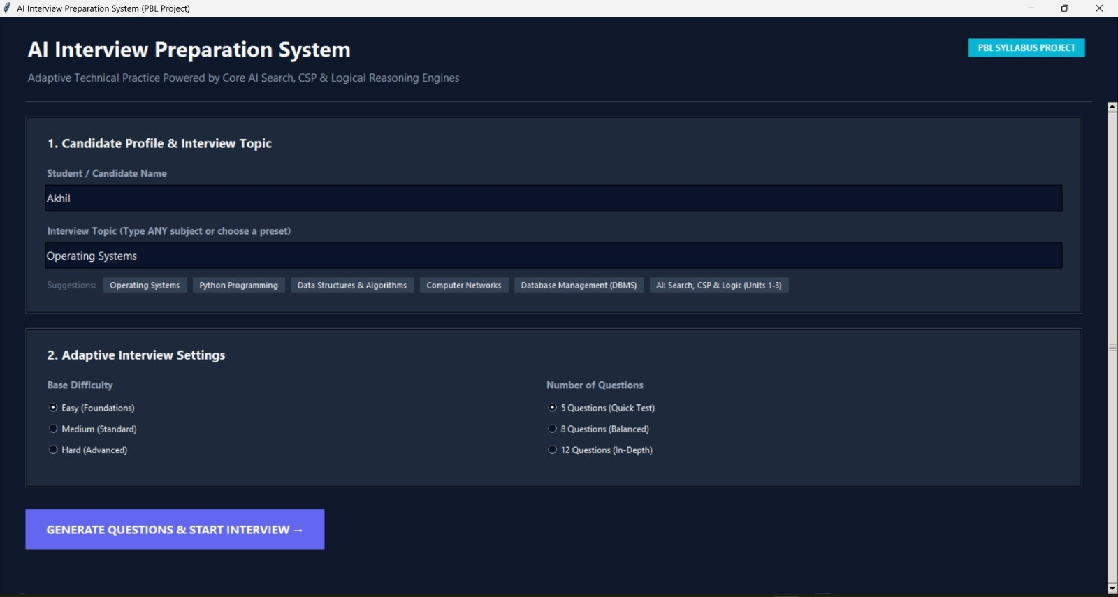
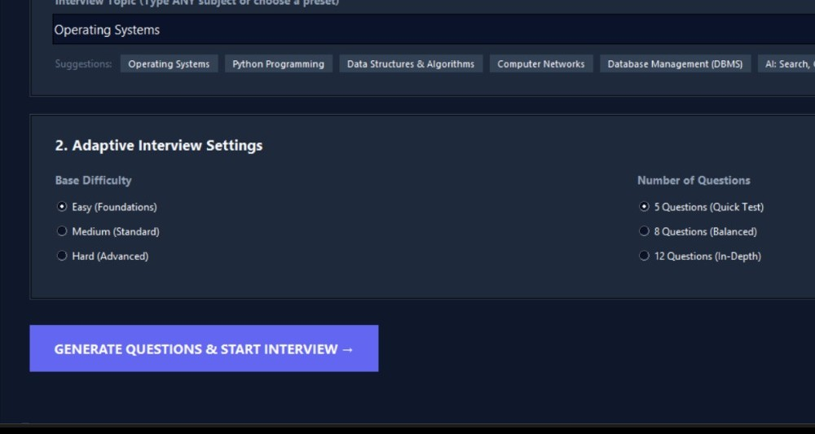
Home screen and interview settings
OUTPUT SCREENS
Fig. 5.1 · Candidate profile and interview topic
Fig. 5.2 · Adaptive interview settings
AI-Based Adaptive Interview Preparation System
12
Notes:
The candidate enters a name and any interview topic, such as Operating Systems, Python or DBMS, then chooses a base difficulty and the number of questions.

Slide 13
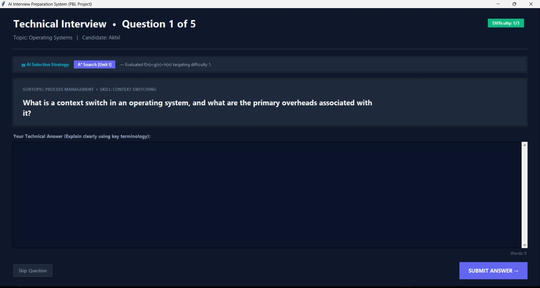
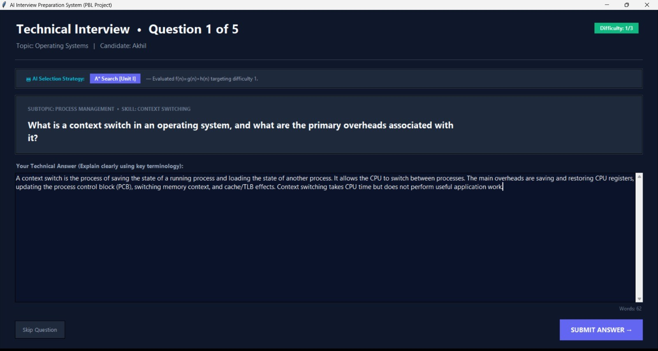
Question screen and answer entry
OUTPUT SCREENS
Fig. 5.3 · Question with the AI selection strategy
Fig. 5.4 · Answer entry and submission
AI-Based Adaptive Interview Preparation System
13
Notes:
Each question screen shows which AI strategy selected the question, which keeps the reasoning transparent. The candidate types the answer in their own words.

Slide 14
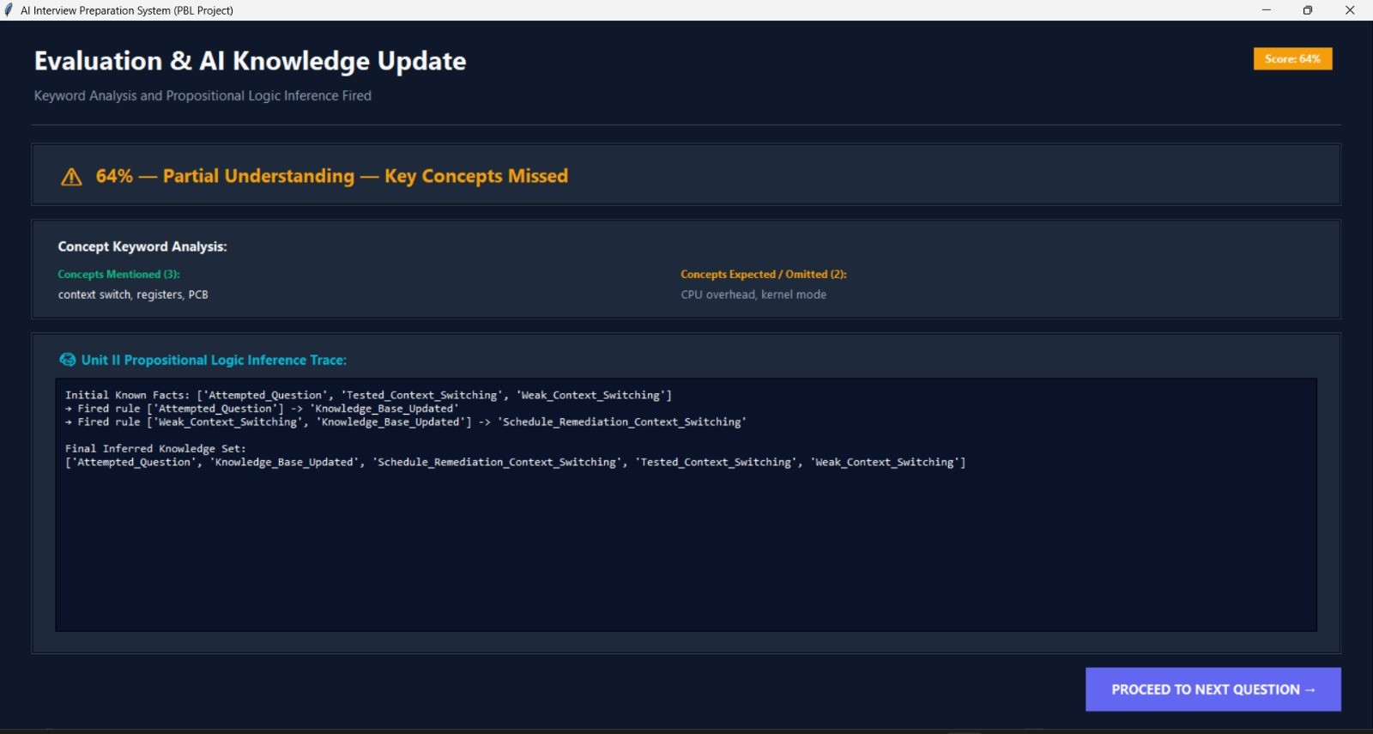
Evaluation and inference trace
OUTPUT SCREENS
Score out of 100
Concepts mentioned and omitted
Logic inference trace
Fig. 5.5 · Evaluation and propositional logic inference trace
AI-Based Adaptive Interview Preparation System
14
Notes:
After each answer the feedback screen shows the score, a keyword analysis of the concepts mentioned and omitted, and the propositional logic inference trace that updates what the system believes about the candidate.

Slide 15
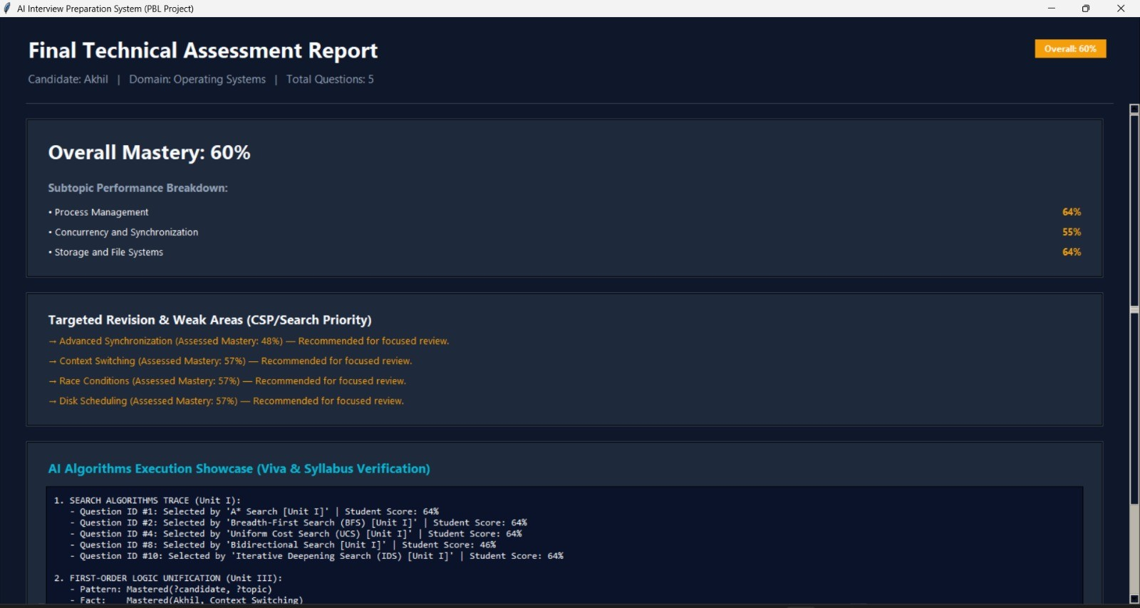
Final technical assessment report
OUTPUT SCREENS
Overall mastery
Subtopic performance
Recommended revision areas
Algorithm trace
Fig. 5.6 · Final technical assessment report
AI-Based Adaptive Interview Preparation System
15
Notes:
At the end of the session the report summarises overall mastery, subtopic performance, recommended revision areas and a trace of the AI algorithms that were executed.

Slide 16
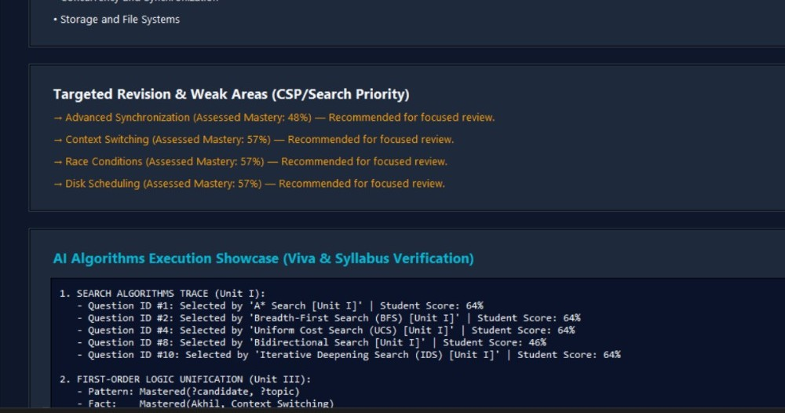
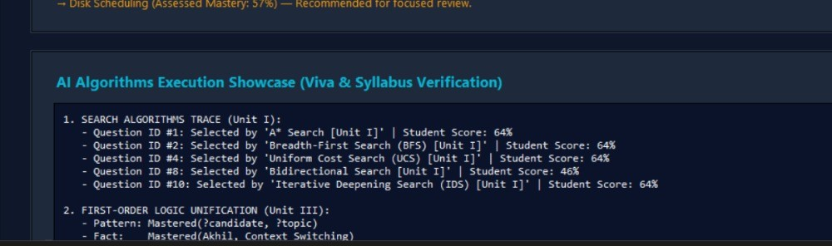
Weak areas and algorithm showcase
OUTPUT SCREENS
Fig. 5.7 · Targeted revision and weak areas
Fig. 5.8 · AI algorithms execution showcase
AI-Based Adaptive Interview Preparation System
16
Notes:
The report names the weak areas for focused revision. The showcase screen records which search algorithm selected each question, and demonstrates first-order logic unification, which helps with viva and syllabus verification.

Slide 17
AI PROJECT BASED LEARNING · CLASSICAL AI
TESTING & VALIDATION
Checking that the main features behave as expected
01
Input validation
Check topic, difficulty and question-count inputs.
02
Question selection
Confirm that a question is not repeated in the same session.
03
Adaptation
Verify that recent scores change the target difficulty at the configured thresholds.
04
Fallback mode
Check that the offline question generator works when the API is unavailable.
AI-Based Adaptive Interview Preparation System
17 / 20

Slide 18
AI PROJECT BASED LEARNING · CLASSICAL AI
RESULTS & OBSERVATIONS
What the prototype demonstrates
01
Personalised practice
Questions can be generated around a candidate's chosen topic.
02
Adaptive selection
Search strategies and CSP filtering guide the next-question choice.
03
Progress tracking
Scores update the weakness profile and influence later questions.
04
Explainable output
Feedback and the final report show scores, revision areas and algorithm traces.
AI-Based Adaptive Interview Preparation System
18 / 20

Slide 19
AI PROJECT BASED LEARNING · CLASSICAL AI
LIMITATIONS & FUTURE ENHANCEMENTS
Current constraints and planned improvements
01
Keyword-based scoring
Correct answers phrased differently may receive lower scores.
02
Generated content
Questions and expected keywords need quality checks.
03
Semantic evaluation
Future versions could evaluate meaning, not just keyword overlap.
04
Progress history
Persistent profiles and topic-wise analytics could track improvement over time.
AI-Based Adaptive Interview Preparation System
19 / 20

Slide 20
AI PROJECT BASED LEARNING · CLASSICAL AI
CONCLUSION & REFERENCES
Classical AI concepts brought together in one application
01
Conclusion
The prototype combines search, constraint satisfaction and logical reasoning for adaptive interview practice.
02
Key benefit
Candidates receive targeted questions, answer feedback and revision recommendations.
03
AI reference
Russell and Norvig, Artificial Intelligence: A Modern Approach.
04
Technical references
Python documentation for tkinter, threading, json and urllib.request; Google Gemini API documentation for optional question generation.
AI-Based Adaptive Interview Preparation System
20 / 20

