Slide 1


Mini Project - Synopsis on
“QR Code-Based Digital RESPONSIVE WEBSITE “
Dept. of CS&E ( DATA SCIENCE)
Adichunchanagiri Institute of Technology
Chikkamagaluru - 577102
Presented By,
Chandana C M (4AI22CD011)
Bhagya Sree (4AI22CD022)
Pratibha B M (4AI22CD040)
Tejaswini M (4AI22CD058)
Under the Guidance of
Prof.Gagana Deepa

Slide 2
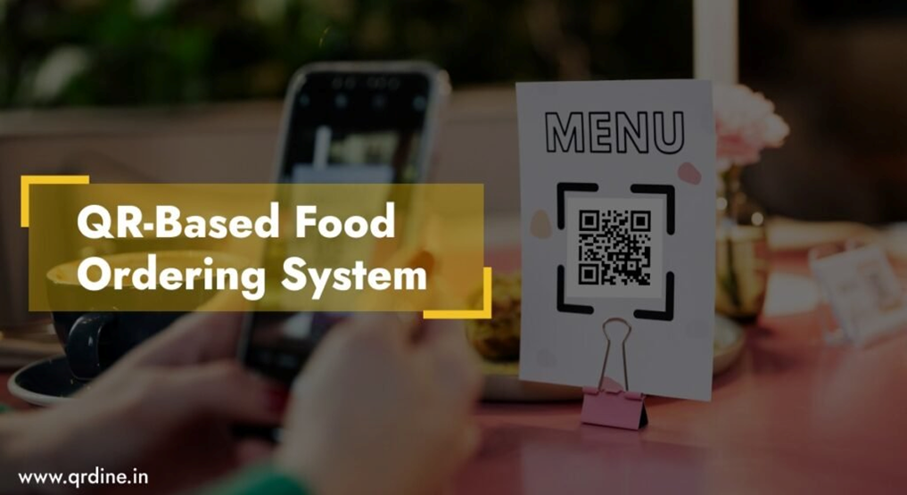
PROJECT TITLE QR CODE-BASED DIGITAL RESPONSIVE SYSTEM
Team Members:
Ganugapenta Bhagyasree: QR Code Development & Functionality
Chandana C M: Front-End Web Design
Tejaswini M: Web-Customer Interaction
Prathibha B M: Data Storage and Management
Date: Saturday, December 16, 2024

Slide 3
PROBLEM STATEMENT
Delays in Ordering: Manual order-taking can lead to long waiting times.
Order Errors: Miscommunication during manual processes often results in incorrect orders.
Limited Accessibility: Customers rely on servers to bring menus and take orders, causing inconvenience.
Hygiene Concerns: Traditional systems lack a contactless solution, which is especially important in the current health-conscious world.
Solution: Our QR Code-Based Food Ordering System provides a fast, error-free, and contactless way for customers to access menus and place orders, improving efficiency and enhancing the dining experience.

Slide 4
SCOPE OF THE PROJECT
TARGET BENEFICIARIES:
Customers: Simplified and faster food ordering experience.
Restaurant Owners: Streamlined operations and reduced staff workload.
KEY FUNCTIONALITIES:
QR code integration for easy menu access.
Efficient order placement through a user-friendly interface.
Real-time data storage for seamless order management.

Slide 5
PROJECT DESIGN
System Architecture Overview:
FRONT-END:
Developed using HTML, CSS, and JavaScript for a responsive and user-friendly interface.
Displays the menu dynamically fetched from the HTML section, not stored in the database.
Allows customers to place orders.

Slide 6
PROJECT DESIGN
2. BACK-END:
Built with PHP to process order details and manage data storage.
Ensures secure communication between the front-end and database.
3. DATABASE:
NoSQL database stores order-related details such as table number, order items, and total price.
Flexible structure for real-time storage and retrieval of customer orders.

Slide 7
METHODOLOGY
Requirement Analysis: Defined project scope, features, and target audience.
QR Code Generation: Created QR codes for menu access, ensuring smooth redirection.
Front-End Development: Designed a responsive interface using HTML, CSS, and JavaScript.
Back-End Development: Used PHP to process orders and interact with the database.
Database Integration: NoSQL database to store order details in real time.
Testing and Deployment: Performed functional testing and deployed for demonstration.
Tools Used: HTML, CSS, JavaScript, PHP, NoSQL, XAMPP

Slide 8
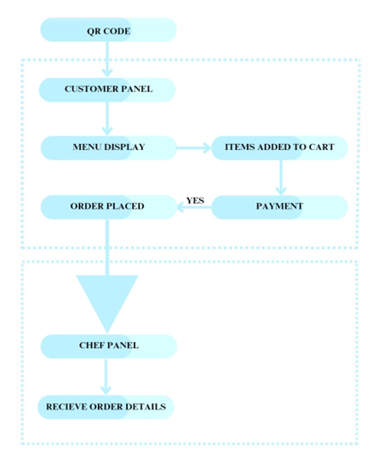
IMPLEMENTATION
QR Code Generation: Generated QR codes for easy menu access via scanning.
Front-End Development: Designed with HTML, CSS, and JavaScript to display the menu and collect orders.
Back-End Development: Used PHP to process orders and connect the front end with the database.
Database Integration: Implemented a NoSQL database to store real-time order details.

Slide 9
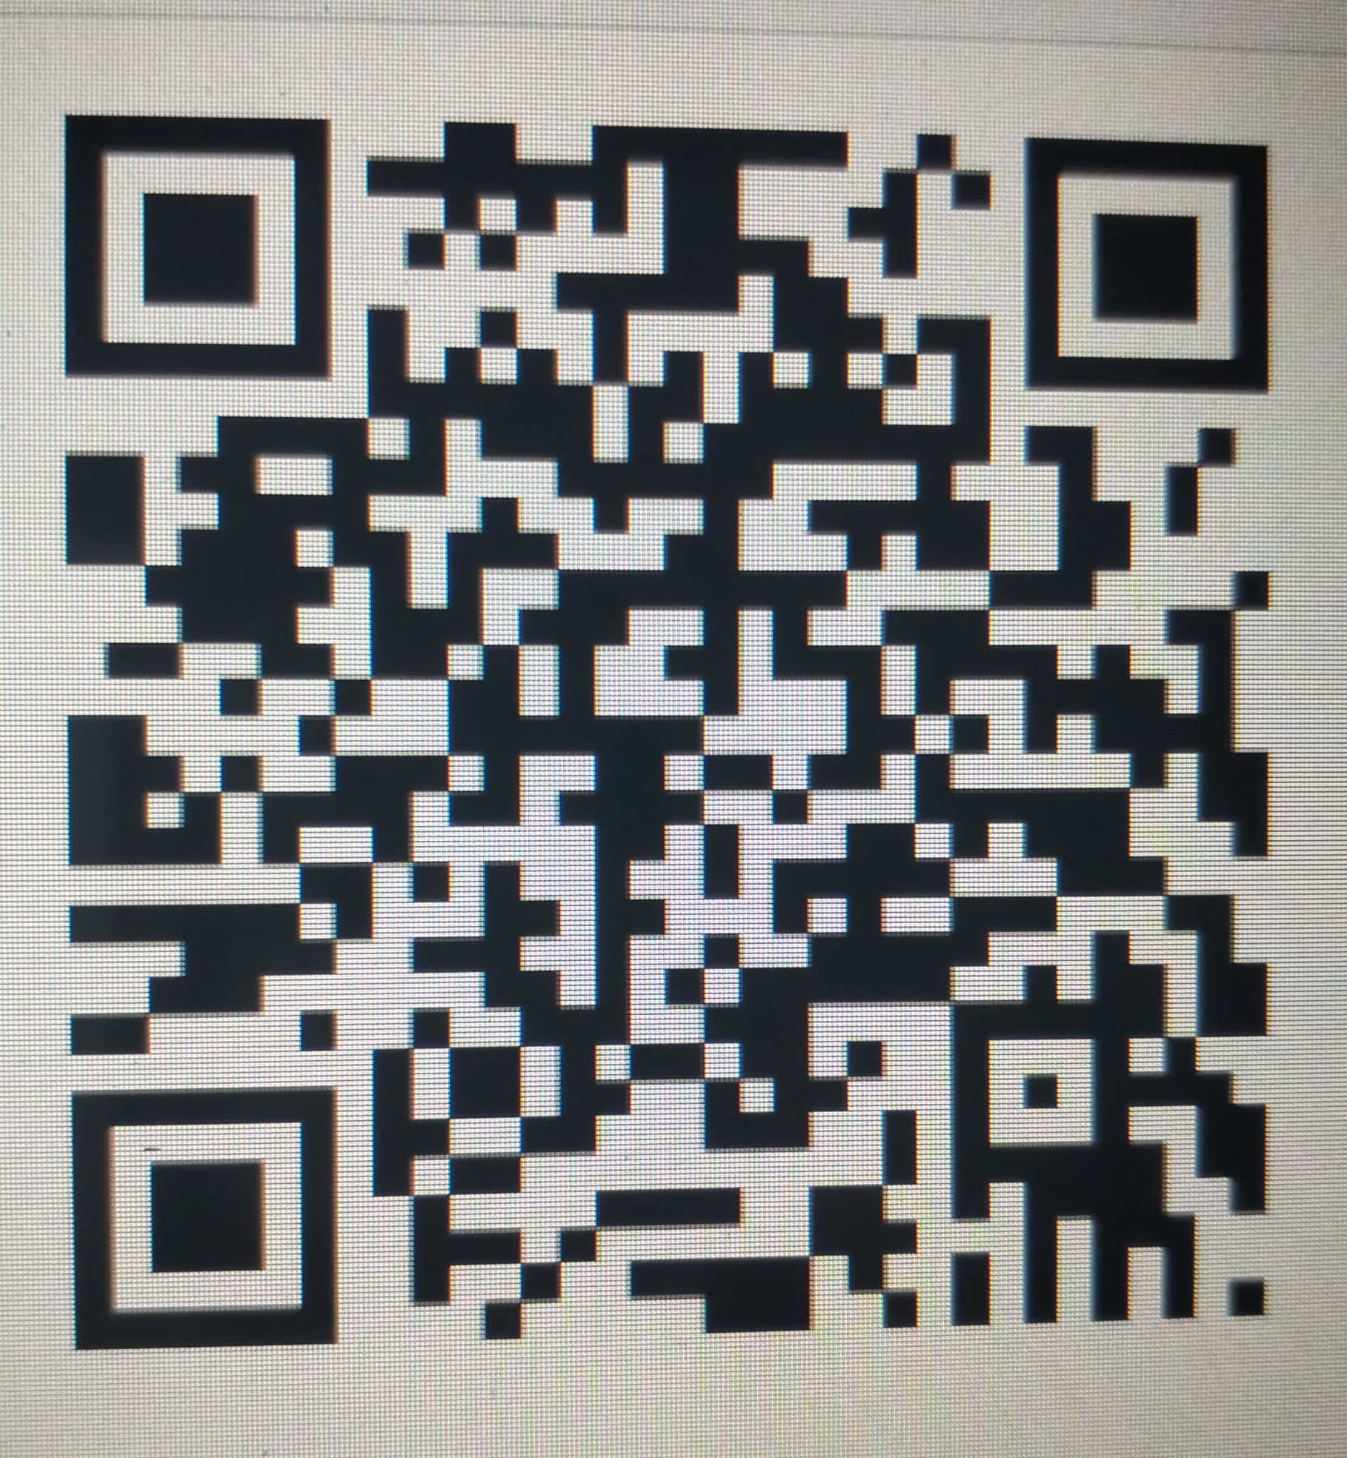
RESULTS
Faster Ordering Process: Orders are placed and processed quickly using a streamlined system.
Reduced Human Errors: Automated order handling minimizes mistakes in order entry and management.
Improved Customer Experience: Contactless and efficient process enhances satisfaction and convenience.
Scan this QR code to access the menu and place your order seamlessly through our system.

Slide 10

This is the user-friendly interface displayed upon scanning the QR code, allowing customers to browse the menu, place orders, and provide table details effortlessly.

Slide 11
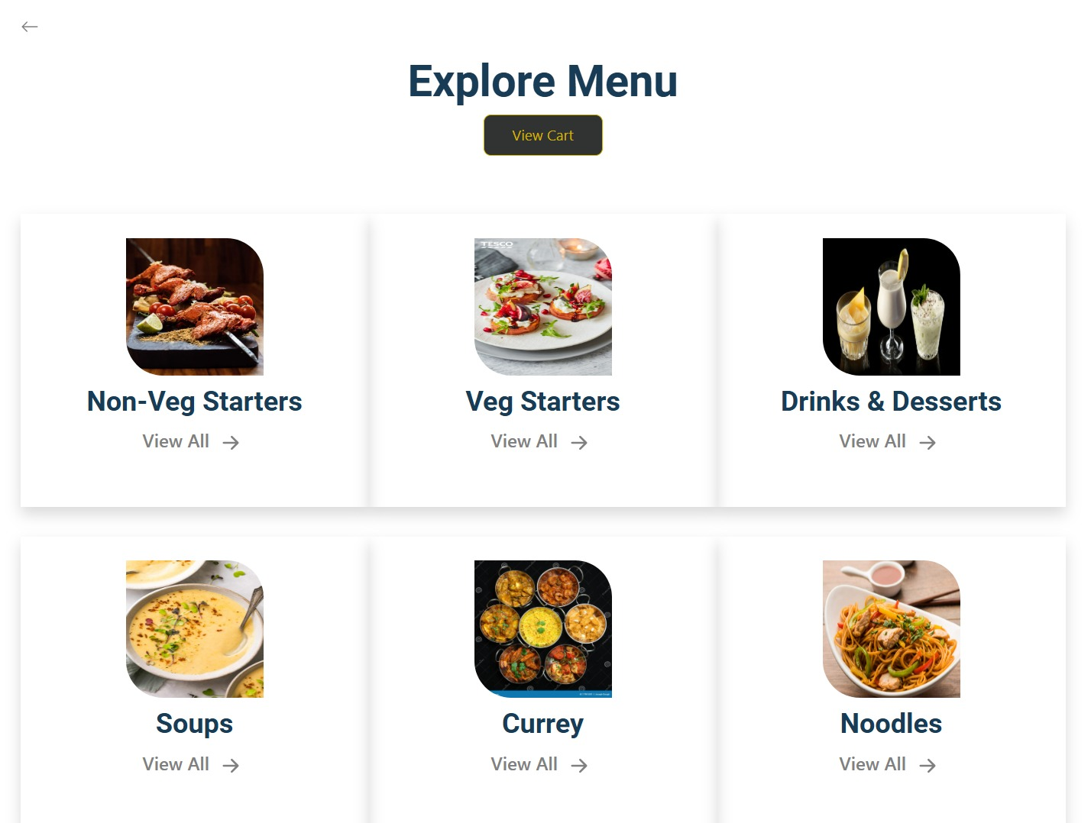
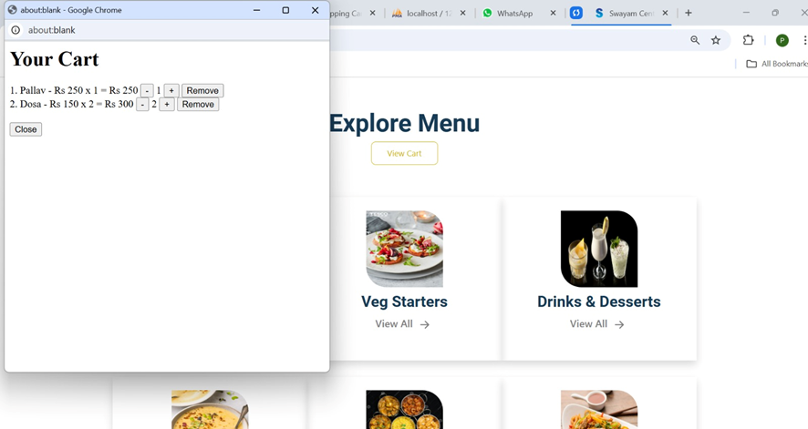
This page allows customers to easily navigate through various menu categories such as Veg Starters, Non-Veg Starters, Desserts, and more, ensuring a smooth and organized ordering experience.
The cart page displays selected items, quantities, and total prices, allowing customers to review and modify their orders before finalizing

Slide 12
CHALLENGES FACED
Debugging QR Code Functionality: Ensuring the QR code works seamlessly with all devices and is redirected accurately.
Responsiveness Across Devices: Adapting the user interface to function smoothly on various screen sizes and devices.
Data Consistency: Maintaining real-time and accurate synchronization between the database and the front-end.
Integration of Functionalities: Developing individual components was manageable, but connecting them into a cohesive system posed significant challenges.

Slide 13
FUTURE WORK
Table-Specific QR Codes: Generate unique QR codes for each table to streamline the ordering process further.
Integration of Payment Gateway: Enable secure online payment options directly through the system.
Advanced Analytics: Provide restaurant owners detailed insights on sales, popular items, and customer preferences.
Multi-Language Support: Implement language options to cater to a diverse customer base.
Multiple Franchise Management: Expand the system to handle orders and data from various restaurant branches under a unified platform.

Slide 14
CONCLUSION
Problem:
Traditional food ordering systems were inefficient, prone to errors, and lacked contactless solutions.
Approach:
Developed a QR code-based food ordering system with a responsive design, enabling seamless access to the menu and order placement.
Results:
The system improved the ordering process by reducing errors, speeding up service, and enhancing the customer experience.
Achieved Goals:
The project successfully created a responsive website that streamlines food ordering through QR codes, meeting the need for a modern, efficient solution.

Slide 15
GITHUB LINK
Prathibha B M: https://github.com/Prathibha-bm/orders
Chandana C M: https://github.com/Chandana1509/mini_project
Tejaswini M: https://github.com/tejaswini201/MINIPROJECT
Bhagyashree: https://github.com/bhagyasreeganuga/Miniproject

Slide 16
QUESTION AND ANSWER
We welcome your questions! Feel free to ask about any part of the project, and we’ll be happy to discuss further.

