Slide 1
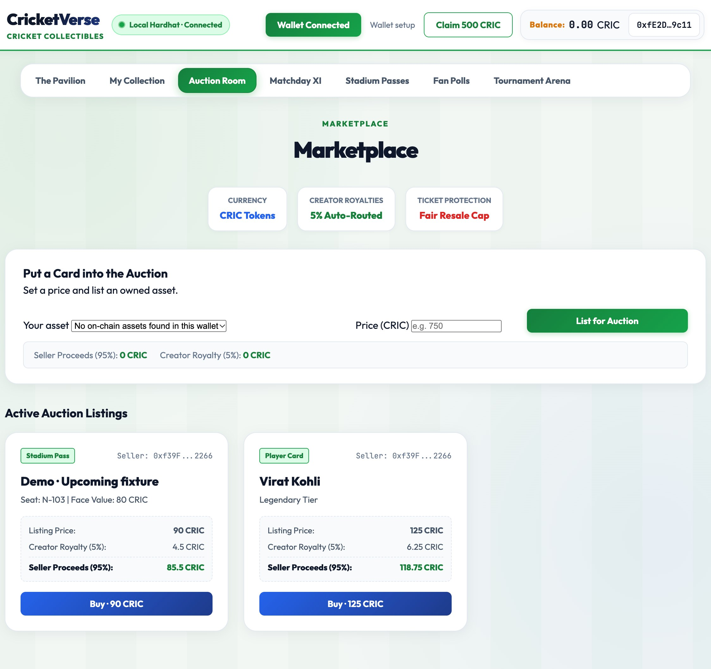
CRICKETVERSE / BLOCKCHAIN DEMO
Own the moment.
Prove the play.
A hands-on guide to wallets, collectibles, trading, tournaments, fan polls and ticket entry.
LOCAL DEMO
EVM · HARDHAT
Real CricketVerse UI · Auction Room
Classroom prototype • chain ID 31337 • seeded demo state

Slide 2
CRICKETVERSE / DEMO FIELD GUIDE
Get ready in three steps
01 START CHAIN
02 START APP
03 CONNECT
Terminal 1
npm run chain:node
→
Terminal 2
npm start
→
Chrome + MetaMask
http://localhost:3000
WALLET SETUP
IMPORTANT
Open in Chrome with MetaMask. Select CricketVerse Local Hardhat, connect, then click Get 20 demo ETH for gas.
Seeded player wallets start with 10,000 CRIC. Fresh wallets can claim 1,000 CRIC; native ETH pays gas.
02

Slide 3
CRICKETVERSE / DEMO FIELD GUIDE
One wallet. Contracts do the settling.
PLAYER
WEB APP
LOCAL EVM
CONTRACTS
MetaMask
EIP-1193 signer
→
ethers.js
reads + transactions
→
Hardhat RPC
chain 31337
→
CRIC · NFTs ·
market · polls
WHAT “ON-CHAIN” MEANS HERE
Wallet signs a transaction → contract checks rules → EVM updates state → receipt and events can be inspected. The browser is a client; ownership and settlement live in deployed contracts.
Local Hardhat is a classroom chain on this computer. Shared access requires a public testnet deployment and hosted site.
03

Slide 4
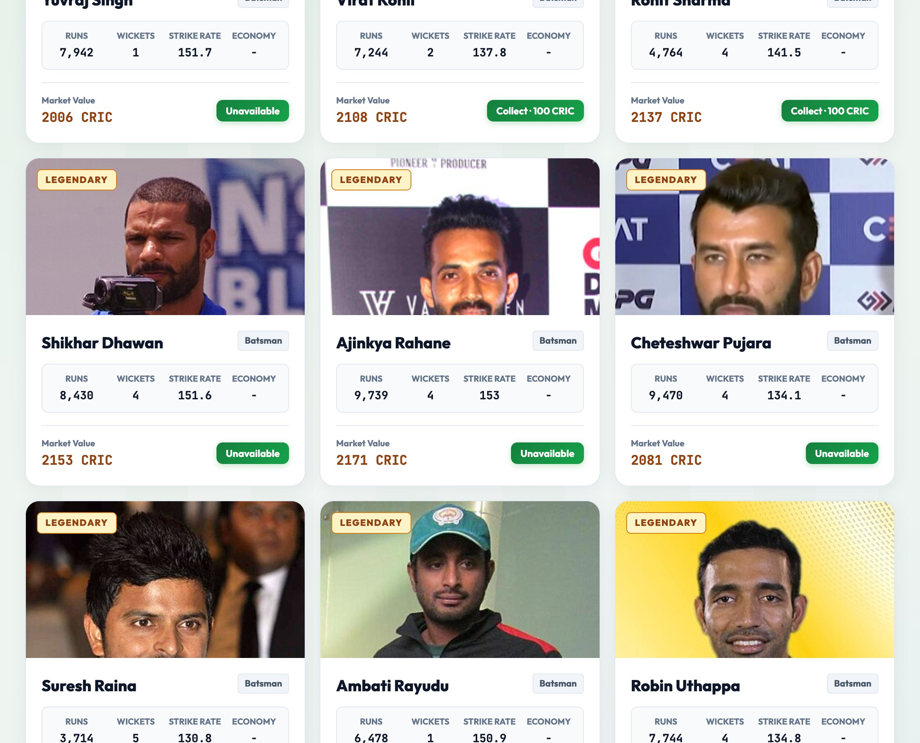
CRICKETVERSE / DEMO FIELD GUIDE
Wallet + 1,000 CRIC faucet
CLAIM FLOW
Connect → check gas → claimFaucet() → 1,000 CRIC minted
WHY YOUR CLAIM FAILED
Connected wallet had 0 Hardhat ETH. The contract cannot pay gas on your behalf.
LOCAL DEMO FIX
Click Get 20 demo ETH, then claim 1,000 CRIC in this wallet.
Screenshot: collectibles UI. The wallet address is intentionally cropped out in this deck.
04

Slide 5
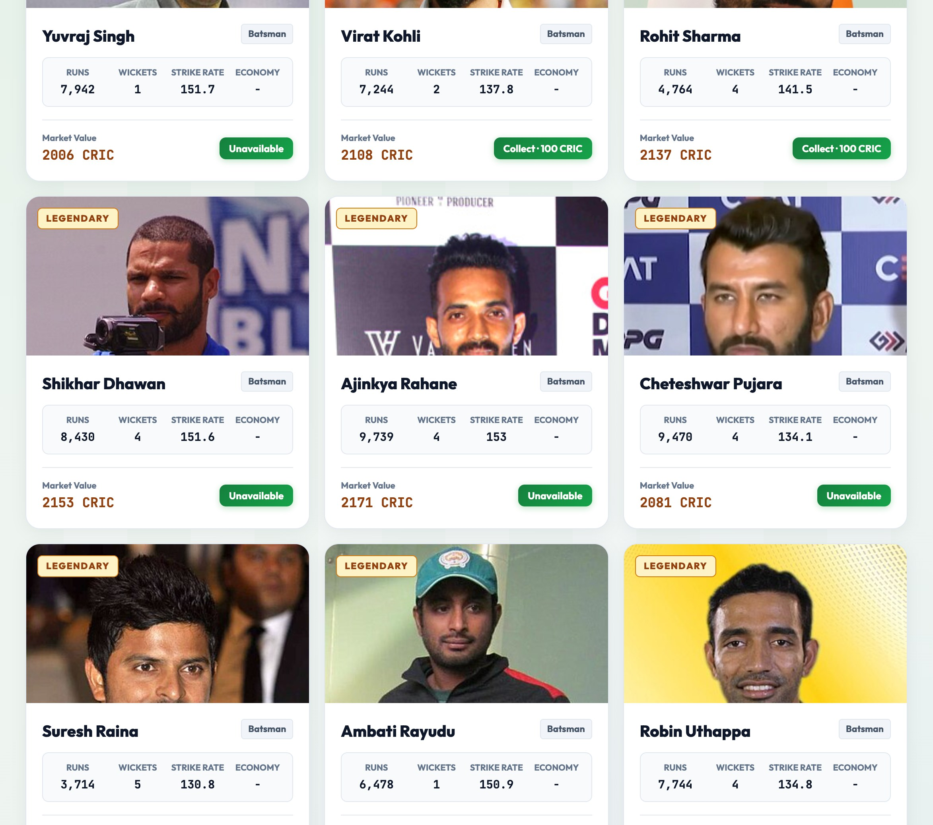
CRICKETVERSE / DEMO FIELD GUIDE
Collectible cards: mint, own, transfer
REGISTERED
MINT
OWN
Catalog
entry
→
PlayerCardNFT
ERC-1155
→
Wallet balance
on-chain
DEMO SCRIPT
Claim CRIC → collect a card → confirm MetaMask → inspect the card balance in My Collection.
05

Slide 6
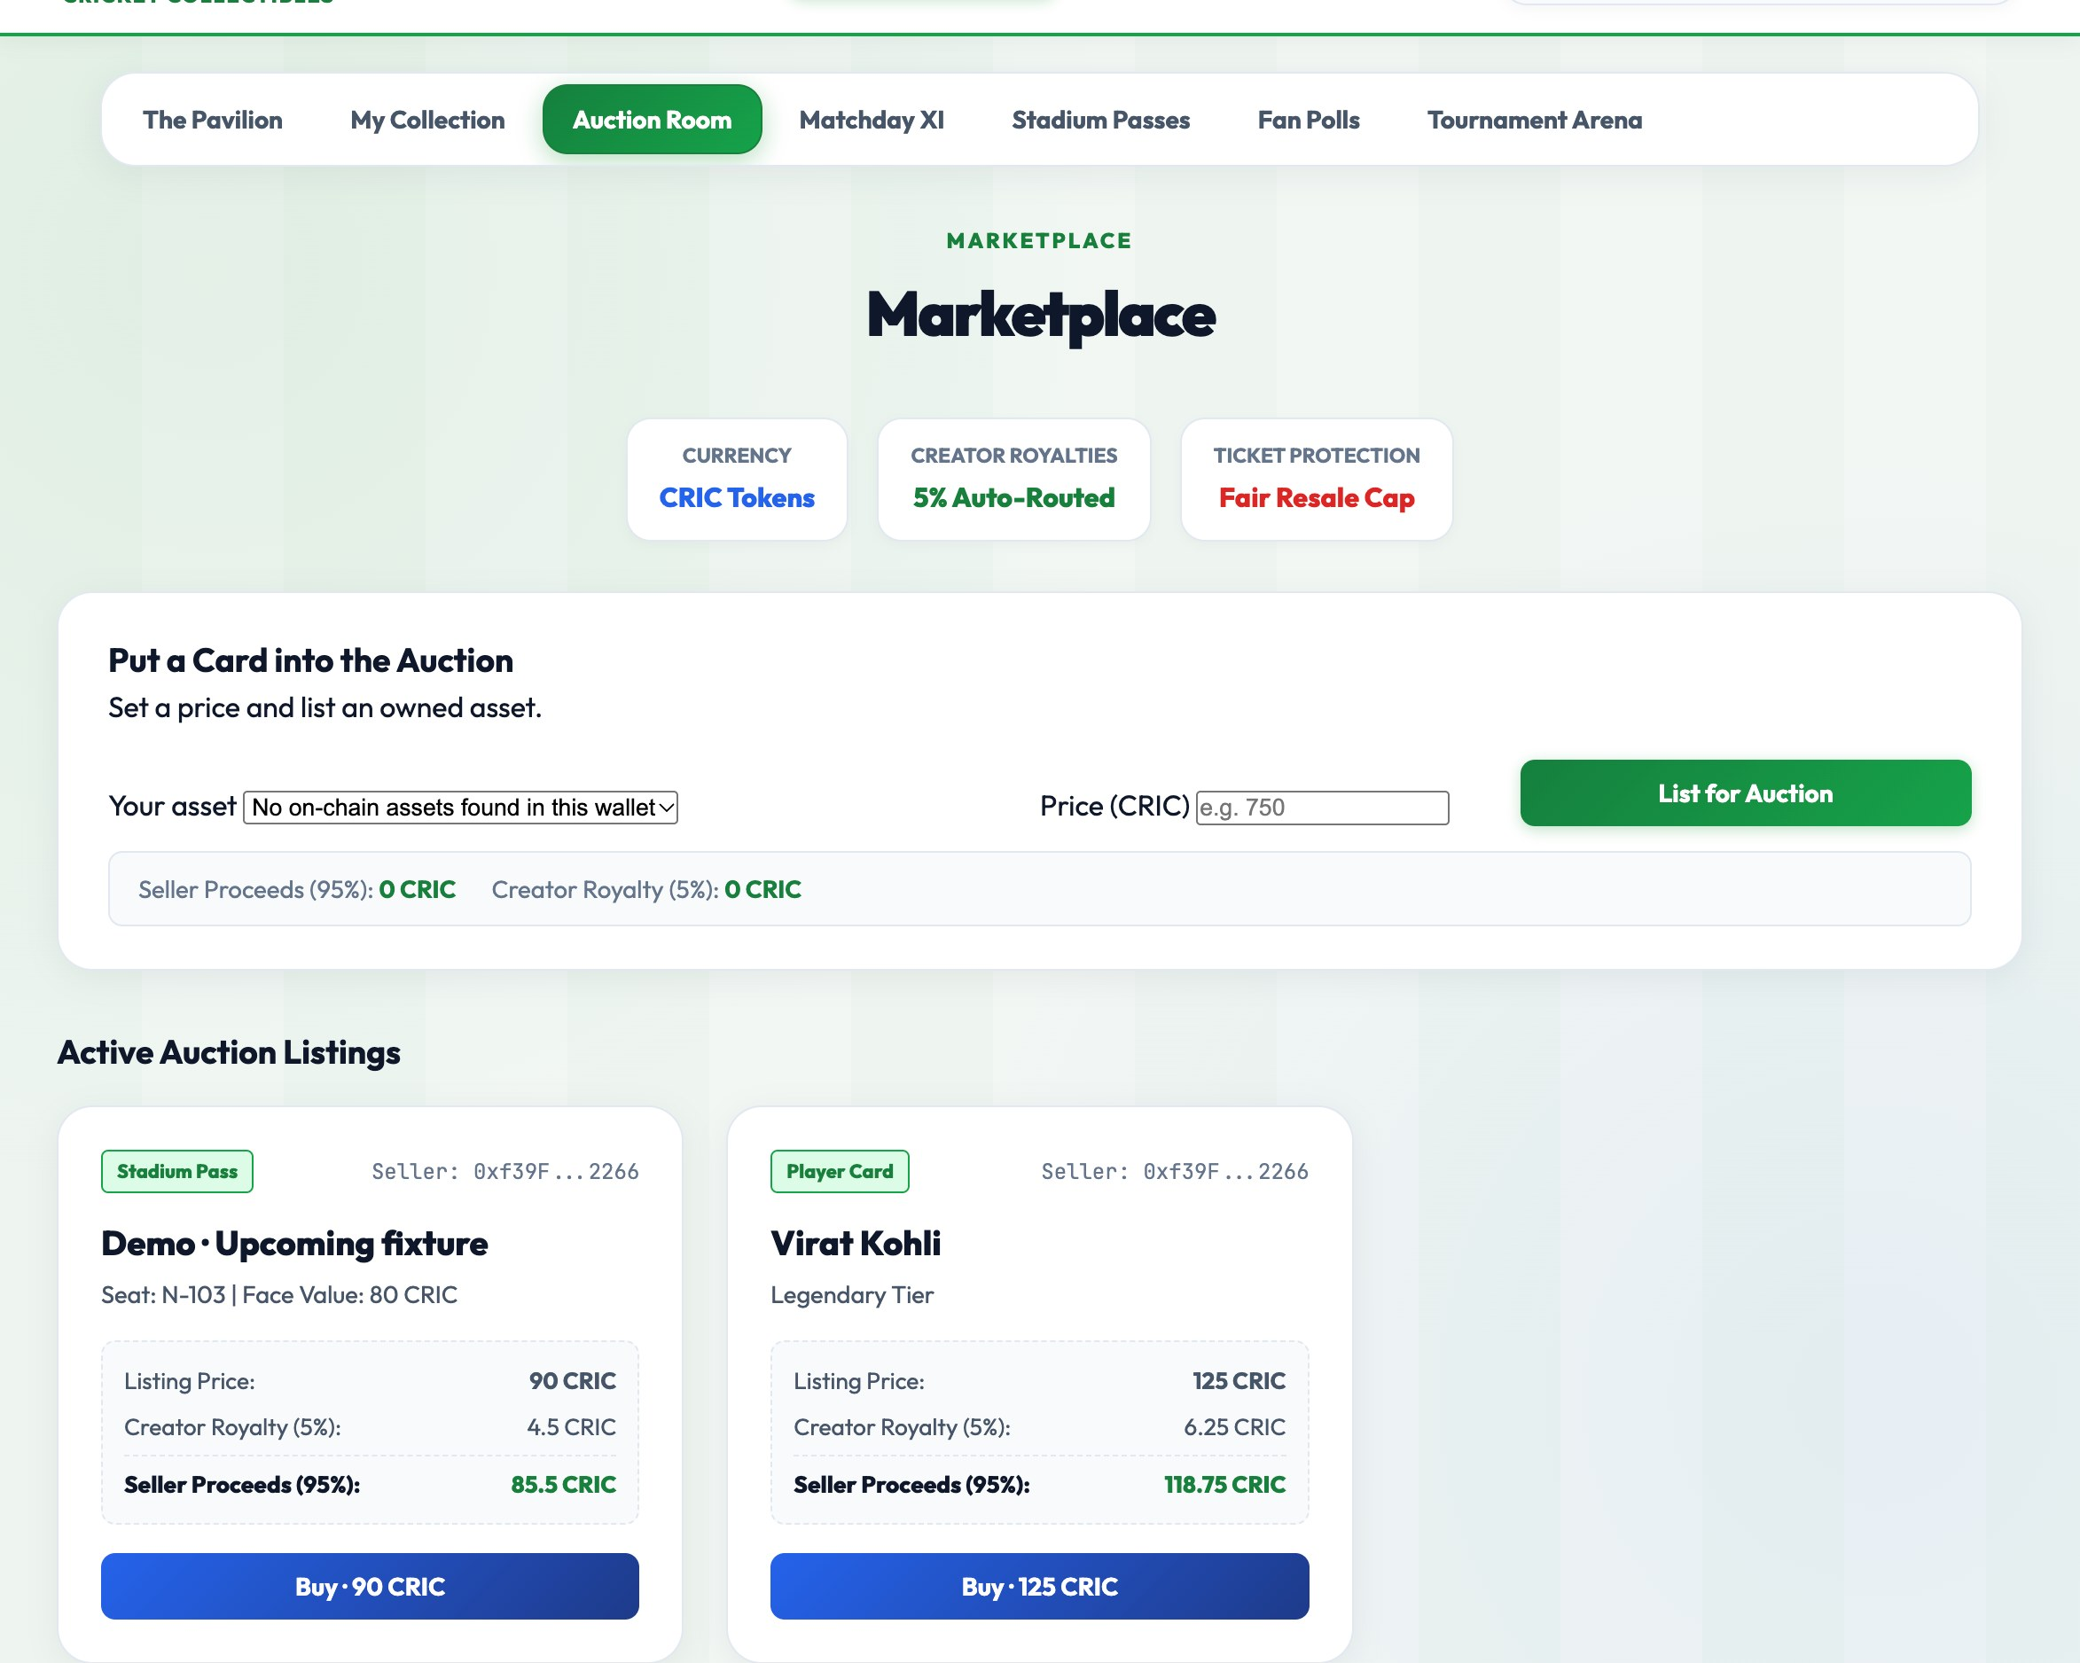
CRICKETVERSE / DEMO FIELD GUIDE
Auction Room: fixed-price card + ticket trades
SEEDED LIVE LISTINGS
Card · 125 CRIC Ticket · 90 CRIC
APPROVE
BUY
RECEIPT
CRIC allowance
→
Marketplace
checks + transfers
→
Ownership +
settlement events
Buy from a wallet other than the seller. These are fixed-price listings, not timed bidding auctions.
06

Slide 7
CRICKETVERSE / DEMO FIELD GUIDE
Ticketing: collectible proof, controlled entry
HOLD
SIGN
SCAN
REDEEM
MatchTicketNFT
ERC-721
→
Holder signs
entry pass
→
Gatekeeper
verifies
→
Contract marks
used once
CONTRACT CHECKS
DEMO NOTE
Correct ticket owner · authorized gatekeeper · fixture time window · not previously redeemed
Use a wallet with GATEKEEPER_ROLE for scan verification.
07

Slide 8
CRICKETVERSE / DEMO FIELD GUIDE
Tournament: entry escrow → organizer settlement
BUILD XI
JOIN
LOCK
SETTLE
Squad committed
as hash
→
50 CRIC entry
into escrow
→
Organizer closes
entry
→
PrizePaid events
to winners
SEEDED PAST SETTLEMENT
TRUTH IN DEMO
100 CRIC pooled → 5% fee → 66.5 + 28.5 CRIC prizes (two PrizePaid events)
Organizer inputs winners; no live score oracle calculates results.
08

Slide 9
CRICKETVERSE / DEMO FIELD GUIDE
Fan polls: one wallet, one recorded vote
ON-CHAIN VOTE PATH
SEEDED POLLS
Match winner · wicket range
Open; vote counts start at zero
Choose an option
↓
Sign vote transaction
↓
FanPolls records voter + option
↓
Vote count increments
RULE
One address can vote once per poll. A vote is not a CRIC reward, and seeded poll questions are classroom data.
09

Slide 10
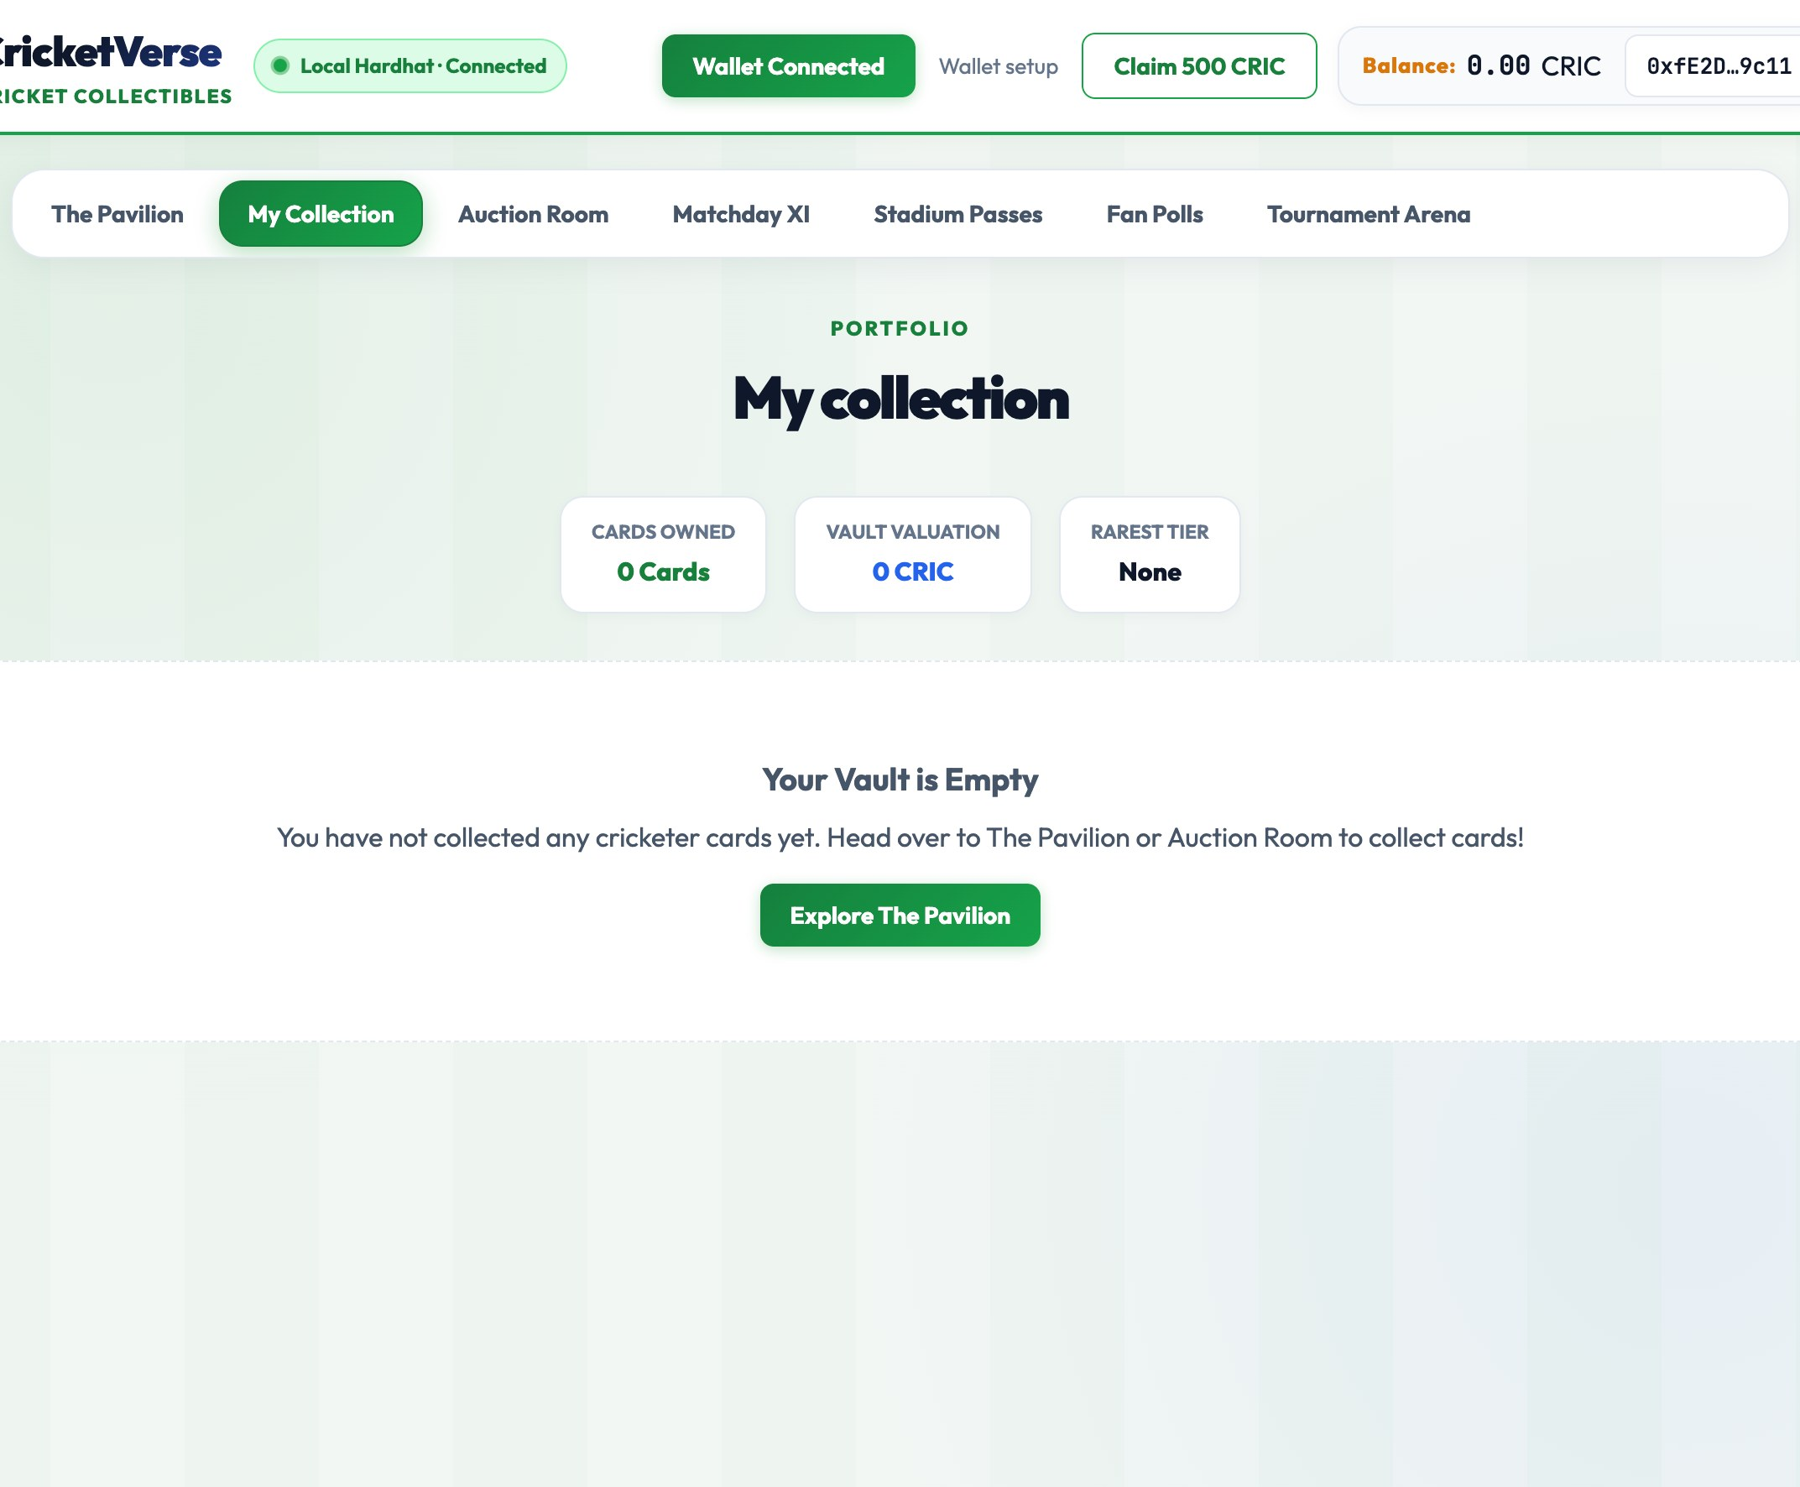
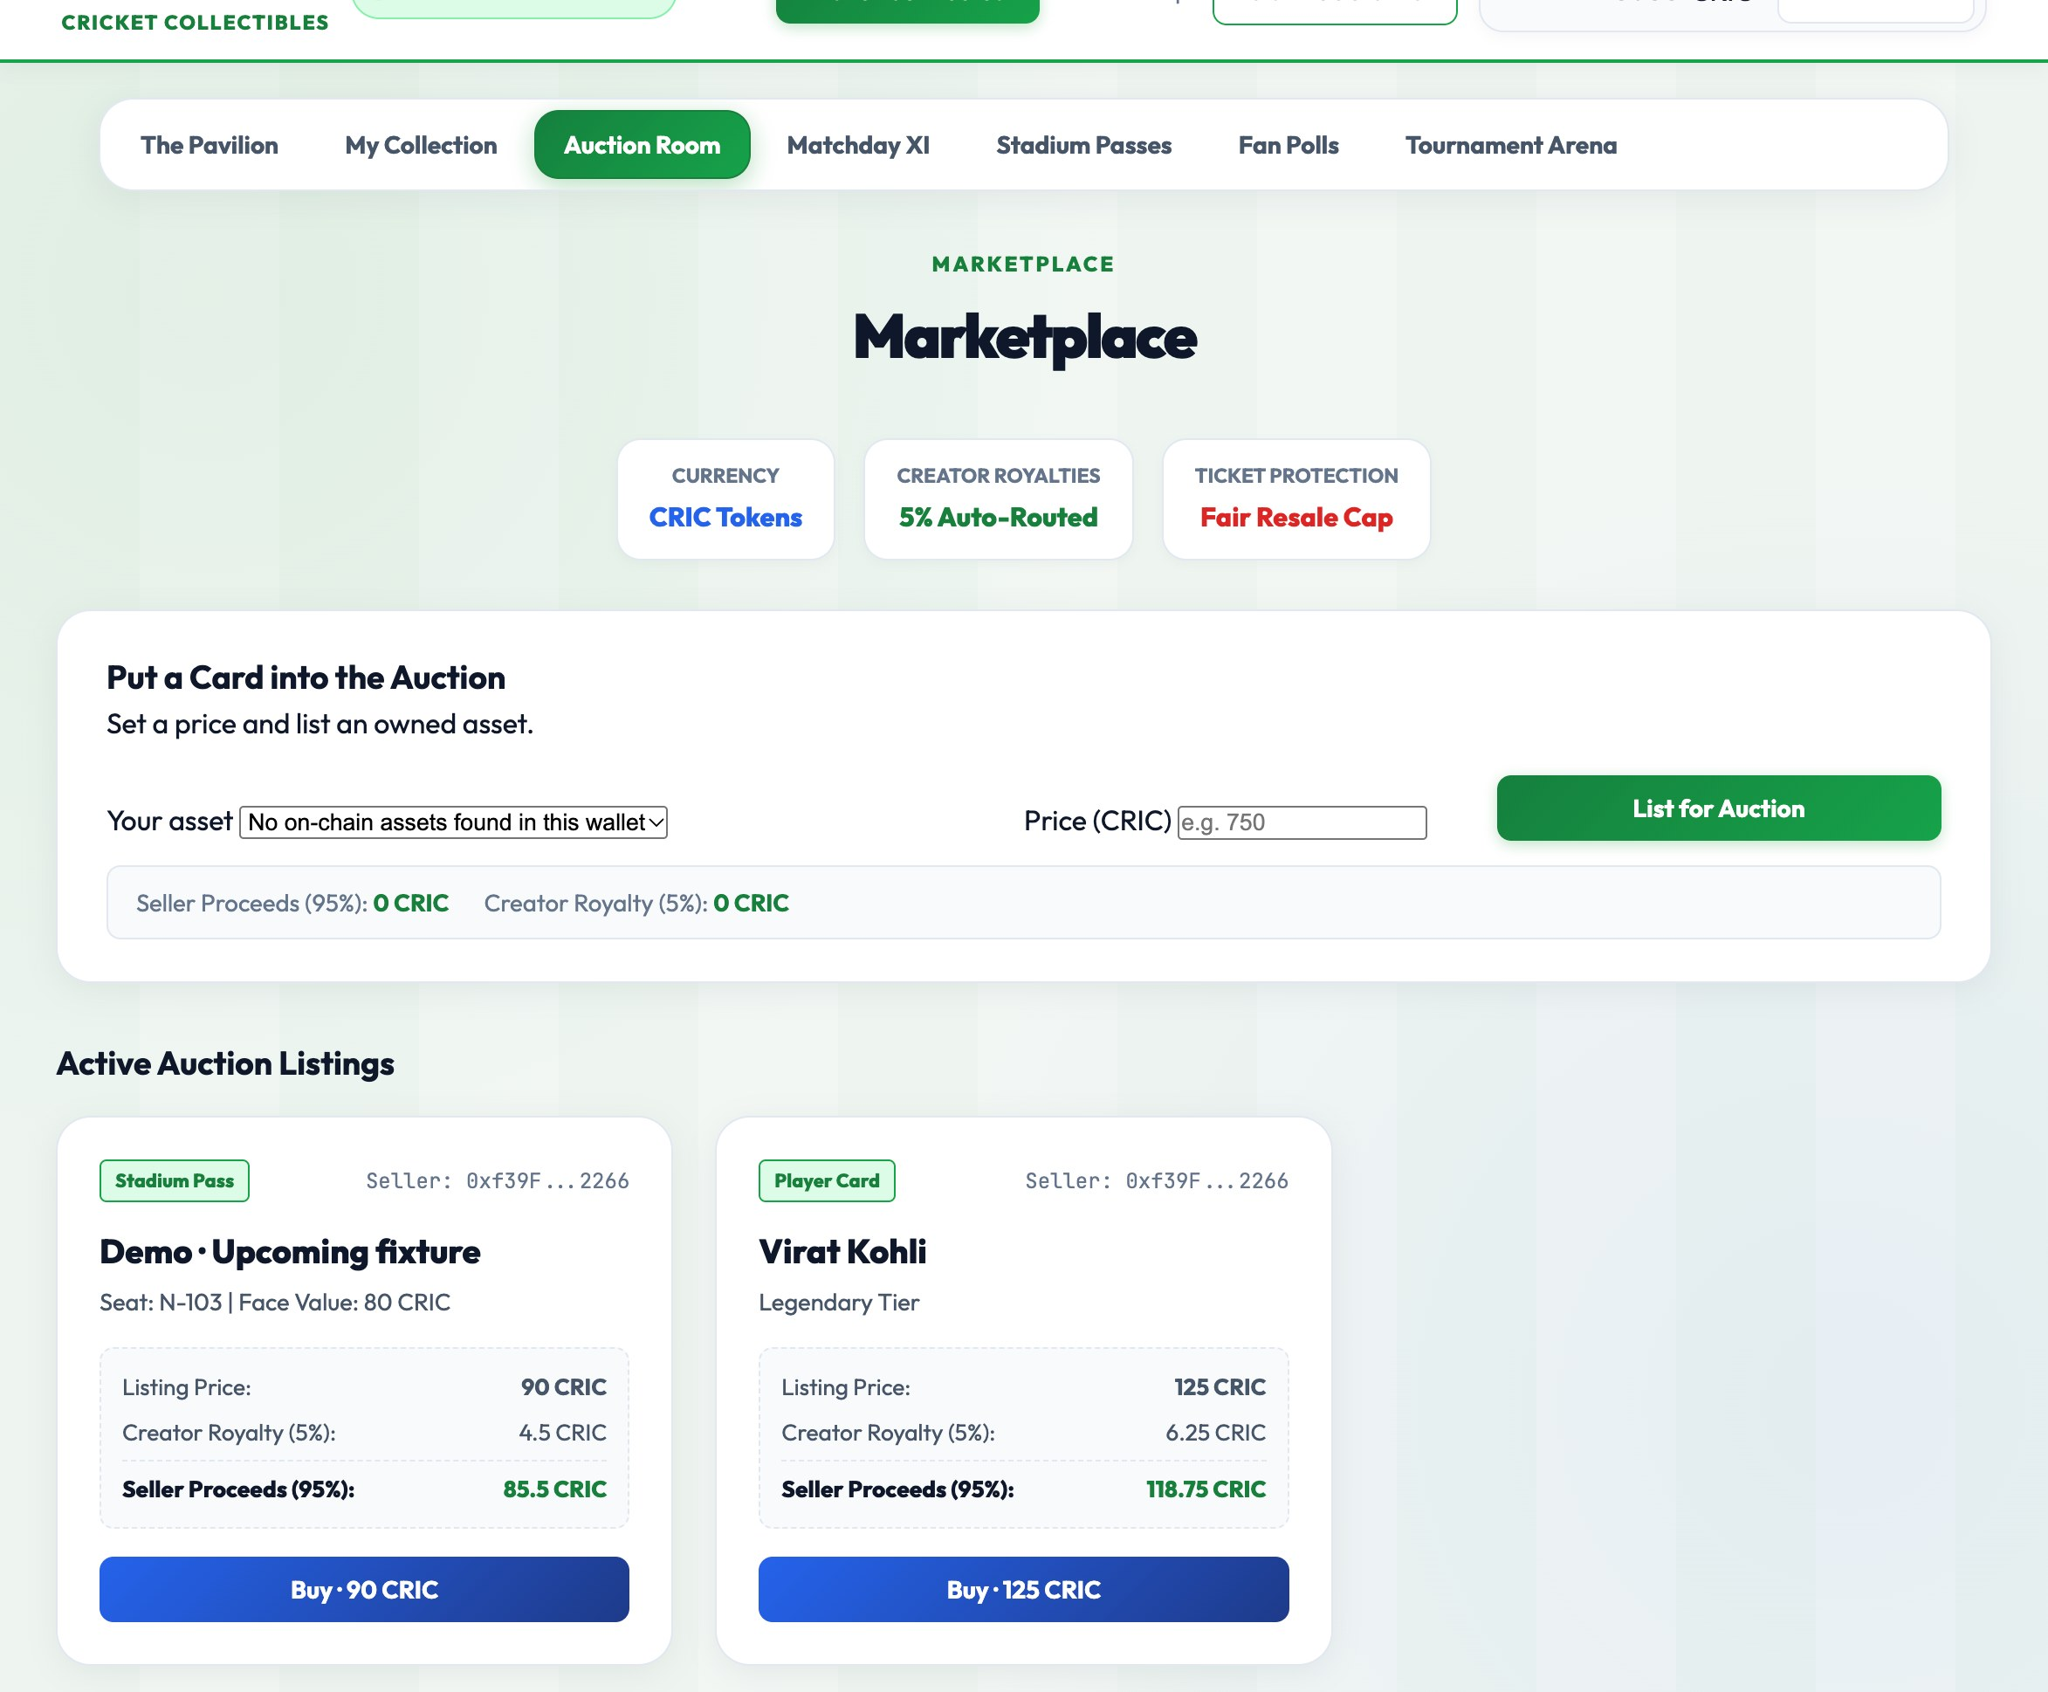
CRICKETVERSE / DEMO FIELD GUIDE
The experience: collectible shelf + trading floor
MY COLLECTION · screenshot captured with an empty personal wallet
AUCTION ROOM · seeded listings visible
10

Slide 11
CRICKETVERSE / DEMO FIELD GUIDE
How to prove a feature really used the chain
1 · WALLET
2 · TX HASH
3 · EVENT
4 · STATE
Confirm account +
chain ID
→
Open transaction
in local explorer / logs
→
Find event emitted
by expected contract
→
Read balance,
owner or status
GOOD DEMO EVIDENCE
Show MetaMask confirmation, the mined receipt, emitted event, and resulting state. For ticket scan and polls, use a fresh test wallet so the one-time rule is visible.
11

Slide 12
CRICKETVERSE / DEMO FIELD GUIDE
What is live, seeded, or still a prototype
LIVE CONTRACT LOGIC
SEEDED CHAIN DATA
NOT LIVE DATA
Token · cards · tickets
market · pools · polls
Listings · fixtures · polls
three contest states
Player catalog · fantasy
points · cricket oracle
CLASSROOM LIMITS TO SAY OUT LOUD
Local chain only · no public deployment · no live scores/oracle · organizer chooses winners · auction is fixed price · UI screenshots show seeded interface, not proof that every user action was executed during capture.
The code and tests verify contract behavior; the presentation should distinguish reproducible actions from seeded example state.
12

Slide 13
CRICKETVERSE / DEMO FIELD GUIDE
Suggested 6-minute live walkthrough
0:00
0:30
1:00
2:00
3:30
5:00
Connect MetaMask
wallet
→
Get local ETH
for gas
→
Claim CRIC +
collect a card
→
Buy seeded card
from another wallet
→
Join contest +
show settlement
→
Vote + scan
with gatekeeper
BEFORE YOU PRESENT
For each wallet: connect → Get 20 demo ETH → claim 1,000 CRIC. Seeded player wallets start at 10,000 CRIC.
Polls record votes but pay no CRIC. Card/ticket buys spend CRIC; tournament rewards require organizer settlement.
13

