Slide 1
STUDENT PLACEMENT
MANAGEMENT SYSTEM
Presented by : Polanati Gayathri Tejaswini
(PFS-ONR-006)

Slide 2
Theme & Modules
Theme : A college placement cell needs a structured database for student details, companies, job roles, applications, assessments and placement offers.
Students : profile, department, CGPA and skills.
Companies : company name, location and industry.
Job Roles : role title, eligibility CGPA and package.
Applications : application date and current status.
Assessments : aptitude and technical scores.
Placements : offered package, offer date and status.

Slide 3
Problem Statement & Objectives
PROBLEM
OBJECTIVES
Placement records may be stored in separate files.
Tracking applications and status manually is difficult.
Reporting student eligibility and offers takes time.
Centralize placement data.
Connect related records using primary and foreign keys.
Retrieve information using SQL filters, joins and aggregate functions.
Generate useful placement reports.

Slide 4
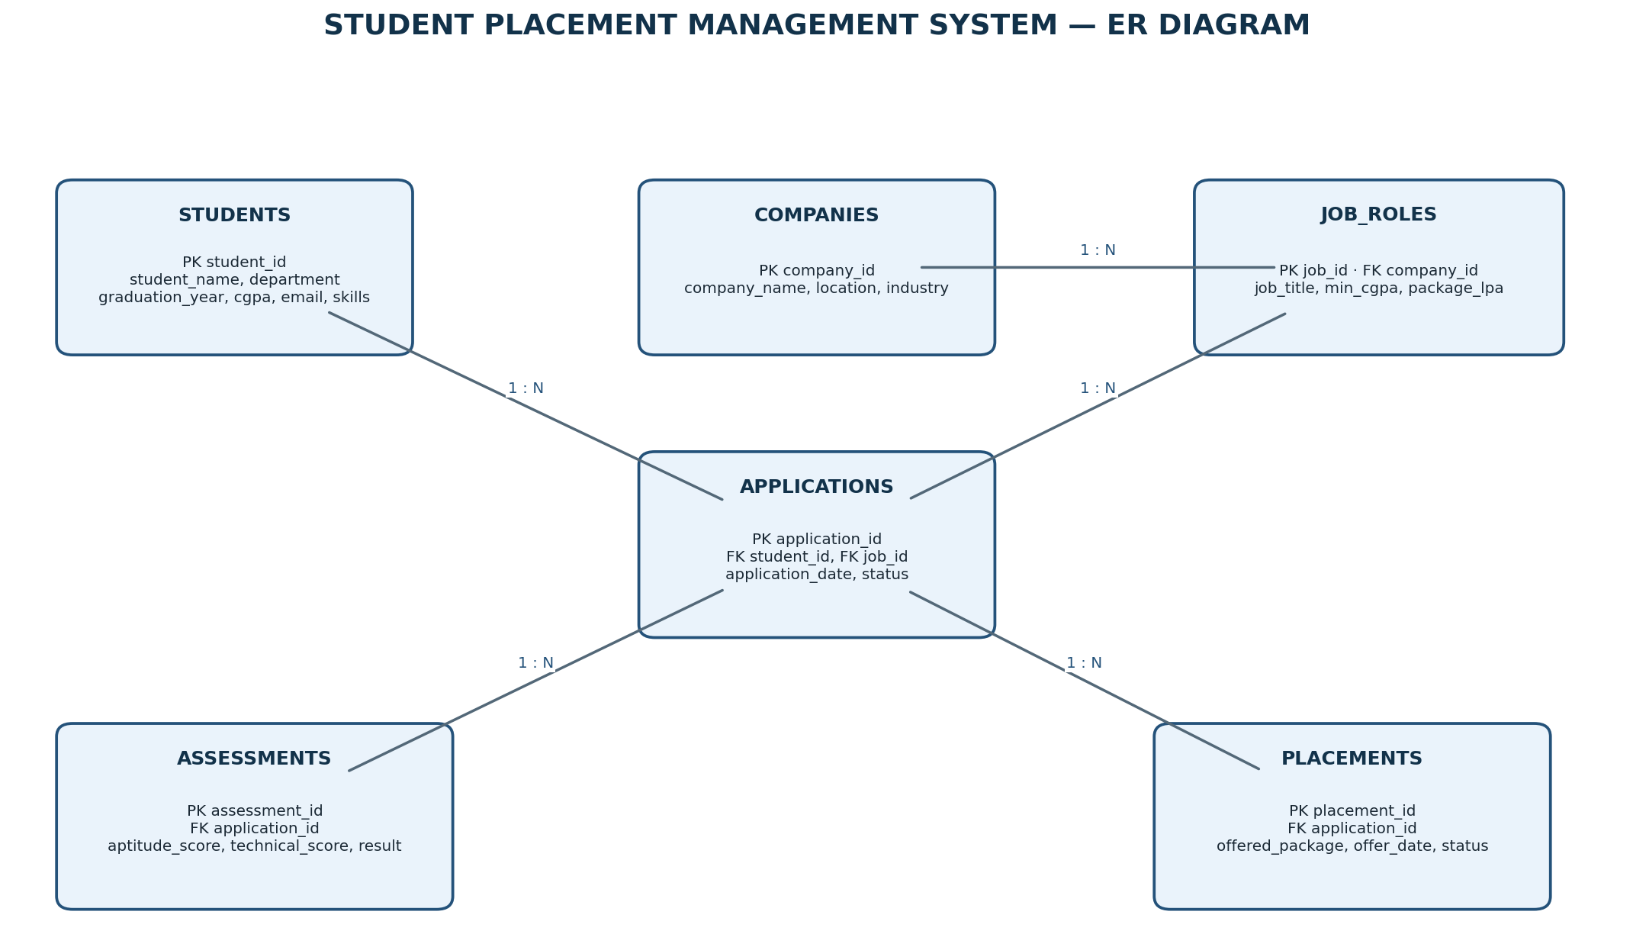
ER Diagram

Slide 5
Sample Data — Students
ID | Name | Dept. | Year | CGPA | Email | Skills
1 | Ananya Rao | CSE | 2026 | 8.60 | ananya.rao@example.com | Python, SQL
2 | Rahul Kumar | ECE | 2026 | 7.80 | rahul.kumar@example.com | SQL, Excel
3 | Meghana Reddy | CSE | 2026 | 9.10 | meghana.reddy@example.com | Java, SQL
4 | Arjun Varma | IT | 2026 | 7.20 | arjun.varma@example.com | HTML, SQL
5 | Sravya Patel | CSE | 2026 | 8.00 | sravya.patel@example.com | Python, Java
6 | Kiran Das | EEE | 2026 | 6.90 | kiran.das@example.com | Excel, Communication
7 | Nisha Sharma | IT | 2026 | 8.40 | nisha.sharma@example.com | Python, Power BI
8 | Vivek Raju | ECE | 2026 | 7.50 | vivek.raju@example.com | C, SQL

Slide 6
Sample Data — Companies & Job Roles
Job ID | Company ID | Job Title | Min CGPA | Package (LPA)
101 | 1 | Junior SQL Developer | 7.00 | 4.50
102 | 2 | Data Analyst Trainee | 7.50 | 5.00
103 | 3 | Support Engineer | 6.50 | 3.80
104 | 1 | Python Developer Trainee | 8.00 | 5.50
105 | 4 | Graduate Engineer Trainee | 7.00 | 4.20
106 | 2 | Business Intelligence Intern | 8.00 | 4.80
Company ID | Company Name | Location | Industry
1 | TechNova | Hyderabad | Information Technology
2 | DataBridge | Bengaluru | Analytics
3 | CloudPeak | Chennai | Cloud Services
4 | NextGen Systems | Hyderabad | Information Technology

Slide 7
Sample Data — Applications
App ID | Student ID | Job ID | Date | Status
1001 | 1 | 101 | 2026-01-10 | Selected
1002 | 2 | 101 | 2026-01-11 | Interview
1003 | 3 | 102 | 2026-01-12 | Selected
1004 | 4 | 103 | 2026-01-13 | Applied
1005 | 5 | 104 | 2026-01-14 | Rejected
1006 | 6 | 103 | 2026-01-15 | Applied
1007 | 1 | 104 | 2026-01-16 | Interview
1008 | 7 | 106 | 2026-01-17 | Assessment
1009 | 8 | 105 | 2026-01-18 | Applied
1010 | 3 | 104 | 2026-01-19 | Selected
1011 | 5 | 102 | 2026-01-20 | Interview

Slide 8
Sample Data — Assessments & Placements
Assessment ID | Application ID | Aptitude | Technical | Result
1 | 1001 | 85 | 88 | Passed
2 | 1002 | 72 | 78 | Pending
3 | 1003 | 92 | 94 | Passed
4 | 1005 | 65 | 70 | Failed
5 | 1008 | 88 | 82 | Passed
6 | 1010 | 90 | 91 | Passed
Placement ID | Application ID | Package (LPA) | Offer Date | Status
1 | 1001 | 4.50 | 2026-02-01 | Accepted
2 | 1003 | 5.00 | 2026-02-05 | Offered
3 | 1010 | 5.50 | 2026-02-08 | Offered

Slide 9
Queries 1–4 | Basic Filtering
1. Find students with CGPA above 8
SELECT * FROM students WHERE cgpa > 8.0;
2. Display CSE students
SELECT * FROM students WHERE department = 'CSE';
3. Show companies located in Hyderabad
SELECT * FROM companies WHERE location = 'Hyderabad';
4. Display selected applications
SELECT * FROM applications WHERE application_status = 'Selected';

Slide 10
Queries 5–8 | Filters & Aggregates
5. Find job roles with package above 4 LPA
SELECT * FROM job_roles WHERE package_lpa > 4.0;
6. Count total students
SELECT COUNT(*) AS total_students FROM students;
7. Count students department-wise
SELECT department, COUNT(*) AS student_count FROM students GROUP BY department;
8. Calculate average CGPA
SELECT ROUND(AVG(cgpa),2) AS average_cgpa FROM students;

Slide 11
Queries 9–12 | Aggregates & JOINs
9. Find highest job package
SELECT MAX(package_lpa) AS highest_package_lpa FROM job_roles;
10. Count applications by status
SELECT application_status, COUNT(*) AS total FROM applications GROUP BY application_status;
11. Display student names and job roles applied for
SELECT s.student_name, j.job_title FROM applications a JOIN students s ON a.student_id=s.student_id JOIN job_roles j ON a.job_id=j.job_id;
12. Display job titles with company names
SELECT j.job_title, c.company_name FROM job_roles j JOIN companies c ON j.company_id=c.company_id;

Slide 12
Queries 13–16 | Placement Reports
13. Display students who received placement offers
SELECT s.student_name, p.offered_package_lpa FROM placements p JOIN applications a ON p.application_id=a.application_id JOIN students s ON a.student_id=s.student_id;
14. Count job roles for each company
SELECT c.company_name, COUNT(j.job_id) AS job_count FROM companies c LEFT JOIN job_roles j ON c.company_id=j.company_id GROUP BY c.company_id,c.company_name;
15. Find students who have not applied
SELECT s.student_name FROM students s LEFT JOIN applications a ON s.student_id=a.student_id WHERE a.application_id IS NULL;
16. Students with CGPA above average
SELECT student_name, cgpa FROM students WHERE cgpa > (SELECT AVG(cgpa) FROM students);

Slide 13
Queries 17–20 | Advanced SQL
17. Count placement offers
SELECT COUNT(*) AS total_placements FROM placements WHERE placement_status IN ('Offered','Accepted');
18. Average package company-wise
SELECT c.company_name, ROUND(AVG(j.package_lpa),2) AS average_package_lpa FROM companies c JOIN job_roles j ON c.company_id=j.company_id GROUP BY c.company_id,c.company_name;
19. Technical assessment scores above 80
SELECT s.student_name, ass.technical_score FROM assessments ass JOIN applications a ON ass.application_id=a.application_id JOIN students s ON a.student_id=s.student_id WHERE ass.technical_score > 80;
20. Count applications per student
SELECT s.student_name, COUNT(a.application_id) AS application_count FROM students s LEFT JOIN applications a ON s.student_id=a.student_id GROUP BY s.student_id,s.student_name;

Slide 14
THANK YOU!

