Slide 1
IBM University Engagement Project Submission
Street Vendor Digitalization Agent

Slide 2

Project Tile – Street Vendor Digitalization Agent
Domain of Project – Financial Inclusion
Student Name | Recent Passport Photo | Email ID | Mobile number [WhatsApp]
Tejaswini A |  | tejaswinia821@gmail.com | 9538078331

Slide 3
Problem Statement
Street Vendor Digitalization Agent
The Challenge
Millions of street vendors and micro-entrepreneurs across India operate entirely offline, and struggle with business visibility, digital payments, and access to formal credit. Information about relevant government schemes, listing platforms, and payment setup is scattered across many portals and rarely reaches vendors directly. Without personalized, real-time guidance, many vendors remain excluded from the digital and formal economy.
The Objective
Build an AI-powered Street Vendor Digitalization Agent that delivers one-sentence-to-storefront digital onboarding for street vendors and micro-entrepreneurs. The solution should:
Personalized Business Profile – Generate a business name, bio, and listing text from one plain-language sentence, in the vendor’s own language.
Local Scheme & Platform RAG Retrieval – Fetch and summarize live details from PM SVANidhi, ONDC, and Google Business Profile onboarding sources.

Slide 4
Digital Payment Enablement – Guide vendors step-by-step through UPI QR code setup so they can accept digital payments immediately.
Hyperlocal Promotion – Suggest pricing tips, local SEO, and promotional content suited to the vendor’s exact trade and area.
Multi-Agent System –
Business Profile Agent (generates name, bio, and listing text)
Scheme & Listing Agent (retrieves scheme and platform data via RAG)
Payment Enablement Agent (walks through UPI QR setup)
Promotion Agent (pricing tips and local promotion ideas)
Vendor Dashboard – Show the generated profile, saved action plan, and a quick-start checklist for going digital.

Slide 5
Proposed Solution
Proposed Solution: AI-Powered Street Vendor Digitalization Agent
The proposed solution is a multi-agent AI-powered Street Vendor Digitalization Agent built using IBM watsonx Orchestrate, IBM watsonx.ai, and Granite Models to take a vendor from a single spoken sentence to a usable digital storefront. The system addresses gaps in business visibility, scheme access, and digital payment adoption through an intelligent, modular architecture.
At its core, the solution uses a Retrieval-Augmented Generation (RAG) pipeline to fetch accurate, current information from trusted sources such as PM SVANidhi, ONDC, and Google Business Profile. This data is embedded and stored in a vector database, enabling the system to retrieve and ground scheme, listing, and payment guidance using Granite models.
The system consists of four key agents:
Business Profile Agent generates a business name, bio, and listing text from the vendor’s plain-language input.
Scheme & Listing Agent retrieves relevant government schemes and platform onboarding steps using RAG.

Slide 6
Payment Enablement Agent walks the vendor through UPI QR code setup for digital payments.
Promotion Agent generates pricing tips and hyperlocal promotion ideas suited to the vendor’s trade and area.
The solution includes a simple, card-based vendor dashboard (built with React) that displays the generated profile, action plan, and a quick-start checklist for going digital.
IBM watsonx Orchestrate is used to orchestrate agent workflows, while watsonx.ai ensures scalable model deployment, embeddings, and AI governance. Granite models power reasoning, summarization, and personalization.
Overall, this solution delivers an end-to-end intelligent digitalization assistant that helps street vendors gain visibility, access credit, and accept digital payments.

Slide 7
Technologies Used
IBM Granite model - for eg – ibm-granite-3-2-8b – For natural language understanding, reasoning, and generating vendor profiles and guidance
IBM Cloud – It provides the infrastructure to build, deploy, and scale the Street Vendor Digitalization Agent efficiently. IBM Cloud enables a reliable, secure, and scalable environment for deploying the agent to thousands of vendors.
RAG– RAG to fetch real scheme and platform data first, then generate grounded guidance, making the agent more trustworthy and effective.
IBM Watsonx.ai - For model deployment, embeddings, and AI governance
Vector Database (FAISS/Chroma) – For RAG-based retrieval of scheme and platform documents

Slide 8
Orchestrate components used
1) Chat Input – Interface where vendors enter their business description in plain language (text/voice).
2) IBM watsonx AI Agent - Processes vendor input using Granite models to generate a grounded business profile and action plan.
3) Name of IBM Granite model - Granite-3-2-8B-Instruct → Fast, efficient for real-time profile and guidance generation
4) Chat output -Displays the generated business profile, pricing tips, listing steps, QR setup, and promotion ideas.
5) File component - Stores and retrieves scheme documents, onboarding guides, and vendor session data for retrieval.
6) Web Search / Knowledge Base tool – connects to PM SVANidhi, ONDC, and Google Business Profile sources for grounded retrieval.

Slide 9
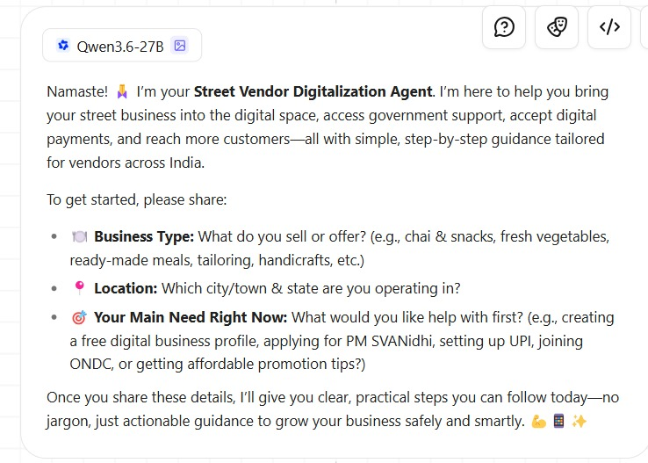
Agent Instructions Screenshot

Slide 10
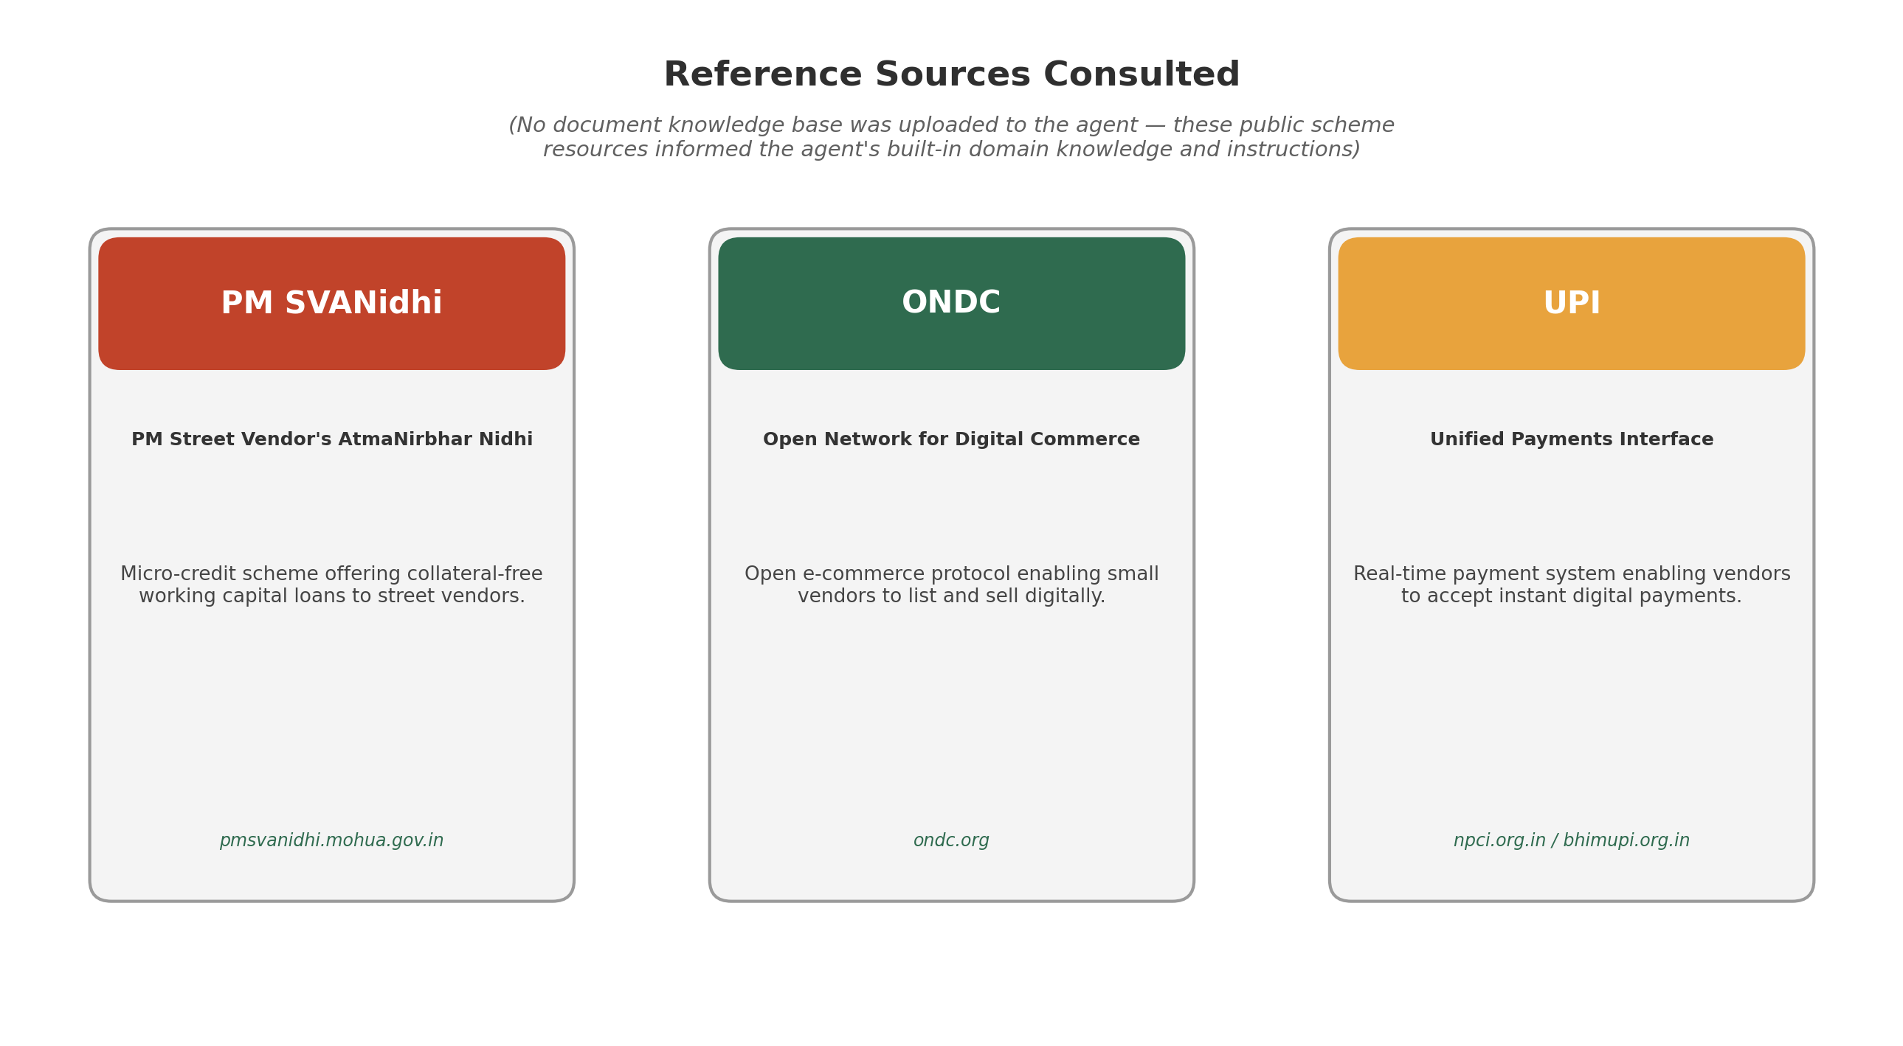
Document Uploaded Screenshot

Slide 11
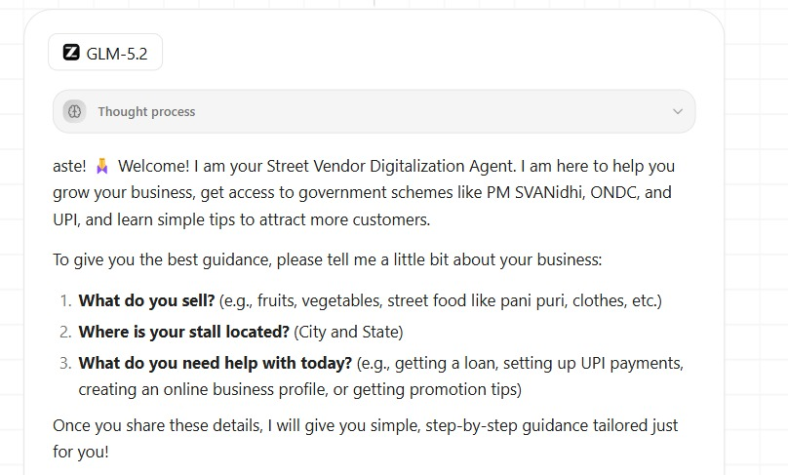
Prompt with output Screenshot

Slide 12
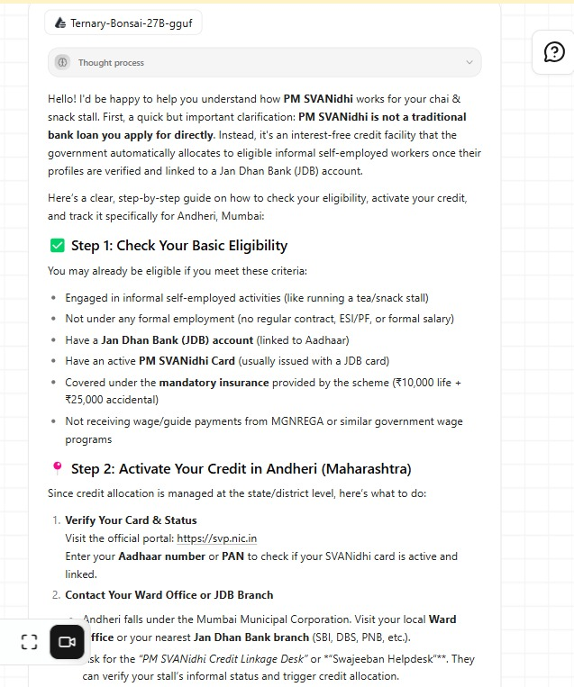
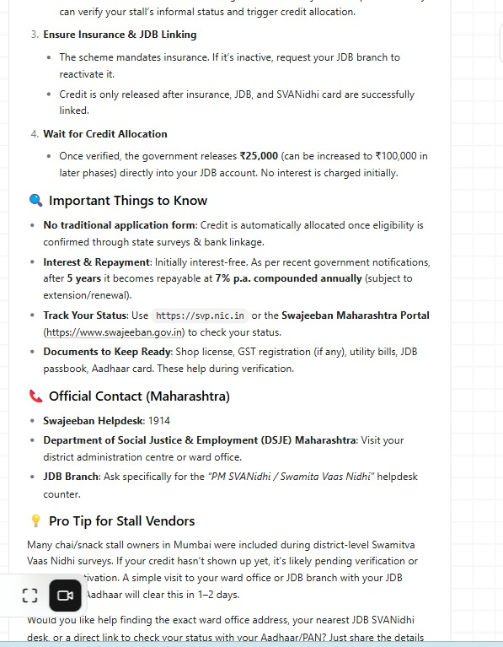
Other Applicable Screenshots

Slide 13
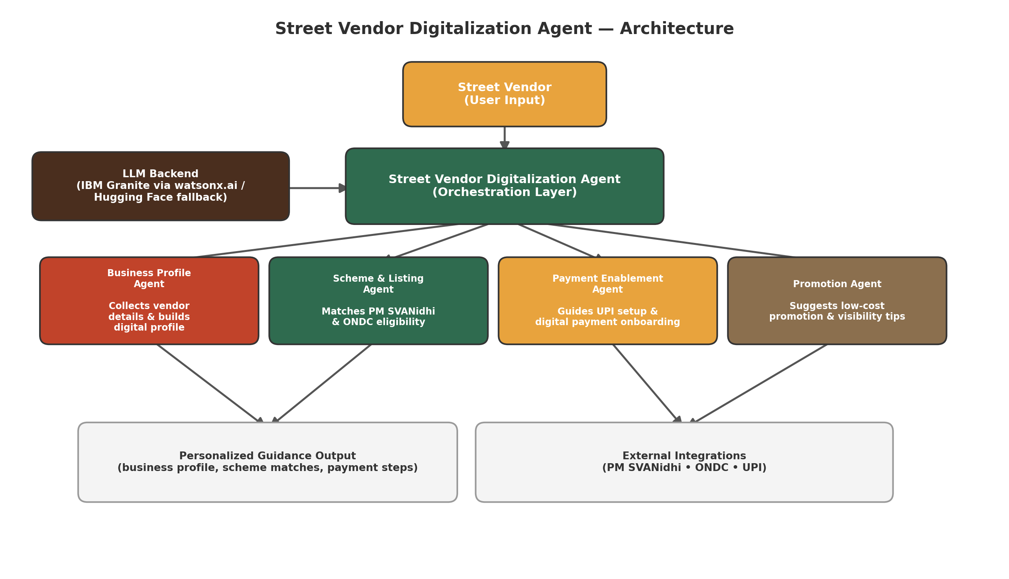
Orchestrate architecture blueprint

Slide 14

Role of Agentic AI in the solution
Role of Agentic AI in the Street Vendor Digitalization Agent
Agentic AI enables the Street Vendor Digitalization Agent to function as an intelligent, autonomous system rather than a simple chatbot. Using IBM watsonx.ai and IBM Granite models, it coordinates multiple specialized agents to take a vendor from one sentence to a usable digital storefront.
Each agent performs a specific role—such as generating a business profile, retrieving relevant schemes, enabling digital payments, and suggesting promotion—while working collaboratively. This multi-agent approach ensures efficient task execution and accurate, grounded results.
Agentic AI also brings context awareness, understanding the vendor’s trade, location, and language to generate tailored guidance. It supports real-time adaptation, grounding every answer in the latest scheme and platform information.
Additionally, agents communicate with each other, enabling better decision-making and a coherent end-to-end action plan.
Overall, Agentic AI makes the system proactive, personalized, and goal-driven, acting like a smart digital onboarding assistant that helps vendors go digital in minutes, not weeks.

Slide 15
Novelty and Uniqueness
The proposed Street Vendor Digitalization Agent stands out by combining Agentic AI, RAG, and hyperlocal personalization into a single intelligent system.
Multi-Agent Intelligence – Instead of a single chatbot, four specialized agents collaborate to deliver a complete, actionable digital onboarding plan.
RAG-Based Accuracy – Integrates real-time scheme and platform data retrieval with AI generation, reducing misinformation and ensuring trustworthy guidance.
Hyper-Personalization – Tailors business names, pricing tips, and promotion ideas to the vendor’s exact trade and location.
One-Sentence Onboarding – Converts a single plain-language sentence into a complete digital storefront plan, removing the biggest usability barrier for low-digital-literacy users.

Slide 16
Multi-Language Ready – Designed to accept and respond in regional Indian languages for real accessibility.
Financial Inclusion Focus – Goes beyond visibility to connect vendors with credit-access schemes like PM SVANidhi.
Scalable & Enterprise-Ready – Built on IBM watsonx.ai with IBM Granite models, ensuring reliability and governance for a national rollout.
This makes the solution a smart, adaptive digital onboarding partner, not just a static profile generator.

Slide 17
Future Scope
1. Voice-First & WhatsApp Deployment –
The agent can be deployed as a WhatsApp bot with voice input support, reaching vendors who are not comfortable typing and giving near-universal access without requiring an app install.
2.Transaction-Based Credit Scoring –
By tracking UPI transaction history after onboarding, the agent can build a credit-readiness score, creating a direct bridge from digital payment adoption to formal micro-credit eligibility.
Inventory & micro-loan agents – extending the same Granite + RAG pattern to stock tracking and credit eligibility checks
Direct government portal integration – automated submission to PM SVANidhi and ONDC, removing manual steps.

Slide 18
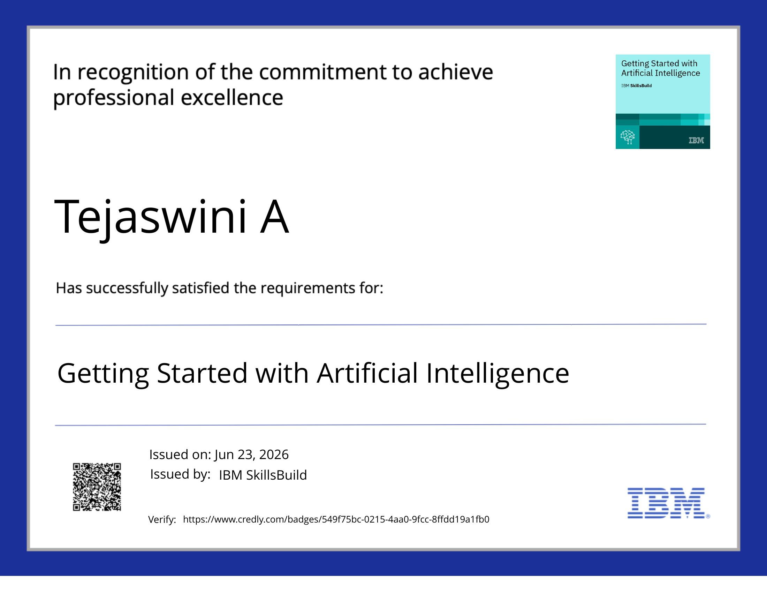
Credly Certificate

Slide 19
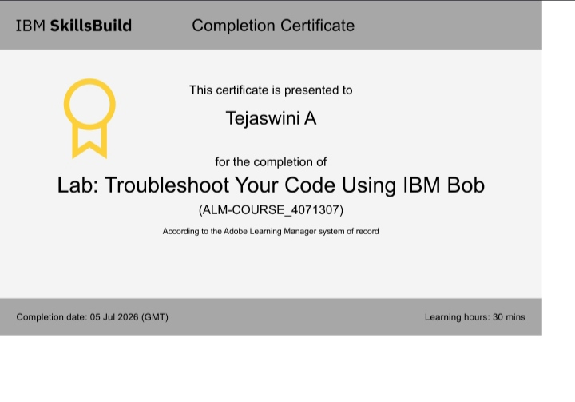
IBM BOB Certificate

