Slide 1
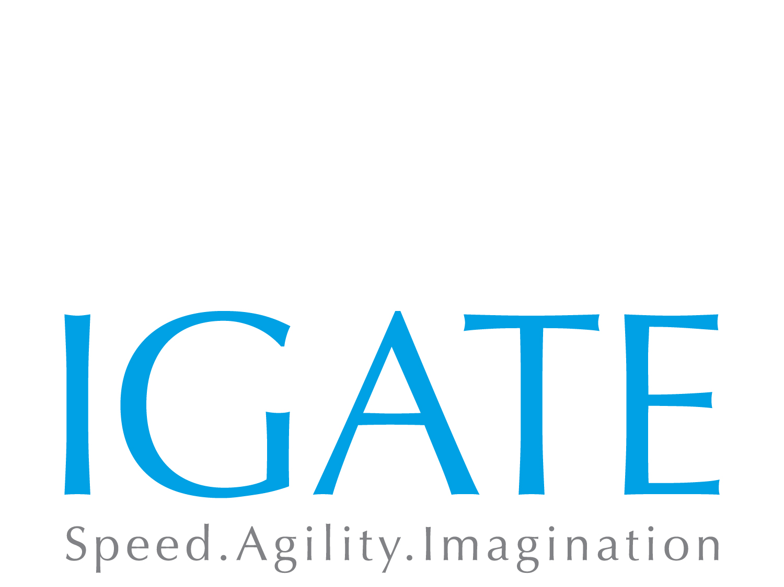
Sales Process Innovation (SPI)
Project Phase1

Slide 2
The Client
Manulife Financial Corporation is a Canadian insurance company and financial services provider, with a head office in Toronto, Canada. The company operates in Canada and Asia as "Manulife Financial" and in the United States primarily through its John Hancock division.
As of November 2014, it employed approximately 29,800 people and had 53,000 agents under contract.
Manulife Life Insurance Company Japan is a wholly owned subsidiary of Manulife Financial Corporation.

Slide 3
Need for revamped Sales Platform
Manulife Japan is facing constant challenge in coping up with the highly agile requirements of the sales and agency users and channel partners who are involved in selling Manulife products. Key requirements of a revamped platform were
A shift in the system outlook towards a customer centric approach than a product centric approach for enhancing the sales and better customer satisfaction.
Underlying application to lead into future sales penetrations
Separate sales systems for each sales channel, with new business process different amongst three sales channels (MGA, PA, FI)
Manage the pulling together of multi-products in one illustration document
Make the application multiple browsers compatible
Ensure Technology upgrade limitations are managed
To gain the competitive advantage in the market place by reducing Time to Market

Slide 4
Business purpose of the SPI system
Enhance the sales by providing packaged product offerings
Make the applications more agile and configurable to changing business needs
Transform the sales applications to a provide highly responsive and consistent User Interface across all channels
Provide support for multiple devices and offline mode access
Ensure better user experience and better customer satisfaction
Single application for multiple sales channels
Multi product illustration & application reports ( grouped by plan details)
Time-to-market for new product developments
Product sales improvements
Process time improvements
Competitive differentiation

Slide 5
The Business Objectives
Business Goal | Candidate Business Initiative | Technology as enabler
Retail MGA Expansion
Achieve 20 billion yen sales from the retail business by 2017 (1.9 billion yen for 2012 forecast) | Introduce new products (Nursing Care, Annuity, etc.) in addition to major 4 retail products (Whole Life, Income Protection, Medical and Retail Cancer Organize the retail oriented distribution teams and assign them to major cities to have closer contact with retail agents in those regions | Complete Sales Process Innovation (SPI) initiative by Q1 2014 Develop advanced distribution capabilities based on new technology trends in the market (mobile etc.)
Build a Leading Customer Centric Organization
Identify target customer segments and build a clear profile of segment characteristics - channel preference, need for advice, financial position. | Build a customer research capability and integrate customer insights into all business decisions. Systematically capture the voice of the customer in all customer interactions Simplify, simplify, simplify! Review product design, customer sales and marketing materials, operational processes with a view to simplifying from the perspective of the customer wherever possible | Develop a best-in-class customer portal Multi-channel support Consolidation of products into single platform
Medical Market Opportunities
Expand MLJ’s share in the medical market, which is growing at 5% per year | Launch Retail Cancer for MGA channel by 2014 Redesign (or reprice) UL Medical Riders product portfolio | Standardize technology offerings and development cycle to reduce time to market

Slide 6
The Solution
There are several success factors for MGA retail strategy. One is the “Sales Tool/New Business Process”
We must not miss sales opportunities
Success Factors
Product
(Premium)
Results from interviewing individual agencies
Agencies only suggest the best companies which their “product (premium), “commission”, “sales tool” and “sales tool/new business process/after service” comes into the top 5
Out of these companies, the base proposal to the customer is chosen upon the usability of “sales tool/new business process”. (At the agencies we interviewed, sales tool of Sony Life and NKSJ Himawari is highly rated, gets many chances to be used for base proposal)
Number of
Agencies
Commission/
Incentives
Expand/Enhance
MGA
Branch Network
(Agency Support/
Training)
Sales Tool/
New Business
Process/
After service
What is a superior “sales tool/new business process
Quick Response
Easy to
Understand
Fast to re-illustration/
Re-calculation
With Guidance
Easy view
Shortens
sales time
No Document
Defects
Easy to
Explain

Slide 7
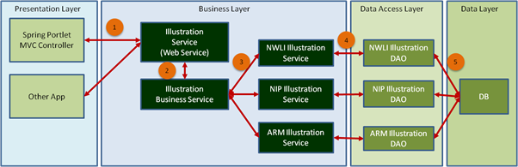
High Level Architecture proposed
The portlets in SPI Portal will be implemented using a layered architecture comprising of:
Client Layer
Presentation Layer (Portal)
Business Layer
Data Access Layer
Data Layer
The diagram below depicts the high level components in each layer for Illustration Module.
*Illustration above depicts the high level components in each layer for the Illustration Module

Slide 8
Technology stack Proposed
Product / Software | Version
UI Layer
HTML | 5
CSS | 3
JQuery Mobile | 1.3.1
JSON
Portal Layer
JSR 286 | Portlet 2.0
Spring MVC Portlet | 3.2.3
Business Services
Spring | 3.2.3
REST
Websphere Content Manager
Data Access Layer
JPA | 2.0
Hibernate | 4.2.3
General
JEE | 6
Log4J | 1.2.15
Acrobat Reader | 6.1
Software Infrastructure
Client
IBM HTTP Server | 8.0
IBM WebSphere Portal Server | 8.0
IBM WebSphere Application Server | 8.0
DB2 | V9.7.5 EE

Slide 9
Achieved Benefits
Benefit | Approach
Enhanced Sales | Packaged product offerings and ability to meet diverse requirements of the customers Renovate new business infrastructure and processes to increase the sales opportunity Support business growth by implementing efficient and effective back office operations INCREASE IN ANNUAL SALES NUMBERS BY ~30-40%
Better customer satisfaction | Quick and efficient application and illustration experience Customer-centricity focus via improved customer experience through more effective sales processes
Increased transparency | Packaged offering provides lot of flexibility and freedom for the customers and agents and enables them to have a holistic view of all the products and policies from the customer perspective.
Process Efficiency and increased productivity | Consolidated new business processing across channels Cross selling of retail products for corporate customers with multi-product and multi-insured capability Improve in operations
Predictive Modeling | Trends in business can be derived from the available data and can be used for sales forecast.
Time to market | IGATE build this product in 5 months time which was a crunch schedule as compared to the initial Estimate of 8 months. This was done utilizing a Hybrid Iterative Method approach for Development. Manulife was able to launch the products much earlier to gain the competitive advantage in the market

Slide 10
Benefits
30%~40% sales (ANP) increase of MGA Retail products is expected by reinforcing the “sales tool/NB process”
Current
SPI
40%
40%
40%
30%
30%

Slide 11
Thank you

