Slide 1
Why This Dataset?
In a well-developed financial system, crisis management is on the downstream and risk prediction is on the upstream, with the latter aiming to mitigate harm and uncertainity. Utilizing financial data like business statements, customer transactions, and repayment records to assess business performance or to estimate individual customer’s credit risk for effective internal risk management.
To meet these requirements financial institutions increasingly rely on models and algorithms to predict customer default losses, making accuarate and robust models crucial for quantitative risk management.
Hence, in this project, we will build an automated model based on the information about the client and historical transactions, capable of identifying key factors and classifying as a credit card default or not.

Slide 2
Details Of Dataset
Dataset characteristics: Multivariate
Associated Tasks: Classification
Instances: 30000
Features: 24
Target Variable: Default payment (Yes=1, No=0)

Slide 3
Overview
In this project, phase-1, we have chosen the dataset about credit card clients and we need to classify whether a given client will default the payment or not. This dataset contains information on default payments, credit data, history of payment, demographic factors( like age, sex, etc..), and bill statements of credit card clients in Taiwan from April 2005 to September 2005.
We collected the dataset from the UCI Machine Learning Repository.
Irregular entries in the dataset are handled by deleting the entries. Outliers are handled using the winsorization technique.
One hot encoding is used to remove the ordinal relationship in between categorical variables.
Data Normalization (Min-Max Scaling) is performed on the dataset to change the values in numeric columns into a common scale. During data reduction and feature selection, we dropped the unwanted columns that were not useful.
The dataset contains imbalanced data. So to handle imbalanced data Synthetic Minority Oversampling Technique (SMOTE) is used. Exploratory Data Analysis and Visualization are performed to derive insights from the data.

Slide 4
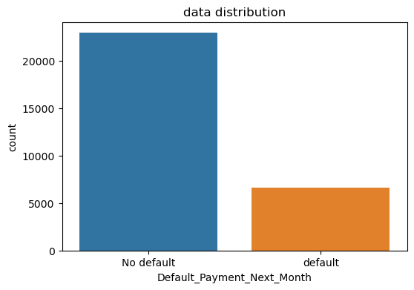
Exploratory Data Analysis And Visualization
The bar graph represents the count of the target variable i.e.., Default_Payment_Next_Month.
From the bar graph, we can observe that the dataset is imbalanced.

Slide 5
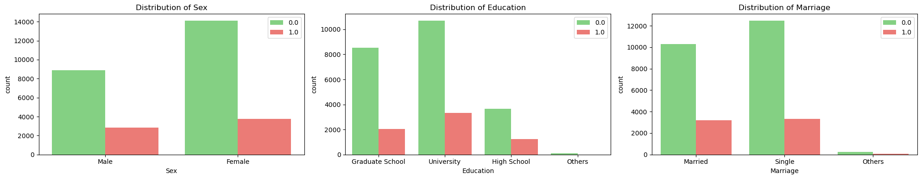
The above bar graph represents the count of making payment default or not with respect to sex. From the graph, females have lower default probability compared to men.
The above bar graph represents the count of making payment default or not with respect to education. As the level of education increases probability of default increases.
The above bar graph represents the count of making payment default or not with respect to marriage variable. From the graph, single people have lower default probabilities with compared to married people.

Slide 6
Machine Learning Models and its Metrics
The machine learning model suitable for the classification task are Logistic regression, KNN, random forest, SVM with linear kernel and non-linear kernel, and decision trees.
The labeled dataset is used to train the above stated models consists of instances with known class labels. The model learns patterns and relationships between features and labels during the training process.
Once the model is trained, it is evaluated on the test set to assess its performance on new, unseen instances.
Classification metrics are used to evaluate the performance of machine learning models. Some commonly used classification metrics are: Accuracy, precision, Recall, F1 score , Area under the ROC Curve and confusion matrix.

Slide 7
Hyper Parameter Tuning
In machine learning, models often have parameters that are learned during training (such as weights in neural networks), and they also have hyperparameters that are set prior to training, impact machine learning model’s performance.
Proper tuning is crucial for optimal results on unseen data.
Grid Search is a hyperparameter tuning technique, systematically explores predefined set of hyperparameter combinations to find the best-performing model configuration.

Slide 8
Bias-Variance Tradeoff & Cross-Validation
Bias-variance tradeoff involves balancing a model’s fit to the training data (bias) and its ability to generalize to new data (variance). Increasing complexity often reduces bias but raises variance and vice-versa.
Cross-validation, is a resampling technique used to assess model performance, partitioning the dataset into multiple subsets, training the model on some of the subsets, and evaluating its performance on the remaining subsets.
In this project we considered 5-fold cross-validation for all the models, the dataset is divided into 5 subsets or folds. The training and evaluation are then repeated 5 times, each time using a different fold as the test set and the remaining folds as the training set. This provides a more comprehensive assessment of the model’s performance compared to a single train-test split.

Slide 9
Variable Selection
The connection between the target and features is not very strong, showing that there might be non-linear relationships.
Lasso regression is well-suited for capturing both linear and non-linear relationships by penalizing absolute coefficient values.
So, we decided to use Lasso regression to pick out the most important features. Lasso is good for finding both simple and more complicated connections because it adjusts the impact of different features. This helps us narrow down the features that matter the most for predicting the target.

Slide 10

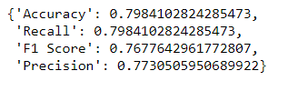
Logistic Regression
Logistic Regression, a key binary classification model, predicts binary outcomes., like credit card default, by minimizing the negative likelihood cost function through iterative optimization (e.g.,gradient descent).
The model is implemented with C value as 10 and the maximum number of iterations as 1000, it has hyperparameters like regularization strength (C) and penalty.
Grid search optimizes and penalty, emphasizing L2 regularization to enhance model performance, with higher C potentially causing overfitting and lower values preventing it.The output from the model is:
Performance of Model Before and After Tuning
Best Parameters: {'C': 100, 'penalty': 'l2'}

Slide 11


K-Nearest Neighbors
Performance of Model Before and After Tuning
KNN is a supervised Machine Learning Technique algorithm used for classification and regression by considering the majority class or mean of the k-nearest data points.
In this project, we use a K value of 4 Choosing the right k is crucial, to balance overfitting and oversimplification.
Feature scaling is essential for accurate distance calculations. Hyperparameter optimization via grid search includes neighbors, weights (uniform/distance), and distance metric (Manhattan, Euclidean, p=1/2).
The output from the model is:
Best Parameters: {'n_neighbors': 15, 'p': 2, 'weights': 'distance'}

Slide 12


Random Forest
Performance of Model Before and After Tuning
Random Forest, an ensemble prevents overfitting by aggregating individual tree predictions, through majority voting. The model is implemented with number of estimators (decision trees) equal to 100.
It uses Gini impurity instead of a loss function for training, with hyperparameters including the number of trees and maximum depth.
Grid search is employed to optimize hyperparameters, balancing model robustness with computation time and overfitting risks.
The output from the model:
Best Parameters: {'max_depth': 30, 'min_samples_leaf': 1, 'min_samples_split': 2, 'n_estimators': 100}

Slide 13


SVM with Linear and Non-Linear Kernel
Performance of Model Before and After Tuning for Linear Kernel
Support Vector Machines (SVM) are robust algorithms for classification tasks, uses linear kernel, separable data and non-linear kernels, like polynomial or RBF kernels, for complex, non-linearly separable data.
SVM seeks to find the best hyperplane in a high dimensional space, beneficial for tasks like credit risk assessment. In this project, SVM is implemented through linear and RBF (a non-linear kernel) kernels.
Key SVM hyperparameters such as C (regularization parameter) and kernel type are crucial. The project involves optimizes performance through grid search over SVM hyperparameters, including gamma, RBF, influencing the decision boundary.The output from the model is:
Best Parameters: {'C':0.01, 'kernel':'linear’}

Slide 14


Decision Trees
Performance of Model Before and
After Tuning
Decision Trees, versatile for both classification and regression tasks creates complex decision boundaries.
Hyperparameters like maximum depth, minimum samples per leaf and criterion (e.g., gini or entropy) influence the tree’s depth and quality of split.
A grid search to optimize these parameters for improved model performance and generalization.
The output from the model is:
Best Parameters: {'criterion': 'entropy', 'max_depth': 10, 'min_samples_leaf': 3, 'min_samples_split': 2}

Slide 15
Wrapper Methods
Wrapper methods assess the performance of a model by using subsets of features and are guided by the predictive performance of the model. However, the disadvantage of this model is the high computational cost due to iterative model training.a
Bi-directional elimination: This method uses both forward selection and backward elimination techniques simultaneously to reach one unique solution. In this project, bidirectional elimination is used for variable selection to the best model obtained from before and after hyperparameter tuning.
,
Set of all features
Consider subset of all
Features
Learning Algorithm
Performance
Wrapper Methods Implementation
Selecting the best Subset

Slide 16


Advanced Machine Learning Models
XGBoost
XGBoost is an efficient and powerful gradient-boosting algorithm that excels in both regression and classification tasks.
It leverages a combination of decision trees to iteratively correct errors in predictions, offering high predictive accuracy and scalability.
Deep Leaning Model
A simple Deep Learning Model with two layers typically consists an input layer, a hidden layer for feature extraction, and an output layer for predictions.
While limited in complexity, such models can effectively capture non-linear relationships in data.

Slide 17


Advanced Machine Learning Models
Extreme Machine Learning Model
Extreme Machine Learning Model (MLP Classifier) is a machine learning paradigm that emphasizes fast and efficient training of neural networks.
Unlike traditional methods, Extreme Machine Learning Model randomly assigns input weight and optimizes only the output weights, making it particularly suitable for large-scale and high-dimensional data.
Ensemble Model
An ensemble model containing the top three models refers to a sophisticated approach that integrates the predictions of three distinct high-performing models, leveraging the strengths of each.
This ensemble strategy, aims to enhance overall predictive performance and robustness by mitigating individual model bias.

Slide 18
Comparison of Models Performance Before and AfterTuning
Model | ACCURACY | RECALL | F1 SCORE
Logistic Regression | 0.80 | 0.80 | 0.77
KNN | 0.77 | 0.77 | 0.74
Random Forest | 0.78 | 0.78 | 0.78
SVM with Linear kernel | 0.79 | 0.79 | 0.72
SVM with Non-Linear kernel | 0.81 | 0.81 | 0.79
Decision Trees | 0.68 | 0.68 | 0.70
Model | ACCURACY | RECALL | F1 SCORE
Logistic Regression | 0.80 | 0.80 | 0.77
KNN | 0.77 | 0.77 | 0.76
Random Forest | 0.80 | 0.80 | 0.79
SVM with Linear kernel | 0.75 | 0.75 | 0.69
Decision Trees | 0.79 | 0.79 | 0.78

Slide 19
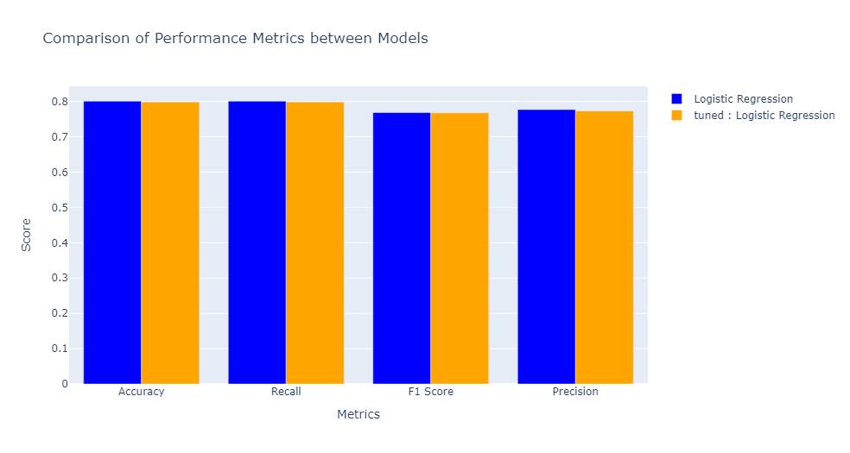
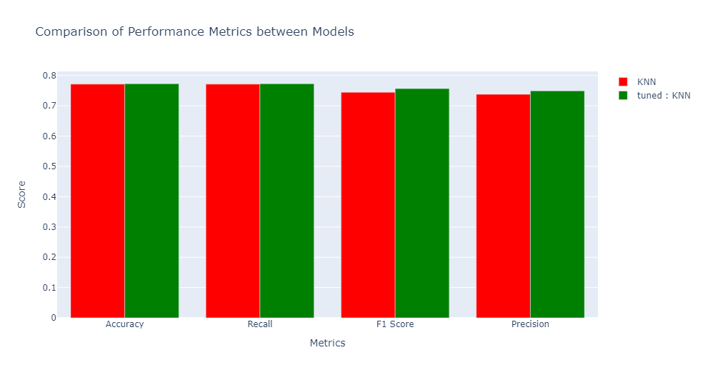
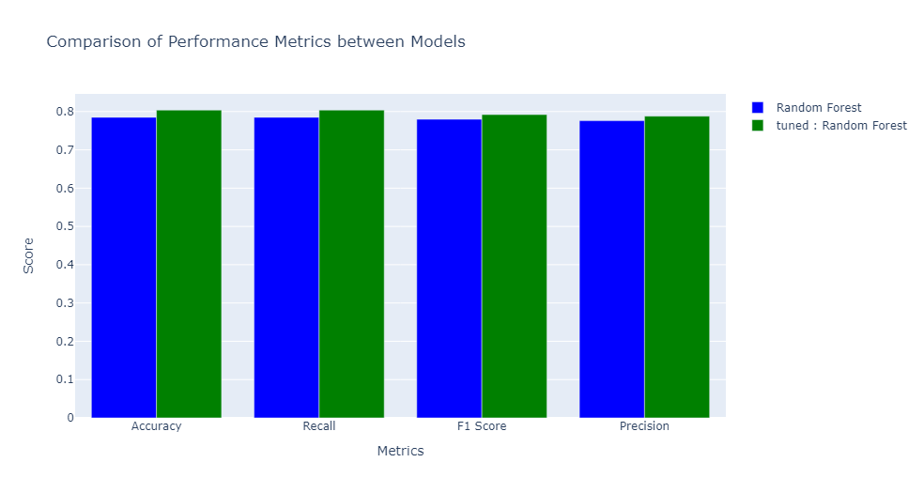
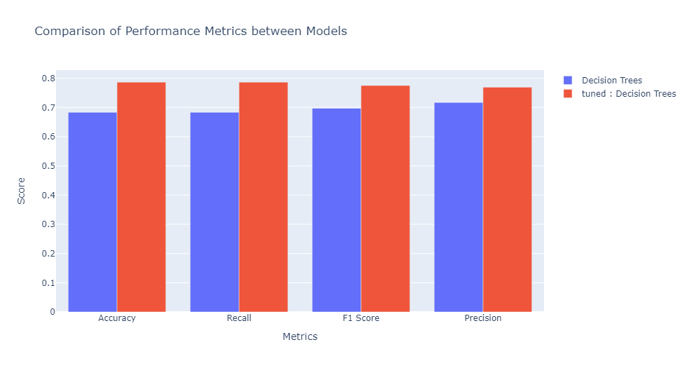
Comparison Of Models Performance Before And After Tuning

Slide 20
Comparison Of Advanced Models Performance
Model | ACCURACY | RECALL | F1 SCORE
XGBoost | 0.81 | 0.81 | 0.78
Deep Learning | 0.81 | 0.81 | 0.78
Extreme Machine Learning Model | 0.69 | 0.69 | 0.70
Ensemble Model | 0.81 | 0.81 | 0.78

Slide 21
Model Selection And Conclusion
The best-performing models, Random Forest (RF) and Logistic Regression achieved an impressive accuracy of 80%.
Before hyperparameter tuning, these models demonstrated notable predictive capabilities, while post-tuning refinement further enhanced their accuracy, solidifying their effectiveness in accurately classifying credit card default cases.
But a complex model is required to handle diverse datasets effectively and try to minimize overfitting which could be made possible by choosing XGBoost.
Since the model XGBoost model has the highest accuracy and F-1 score and it is less complex than the ensemble model and taking into consideration computation time, it is the best choice for classifying the dataset credit card default cases because of its complex nature, handling imbalance data contributes to XGboost's robustness, allowing it to handle diverse datasets effectively, minimize overfitting, and produce reliable predictions even in complex and challenging scenarios.

