Slide 1
19CSE202 DBMS REVIEW 1 ONLINE BANKING SYSTEM
S.No | Reg.No | Name of the Student | Role
1 | CB.EN.U4CSE20244 | Nitheesh M | DESIGNER, TESTING
2 | CB.EN.U4CSE20258 | Sharon Bianca R | DEVELOPER, DOCUMENTATION
3 | CB.EN.U4CSE20266 | Tejaswini Boyapati | TEAM LEADER
4 | CB.EN.U4CSE20271 | Yenepuri Ashish | DEVELOPER

Slide 2
Contents
Problem Definition
Aim
Functionalities
Modules
Schema Diagram
ER Diagram
Development Platform

Slide 3
Problem Definition
With banks being just a few clicks away; online banking allows customers to access their bank accounts from anywhere; 24/7 securely and conveniently. A new age online banking system allows customers to conduct day-to-day money transfers, direct deposits, bill payments to be carried out efficiently with utmost ease and comfort. With the concept of banking turning online, the users can keep a good eye, monitoring all their balance and pending transactions in real-time. In order to deal with the banking tasks online, a database to record all the details is very much needed along with a user interface for both the ends to interact.
This platform is designed to serve as a one-stop solution for both the customers and administrators.

Slide 4
AIM
The main aim of this project is to design and develop a database for the bank to maintain records of various branches of the bank across the country, administrators’ details as well customers' account details, account statements, transaction details, loan details (if availed by the customer) and bill payments in order to nurture the needs of an end banking user by providing various ways to perform banking tasks online.

Slide 5
Functionalities
Provides with individual accounts (savings or current account or both) to customers in order to preform banking tasks online.
Provides a registration link for new customers as well as a login link for existing customers to access their accounts.
Allows customers to deposit money in their accounts.
Aids customers in transactions.
Customers are also issued with debit/credit cards.
If applied, customers are provided with loans.
Various bill payments can be dealt by the customers.
Facilitates customers to view his/her own account details, account statement and all other details regarding transactions, loans, bill payments.

Slide 6
Modules
Interface creation for Online banking system.
Register/Log-in by customers to access their bank accounts (savings or current or both)
Maintaining records of deposition, transactions by customers and customer details.
Issuing receipts, OTP(s) and mails for transactions.
Maintaining records of administrators’ details.
Maintaining records of loans availed to customers.
Debit/Credit card services
Maintaining records of bill payments (electricity bills, water bills, municipal bills, credit/debit card bills, etc.)
Report generation

Slide 7
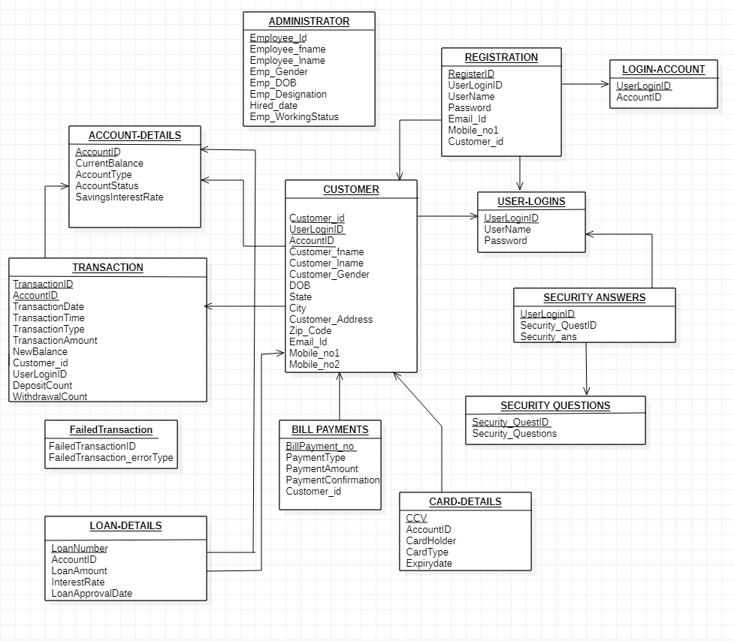



Slide 8
1. ADMINISTRATOR :
Attributes :-
Emp_id – gets the employee ID which is a 6 digit code. (Ex: 200001).
Emp_firstName, Emp_LastName – stores the employee’s name.
Gender – gets gender of the employee (Male/Female).
DOB – date of birth data of the employee.
Designation – employee’s working position in the bank.
Hired_date – Date of employment.
Working Status – Current status of the employee.
Primary Key – Emp_id (int)
This entity set ADMINISTATOR stores the information of the employees.

Slide 9
2. CUSTOMER :
Attributes :-
Customer_id – customer’s verification id with four characters (Ex : AD90).
AccountID– gets the account number which is a 12 digit code.(Ex : 5687 7890 4567).
Customer_firstName, Customer_LastName – stores the customer’s name.
Custome_Gender – gets gender of the customer (Male/Female).
DOB – date of birth data of the customer.
Customer_address ,State,City, zipcode– customer’s address as mentioned in the passbook.
Email_id– email address of the customer .
Mobile_no1, Mobile-no2– Current using mobile number of the customer.
UserLoginID- given to the customer once he registers into online.
Primary Key – AccountID, Customer_id, UserLoginID
Foreign Key – AccountID
This entity set CUSTOMER stores the information of the customer.

Slide 10
3. ACCOUNT DETAILS :
Attributes :-
AccountID – gets the account number which is a 12 digit code.(Ex : 5687 7890 4567).
AccountType – defines the type of the account (savings/current).
AccountStatus – status of the account of the customer (Live/Dead).
CurrentBalance – amount currently present in the bank account.
SavingsInterestRate – Rate of interest bank offers for the savings.
Primary Key – AccountID
This entity set ACCOUNT-DETAILS stores the information of the bank account.
4. LOGIN-ACCOUNT :
Attributes :-
UserLoginID – given to the customer once he registers into online.
AccountID - gets the account number which is a 12 digit code.(Ex : 5687 7890 4567).
Primary Key – UserLoginID
This entity set LOGIN-ACCOUNT gives the details of login information to the bank once the customer logins.

Slide 11
5. REGISTRATION :
Attributes :-
RegisterID – registration number of the customer.
UserLoginID – given to the customer once he registers into online.
UserName – 15 character name of the user.
Password – hidden 12 characters which contains numerical, alphabet and symbols.
Email_id – email address of the customer .
Mobile_no1 – Current using mobile number of the customer.
Customer_id – customer’s verification id with four characters (Ex : AD90).
Primary Key – RegisterID
Foreign Key – UserLoginID, Customer_id
This entity set REGISTRATION contains the initial registration details of the customer.

Slide 12
6. USERLOGINS :
Attributes :-
UserLoginID – gets the employee ID which is a 6 digit code.(Ex : 200001).
UserName – 15 character name of the user.
Password – hidden 12 characters which contains numerical, alphabet and symbols.
Primary Key – UserLoginID
This entity set USERLOGINS captures data for every login of the customer into the bank account.
7. SecurityAnswers :
Attributes :-
UserLoginID – gets the employee ID which is a 6 digit code.(Ex : 200001).
Security_Ans – One word answer for the sequrity questions.
Security_QuestID – ID’s numbered from 1-20 indicates the question.
Primary Key – UserLoginID
This entity set SecurityAnswers captures data for every login and the answers given by the customer.

Slide 13
8. SecurityQuestions :
Attributes :-
Security_QuestID – ID’s numbered from 1-20 indicates the question.
Security_Questions - Questions for the customer for security reasons.
Primary Key – Security_QuestID.
This entity set SecurityQuestions has the permanent information of security Questions.
9. CARD-DETAILS :
Attributes :-
AccountID –gets the account number which is a 12 digit code.(Ex : 5687 7890 4567). .
CardHolder - Name of the card holder present in the ATM card.
CardType – type of the card (visa/debit/credit/Rupay).
CCV – Three digit pin code in the ATM card.
ExpiryDate – Date of Expiration of the card.
Primary Key – CCV.
This entity set CARD-DETAILS has the details of the ATM card.

Slide 14
10. LOAN-DETAILS :
Attributes :-
LoanNumber – first two digit number defines the type of loan (Gold/personal/etc.,) and last character and two digits is specific.
AccountID – gets the account number which is a 12 digit code.(Ex : 5687 7890 4567).
LoanAmount – Approved loan amount to the customer.
InterestRate – rate of interest as per the loan number.
LoanApprovalID – specific number given as soon as the loan approved.
Primary Key – LoanNumber.
This entity set LOAN-DETAILS stores the details of the loan offered by the bank.

Slide 15
11. TRANSACTION :
Attributes :-
TransactionID – unique transaction id for each transaction.
TransactionDate, TransactionTime – date and time of the transaction.
Customer_id– customer’s verification id with four characters (Ex : AD90).
TransactionType – defines the type of transaction(deposit/withdrawal).
TransactionAmount – total transaction amount deposited or withdrawed.
NewBalance – Balance after each transaction.
AccountID – gets the account number which is a 12 digit code.(Ex : 5687 7890 4567).
UserLoginID – given to the customer once he registers into online.
WithdrawalCount – Number of withdrawals per day ( max : 10).
DepositCount – Maximum number of deposits per day ( max : 10).
Primary Key – TransactionID, AccountID.
Foreign Key – Customer_id, UserLoginID
This entity set TRANSACTION has the information of every transaction and gets updated every time.

Slide 16
12. FailedTransactionLog :
Attributes:-
FailedTransaction_errorType – type of transaction error.
FailedTranscationID – transaction id defined in eight characters (Ex : 5674 8907) , the last eight numbers of accountID.
Primary Key – FailedTransactionID.
This entity set FailedTransactionLog captures the failed transaction information.
13. BILL-PAYMENTS :
Attributes :-
BillPayment_no– payment number made through online.
PaymentType – type of payment that customer used.
PaymentConfirmation – tells whether payement is success or not.
PaymentAmount – total payment made by the customer
Customer_id - customer’s verification id with four characters (Ex : AD90).
Primary Key - BillPayment_no.
Foreign Key - Customer_id.
This entity set BILL-PAYMENTS captures every amount paid by the customer through online mode.

Slide 17
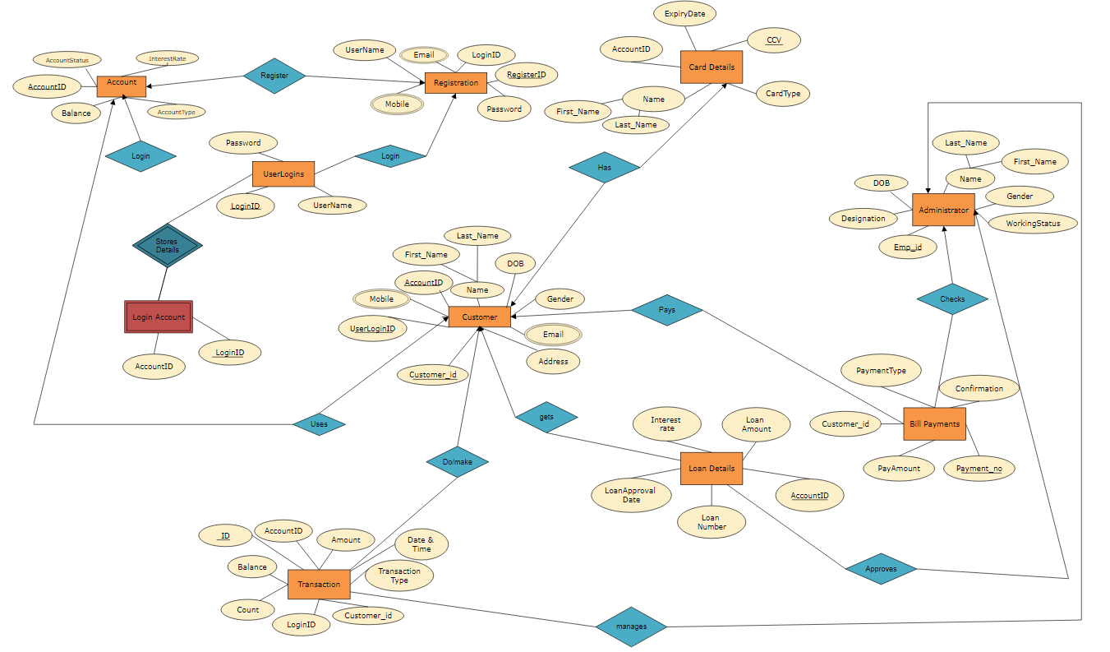
ER
Diagram

Slide 18
Development Platform
For Database: SQL
For User Interface: HTML, CSS and JavaScript

Slide 19
THANK YOU!

