Slide 1
IMPLEMENTING A WEB BROWSER TAB SYSTEM
GROUP NO: 17

Slide 2
TEAM MEMBERS-
Bhavvuk D Kalra [CB.EN.U4CSE20212]
Mahasri V [CB.EN.U4CSE20235]
Tejaswini Boyapati [CB.EN.U4CSE20266]

Slide 3
ABSTRACT-
“IMPLEMENTING A WEB BROWSER TAB SYSTEM”
To implement this, we will be using a Doubly Linked list and Stacks. Each node of a DLL represents a Tab that has been opened, and the structure of each node will be in such a way that it will be pointing to 2 stacks, the ForwardStack and the BackwardStack and each node also holds the value of the current site. The purpose of the ForwardStack is to maintain the sites/URLs that were accessed after the current site/URL in order. Similarly, the BackwardStack holds all the sites/URLs that were accessed before the current site/URL in order. The most recent tab (node) comes to the front of the DLL, and the second node is the one that was used before this Tab.

Slide 4
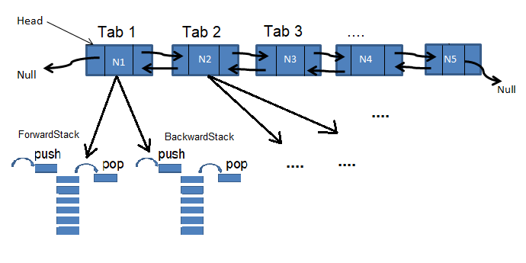

Slide 5
OPERATIONS-
AMONG TABS-
Creating/Making a new Tab – Adding a node to the front of DLL.
Switching Tab – Bringing the other tab to the front of DLL.
Removing a Tab – Removing the front node from DLL.
WITHIN ANY TAB-
Navigating Backward – Push into the ForwardStack, and pop from the BackwardStack.
Navigating Forward – Push into the BackwardStack, and pop from the ForwardStack.
Opening new URL/Site - Push into the BackwardStack, and pop ForwardStack till it is empty.

Slide 6
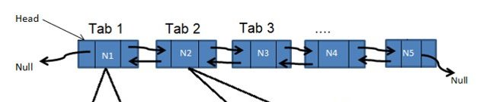
AMONG TABS-
Creating/Making a new Tab: Adding a node to the head of the doubly Linked List and creating 2 stacks for that particular Tab/node (ForwardStack, BackwardStack) and linking the node to these stacks. This tab is set as the current tab now.
Algorithm-
Create_tab(): //insert to front of DLL
New_Tab = new Tab(); //Tab is the class – stacks are created.
New_Tab->next=head;
New_Tab->prev=NULL;
head->prev=New_Tab;
head=New_Tab;
Complexity: O(1)

Slide 7
AMONG TABS-
Switching Tab: As we know which tab to switch from the current tab, there is no need for traversal. The tab is removed from its place and added to the front of the linked list, making it the most recently used tab and the current tab.
Algorithm-
Switch_tab(To_switch): //Remove and insert to front of DLL
To_switch->prev->next=To_switch->next;
To_switch->prev->next->prev=To_switch->prev;
To_switch->next=head;
To_switch->prev=NULL;
Head->prev=To_switch;
head=To_switch;
Complexity: O(1)

Slide 8
AMONG TABS-
Removing a Tab: The node/Tab that was opened most recently will be closed. If we close a Tab that occurs somewhere in the middle of the Linked list, Tab will be switched and brought to the front of the linked list and then deleted. Before removal of the front node, the next node of the front node will be set as the current tab and then it proceeds with the deletion process.
Algorithm-
Remove_tab(): //Remove from front of DLL
Temp=head;
Head=head->next;
Free(Temp);
Head->prev=NULL;
Complexity: O(1)

Slide 9
WITHIN ANY TAB-
Navigating Backward: The current site is pushed into the ForwardStack, and the top of the BackwardStack is made as the current site after popping.
Algorithm-
Nav_Back():
If(BackwardStack.size()>0):
ForwardStack.push(current site); //O(1)
current site=BackwardStack.pop(); //O(1)
Else:
Cannot go back!!
Complexity: O(1)

Slide 10
WITHIN ANY TAB-
Navigating Forward: The current site is pushed into the BackwardStack, and the top of the ForwardStack is made as the current site after popping.
Algorithm-
Nav_Frwd():
If(ForwardStack.size()>0):
BackwardStack.push(current site); //O(1)
current site=ForwardStack.pop(); //O(1)
Else:
Cannot go front!!
Complexity: O(1)

Slide 11
WITHIN ANY TAB-
Opening new URL/Site : the current site is pushed to the BackwardStack, and the new URL/Site will be set as the current site and the ForwardStack is popped till it becomes empty.
Algorithm-
Open_NewURL(url):
BackwardStack.push(current site); //O(1)
current site=url;
While(ForwardStack.size()>0): //O(n)
ForwardStack.pop()
If n is the number of elements in the ForwardStack, that is, there are n sites that were visited after the current site and using back navigation, all of them are inserted into the ForwardStack, the time complexity depends on it.
Complexity: O(n)

Slide 12
THANK YOU

