Slide 1

Contribution Management
Team Members:
Varun Reddy Musku
Tejaswini Challa
Sumanth Raja Ghanta
Chakradhar Prathivada
Shruthi Battu
Rohan Reddy Kondaveeti

Slide 2
Contents
Motivation
Solutions
Android studio
Flow chart
List of Features
Firebase
SMART TRAFFIC MANAGEMENT SYSTEM
Introduction of STMS
Problems faced and Approach
RFID sensors
Green Corridors
List of features in Proteus

Slide 3
Motivation
In highly populated countries food and clothes wastage are disturbing issues.
The streets, garbage bins and landfills have sample proof to prove it.
Marriages, restaurants, and family get-togethers expel out so much food and quick change in trends of fashion results

Slide 4
Solution
Instead of wasting these things we can put them in use by Contribution management android application.
The various organizations such as orphanages, old age homes and Homeless people, etc.

Slide 5
Android Studio
Android Studio provides a unified environment where you can build apps for Android phones, tablets, Android Wear, Android TV, and Android Auto.
The Android Studio comes with an Emulator that helps to start the entire app faster than the actual device.
Android Studio provides a visual drag and drops editor tool for working with XML files. This helps to create an entirely new app layout it is easy to develop.

Slide 6
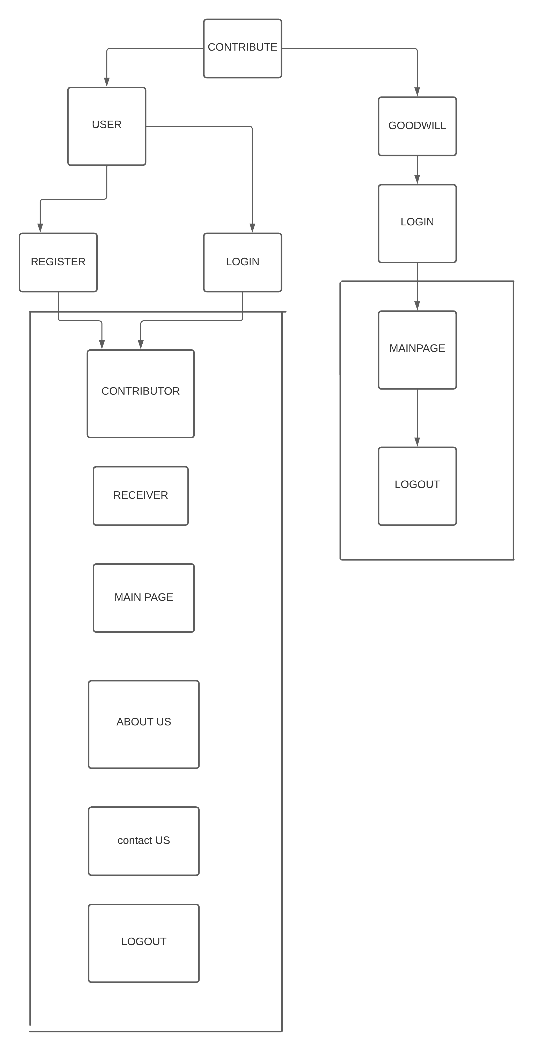
Flow Chart

Slide 7
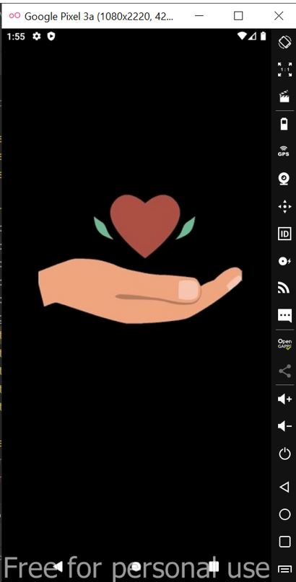
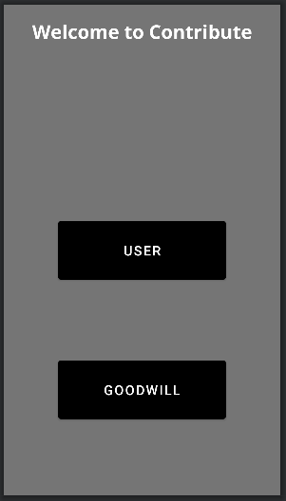
Splash Screen
Splash Screen is most commonly the first startup screen which appears when App is opened
Here we can see the two buttons as shown in fig.
USER
GOODWILL

Slide 8
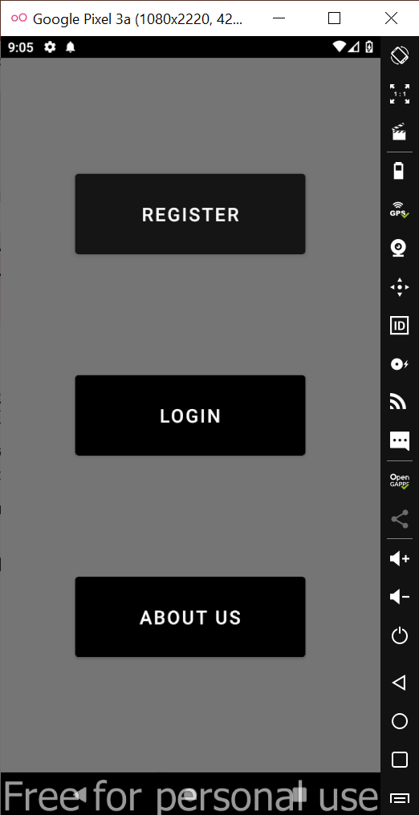
Landing Page
User is provided with ways of interacting with the application.
If user is relatively new, he needs to complete the Registration.
Register
Login
About Us

Slide 9
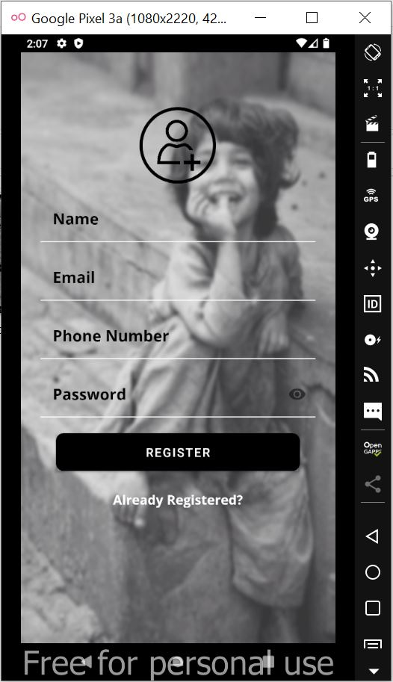
Registration Layout
A signup page (also known as a registration page).
It enables users and organizations to independently register and gain access to your system.
Register.
Already Registered.

Slide 10
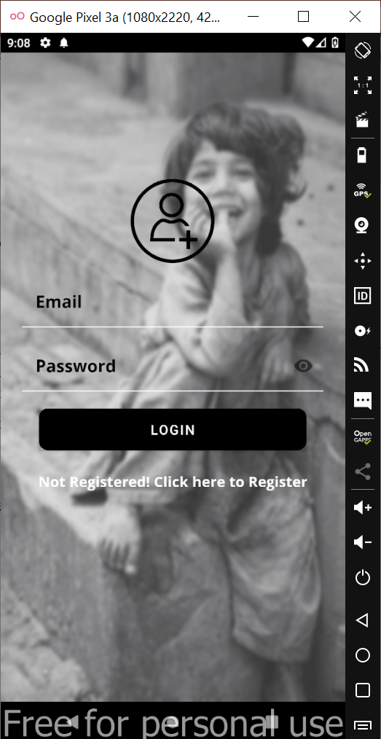
Login Layout
A login page is a starting page to an app that requires user identification and authentication.
Regularly it is performed by entering a username and password combination.

Slide 11
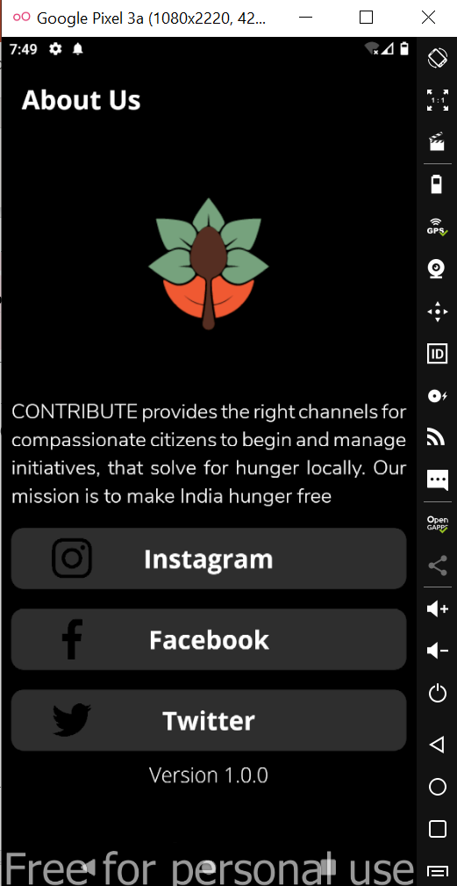
About Us Page
If any user wants to quickly understand the vision of the application, they can navigate here.
All the activities and donations around the organizations are maintained in our social media platforms.

Slide 12
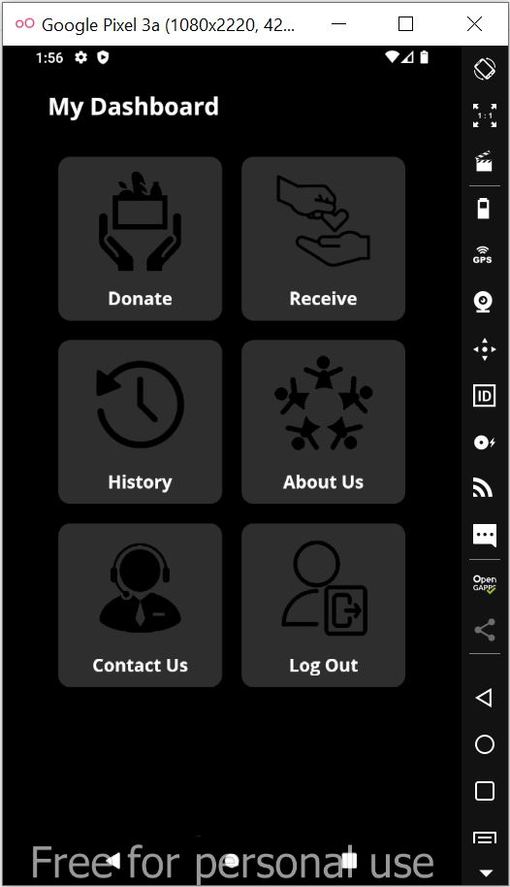
MY DASHBOARD
User can perform any activity.
Donate
Receive
History
About us
Contact Us
Logout

Slide 13
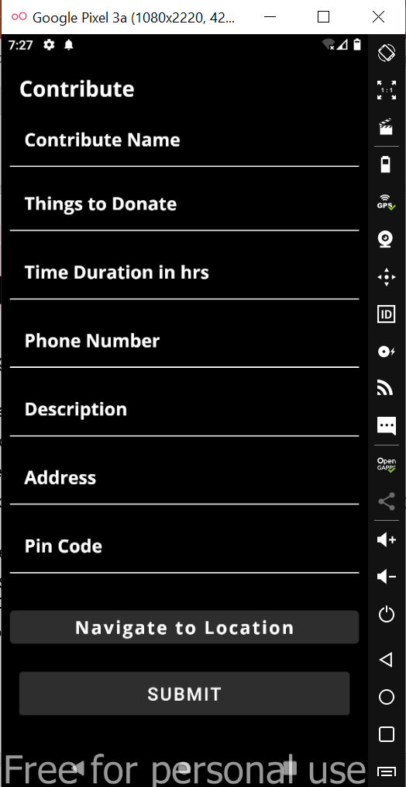
Contribute Page
User is required to provide the information
which includes Name, things to donate, Address and pin code as mandatory.
All fields are mandatory.

Slide 14
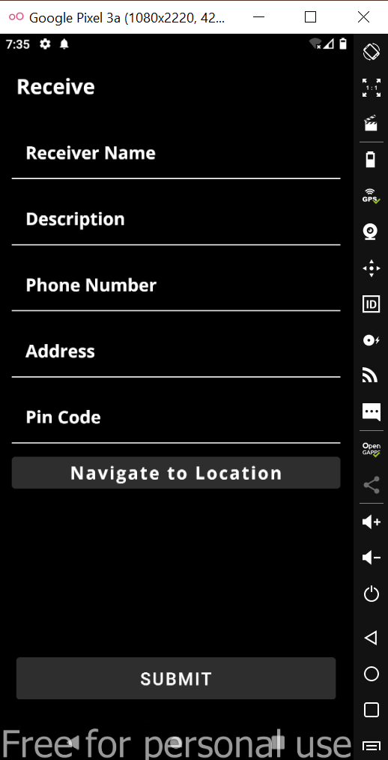
Receive
Receiver can receive any goods from the Donor and receiver can request what he needs.
All the information regarding request and receiver details will be stored in History page.

Slide 15
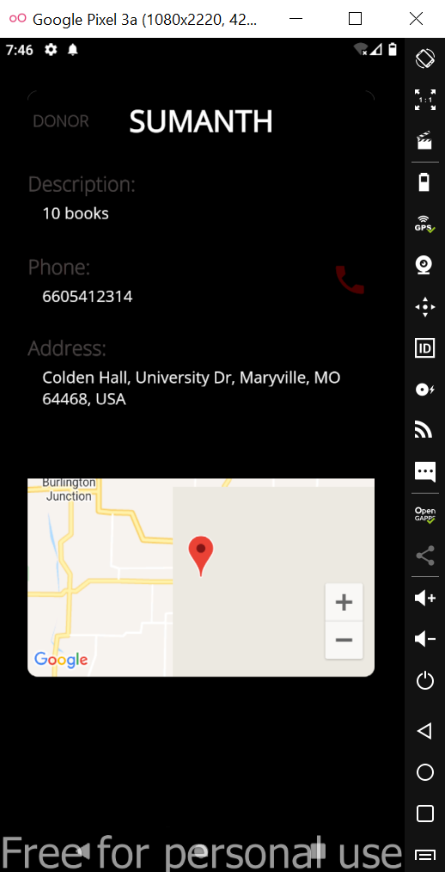
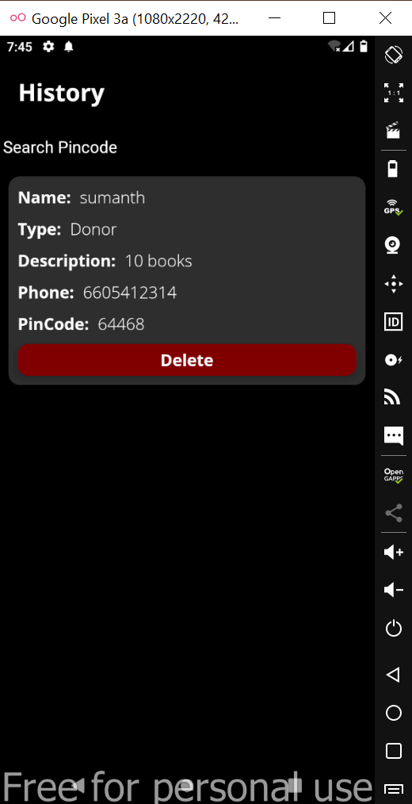
History page
User details page
History page
History page stores the entire details for either Donor or Receiver regarding the transaction.
A Donor or Receiver can search within nearby area by entering Pin code in search box at the top.
In order to differentiate between Donor and Receiver a ‘Type’ field is used which displays the requirement of the user.

Slide 16
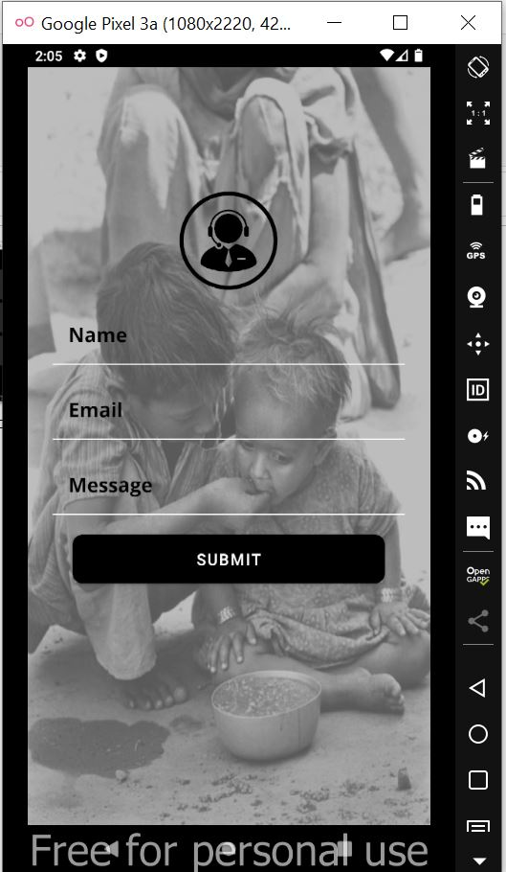
Contact Us page
For any app related queries or issues with application user can submit his details.
A dedicated person will contact the user who raised queries/ issues.

Slide 17
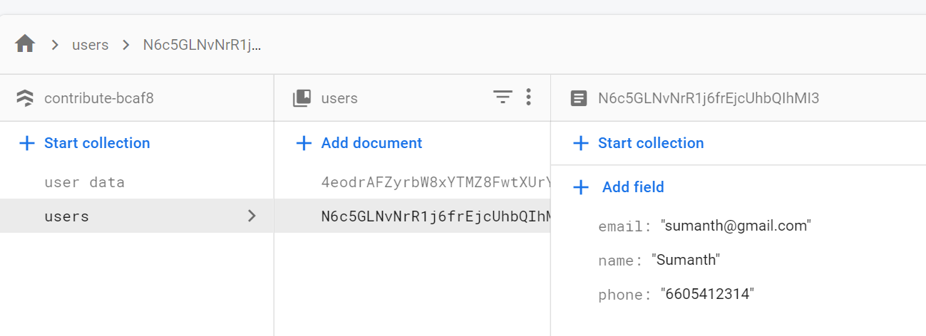
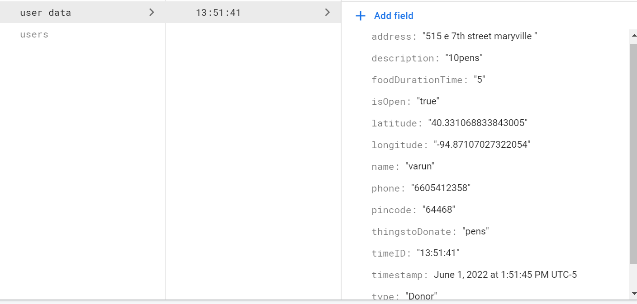
Firebase
Here is the data to store the information in firebase.
In the above fig shows USERS who are login.
In the below fig shows to store the information who entered whether if the donor or receiver.

Slide 18
Contents:
SMART TRAFFIC MANAGEMENT SYSTEM (STMS)
Introduction
Problems faced in Real-time scenario.
Approach to the problem.
RFID sensors and implementation
Implementation of Green corridors.
Arduino in Proteus
Logic Toggle and Serial monitor
Demonstration.

Slide 19
Introduction of STMS
Urban mobility is one of the major problems.
especially in metropolitan cities. Previous traffic management systems are not capable enough to tackle this growth of traffic on the road networks.
traffic-related problems such as traffic jams, emergency vehicle clearance, etc.
Used to predict the traffic density for the future to minimize traffic congestion.
Emergency vehicles demand quick and safe passage as they aim to save a patient’s life.

Slide 20
Problems faced in Real-time scenario
In the current scenario, one of the serious concerns for people in smart cities is traffic congestion. This has turned out to be a daily problem in the current time.
Due to this road congestion accidents in the city have been raised to a great extent so lives lost due to accidents are even more crucial.
Due to this congestion on the roads, emergency vehicles such as ambulances, fire cars, and other vehicles cannot reach on time.

Slide 21
Approach to the problem.
Using IOT technology.
green corridor and reaches their destination on time.
The RFID reader scans the RFID tag applied on the ambulance vehicles.
The ambulance to provide a "Green Corridor" by shifting other lanes.

Slide 22
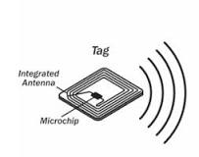
RFID sensors and Implementation
Radio Frequency Identification or RFID is a specific type of radio technology .
RFID reader and transmits an identification number back to the reader.
Tags can be passive or active.
Active tags.
Passive tags.

Slide 23
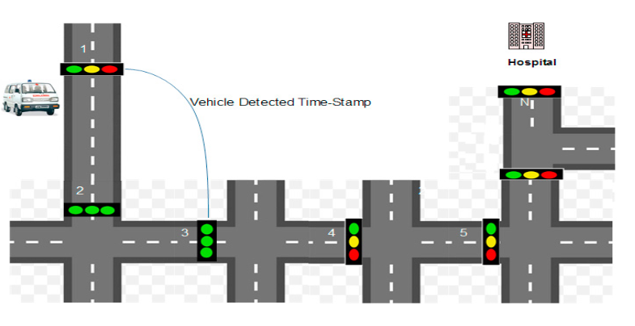
RFID Implementation
Implementing RFID tags in such vehicles.
the green corridor to CTMS through RFID tags.
The request message consists of three information fields namely, Unique Vehicle Identity (UVId).
coordinates of source, and destination.
After the approval of the green corridor

Slide 24
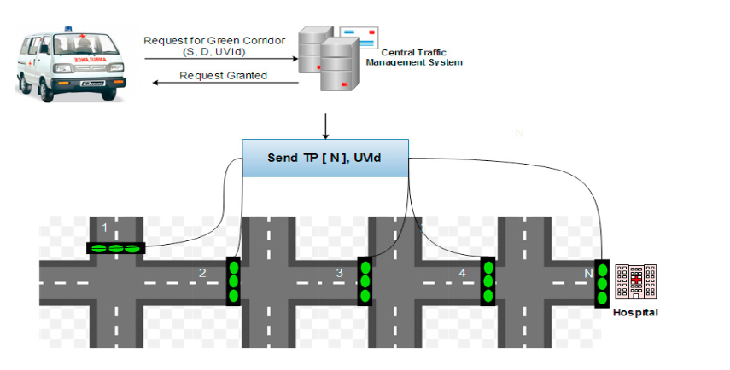
Implementation of Green corridors
Ambulances, fire brigade, and police vehicles.
To avoid this problem, a dynamic real-time green corridor is created.
CTMS
Traffic Post.

Slide 25
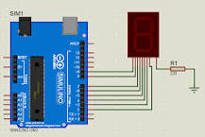
Arduino in Proteus
Arduino is an open-source platform used for building electronics projects.
Now open Your Proteus and Search Arduino.
In this simulation tool we will take the devices like signals, Arduino boards , serial monitors and toggle etc.

Slide 26
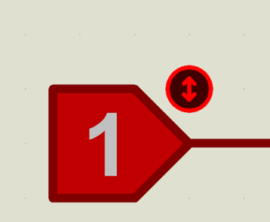
Logic Toggle :
The logic allows you to toggle a device on and off.
When the switch operator pushes the toggle.
the switches contact the position to start or stop an electrical flow.

Slide 27
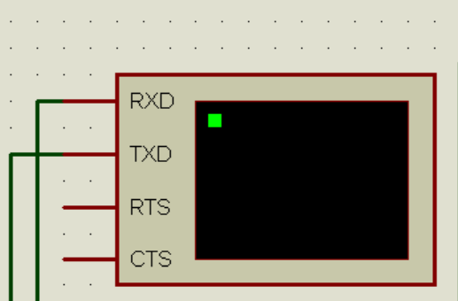
Serial Monitor :
The most common reason to use serial, begin() is when you want to output some information from your Arduino to your computer screen.
That is, you want to print some text out.
The function used to display on the computer

Slide 28
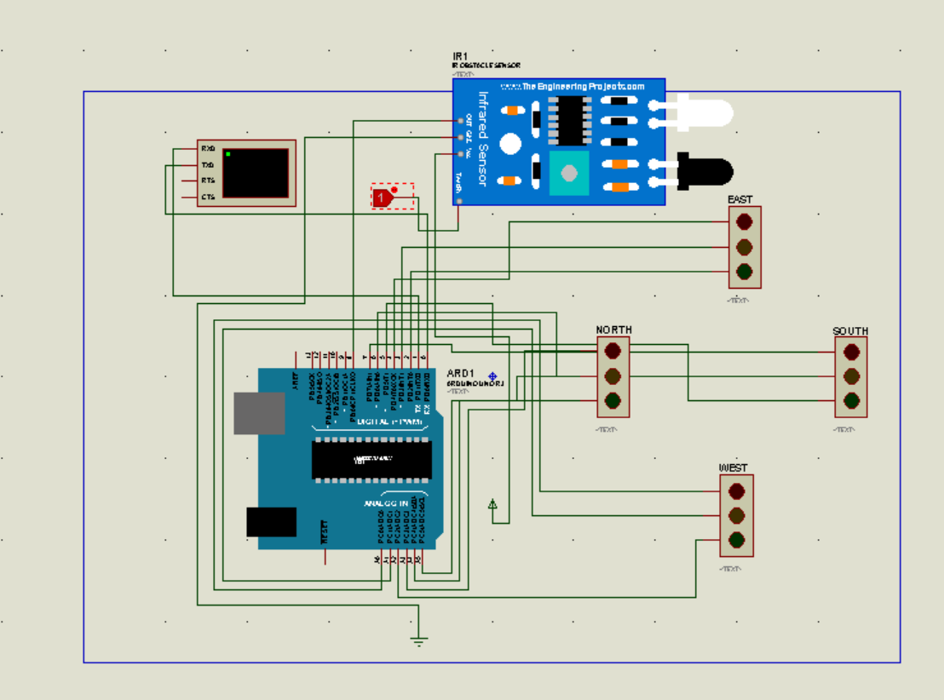
Proteus diagram

Slide 29

Thank you

