Slide 1
SMART TRAFFIC MANAGEMENT SYSTEM
Team members:
Chakradhar Prathivada
Shruthi Battu
Rohan Reddy Kondaveeti
Tejaswini Challa
Sumanth raja Ghanta
Varun Reddy Musku

Slide 2
Contents
Introduction.
Problems faced in Real-time scenarios.
Approach to the problem.
Arduino in Proteus
RFID sensors and implementation
Implementation of Green corridors.
Smart traffic management in the Proteus simulator

Slide 3
Introduction
Urban mobility is one of the major problems, especially in metropolitan cities. Previous traffic management systems are not capable enough to tackle this growth of traffic on the road networks.
The city requires a smart and intelligent traffic management system to deal with traffic-related problems such as traffic jams, emergency vehicle clearance, etc.
An algorithm is used to predict the traffic density for the future to minimize traffic congestion.
Emergency vehicles demand quick and safe passage as it aims at saving the life of a patient. It is becoming a serious problem in our society and an optimal solution where normal traffic flow is least disrupted as well as emergency vehicles too could move quickly is highly desired.

Slide 4
Problems faced in Real-time scenarios.
In the current scenario, one of the serious concerns for people in smart cities is traffic congestion. This has turned out to be a daily problem in the current time.
Due to this road congestion accidents in the city have been raised to a great extent so lives lost due to accidents are even more crucial.
Due to this congestion on the roads, emergency vehicles such as ambulances, fire cars, and other vehicles cannot reach on time.
Approach to the problem
Through IoT-enabled technology, we can solve these issues by creating "Green Corridors" for emergency vehicles.
The system gives emergency vehicles the benefit of a green corridor and reaches their destination on time.
The RFID reader scans the RFID tag applied on the ambulance and updates upcoming traffic lights to switch to green and displays a message to vehicles ahead of the ambulance to provide a "Green Corridor" by shifting other lanes

Slide 5
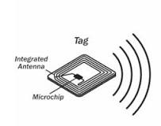
RFID sensors
Radio Frequency Identification or RFID is a specific type of radio technology that uses radio waves to identify tags attached to an object and thus identify the object
The tag contains a transceiver chip that is triggered by the electromagnetic wave from the RFID reader and transmits an identification number back to the reader.
Tags can be passive or active.
Passive tags are only powered by the incident electromagnetic wave from the reader and thus have a shorter operating range.
Active tags are powered by a battery and can have a greater range, up to hundreds of meters.

Slide 6
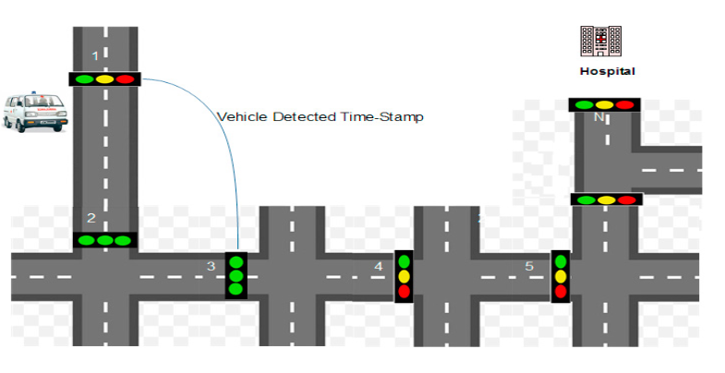
RFID Implementation
RFIDs are used to prioritize emergency vehicles like ambulances, fire brigades, etc. by implementing RFID tags in such vehicles.
Here we are using RFID sensors, it is used to get the live status of that vehicle to the Central traffic management server.
In this scenario emergency vehicle sends a request for the green corridor to CTMS through RFID tags. The request message consists of three information fields namely, Unique Vehicle Identity (UVId), coordinates of source, and destination.
After the approval of the green corridor, CTMS sends UVid (unique vehicle id) information to all TPs. On receiving the UVId, all the TPs turn the traffic signal green, thus creating a green corridor.

Slide 7
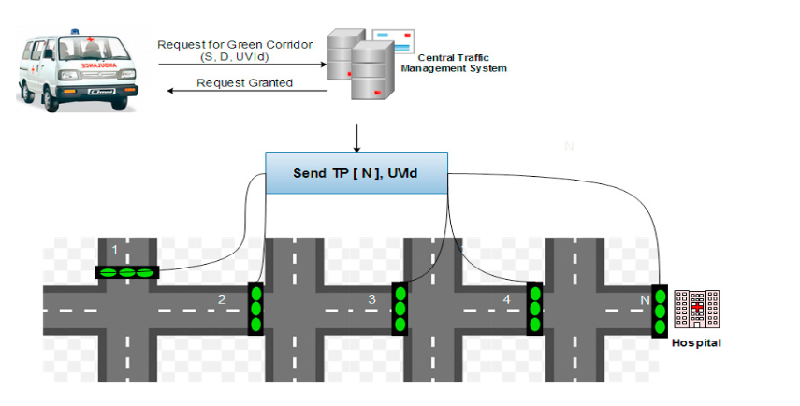
Implementation of Green corridors
The vehicles create congestion on the road, due to which emergency vehicles like ambulances, fire brigade, and police vehicles are unable to reach the destination.
To avoid this problem, a dynamic real-time green corridor is created in a way such that only a part of the route is blocked for the emergency vehicle. Thus, the proposed framework has very less effect on the other vehicles.
If an emergency vehicle is of a very critical nature, one should go for a dedicated green corridor that reduces travel time by 2.76 times. If the emergency is not critical in nature, one can opt for the two-hop dynamic real-time green corridor

Slide 8
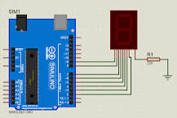
Arduino in Proteus
Arduino is an open-source platform used for building electronics projects. Arduino consists of both a physical programmable circuit board and a piece of software or Integrated Development Environment (IDE) that runs on your computer, used to write and upload computer code to the physical board.
Proteus does not come with an inbuilt Arduino library, so you must install it externally.
Download the Library Files zip Folder from chrome, open it and paste these two files ARDUINO.LIB and ARDUINO.IDX files in the library folder.
Now open Your Proteus and Search Arduino.

Slide 9

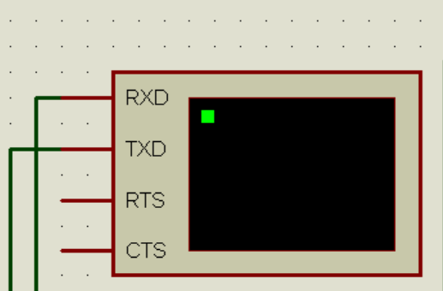
Smart traffic management in Proteus simulator
Logic Toggle :
The logic allows you to toggle a device on and off. Call a function when a button, or toggle, is pressed; or call the function when the button is released.
When the switch operator pushes the toggle, the switches to contact into the position to start or stop an electrical flow.
Serial Monitor :
The most common reason to use serial. begin() is when you want to output some information from your Arduino to your computer screen.
That is, you want to print some text out. The function used to display text on your computer screen from your Arduino board is the serial.

Slide 10
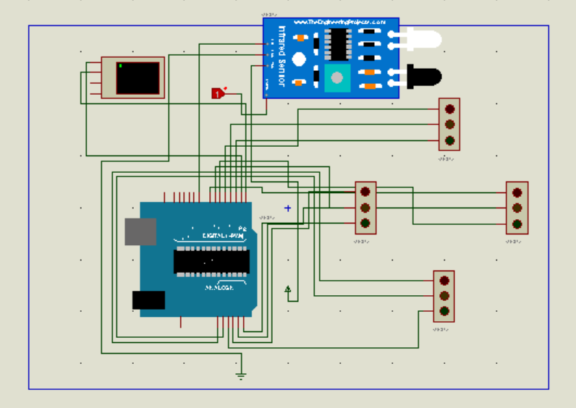
Overall view of Proteus Simulation

Slide 11
Thank you

