Slide 1
IBM University Engagement Project Submission
“Exploring the Power of Agentic AI with IBM Granite and IBM Bob”

Slide 2

Project Tile – Agentic AI for Personalized Course Pathways
Domain of Project – Education / EdTech
Student Name | Recent Passport Photo | Email ID | Mobile number [WhatsApp]
TEJASWINI LV |  | tejaswinilv6@gmail.com (AICTE registered) tejlv36@gmail.com (IBM Skills build registered) | 8073428928

Slide 3
Problem Statement
Problem Statement No.12 - Agentic AI for Personalized Course Pathways.
The Challenge - Students often struggle to identify the right learning path that aligns with their interests and long-term goals due to the overwhelming number of online courses and a lack of personalized guidance. LearnMate aims to solve this by acting as an Agentic AI coach that interacts with students, understands their interests (like Frontend Development, Cybersecurity, UI/UX Design, etc.), assesses their current skill level, and dynamically builds a personalized course roadmap that adapts over time based on progress and preferences.
The Objective - Build an Agentic AI coach that:
Understands student interests (Web Dev, Cybersecurity, UI/UX, etc.)
Assesses current skill level
Builds a personalized course roadmap
Adapts the roadmap as progress changes
Technology - Use of IBM Cloud Lite services / IBM Granite is mandatory.

Slide 4
Proposed Solution
Proposed Solution: LearnMate - AI-Powered Personalized Course Pathway Agent
Conversational Intake - Captures the student's career interest through natural chat, no forms required.
Skill & Time Assessment - Asks targeted questions to gauge current skill level and weekly study availability.
AI-Generated Roadmap - Uses IBM Granite (via watsonx.ai) to build a structured, stage-wise learning plan with time estimates.
Verified Resource Linking - Recommends only trusted domains and safe search links, avoiding broken or fake URLs.
Live Progress Tracking - Sidebar updates in real time as the student completes stages of the roadmap.
Adaptive Re-planning - Regenerates the roadmap when the student's goal, skill level, or time availability changes.

Slide 5
Technology Used
IBM Cloud Lite services - provides the infrastructure for building and running the agent
IBM Granite model - (e.g. granite-4-h-small) – for natural language understanding, conversational reasoning, and roadmap generation
IBM watsonx.ai - for secure model deployment and inference
Python (Flask) - backend framework orchestrating conversation logic and state
HTML/CSS/JS - frontend chat interface with live sidebar (Progress, My Roadmap, Profile)
IBM Bob - AI coding assistant used to build and iterate on the application

Slide 6
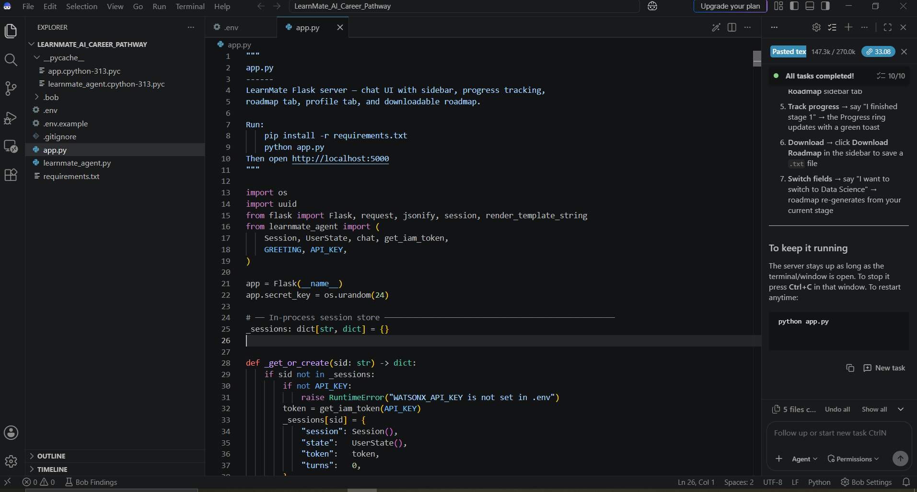
Required Files created using IBM bob

Slide 7
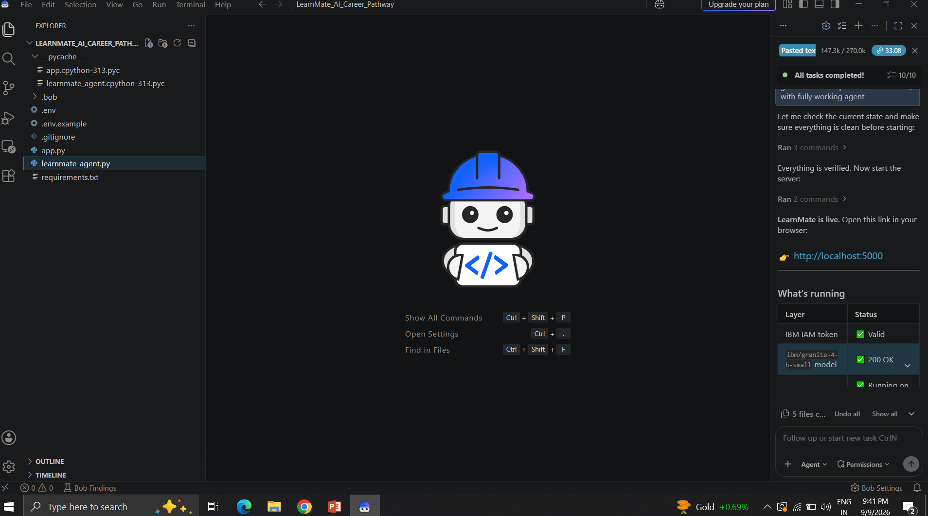
IBM Bob Screenshots:

Slide 8
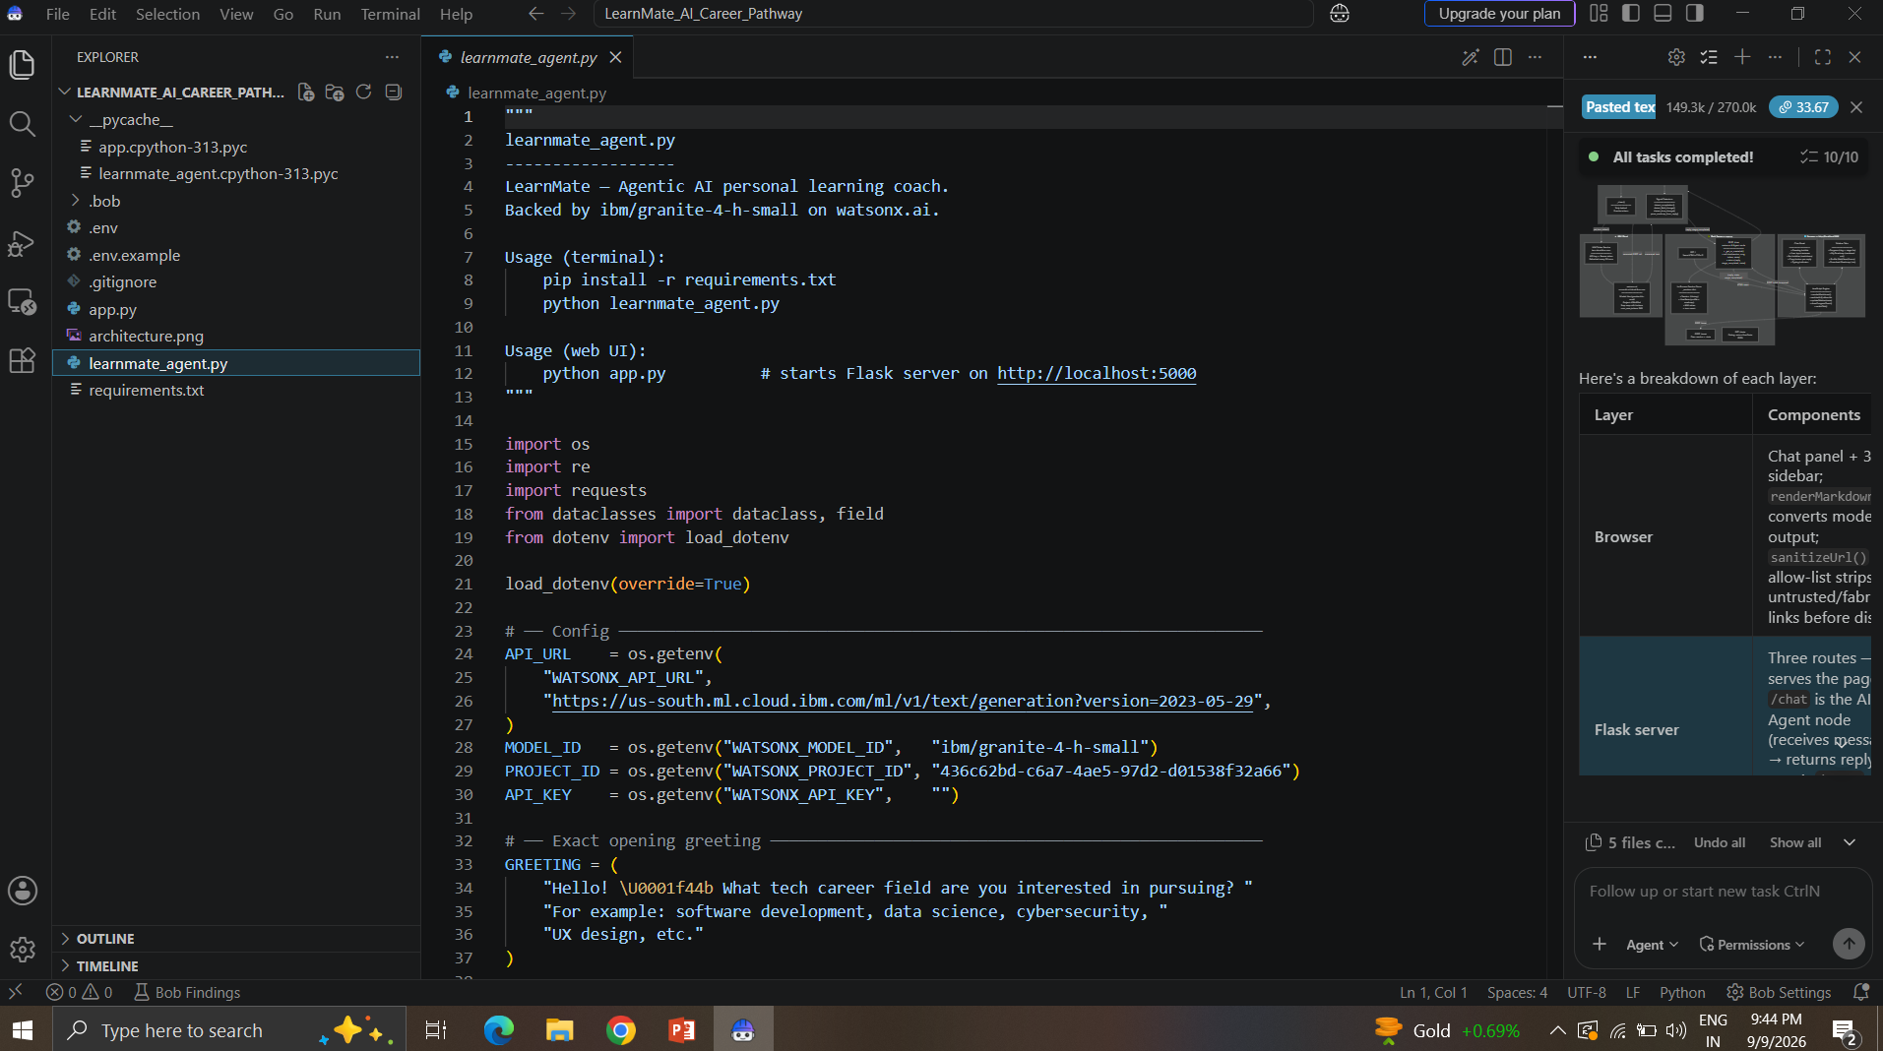
IBM Bob Screenshots:

Slide 9
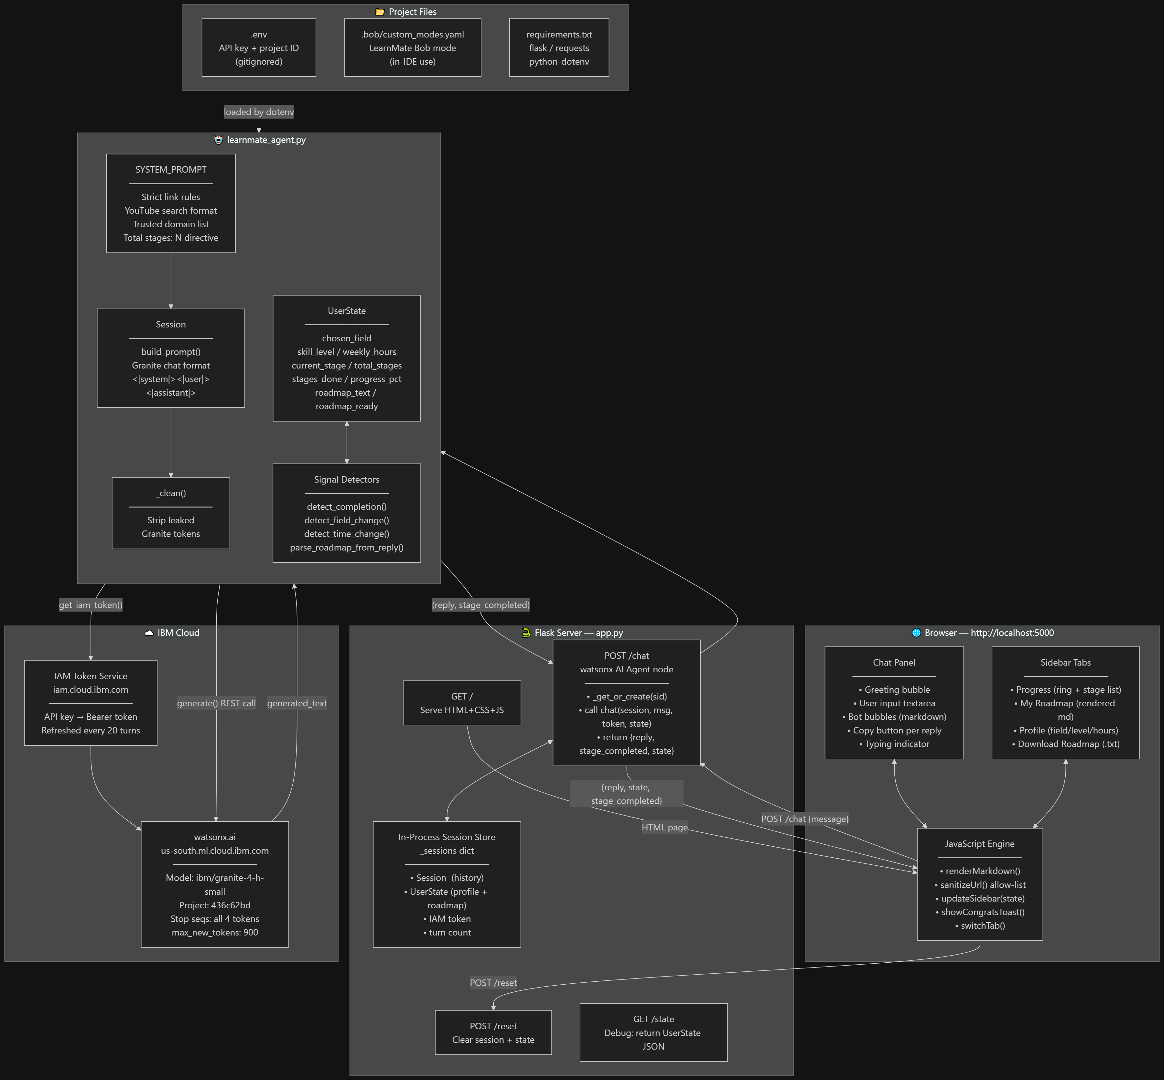
Architecture blueprint for IBM bob:

Slide 10

Role of Agentic AI in the solution
Role of Agentic AI in LearnMate
Agentic AI enables LearnMate to function as an autonomous learning coach rather than a static FAQ bot. Using IBM watsonx.ai and IBM Granite models, it interprets open-ended student input, infers intent (interest, skill level, availability) without rigid forms, and generates a tailored, structured roadmap in response.
The agent maintains context across the conversation - remembering the student's stated goals and progress - enabling real-time adaptation: if a student reports completing a stage or changing their target field, LearnMate updates its recommendations accordingly instead of restarting.
This context-awareness, autonomous reasoning, and adaptive behavior make LearnMate proactive and goal-driven - acting like a personal mentor rather than a static course catalog.

Slide 11
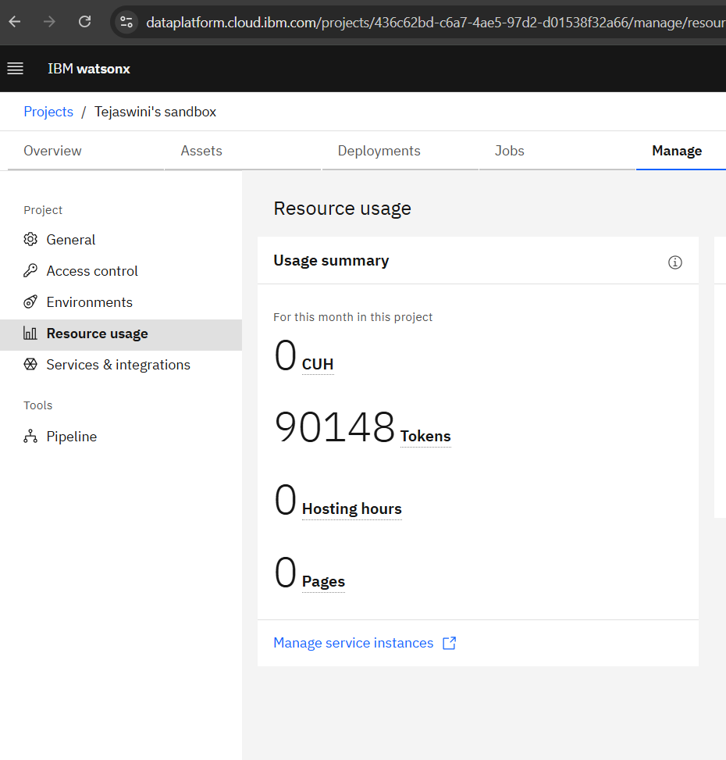
Token Usage
"Total tokens consumed during development and testing: 90,148"

Slide 12
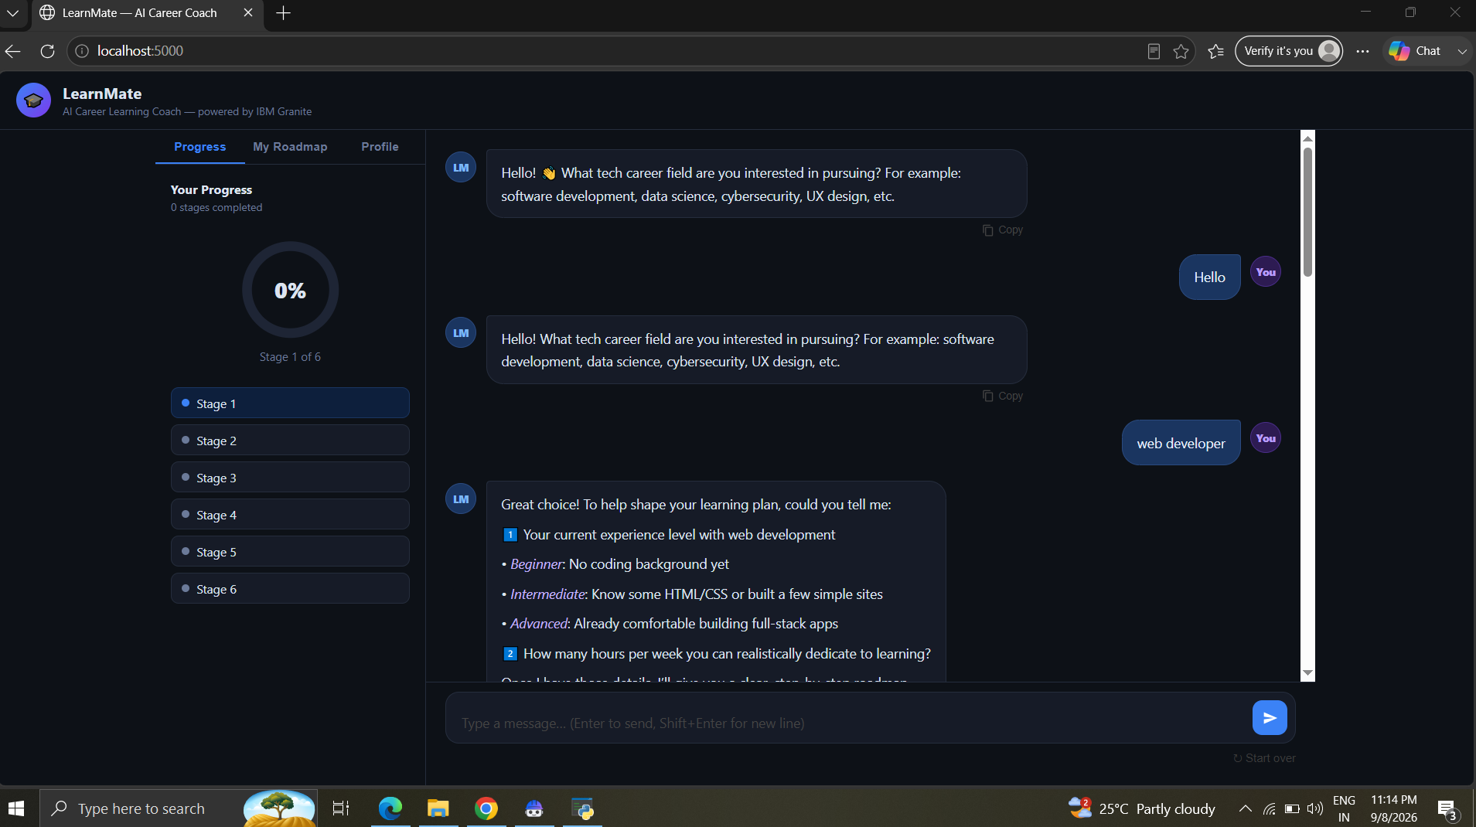
Project Output Screenshot
Please put IBM Bob output screenshots with 2-3 prompts.
You can take 2-3 more slides for each screenshot
·
·
·

Slide 13
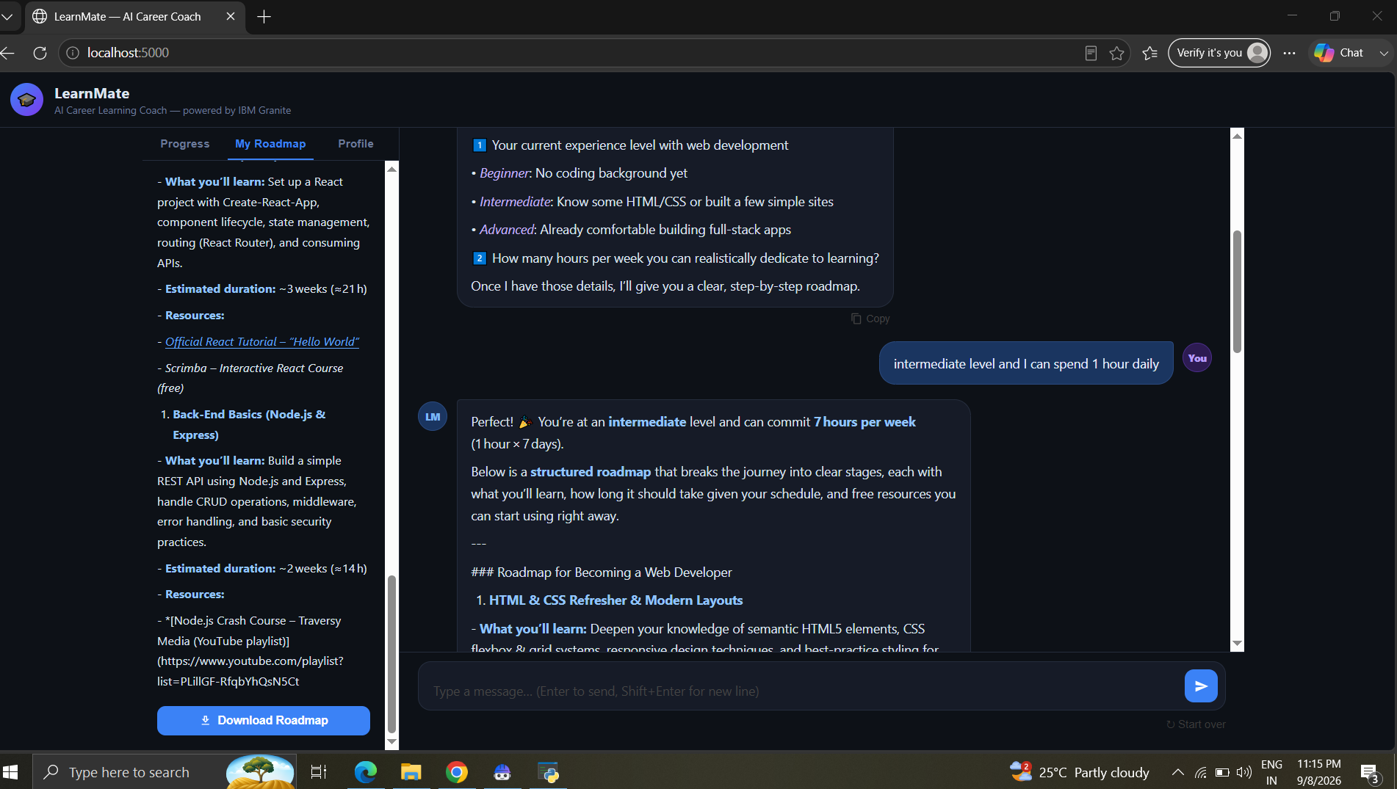
Project Output Screenshot
Please put IBM Bob output screenshots with 2-3 prompts.
You can take 2-3 more slides for each screenshot
·
·
·

Slide 14
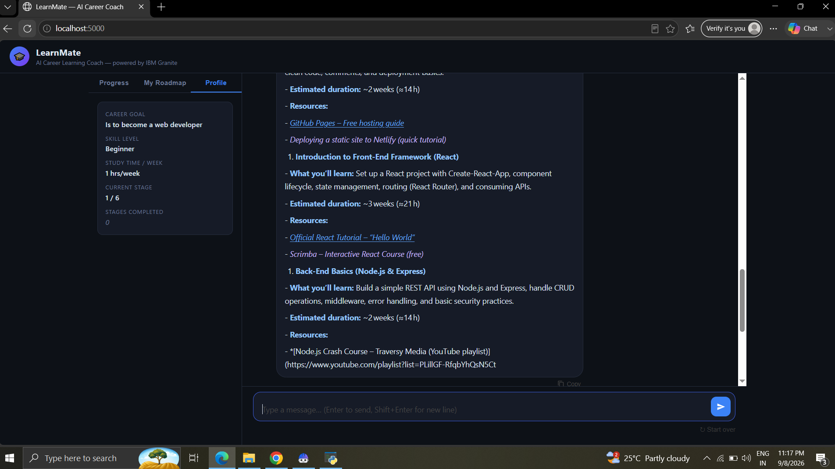
Project Output Screenshot

Slide 15
Novelty and Uniqueness
LearnMate stands out by combining Agentic AI, conversational skill assessment, and adaptive planning into a single system:
Conversational Skill Assessment - No forms; skill level and goals are captured through natural dialogue.
Adaptive Roadmap Regeneration - Updates the plan live when goals, skill level, or time availability change, instead of creating duplicate plans.
Verified Resource Linking - Avoids broken/hallucinated links by restricting recommendations to trusted domains and safe search-query URLs.
Live Progress Reflection - Sidebar (Progress, My Roadmap, Profile) updates in real time from the conversation itself.
Downloadable, Portable Roadmap - Students can export their plan instead of it being locked inside a chat window.
Built on IBM watsonx.ai + Granite, ensuring reliable, governed model access.
This makes LearnMate a genuinely adaptive digital mentor, not a static course-recommendation list.

Slide 16
Git Hub Link
Public GitHub Repository:
https://github.com/tejaswinilv/LearnMate_AI_Career_Pathway.git
Repository includes: source code (app.py, learnmate_agent.py), requirements.txt, .env.example, README.md with setup instructions and screenshots, and this project presentation.

Slide 17
Future Scope
Integration with Learning Platforms -
Connect LearnMate directly to platforms like Coursera, freeCodeCamp, or YouTube APIs to pull live, verified course/video links automatically instead of static recommendations.
Persistent User Accounts & Long-Term Tracking -
Add login/authentication so students can return over weeks or months, with progress saved across sessions rather than reset each time.

Slide 18
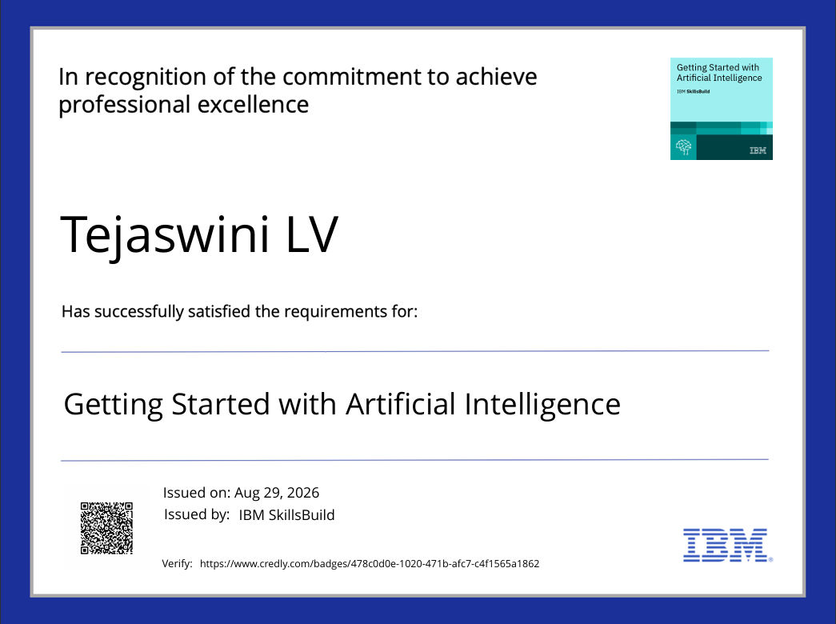
Certificates Earned:
Credly certificates

Slide 19
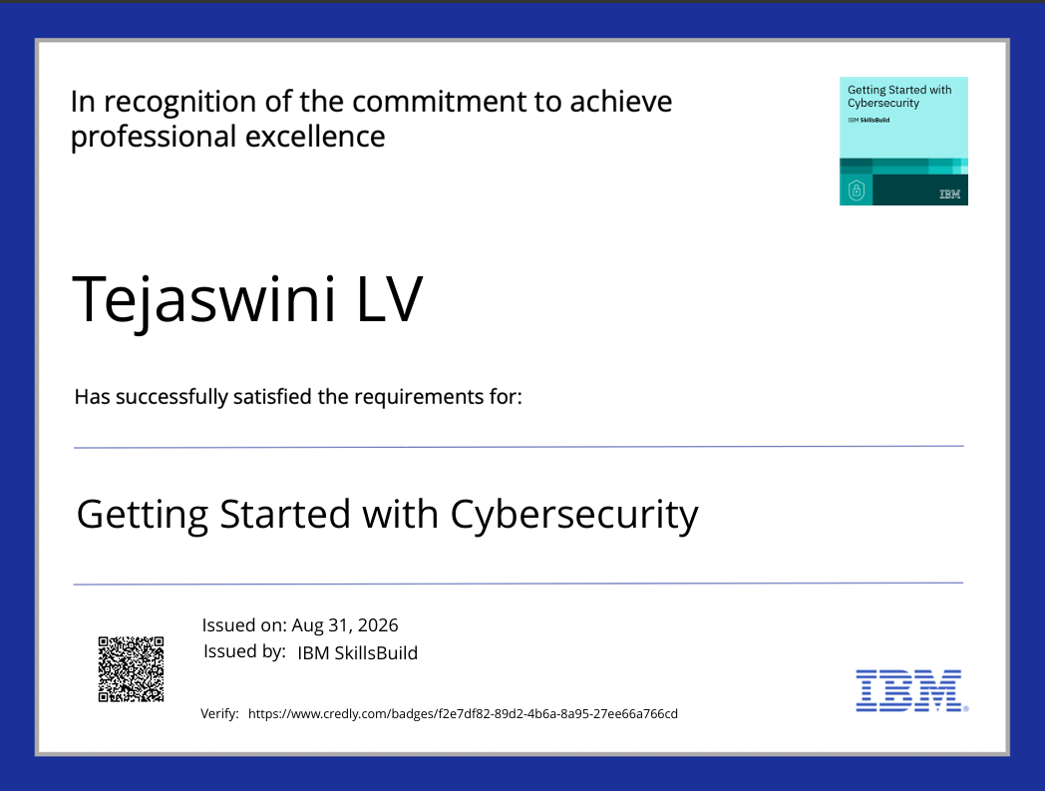
Certificates Earned:
Credly certificates

Slide 20
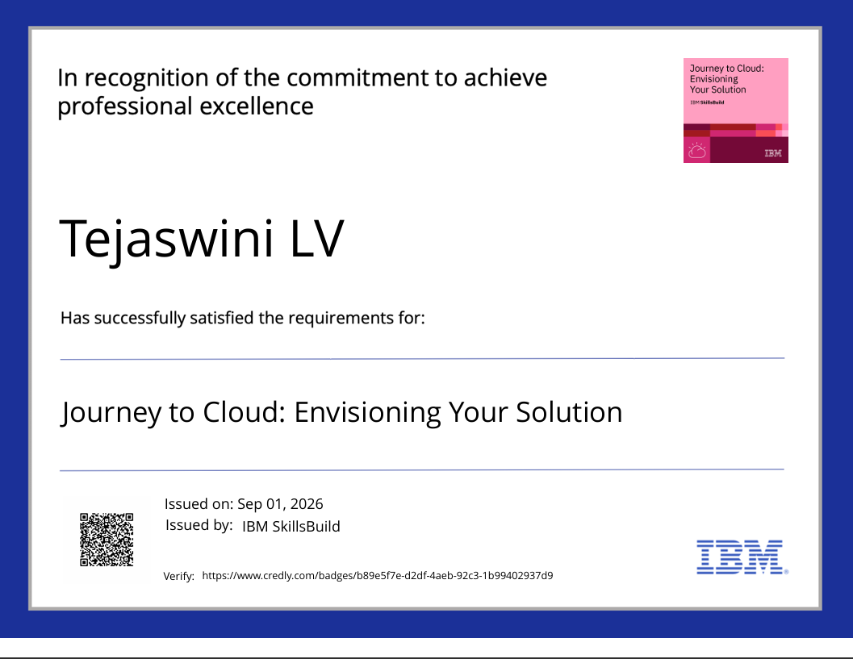
Certificates Earned:
Credly certificates

Slide 21
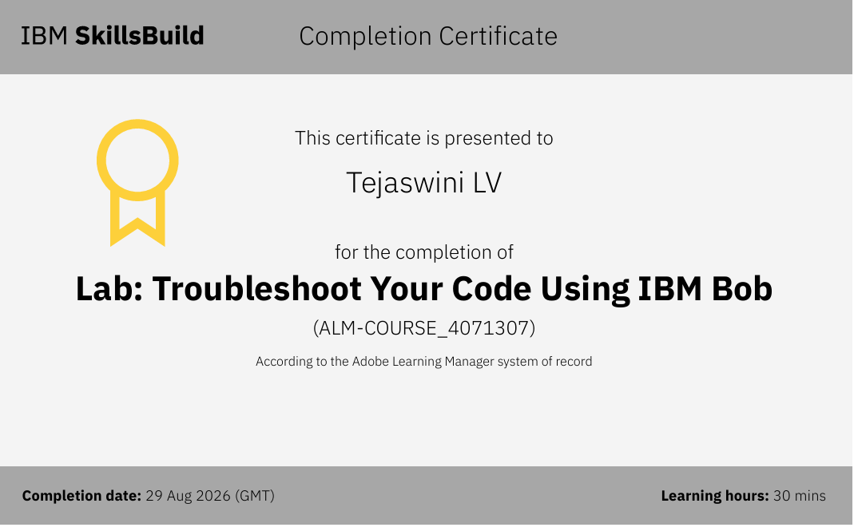
Certificates Earned:​
IBM BOB Certificate

Slide 22


