Slide 1
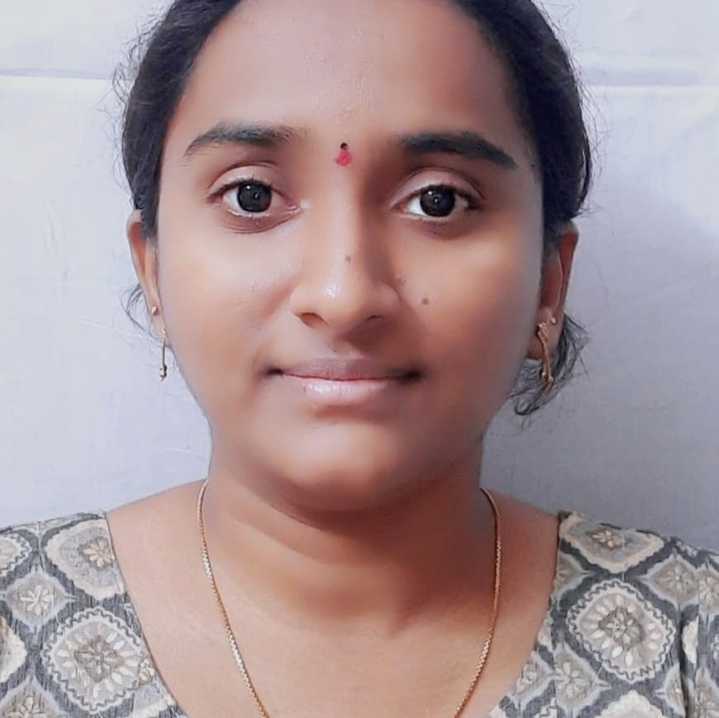


Tejaswini Mukkapati
Analyst/Software Engineer
Bachelor of Technology
Computer Science : 2017 - 2021
Skills Java 8 /J2EE
Spring Boot
Spring MVC
JPA Crud
Bootstrap
Backend
Spring Boot/Spring Security
REST-API
NodeJS
Database
SQL
Postgress
MongoDb(MongoDB Compass)
Web Technologies
HTML5
CSS3
Javascript
AddOns
Github
Maven
Postman
Additional Details
Leadership
Quick Learner
Team management
Hyderabad
tejaswini.mukkapati@capgemini.com
+91 7997698148
A4
Hands on experience in creating web application with Spring Boot, Spring Security, Data JPA.
Hands on experience in creating traditional and reactive application with Visual Basic.
Ready to learn new technologies and implement them to further improve my knowledge.
Eager to work in a team of dedicated people and serve a key role in the enhancement and development of the project.
Has working knowledge on Angular and Java Development using Spring framework on an intermediate level.
Ready to learn DevOps and Cloud Technologies.
https://github.com/tejaswinimukkapati/OnepageResume.git
Training Project : Online Plant Nursery Application
Completed end to end case study of Online Plant Nursery Application using Spring boot and React used for user interface. It is a double-role application project i.e. Admin and User, where Admin will have the main control over the system. Admin will be responsible for maintaining the system and also, keeping a check on the availability of plants, and updating any details related to the Nursery Store. On the other hand, Users can register themselves and can do online shopping.
Certified AWS Cloud Practitioner

