Slide 1


Slide 2

Basic Questions
Why do we need Finance ?
Accountability
Transparency
Sustainability

Slide 3
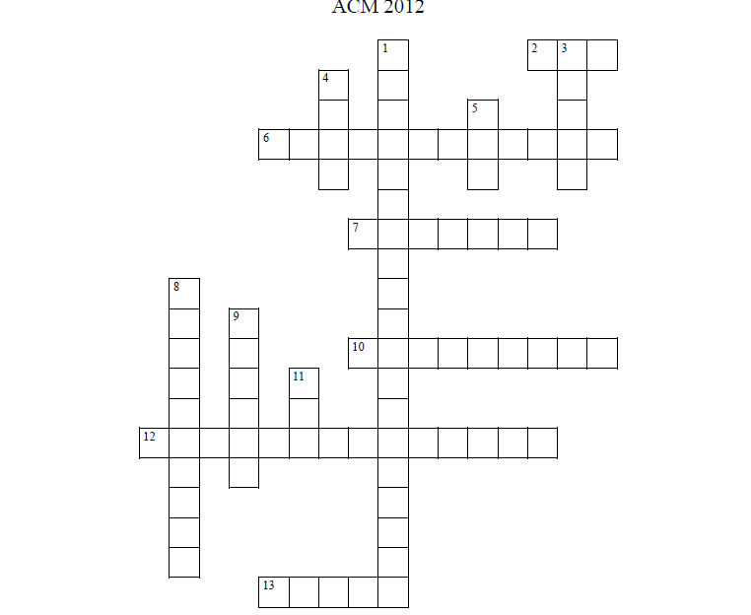
Finance Crossword

Slide 4
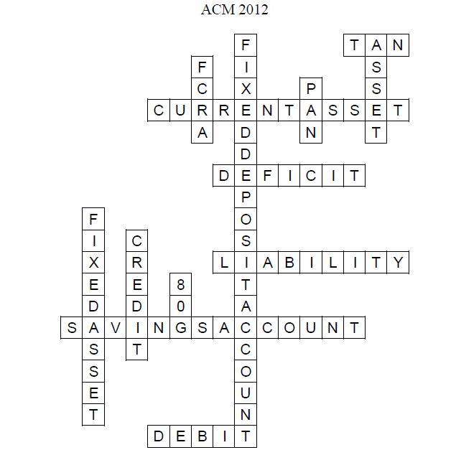
Solution

Slide 5

Terms
Credit, Debit, Deficit
80G,FCRA,TAN,PAN
Assets and Liabilities
Fixed Assets and Current Assets
Current A/c and Savings A/c
IFSC code, MICR code
Financial Year

Slide 6
Terms | Significance
12A | Gives organization Tax Exemption.
80G | Income Tax Act 1961, offers a tax deduction for donations. 50% of the donations provided tax exempted
PAN | Permanent Account Number, required to file IT returns.
TAN | Tax Authorization Number, required to file TDS returns
FCRA | Foreign Exchange Regulation Act, permission for an organization to use foreign funds
IFSC | Indian financial system code
MICR | Magnetic Ink Recognition code, used for cheques

Slide 7
Comparison from 2008-2011

Slide 8
Central Finance Director
Chapter Finance Head
Assistant Finance Head
Project Finance Representatives
Accountant
Assistant Finance Head
Chapter Finance Head
Project Finance Representatives

Slide 9
Functions of Chapter Finance
Seek and Review the Budget Proposals.
Conduct a Bill clearance session at least once in every month.
Sending Monthly receipts and updates to the donors
Prepare and Share Monthly expense sheets, Monthly revenues sheets and income expense statements to Cencom.
Quarterly Auditing

Slide 10
Forms being used
Chapter Internal Auditing
Bill Clearance Form | A form to share the details of the bills before clearing them the Finance head
Cash Advance Form | A certain amount can be taken in advance for a project by signing this form
No Bill form | This can be used in scenarios where there is no bill given the merchant/shopkeeper
Monthly Expense Sheet | A data base of all expenses in a particular month along with project details it is spent for and the bill details
Monthly Revenues Sheet | A database of all revenues obtained in a month along with the source of revenues and the projects they are intended to
Income Statement | A detailed cash flow analysis from the opening balance to the closing balance
Donor Receipts | A receipt

Slide 11
Nirmaan Central Auditing
Debit Vouchers | Details of the bills have to written and corresponding bills have to be attached
Donor Receipts | The Donation receipts given to the donors
Balance Sheet for the Financial Year | Assets and Liabilities of the Organization
Income and Expenditure for the Financial Year | Expenses and Revenues of the Organization

Slide 12

Current Problems
Loss of Bills
Delay in Providing Statements
Unnecessary Expenses
Lack of information sharing
No proper knowledge transfer between finance heads
Ignorance
Donor related information

Slide 13
Changes to be Implemented
The monthly statements have to be reviewed by the Chapter Excom in every excom meet and the project financial details have to be discussed.
Release of Quarterly statements to the whole chapter.
Maintaining a donor database at chapter level

Slide 14
Challenges
Donor Management.
Database of Fixed Assets in all Chapters.
Impact measurement with Finance.

