Slide 1
Analysis of causes of death in children under 5 Using supervised learning to find the key factors and trends
GOLD GROUP:
NIDHI TRIVEDI, TEJASWI NEELAPU,
TILESHWAR NARAYAN​

Slide 2
Introduction:
Relationship between GDP and child mortality under 5 years old.
Economic development and health outcomes.
Classify the causes of death and evaluate their performance.
Predict number of deaths in 2019 using regression models.

Slide 3
Questions:​
How does GDP correlate with the causes of death in children under 5 across different countries?
Can GDP predict the occurrence of specific causes of death in children?
What is the relationship between economic development (measured by GDP) and child mortality rates from different causes?
Can the model predict the death rate for the following year based on past years child mortality rate?

Slide 4
Data Collection and Preparation:
Causes of death in children under 5 from 1990 to 2019 was obtained from "Our World in Data", which was named as "Diarrheal Diseases".
GDP since 1960 to 2022 was obtained from "Our World in Data".
Combined the 1990-2019 causes of death data with the GDP data for each country for that particular year.
Few countries are grouped together, these were excluded. Example: 'World bank high income", "England".
Handled the missing values by replacing them with the mean.
Creating a new column using quartiles of GDP.
Ensure consistency and readability in diseases/causes names.

Slide 5
Exploratory Data Analysis:
Top 10 countries with highest deaths.
Top 10 causes/diseases of death in children under 5 years.
The distribution of diseases by GDP class.
Analyzing the mean number of deaths across different GDP classes.
Trends over the years for top 10 diseases/causes.
Specifically looking at Encephalopathy, Malaria, other Neonatal, Sepsis.
Relationship between GDP and deaths for top 10 causes.

Slide 6
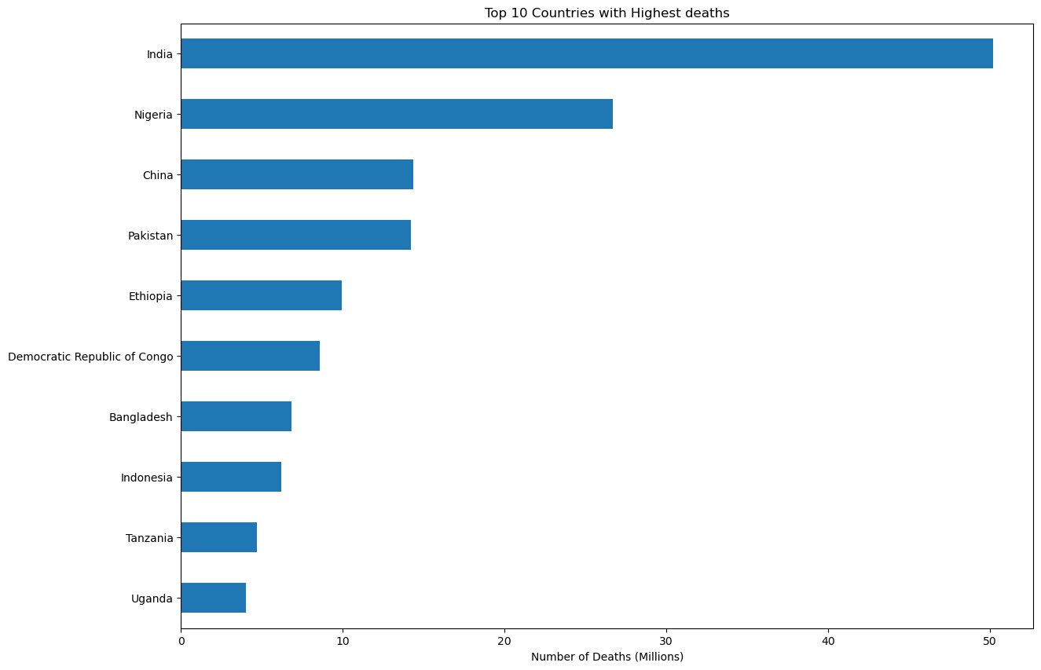

Slide 7
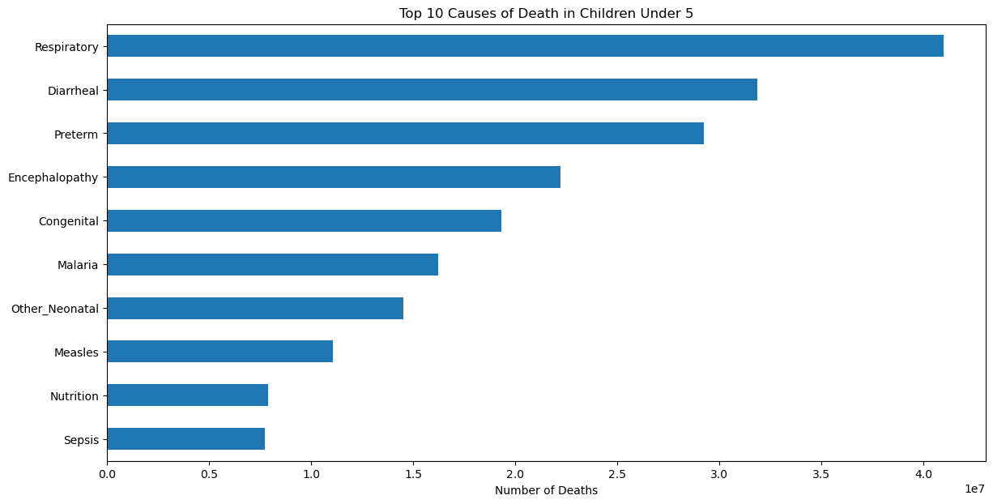

Slide 8
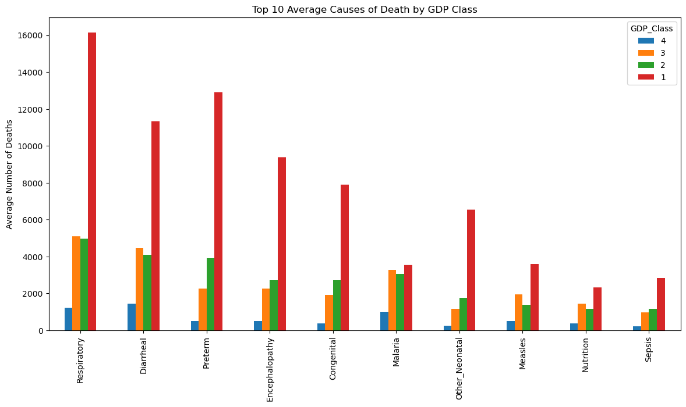

Slide 9
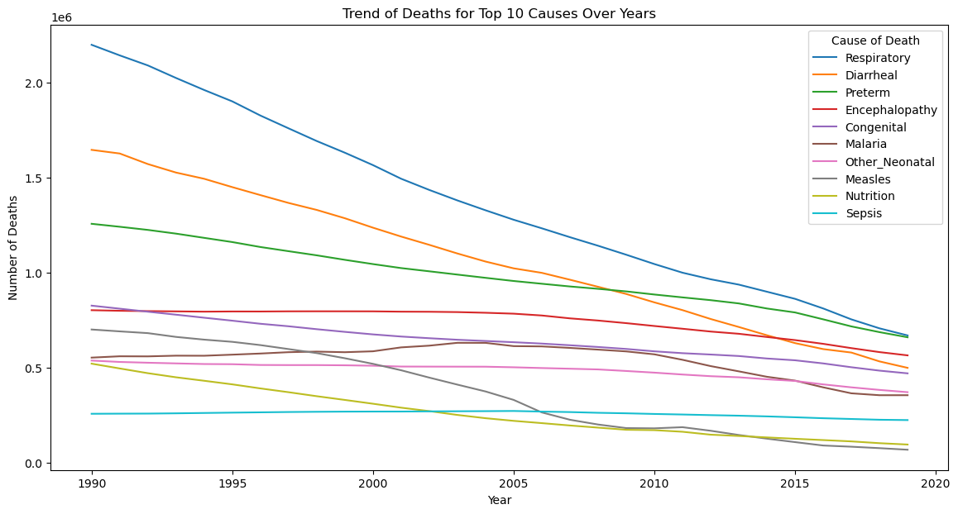

Slide 10
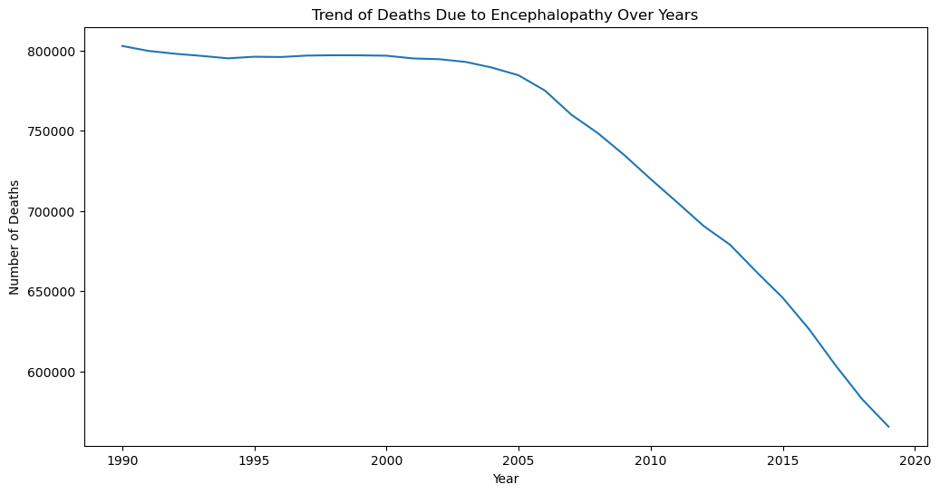
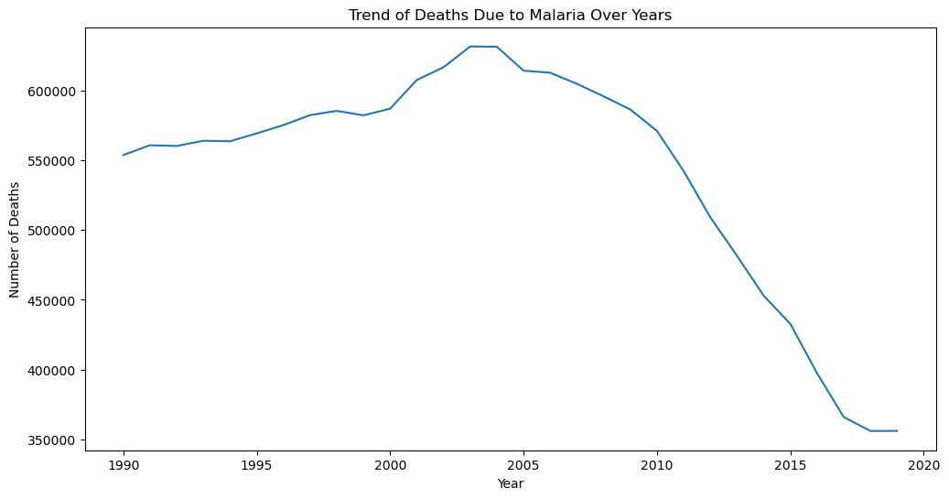
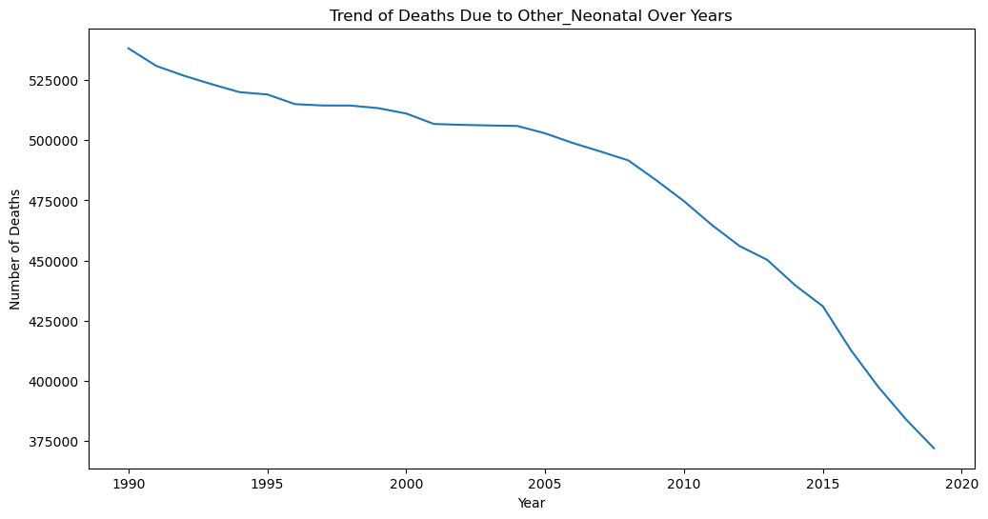
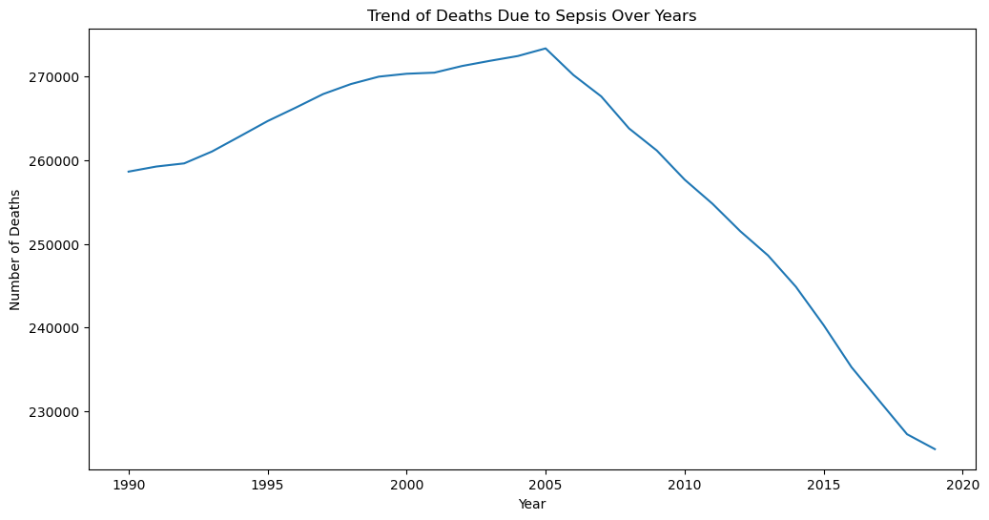

Slide 11
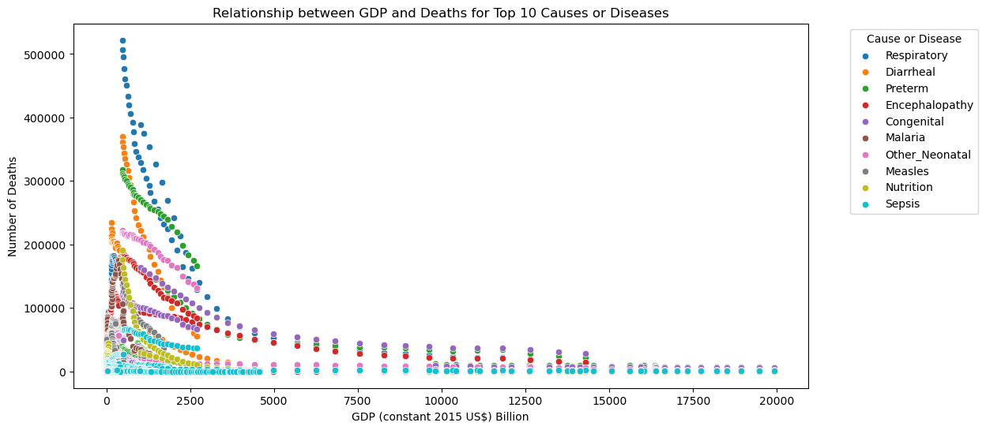

Slide 12
Theoretical Background:
GDP: Economic performance measure, total value of goods/services.
Child Mortality: Deaths under age 5, indicator of health and development.
Economic growth improves health outcomes.
Key for policy-making to reduce child mortality.
Causes of Death Data: 1990-2019, various causes of child mortality.
GDP Data: 1990-2019, economic changes over time.
Classification Methods: Categorize causes of death, assess GDP impact.
Regression Methods: Predict 2019 deaths, compare with actual data.

Slide 13
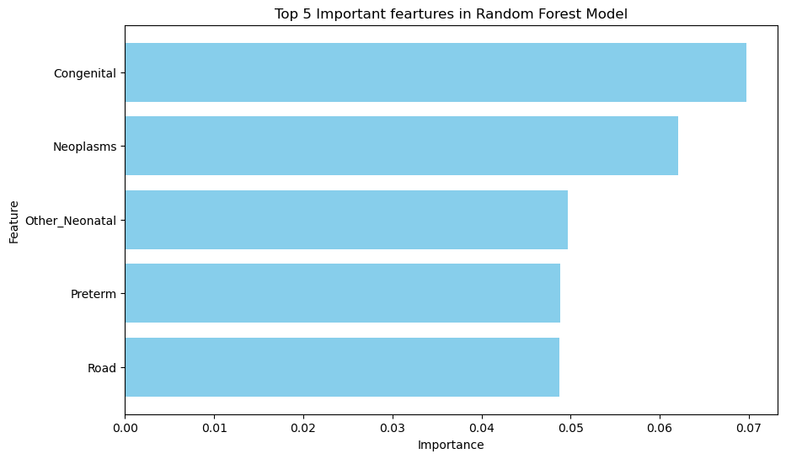
Model Selection and Application:
Random Forest Classifier: Grid search cv to find best parameters; model performance with accuracy; confusion matrix; decision tree and feature importance.
Accuracy: 96.6%
Important Variables: Congenital diseases, Neoplasms, Other Neonatal.

Slide 14
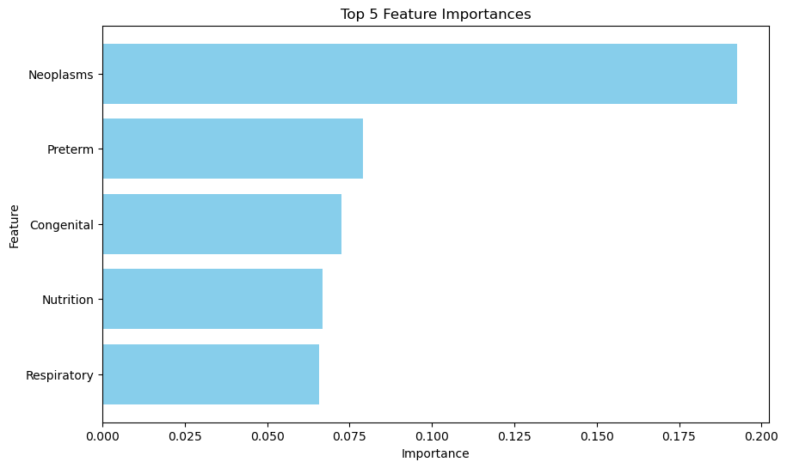
Model Selection and Application:
Bagging: Grid search cv to find best parameters; model performance with accuracy; confusion matrix; decision tree and feature importance.
Accuracy: 95.8%
Important Variables: Neoplasms, Preterm, Congenital.

Slide 15
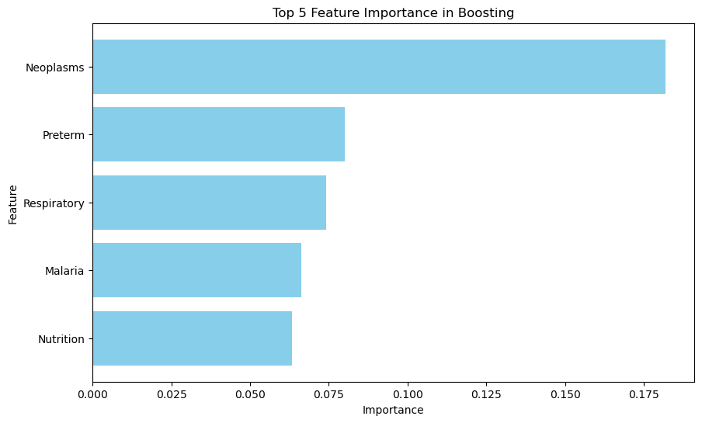
Model Selection and Application:
Boosting: Grid search cv to find best parameters; model performance with accuracy; confusion matrix; decision tree and feature importance.
Accuracy: 96.3%
Important Variables: Neoplasms, Preterm, Respiratory.

Slide 16
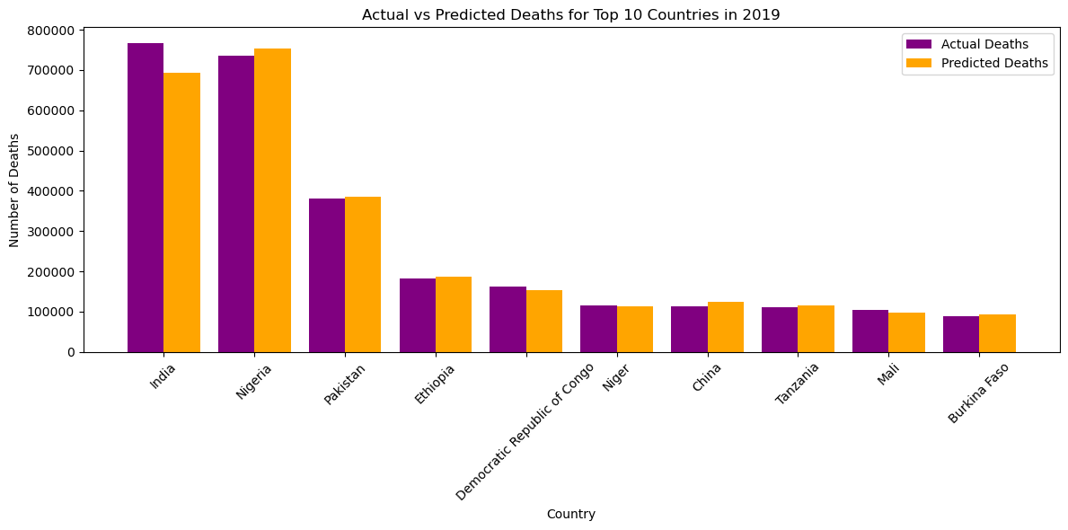
Model Selection and Application:
Random Forest Regressor: Grid search cv to find best parameters; model performance with mean squared error, mean absolute error, R-squared.
MSE = 525904.2801
MAE = 138.2279
R-squared = 0.9432

Slide 17
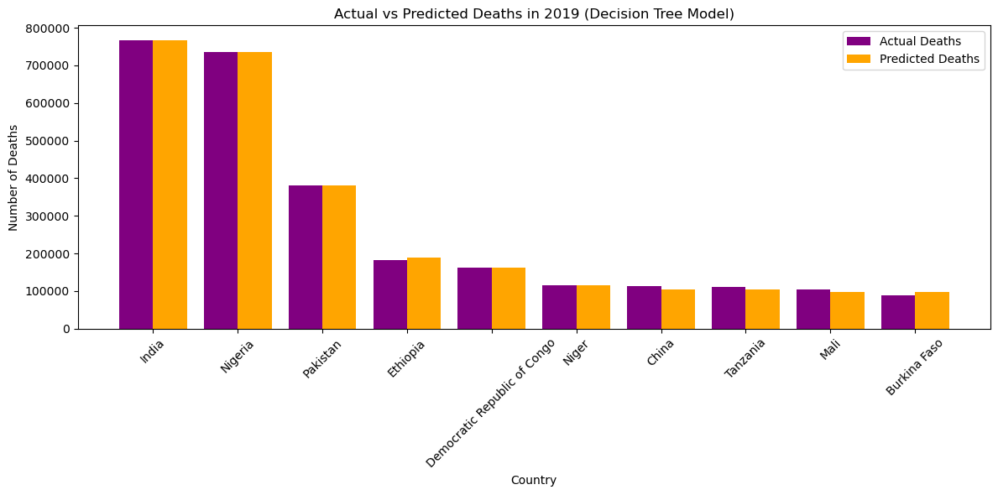
Model Selection and Application:
Decision Tree Regressor: Grid search cv to find best parameters; model performance with mean squared error, mean absolute error, R-squared.
MSE = 1668201.5326
MAE = 191.1044
R-squared = 0.8928

Slide 18
Conclusions:
The analysis showed a significant relationship between GDP and child deaths under 5 years old. Higher GDP levels are corresponding to lower death rates.
Among classification models, Random Forest Classifier was found to be the best with higher accuracy.
Among regression models, Random Forest Regressor was found to be the best with higher R-squared.
The improving economic conditions (GDP growth) can significantly reduce child death rates. Policymakers should focus on economic policies that can allocate resources towards improving healthcare facilities and services for children.
For future work, more features like healthcare system, education can be included to make more informed decisions.

Slide 19
References:
Diarrheal Diseases by Saloni Dattani, Fiona Spooner, Hannah Ritchie and Max Roser. https://ourworldindata.org/diarrheal-diseases
Gross Domestic Product (GDP). Our World in Data. https://ourworldindata.org/grapher/national-gdp-constant-usd-wb?tab=table

Slide 20
Thank you!

