Slide 1


CSA0927 – Programming in Java
SIMATS ENGINEERING
SAVEETHA INSTITUTE OF MEDICAL AND TECHNICAL SCIENCES
Capstone project presentation
Design and Development of a Web-Based Internship and Placement Management System Using Java
Presented by:
N.Tejaswitha(192371057)
N.Vijetha(192311258)
B.Neha(192425033)
V.S.Meenakshy(192325133)
Guided By Dr.S.Pushpa Latha
CSA0927

Slide 2
ABSTRACT
Developed a Web-based Internship and Placement Management System using Java to streamline the recruitment process.
Provides separate modules for Students, Companies, and Admins to manage internship and placement processes.
Students can apply for opportunities, upload resumes, and track application status.
Companies can post opportunities, review applications, and update candidate status.
Admins can monitor users, internships, placements, and applications through a dashboard.
Built using Java, JSP, Servlets, JDBC, HTML, CSS, and MySQL following the MVC architecture.

Slide 3
INTRODUCTION
Internship and placement management is an important process for connecting students with career opportunities.
Traditional methods involve manual work and difficulties in managing recruitment information.
This project provides a structured platform to manage student, company, placement activities & Internship activities.
The system improves efficiency, reduces paperwork, and simplifies the recruitment process.
The portal enables better communication and transparency between students, companies, and admins.

Slide 4
PROBLEM STATEMENT
Traditional internship and placement processes involve manual work and difficulty in managing recruitment data.
Students face challenges in finding opportunities and tracking applications.
Companies and admins lack an efficient platform to manage recruitment activities.
A centralized system is needed to automate and simplify internship and placement management.
The absence of a unified platform leads to poor coordination and communication between students and recruiters.
Lack of real-time updates and centralized records reduces transparency.
CSA0927

Slide 5
OBJECTIVES
To develop a centralized web-based platform for managing internship and placement activities.
To provide separate modules for students, companies, and admins.
01
02
To enable students to find opportunities, apply online, upload resumes, and track application status.
To allow companies to post opportunities and manage student applications efficiently.
03
04
To provide admins with tools to monitor and manage overall portal activities.
To reduce manual work and improve the efficiency and transparency of the recruitment process.
05
06

Slide 6
METHODOLOGY
01
Requirement Analysis – Identify the needs of students, companies, and admin for internship and placement management.
02
System Design – Design the system architecture, database structure, and user modules.
Development – Implement the portal using Java, JSP, Servlets, JDBC, HTML, CSS, and MySQL.
03
Testing – Test all modules including registration, login, resume upload, applications, and status updates.
04
Deployment & Evaluation – Deploy the web application and verify its performance.
05
CSA0927

Slide 7
LITERATURE SURVEY
Author(s) | Year | Parameter | Existing System | Proposed System
R. Sharma et al. | 2022 | Placement Management | Manual placement Process. | Web-based placement portal
P. Kumar & S. Verma | 2021 | Internship Management | Limited internship portal | Integrated internship management
A. Singh et al. | 2023 | Application Tracking | No real - time tracking | Real-time application status tracking
M. Patel & R. Shah | 2020 | User Management | Independent user management | Centralized role-based user management
Proposed Work | 2026 | Complete Management | Fragmented manual process | Web-based Internship & Placement Management System
Table - 01 : Comparison of Existing and Proposed System
CSA0927

Slide 8
PROPOSED METHOD
Develop a Web-Based Internship and Placement Management Portal Using Java to automate recruitment activities.
Provide separate modules for Students, Companies, and Admin with secure access.
Enable students to register, upload resumes, apply for opportunities, and track application status.
Allow companies to post internships and placements, view applications, and update candidate status.
Provide admin with a centralized dashboard to monitor users, opportunities, and applications.
Use Java, JSP, Servlets, JDBC, HTML, CSS, and MySQL for system development.
CSA0927

Slide 9
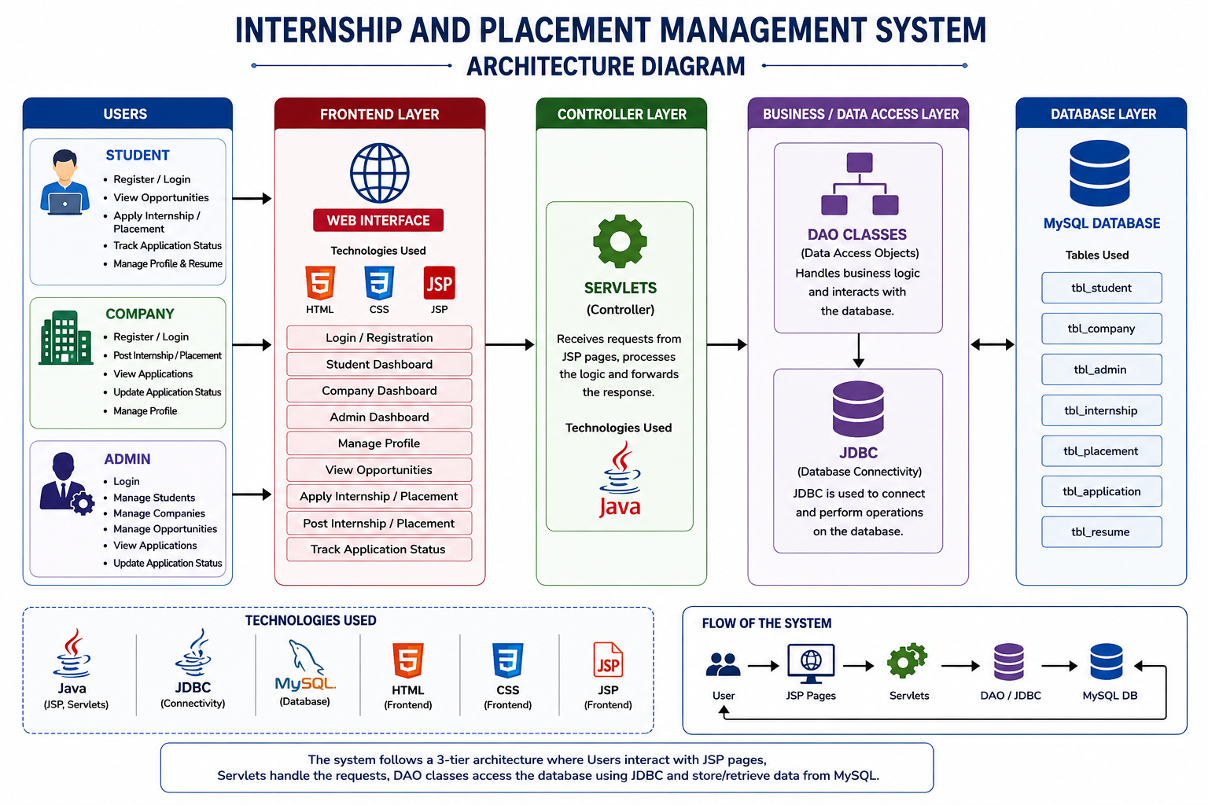
ARCHITECTURE DIAGRAM
FIG - 01 : System Architecture of Internhip and Placement Management Sytem
CSA0927

Slide 10
Module 01: Student Management Module
01
02
Provides student registration and secure login functionality.
Manages student profile details such as name, email, phone, department, and year.
03
04
Allows students to update profile information and upload resumes.
Enables students to view available internship and placement opportunities.
05
06
Allows students to apply for internships and placement drives.
Provides application tracking to check the current status (Applied, Shortlisted, Accepted, Rejected).
CSA0927

Slide 11
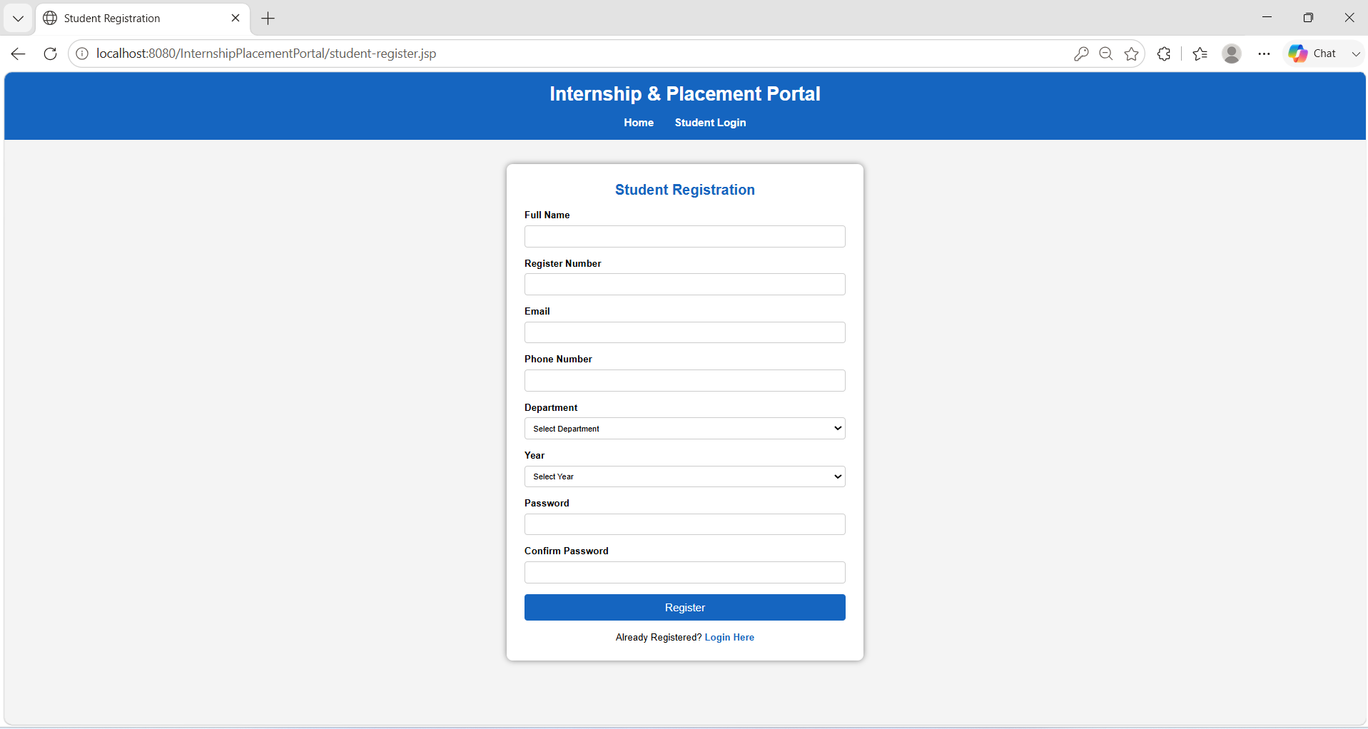
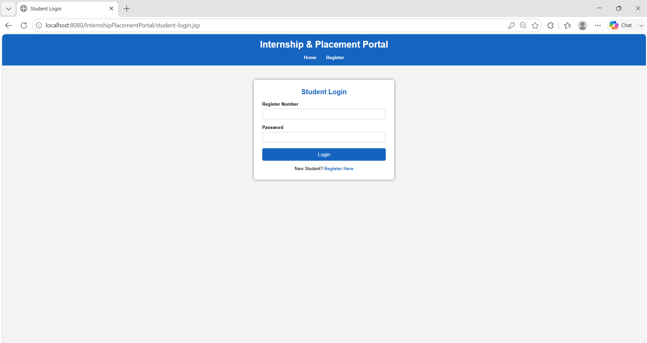
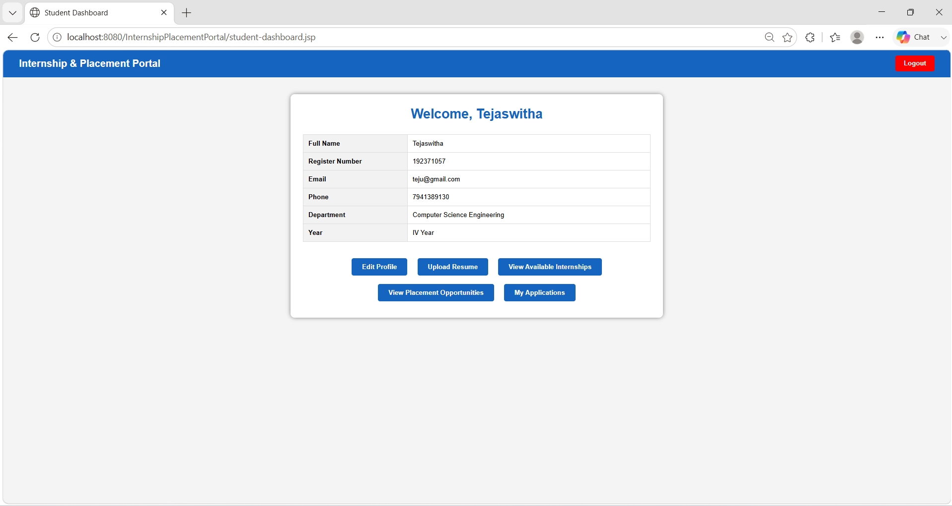
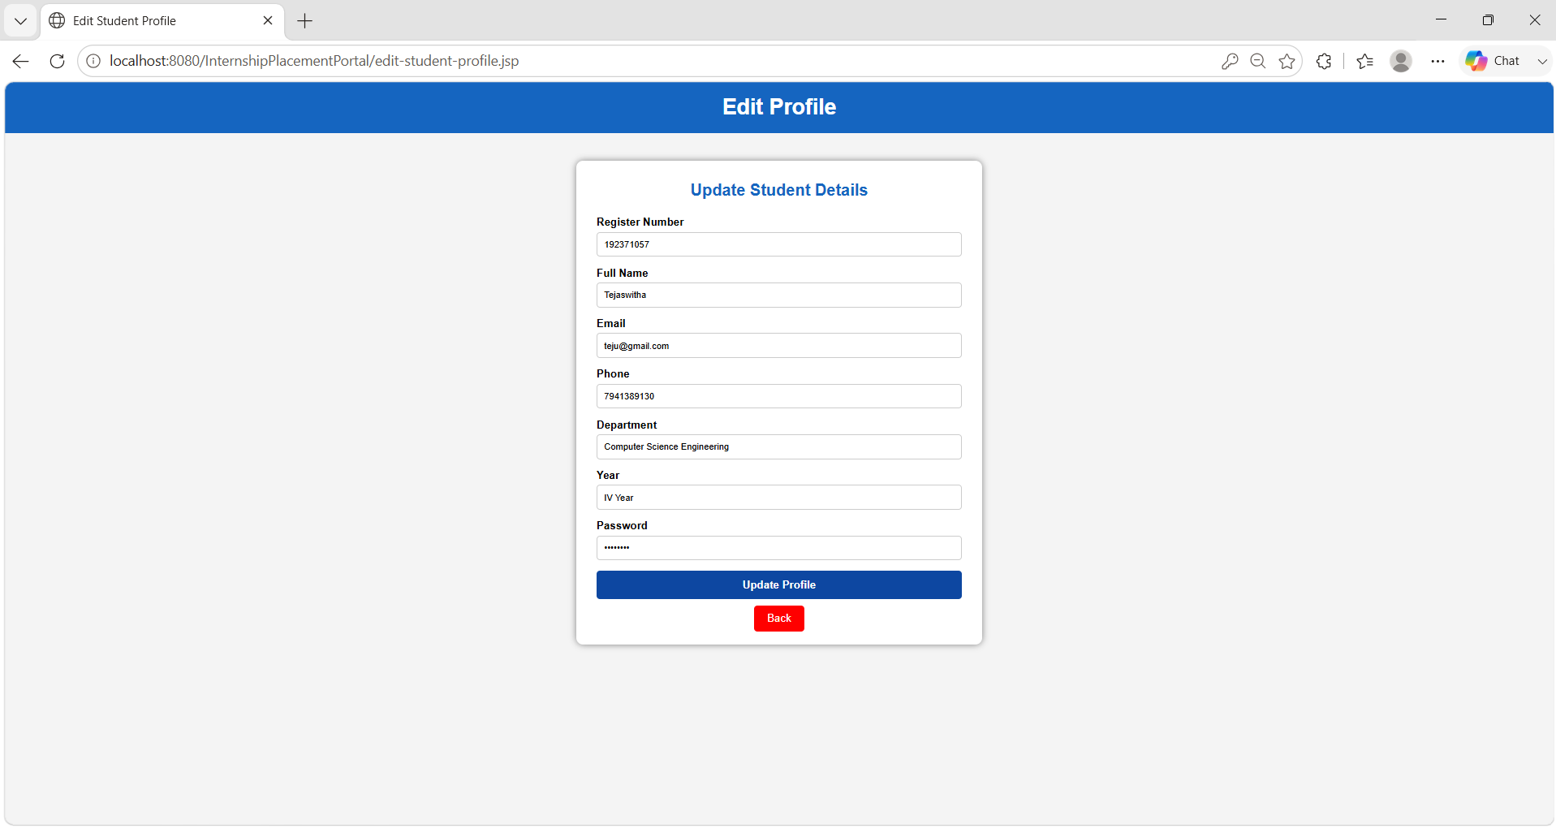
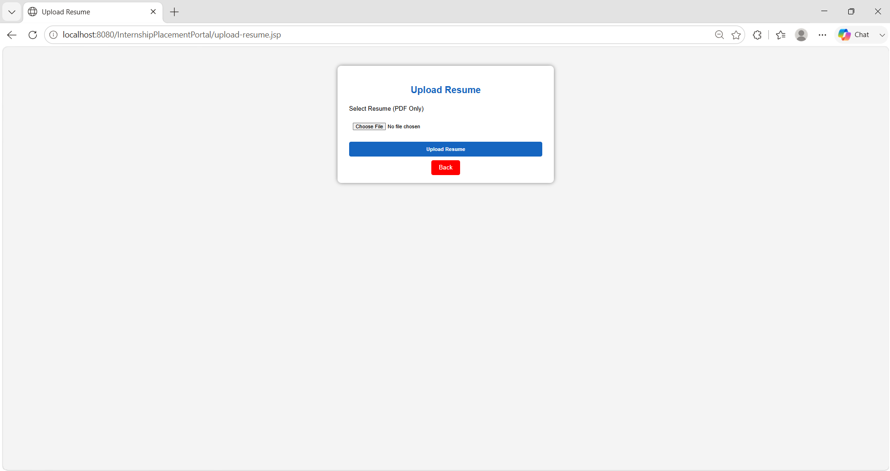
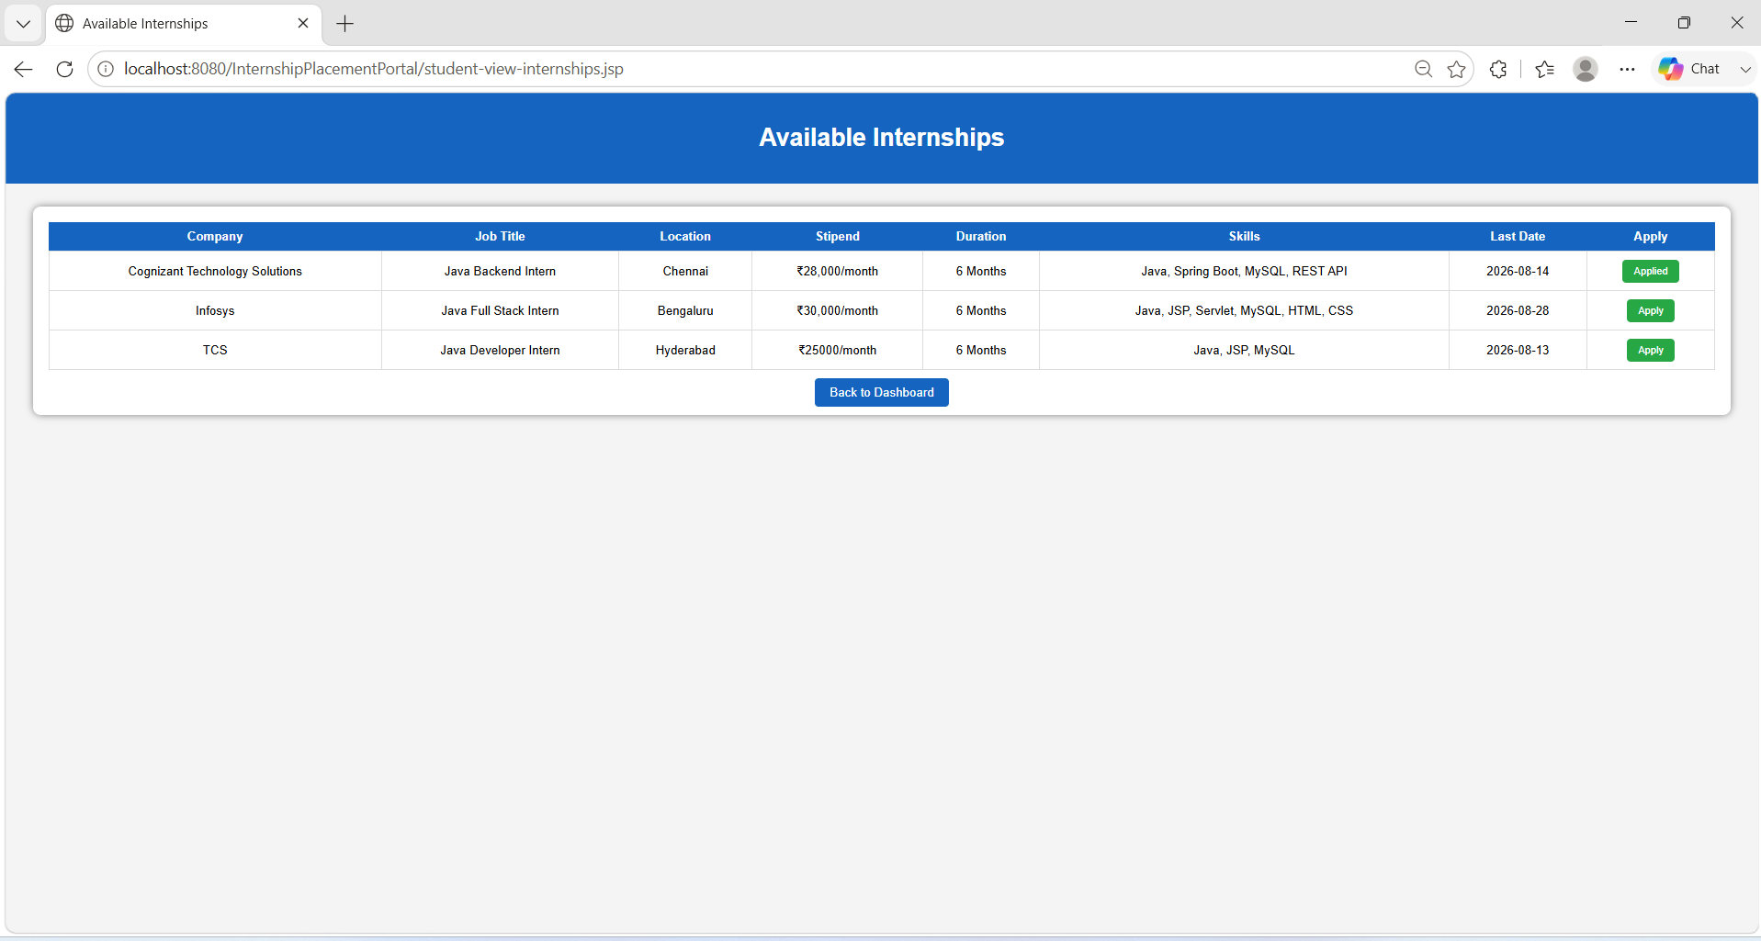
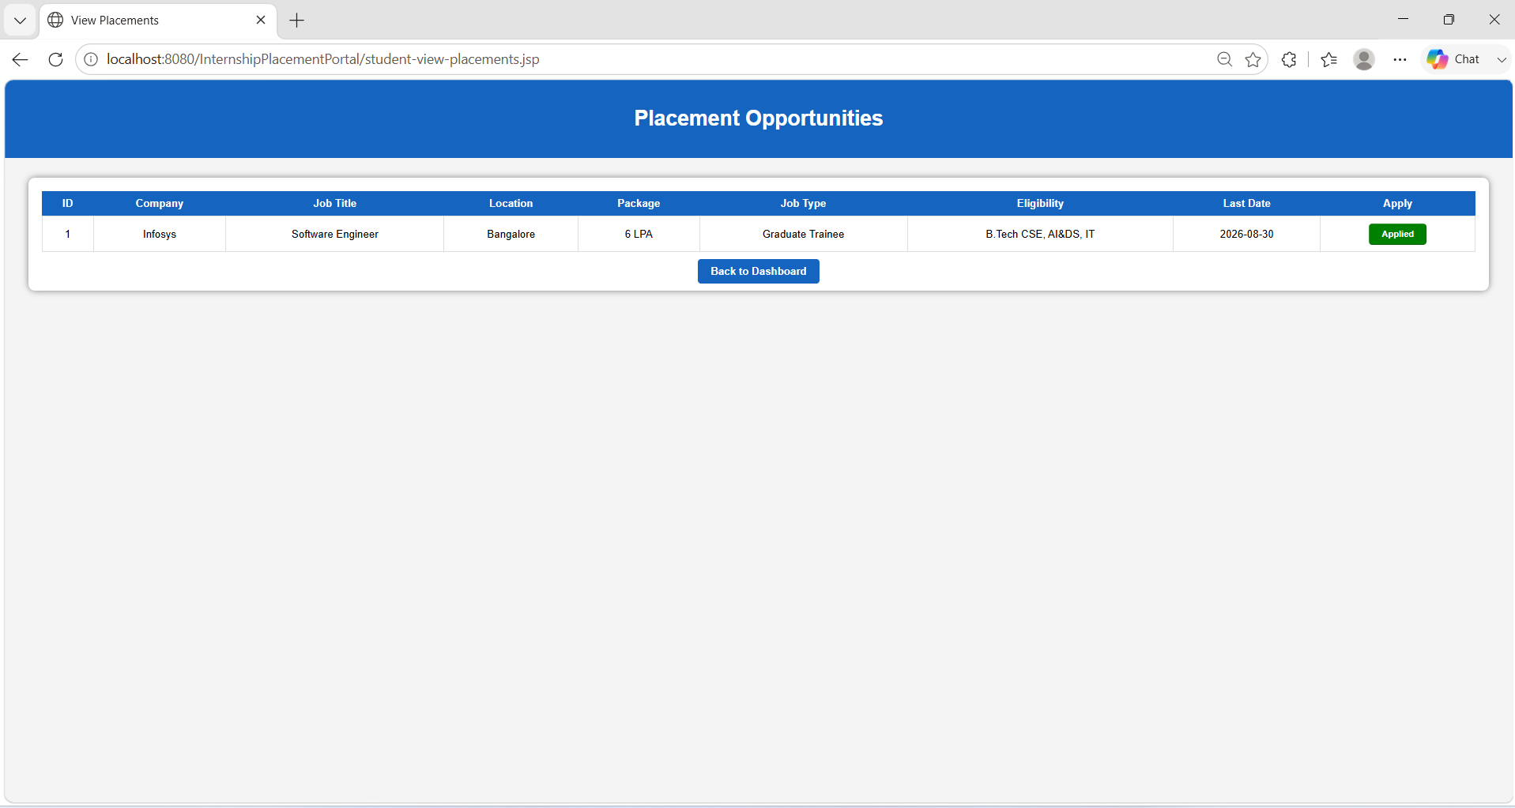
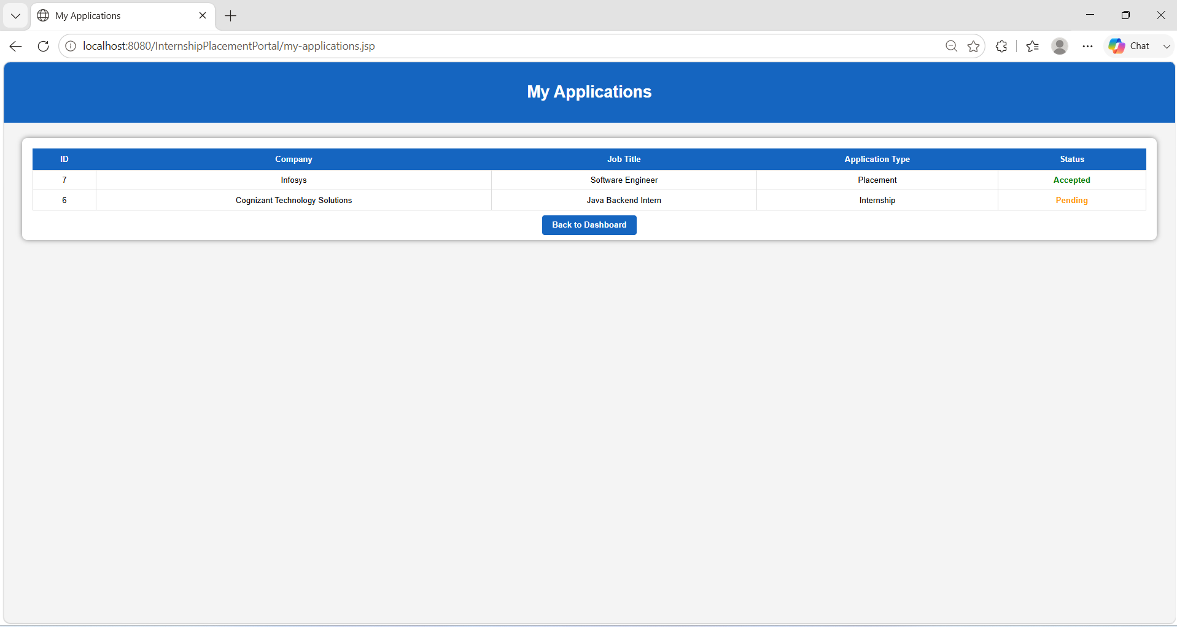
OUTPUT
FIG 02 : Student Register
FIG 03 : Student Login
FIG 04 : Student Dashboard
FIG 05 : Edit Profile
FIG 06 : Upload Resume
FIG 07 : View Available Internships
FIG 08 : View Placement Opportunities
FIG 09 : My Applications
CSA0927

Slide 12
Module 02: Company Management Module
Provides company registration and secure login functionality.
Manages company profile details such as company name, email, phone, location, and website.
Allows companies to post internship and placement opportunities.
Enables companies to view student applications and uploaded resumes.
Allows companies to update application status through shortlist, accept, and reject actions.
Helps companies manage recruitment activities efficiently through a centralized dashboard.
CSA0927

Slide 13
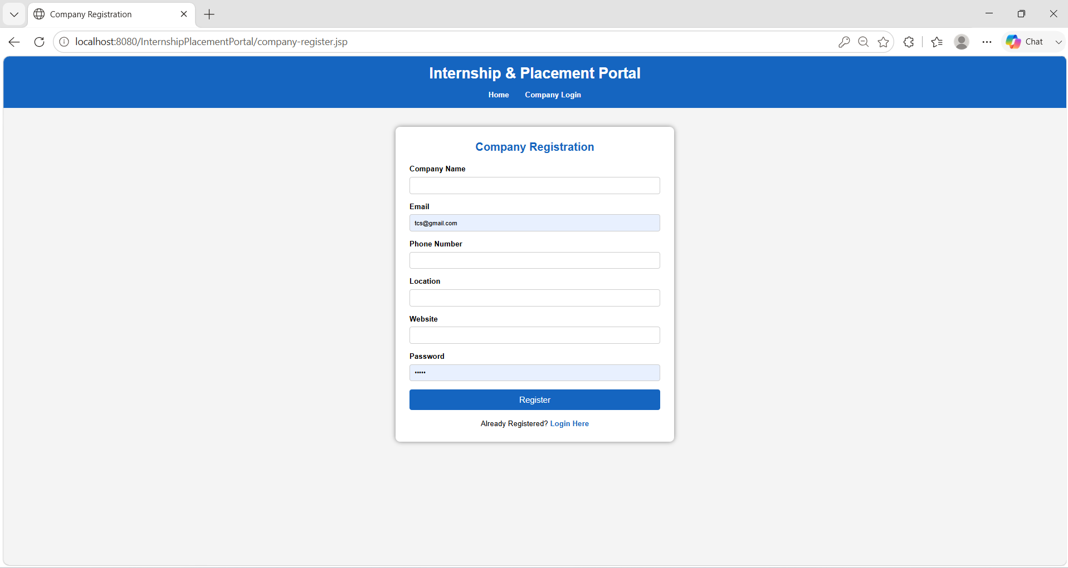
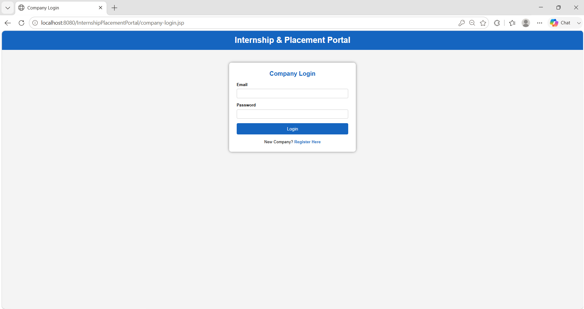
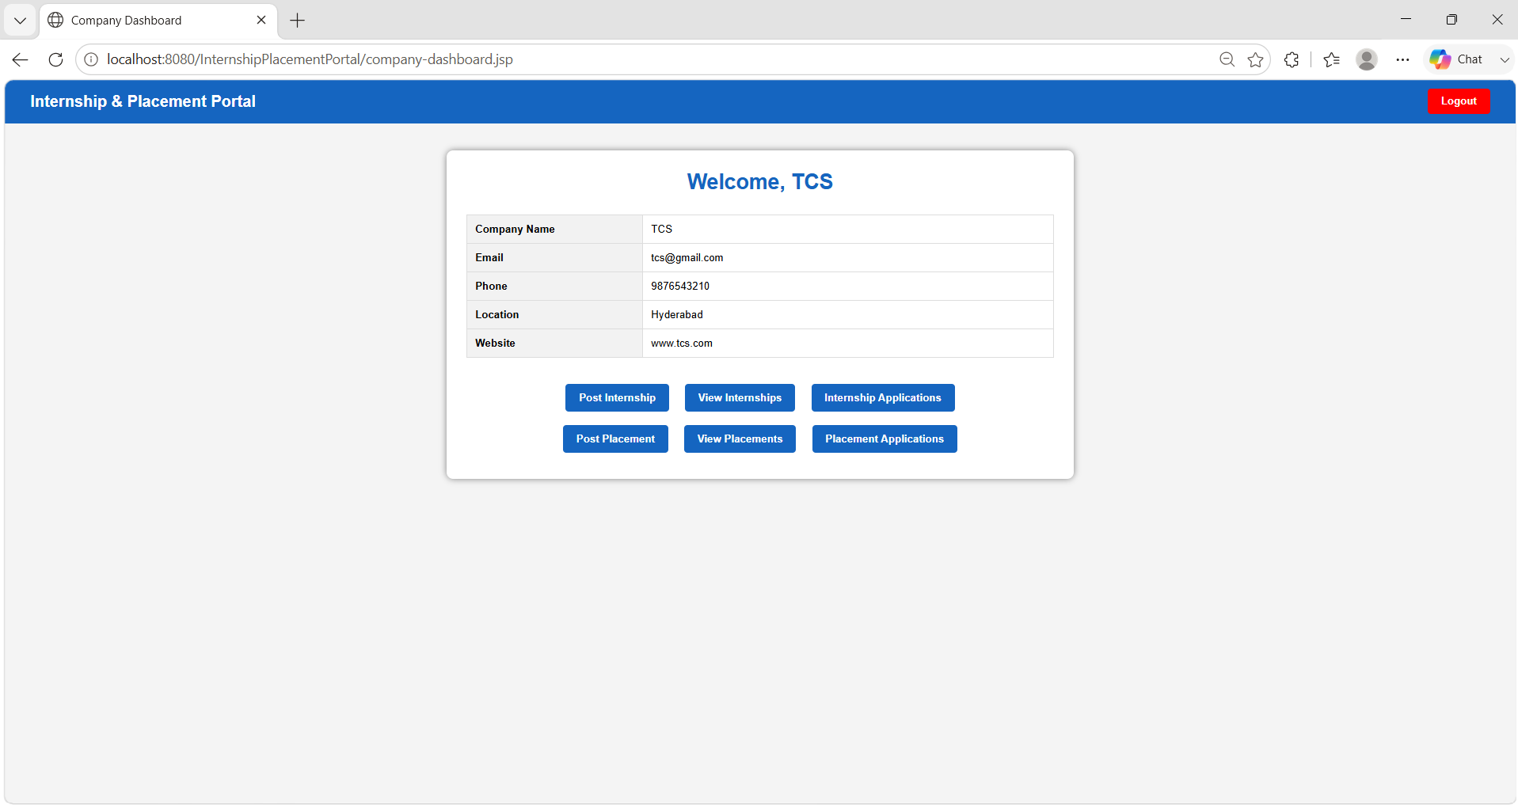
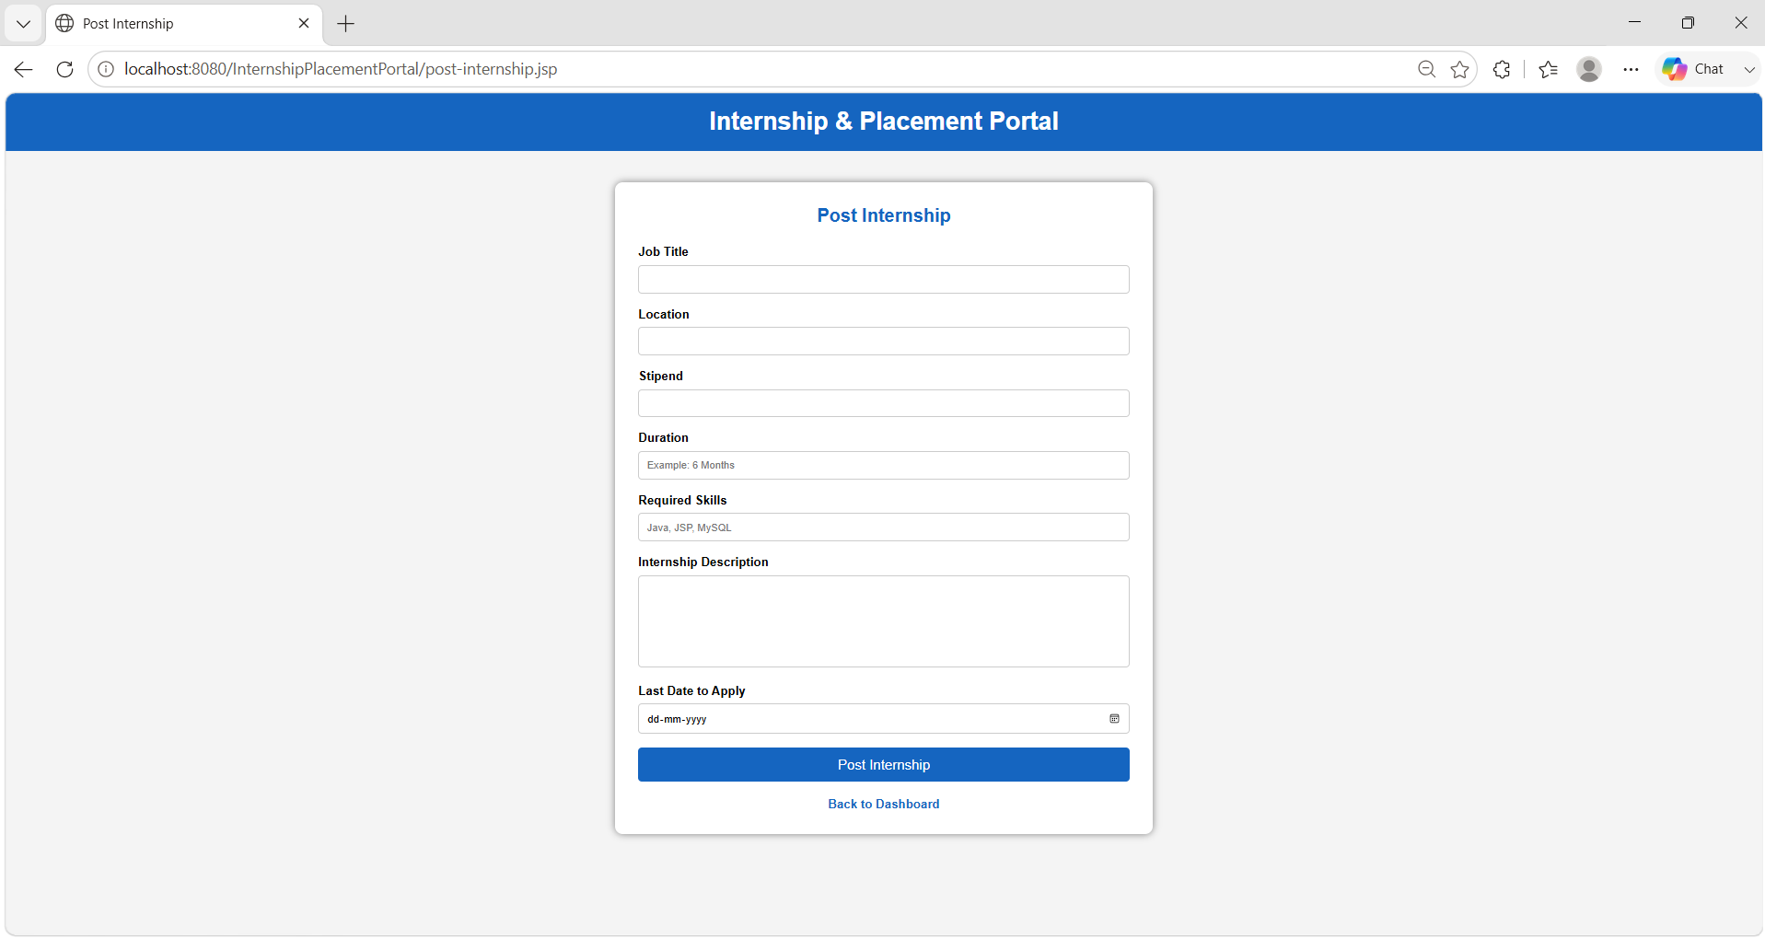
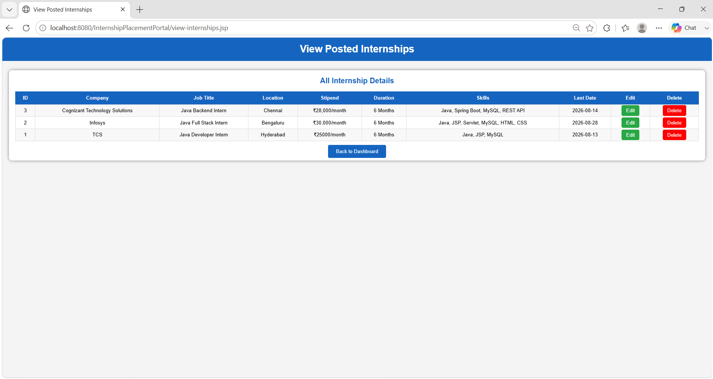
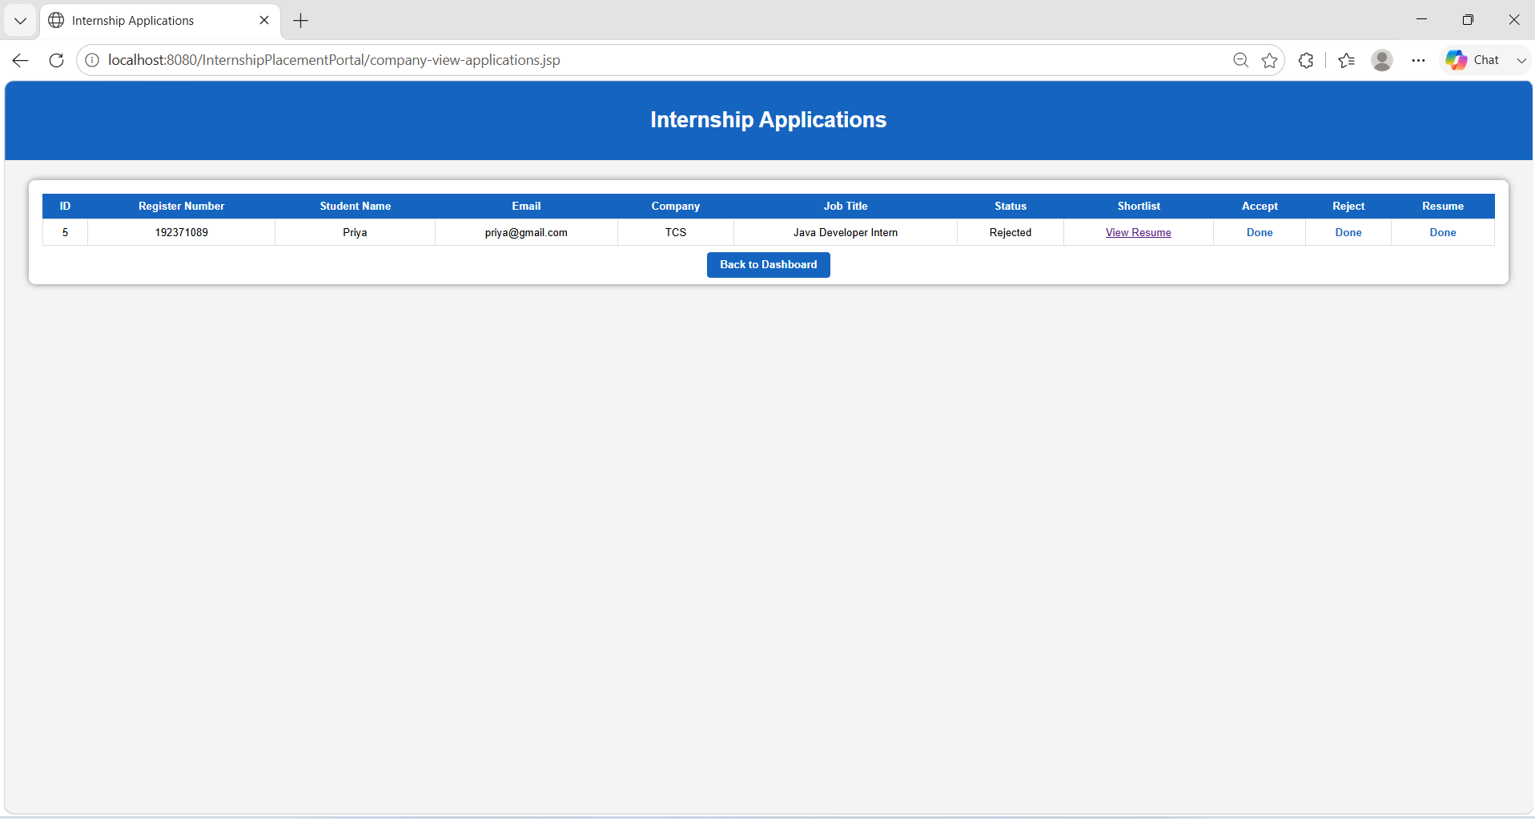
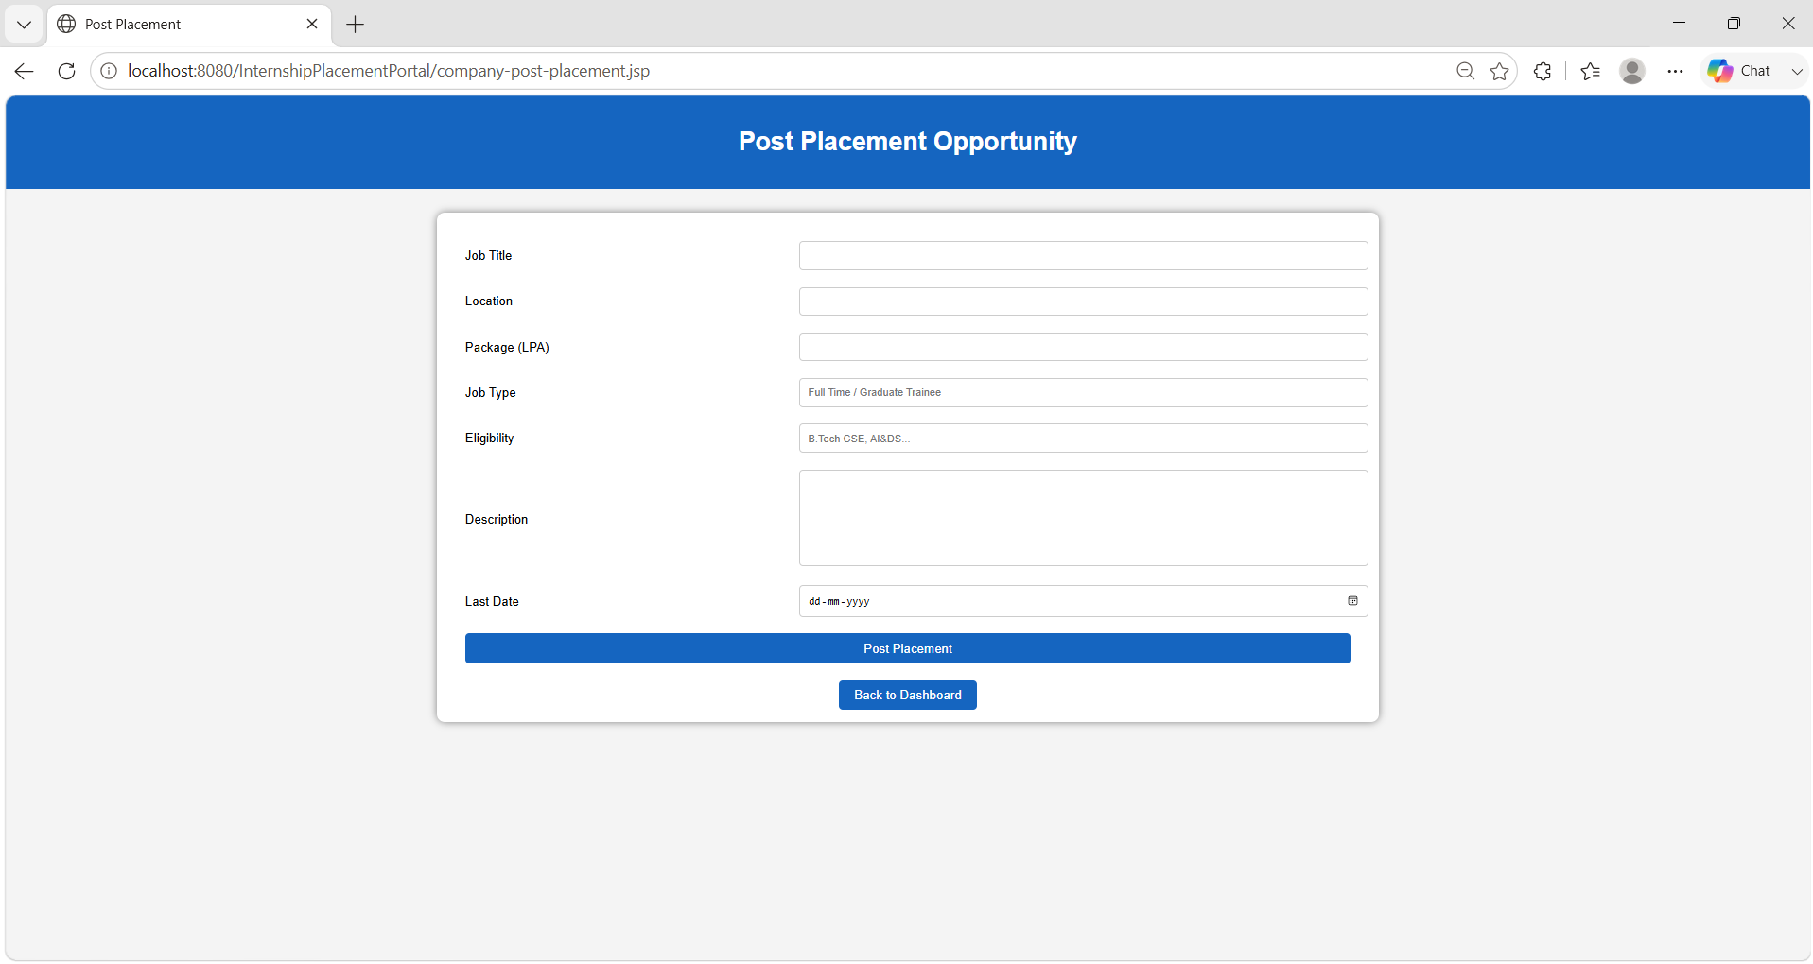
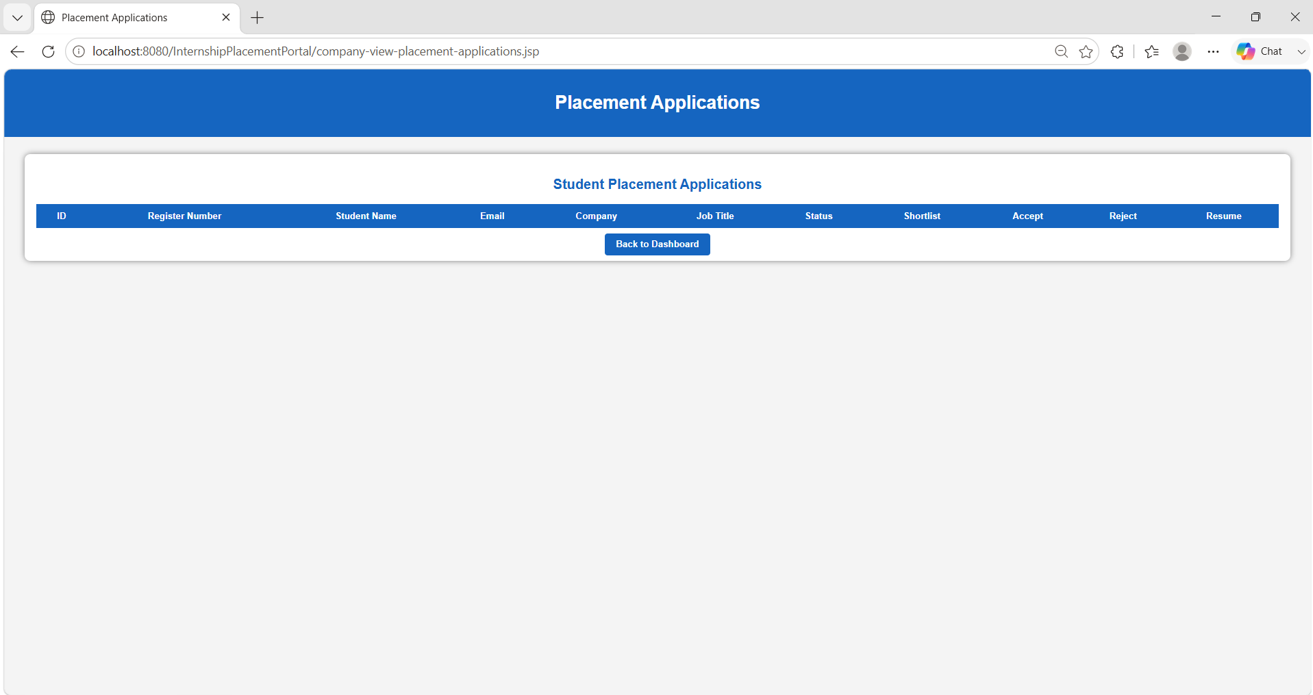
OUTPUT
FIG 10 : Company Register
FIG 11 : Company Login
FIG 12 : Company Dashboard
FIG 13 : Post Internships
FIG 14 : View Internships
FIG 15 : Internship Applications
FIG 16 : Post Placements
FIG 17 : Placement Applications
CSA0927

Slide 14
Module 03: Internship & Placement Management Module
Allows companies to create and manage internship and placement opportunities.
Stores details such as job title, location, stipend/package, eligibility, skills, and last date.
01
02
Enables students to view available internship and placement opportunities.
Allows students to apply for suitable internships and placement drives.
03
04
Maintains application records and tracks student application status.
Helps companies manage applicants through shortlist, accept, and reject actions.
05
06
CSA0927

Slide 15
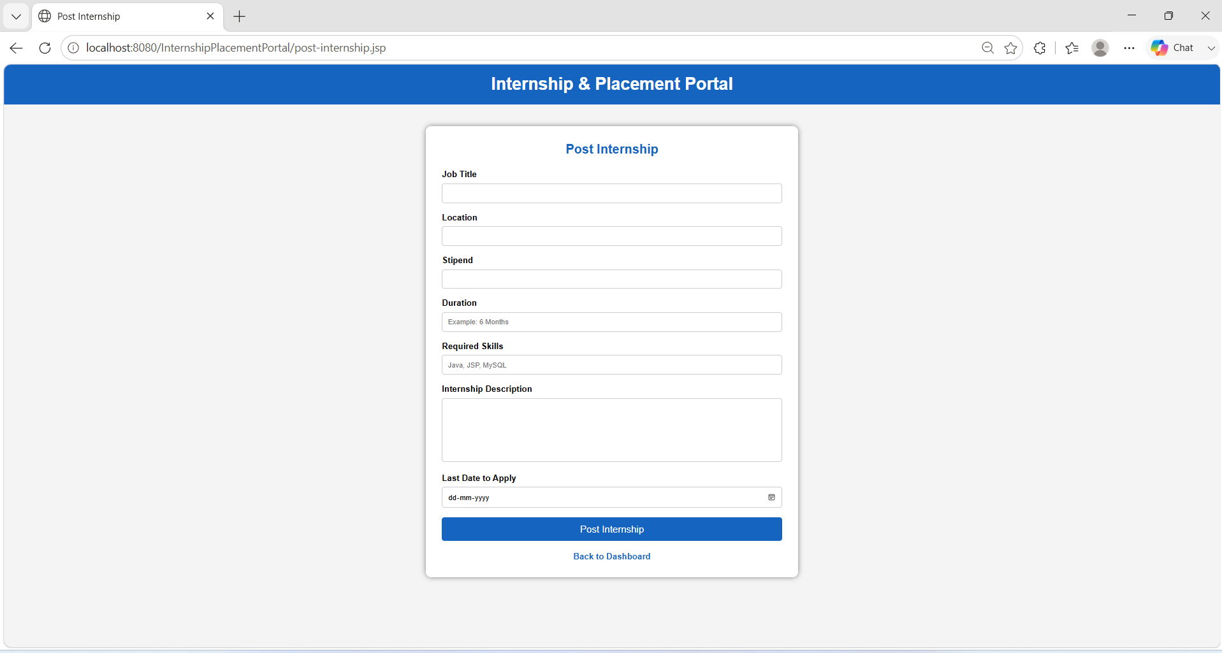
OUTPUT
Fig 18 : Internship Management
Fig 19 : Placement Management
CSA0927

Slide 16
Module 04: Administration & System Management Module
01
Provides secure admin login and access control functionality.
02
Allows admin to manage student and company information.
Enables admin to monitor internships, placements, and application records.
Provides a dashboard to display overall system statistics.
03
04
Ensures proper organization and maintenance of the internship and placement management system.
05
Allows admin to view and manage portal activities from a centralized platform.
06
CSA0927

Slide 17
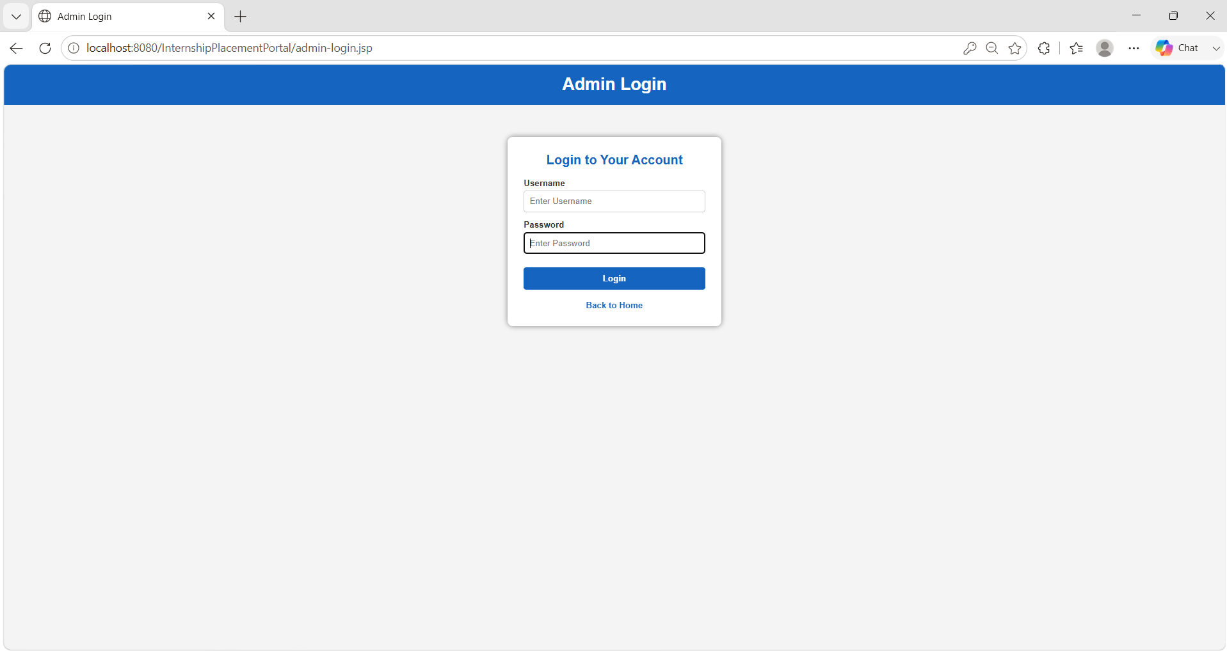
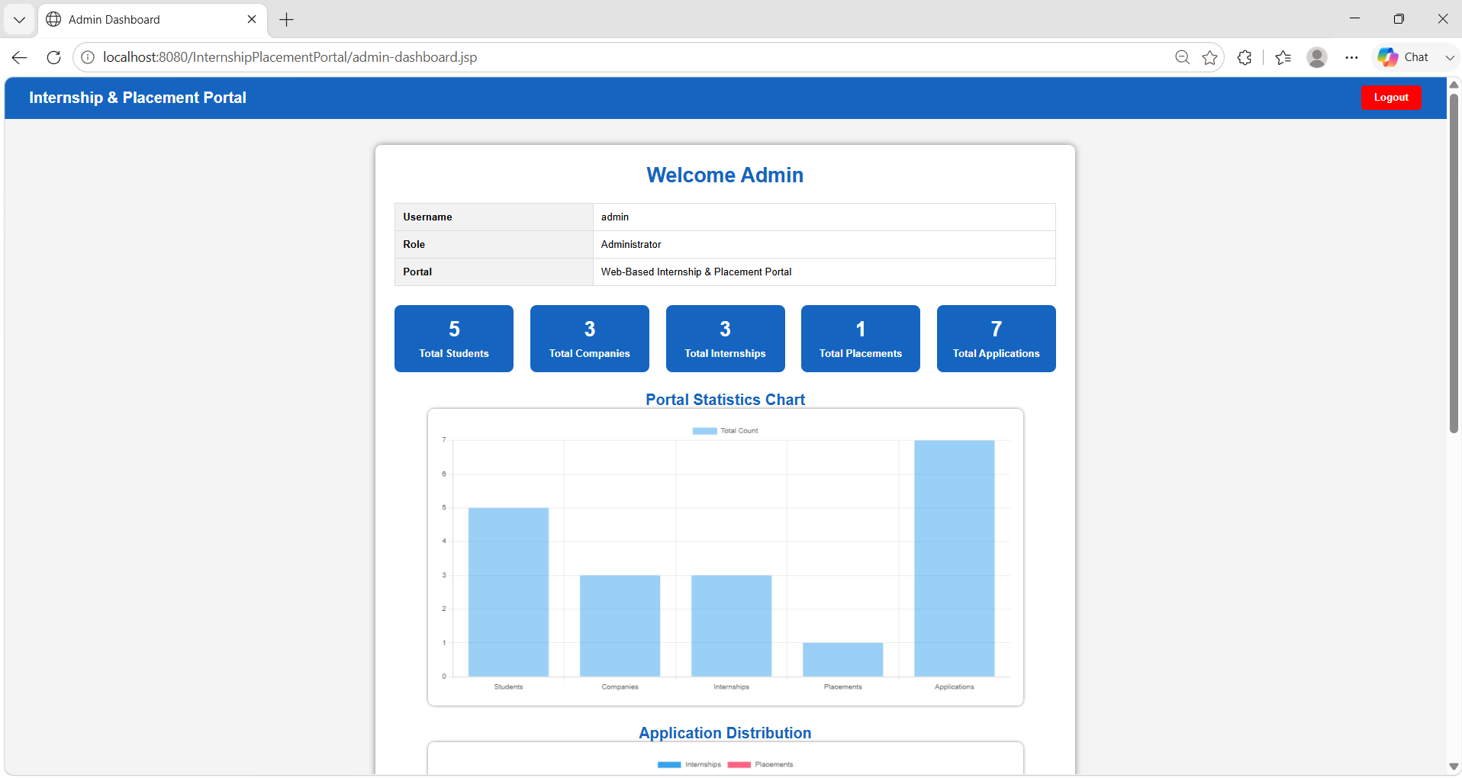
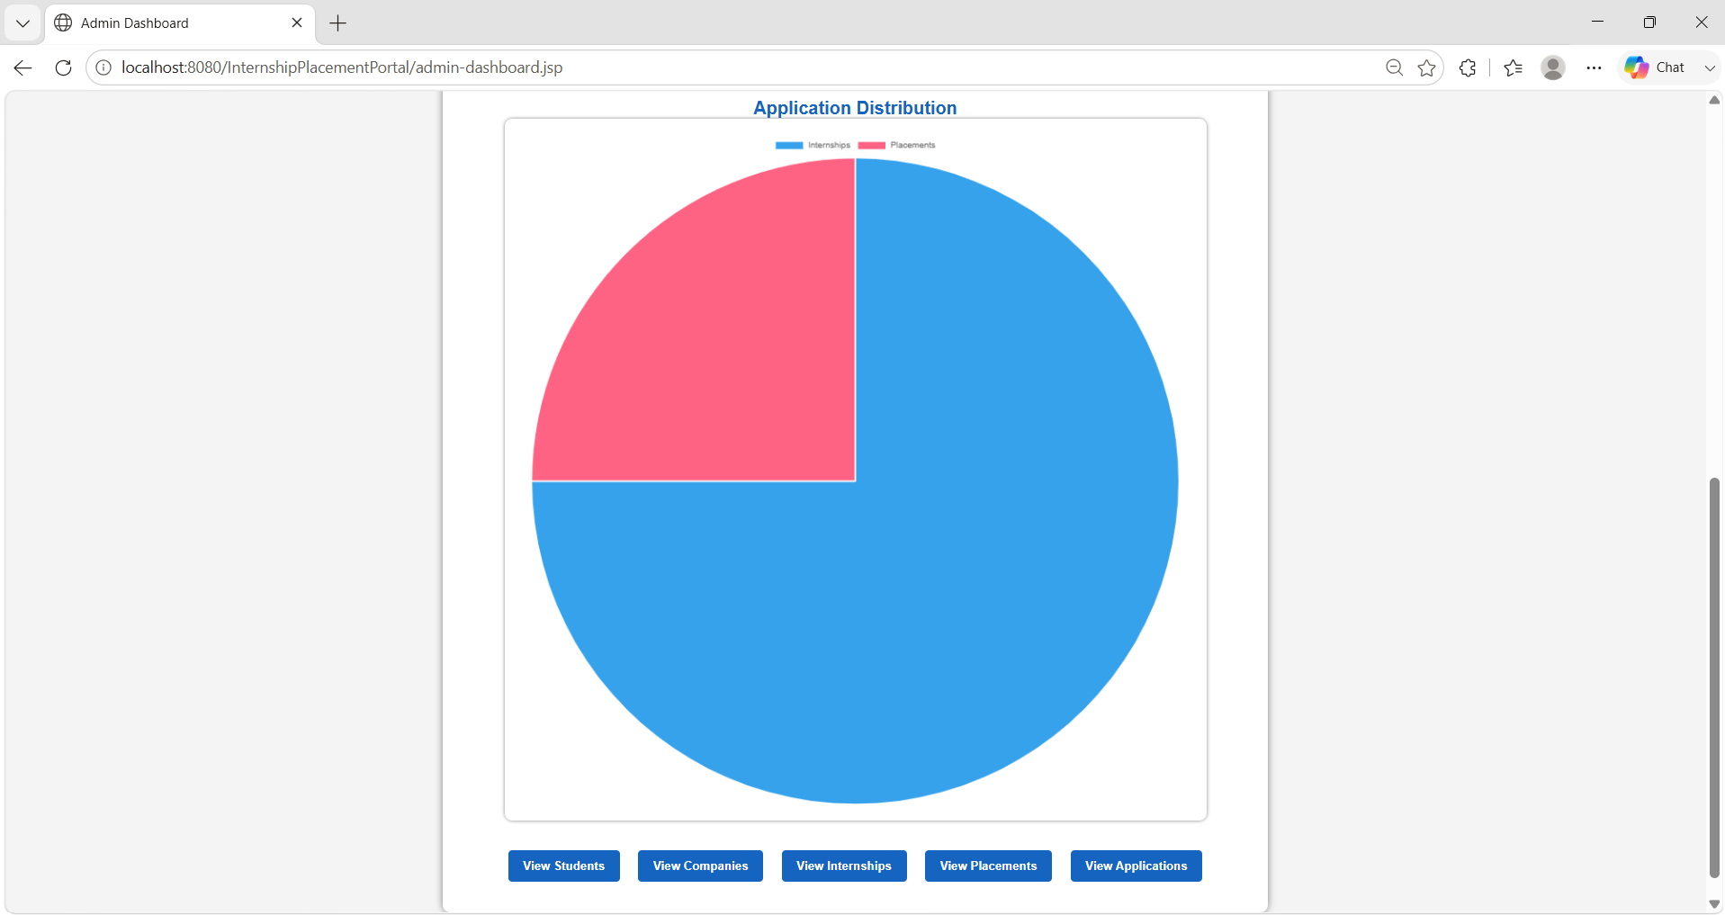
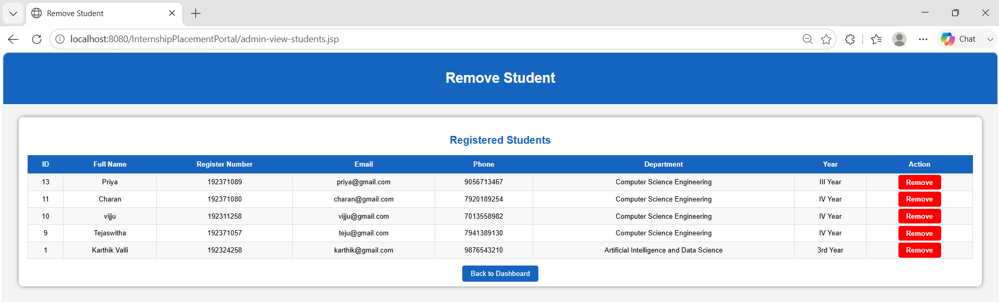
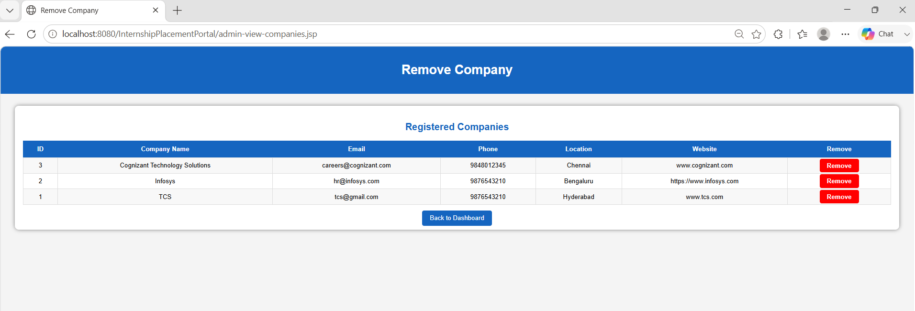
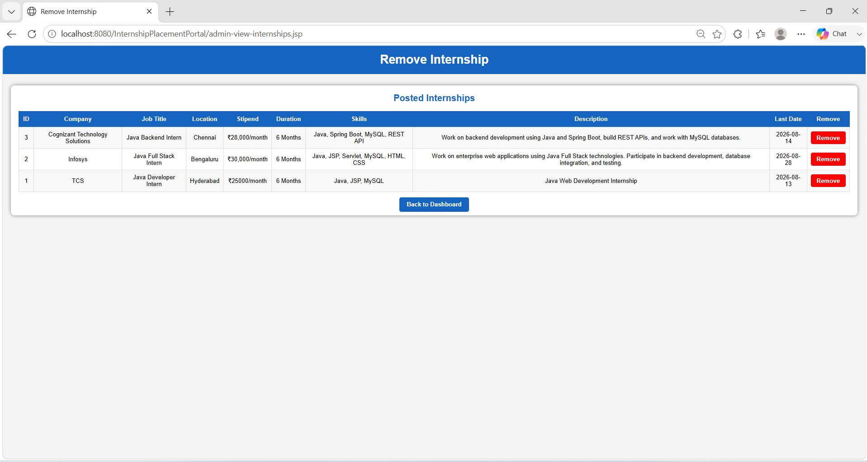
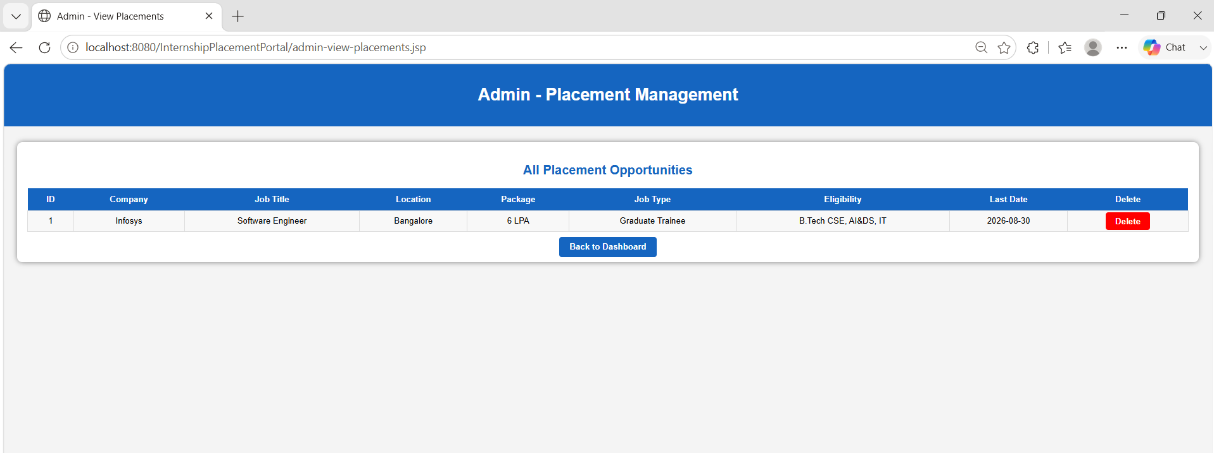
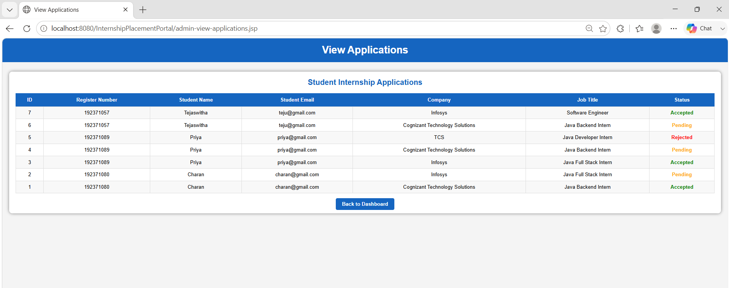
OUTPUT
FIG 20 : Admin Login
FIG 21 : Admin Dashboard
FIG 22 : Admin Dashboard
FIG 23 : View Students
FIG 24 : View Companies
FIG 25 : View Internships
FIG 26 : View Placements
FIG 27 : View Applications
CSA0927

Slide 18
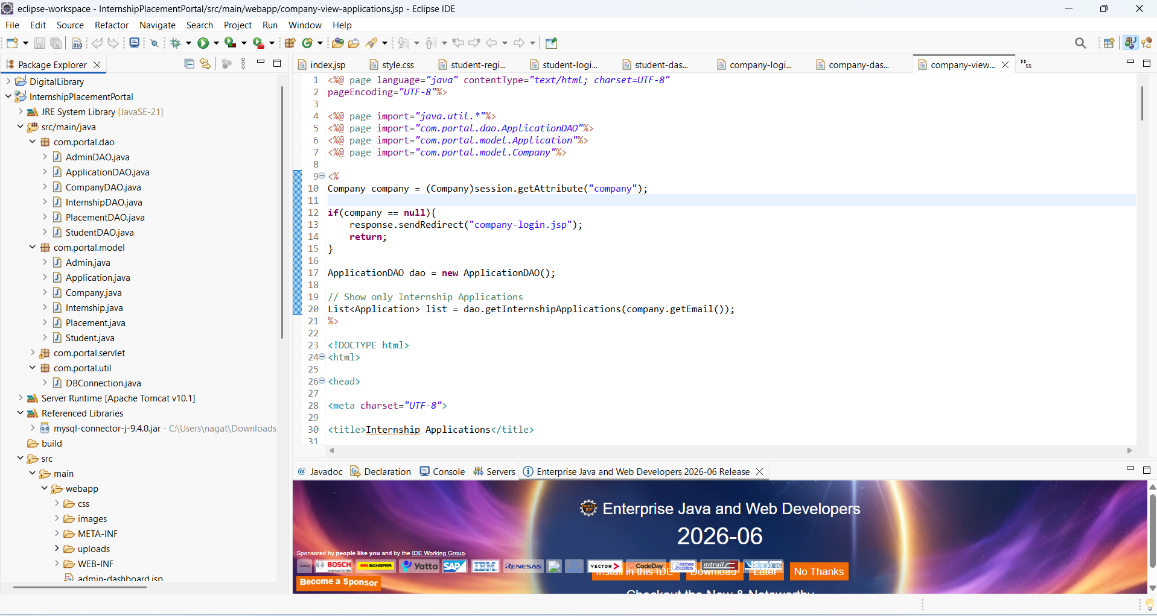
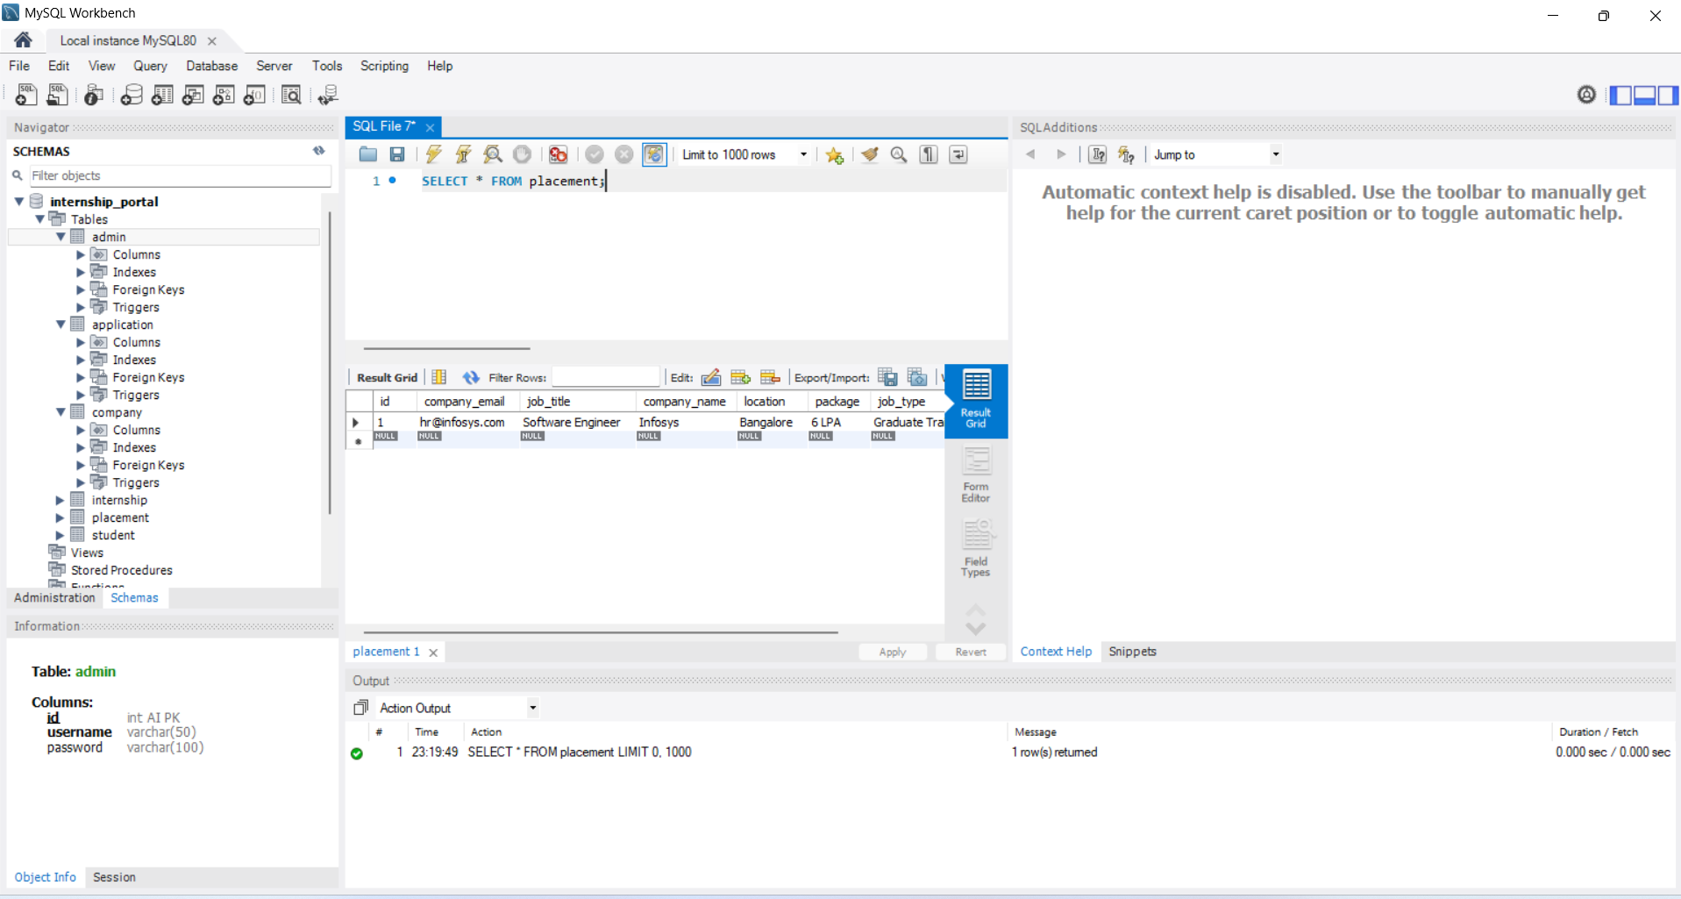
IMPLEMENTATION
FIG 28 : Web Application Development and Implementation Using Eclipse IDE
FIG 29 : Database Design and Implementation Using MySQL
CSA0927

Slide 19
RESULTS & DISCUSSION
Developed a functional Web-Based Internship and Placement Management Portal Using Java with Student, Company, and Admin modules.
Students can apply for opportunities, upload resumes, and track application status.
Companies can post opportunities and manage student applications.
Admin can monitor overall portal activities through a dashboard.
The system successfully integrates Java, JSP, Servlets, JDBC, and MySQL with efficient data management.
Testing confirmed that all modules are working successfully.
CSA0927

Slide 20
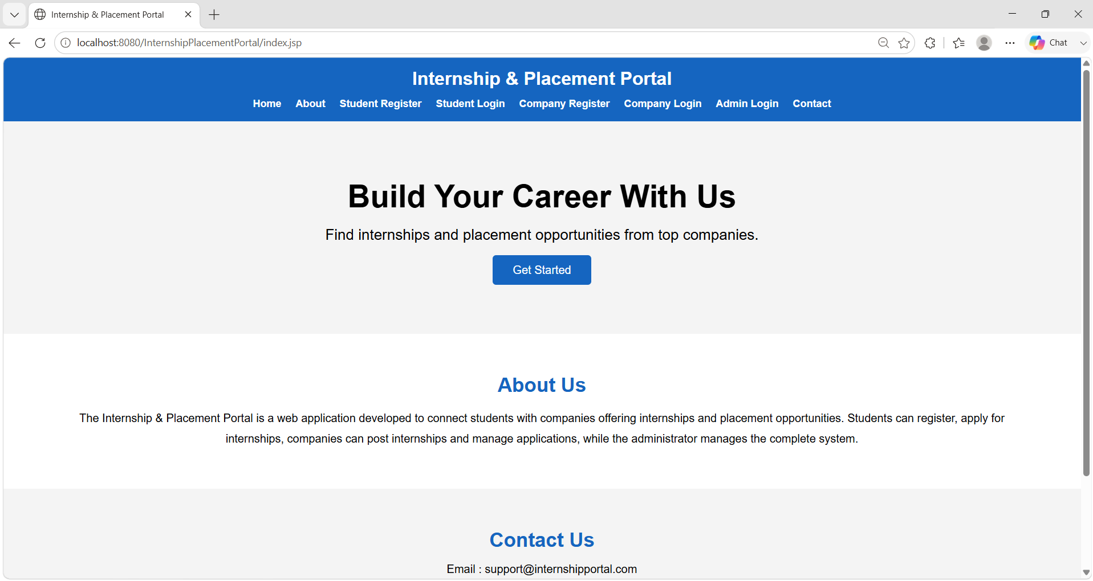
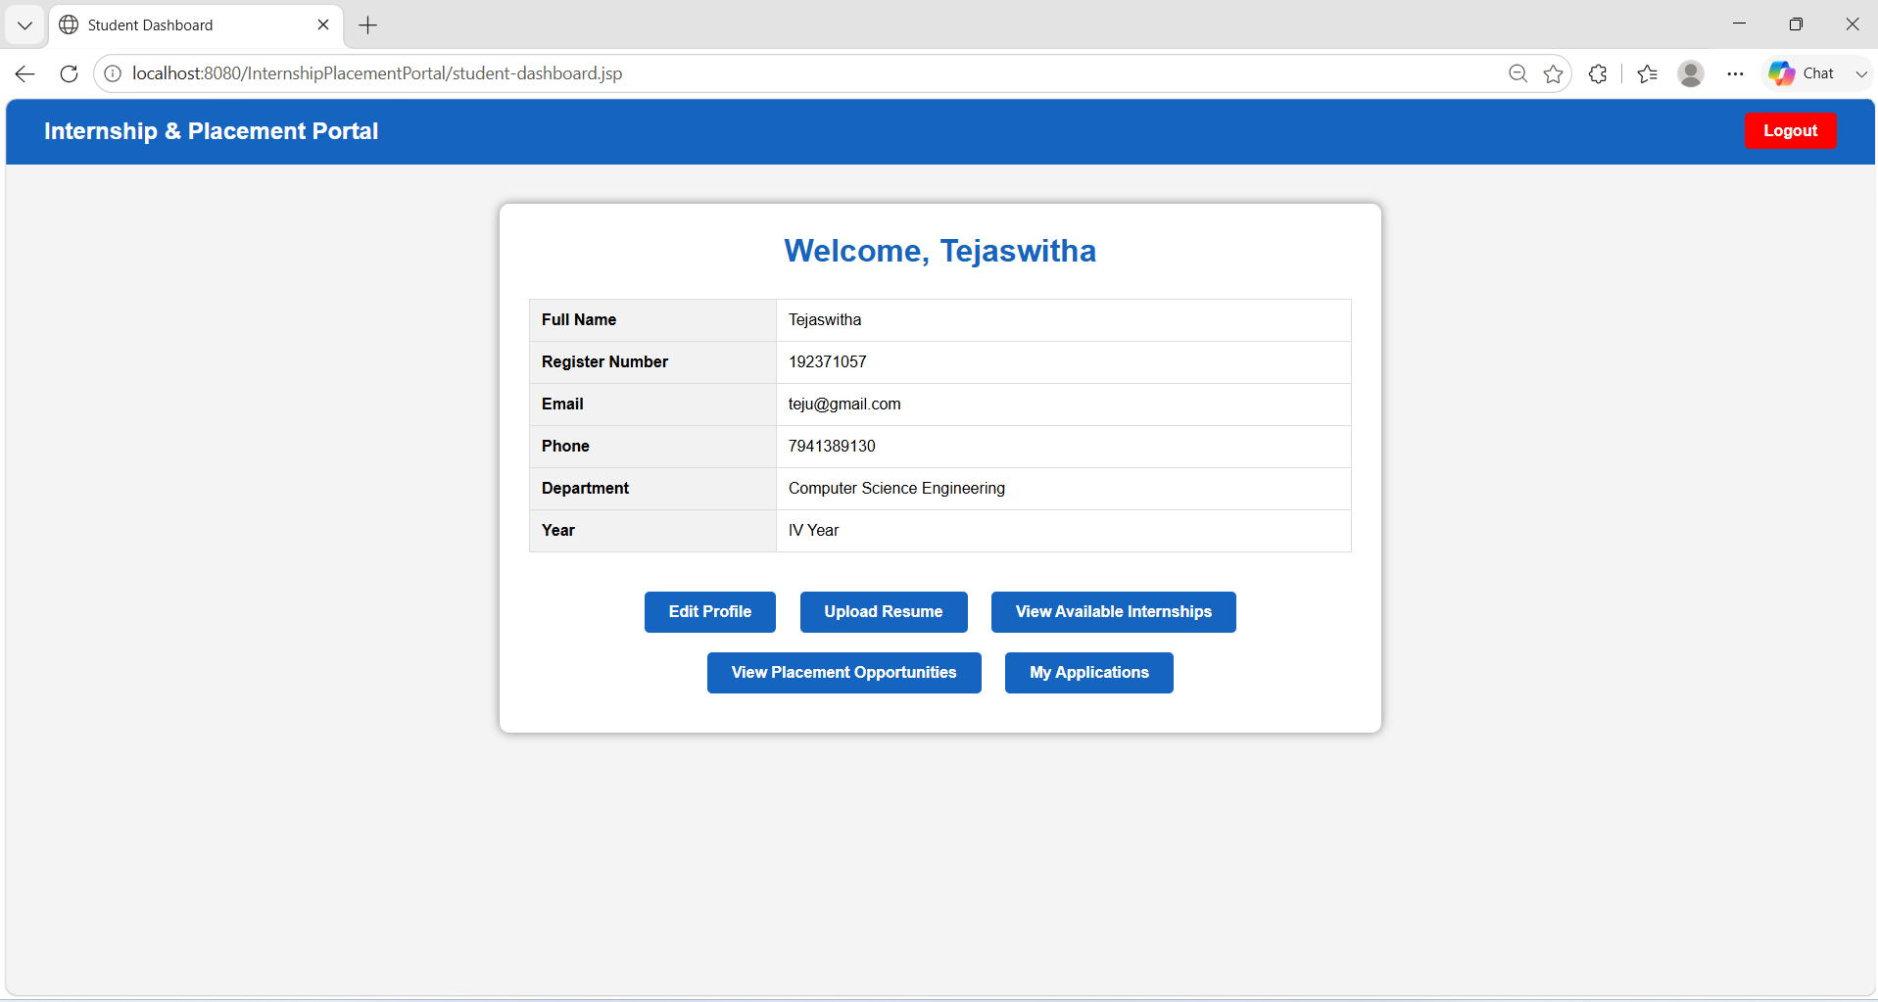
OUTPUT
FIG 30 : Internship & Placement Portal
FIG 31 : Student Dashboard
CSA0927

Slide 21
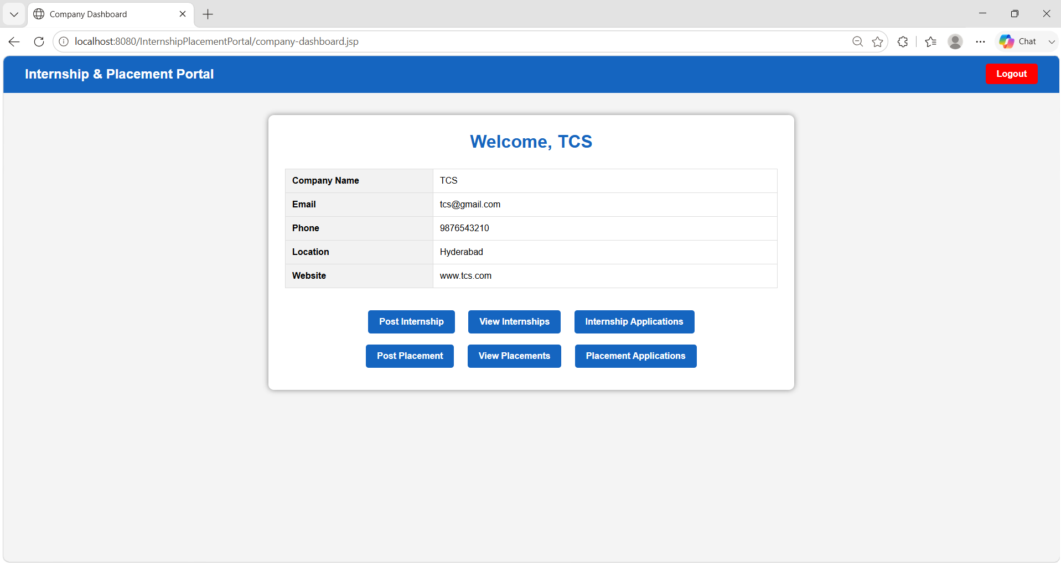

FIG 32 : Company Dashboard
FIG 33 : Admin Dashboard
CSA0927

Slide 22
CHALLENGES & LIMITATIONS
Designing and integrating multiple modules (Student, Company, and Admin) into a single system.
Managing database connectivity and maintaining consistency between application data and MySQL records.
01
02
Implementing secure authentication and role-based access for different users.
Handling resume uploads and application status updates efficiently.
03
04
Thank you
The system currently does not include real-time notifications for application updates.
The portal is limited to web-based access and requires further enhancement for mobile platforms.
05
06
CSA0927

Slide 23
CONCLUSION & FUTURE SCOPE
Developed a Web-Based Internship and Placement Management Portal Using Java to automate recruitment activities.
Provides a centralized platform for students, companies, and admin to manage internship and placement processes.
Handles registration, resume upload, opportunity posting, applications, and status updates efficiently.
Implemented using Java, JSP, Servlets, JDBC, and MySQL.
Future scope includes real-time notifications, mobile support, and AI-based recommendations.
CSA0927

Slide 24
REFERENCES
[1] M. Patel and R. Sharma, Web-Based Internship Management System, 2023.
[2] S. Kumar and P. Verma, Online Campus Recruitment Portal, 2024.
[3] A. Singh et al., Placement Management Using MVC Architecture, 2024.
[4] R. Das and S. Roy, Internship Management System Using Java and MySQL, 2025.
[5] P. Reddy and V. Rao, Centralized Internship and Placement Portal, 2025.
[6] N. Gupta and S. Mishra, Smart Placement Management System Using Java, 2025.
[7] K. Ramesh and A. Prasad, Web-Based Recruitment and Internship Portal, 2023.
CSA0927

Slide 25


