Slide 1
Moody Grades Analysis
By Tejaswi Tripathi

Slide 2
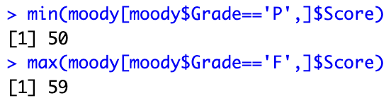
The Data
Grade (P/F) | Row | Section | Attendance | Score
As I skimmed through the data at a first glance, I assumed that aside from the Score column, Attendance would be the defining way to determine whether someone passes or fails.
Checking the minimum score of those who passed and the maximum score of those who failed:
It’s clear that within the score range of 50-59, a student can either pass or fail depending on other factors.

Slide 3
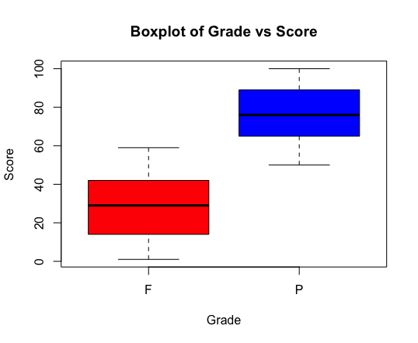
Boxplot
This boxplot visualizes the range that we’re working with.
Therefore, we’ll subset the data such that we’re only looking at that range.

Slide 4
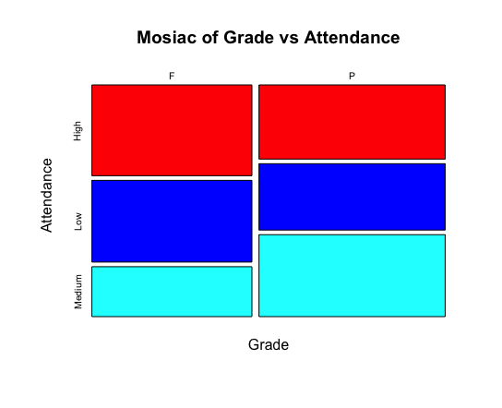
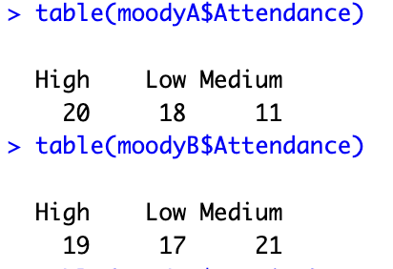
Mosaic
First, I analyzed the data for attendance. Although it looks like if you only attend sometimes, you are more likely to pass given that you scored below a 60, I find it hard to believe that this would affect the professor’s decision on a grade. To verify this, I made a table that shows the exact numbers of people in each attendance category:
(MoodyA is people who failed with high scores, MoodyB is people who passed with low scores)

Slide 5
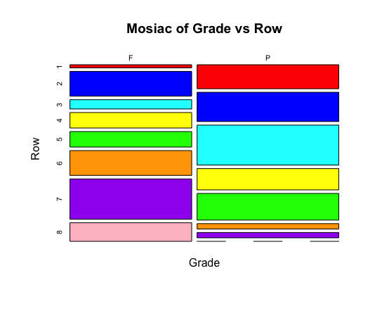
Mosaic
Next, I analyzed the data for Row. I found this data to be more interesting. It looks like if you are sitting closer to the front of each section (Rows 1-5), you are more likely to pass, while if you are sitting close to the back of each section, you are more likely to fail. Interestingly, nobody in the last row (Row 8) of any section passed the class, given that they had a score between 50-59.

Slide 6
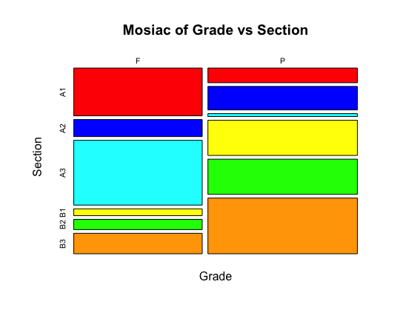
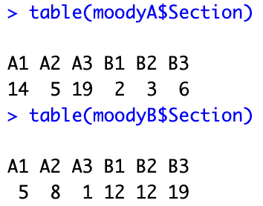
Mosaic
Finally, I analyzed the data for section. This data was the most interesting to me, because it looks like you are most likely to pass if you are in any of the B sections, while you are more likely to fail if you are in any of the A sections (with the exception of section A2, which seems to have a mostly even distribution). Here are the tables:
(MoodyA is people who failed with high scores, MoodyB is people who passed with low scores)

Slide 7
Summary
Overall, score is the biggest factor determining whether you pass or fail. However, within the score range of 50-59, there are some determining factors. Those in the front rows of each section are more likely to pass than those in the back rows. Those in the B sections are also more likely to pass than those in the A sections. If the B sections are closer to the back of the lecture hall where the exit would be, it looks like the professor prefers those who are further away from him. However, if the B sections are in the front, then he likely prefers those who are closest to him. I believe that if there was another column in the dataset that corresponds to class participation, it would reveal more about where Professor Moody’s preferences lie. Those closer to the front of the lecture hall would probably ask more questions and participate more in class discussions than those in the back, which I feel would affect the professor’s grading policy in ways not revealed by this dataset.

