Slide 1
Used Cars in Pakistan
Analysis in R
By Tejaswi Tripathi

Slide 2
About the Data
Make | Model | City | Year | Mileage | Engine Displacement | Price in Rupees
The make of the car | The model of the car | City this car was sold in | Year of the car | How much mileage this car had at the time of sale | This car’s engine displacement | Price this car was sold at

Slide 3
My interest in the data
I was curious to find odd, unintuitive correlations between different columns of the data.
Initially I used the tapply() function to analyze the average mileage of used Toyotas for each city, then the average price of used Toyotas.

Slide 4
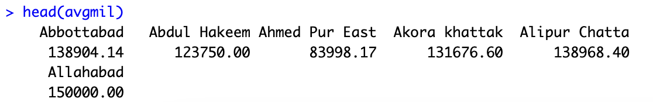
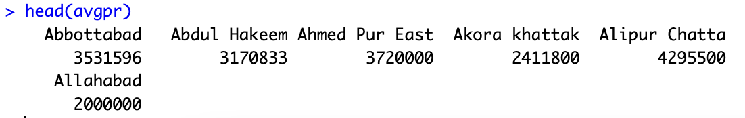
Head of average mileage vector
Head of average price vector

Slide 5
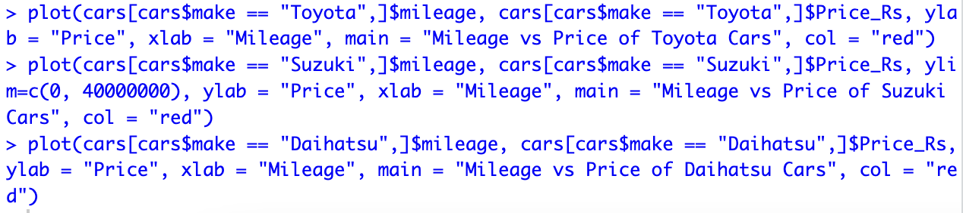
This did not reveal much, until I plotted:
I changed the ylimit for Suzuki cars because there was an outlier in the -10000 range.

Slide 6
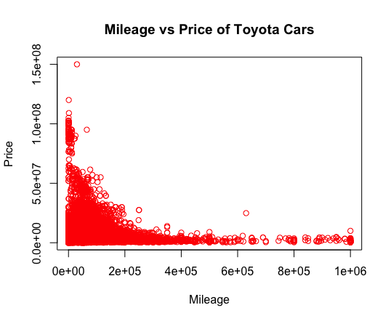
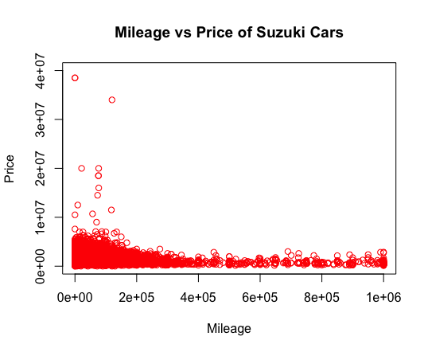
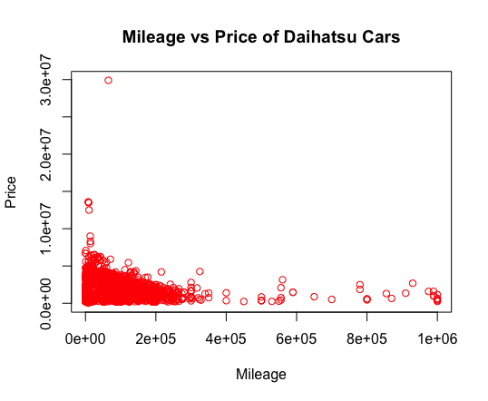

Slide 7
Summary
The correlation between mileage and price for used Toyota cars follows a steep exponential curve. However, for used Suzuki and Daihatsu cars, it seems that they are sold at the relatively same price regardless of mileage, with not nearly as steep of a curve as for used Toyota cars. This difference in correlations surprised me.
I believe my findings reveal the differences in perception of brands of used cars in Pakistan. With Toyota, it is possible that there is far more demand than there is supply, as opposed to other cars. I argue that because Toyota cars are viewed more as a commodity like iPhones are in the USA, there is a steep price increase for newer models. With used Daihatsu cars, I believe that the relatively low demand compared to Toyota leads to the smaller, flatter price curve with respect to the year. The same applies to used Suzuki cars, which as a category has a very similar graph to used Daihatsu cars. It is possible that used Daihatsu and used Suzuki cars are sought after for their functionality, leading to the flat price regardless of year or mileage, while used Toyota car buyers have more luxury in mind when they make their purchases.
You can argue that I am assuming a lot about the market for used cars in Pakistan: how can I know for sure where the demand lies based on this data? I would say that the data reveals quite a bit about where consumers in Pakistan want to spend their money on used cars.

