Slide 1



covid19dashboard_dataFromWorldometerLive
View in Power BI
Last data refresh:
5/7/2021 10:34:59 AM UTC
Downloaded at:
5/7/2021 10:42:21 AM UTC

Slide 2
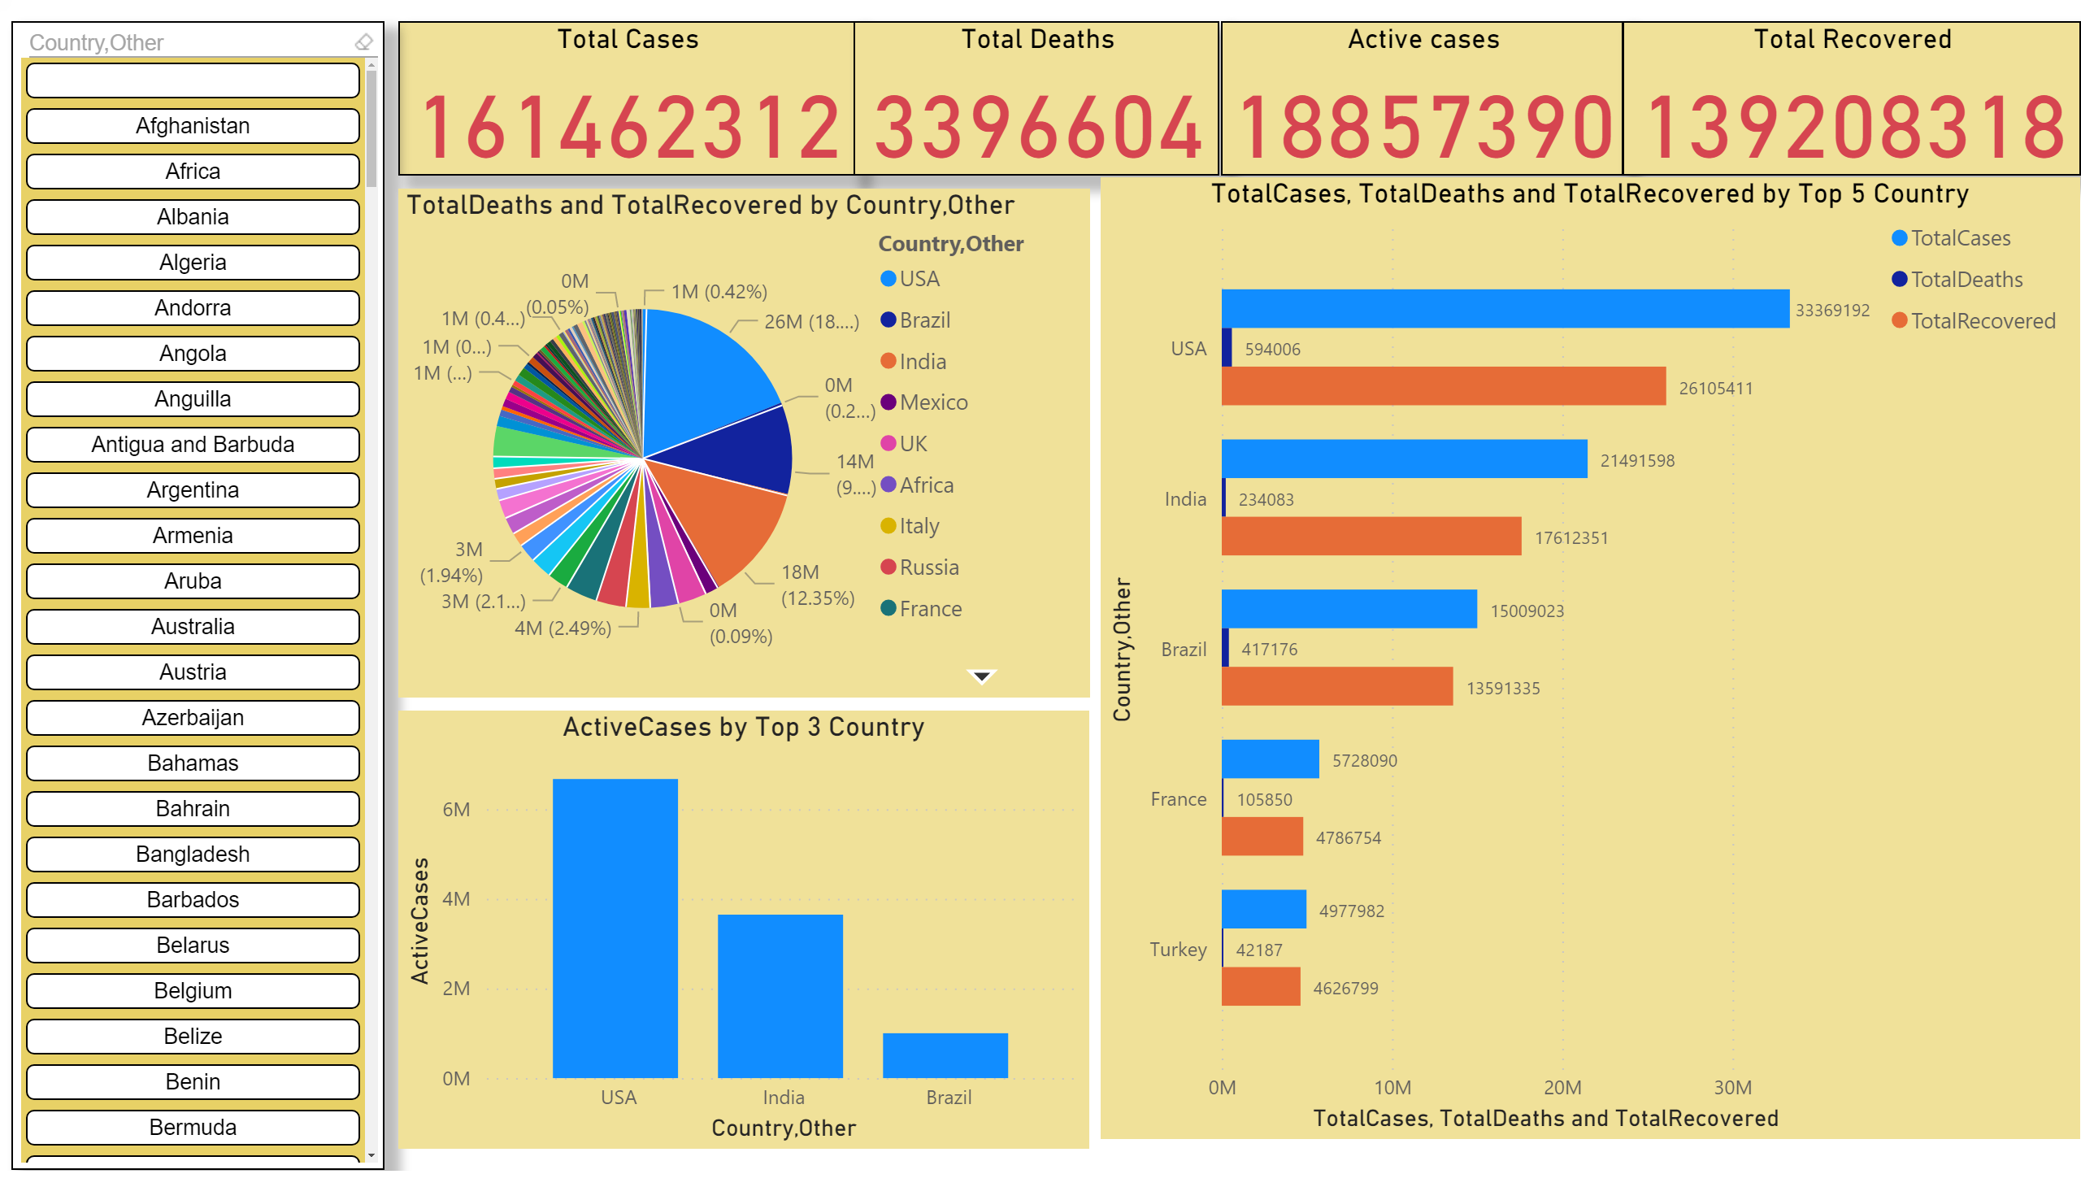
Page 1
Notes:
Total Cases
No alt text provided.
Total Deaths
No alt text provided.
ChicletSlicer1448559807354
No alt text provided.
Active cases
No alt text provided.
Total Recovered
No alt text provided.
TotalCases, TotalDeaths and TotalRecovered by Top 5 Country
No alt text provided.
ActiveCases by Top 3 Country
No alt text provided.
pieChart
No alt text provided.

Slide 3
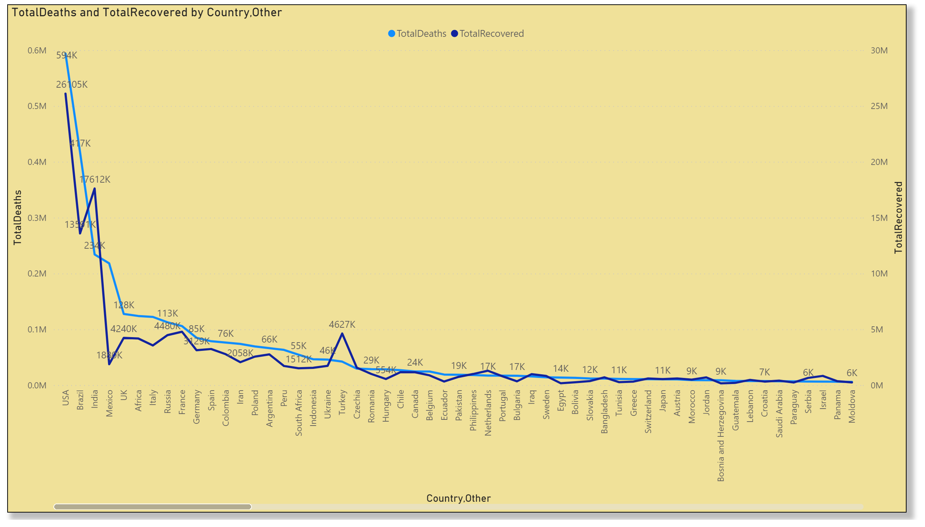
Page 2
Notes:
lineChart
No alt text provided.

Slide 4
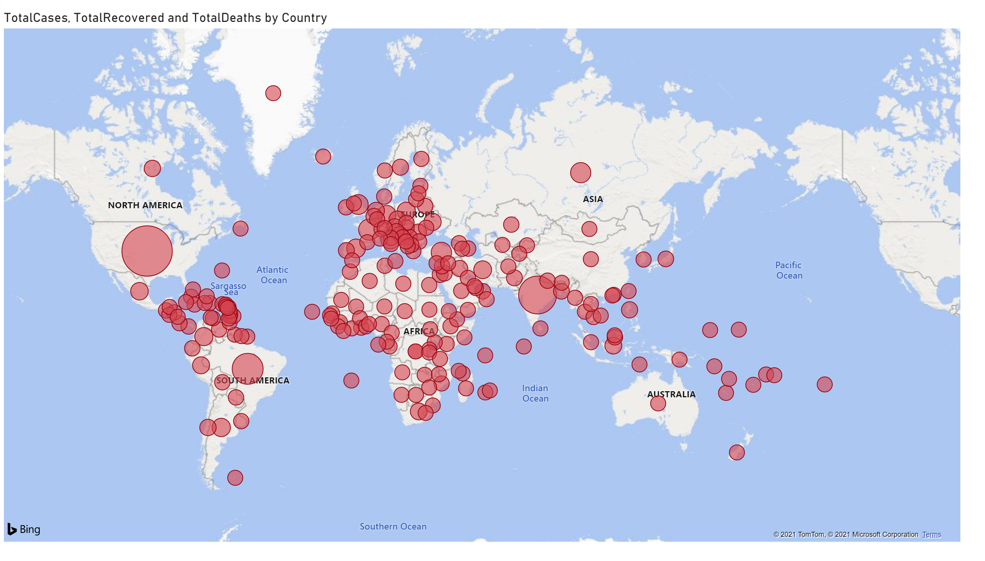
WorldMap
Notes:
TotalCases, TotalRecovered and TotalDeaths by Country
No alt text provided.

