Slide 1


Slide 2

Mini Project (01CE0609)
Review 1
WIFI BASED ATTENDANCE SYSTEM
Team ID: 102
Team Member 1: TEJ DEKIWADIYA (92100103011) (6TC2)
Team Member 2: UTSAV KHUNT (92100103007) (6TC2)
Team Member 3: SOHAM NAGPARA (92100103034) (6TC2)
Guided By
Internal Guide Name: Prof. Samir Kariya
Department of Computer Engineering, Faculty of Technology

Slide 3
Outline
Introduction
Abstract
Literature Review
Mind Map Diagrams / Sequence diagrams / Database Design / Use Case Diagram etc.
Proposed Solution
Project Flow Chart
Tools & Technology to be used
Gantt Chart
Expected Outcomes
References

Slide 4
Introduction
Project Summary
Our project is a modern attendance system called the WiFi-Based Attendance System. It's a web application built using ReactJS for the frontend, Node.js with Express for the backend, and MongoDB for the database. This system simplifies attendance tracking by leveraging WiFi technology to automate the process. Through an user friendly web interface, users can easily manage attendance records, view reports, and monitor attendance trends. It streamlines administrative tasks and provides real-time insights, enhancing efficiency for both students and instructors.
Purpose
The purpose of this project is to create a hassle-free attendance tracking system for educational institutions. By using WiFi technology and modern web development tools, we aim to streamline the process of recording attendance, making it easier for both students and faculty. This system aims to reduce manual effort, minimize errors, and provide real-time insights into attendance patterns, ultimately improving administrative efficiency and enhancing the overall educational experience.

Slide 5
Introduction
Objective
This project aims at developing a new smart attendance procedure, which can streamline the process for both students and teachers. With the help of WiFi technology and user-friendly interfaces, this system will automate attendance recording, offering real time data and easing administrative burden. The goal is to improve the education process as a whole, eliminating manual workload, increasing accuracy, and providing data-driven insights for making better decisions. In the long run, the objective is to come up with a system that helps to save time and makes everything easier by improving the efficiency of education in all aspects.
Scope
The scope of this project comprises the creation of an extensive WiFi-Based Attendance System for educational establishments. This system will provide provision of user-friendly dashboards for both the students and the instructors to manage attendance. Automated tracking using WIFI technology, real-time reports and analytics together with integration of existing educational online platforms. The range also includes support for multiple devices and browsers, scalability to fit all class sizes, and customizable features that address the needs of various educational institutions. Furthermore, the implementation will also be documented with testing and support to ensure that it is upheld after implementation.

Slide 6
Introduction
Technology
FrontEnd: ReactJS, Bootstrap
BackEnd: Node, Express
DataBase: MongoDB
Roles and Responsibilities
Tej Dekiwadiya: BackEnd, FrontEnd
Utsav Khunt: DataBase, BackEnd
Soham Nagpara: FrontEnd

Slide 7
Abstract
The "WiFi-Based Attendance System" is a modern solution crafted using the MERN stack, designed to simplify the hassle of attendance tracking. Our goal with this project is to revolutionize attendance management by utilizing the familiar technology of WiFi and the unique MAC addresses of users' devices. When a user signs up, their device's MAC address is securely stored in our database for future authentication. During login attempts, we ensure the legitimacy of the user's device by verifying its MAC address against the stored one, ensuring only authorized devices gain access. To prevent misuse, we've integrated real-time location tracking, allowing us to verify that the user is within the specified range set by the administrator before allowing attendance marking. This innovative feature not only enhances security but also ensures the accuracy of attendance records. With our system, organizations can bid farewell to manual attendance processes and embrace a seamless, reliable, and efficient solution that saves time and reduces administrative burden. By harnessing WiFi technology and real-time location tracking, our "WiFi-Based Attendance System" aims to redefine attendance management, offering a user-friendly and robust solution for modern organizations.

Slide 8
Literature Review
Title: Wifi Based Attendance System (By ANITS)
Description:
The Wi-Fi based attendance system for this project is targeted towards making taking of class attendance much easier and leaving teachers with adequate time to concentrate on their work activity. The system includes an automatic Wi-Fi hotspot activation by the teacher during each lecture, with students connecting via a mobile application to scan a QR code and enter their details for marking attendance. The project aims to optimise the attendance system in classroom management.
Advantages of the Project:
Efficient Attendance Tracking
Streamlined Process
Time-Saving
Real-Time Tracking
Limitations of the Project:
Dependency on Technology
Initial Setup
Security Concerns

Slide 9
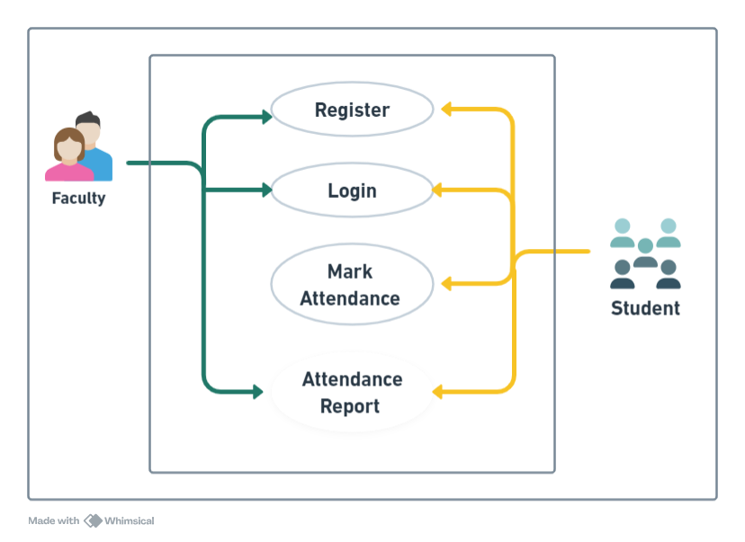
Diagram
Use Case Diagram

Slide 10
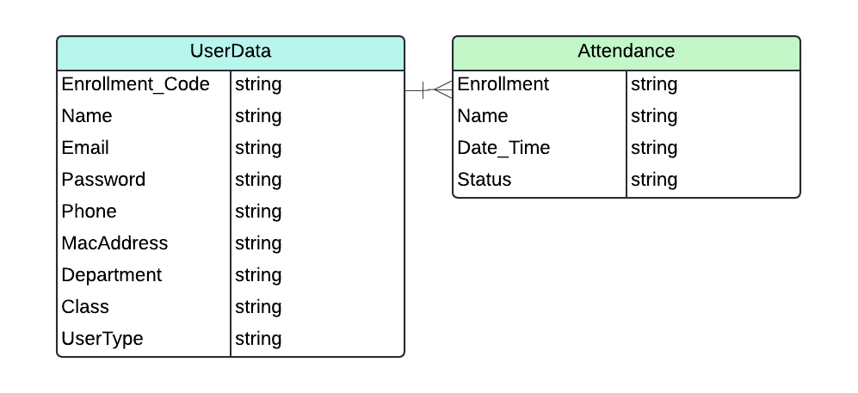
Diagram
Database Design

Slide 11
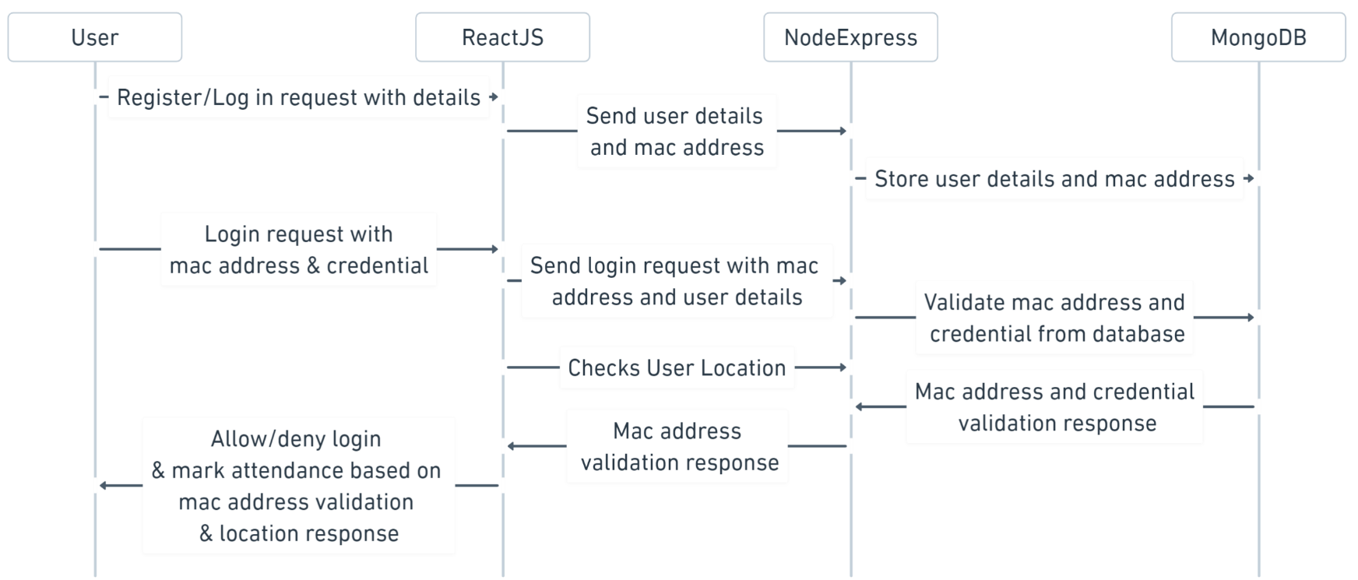
Diagram
Sequence Diagram

Slide 12
Proposed Solution
Project Structure:
Frontend: React.js application created with Create React App.
Backend: Node.js server using Express for handling API requests.
Database: MongoDB used to store user registration details.
Backend Implementation:
Express server set up to handle registration and login API endpoints.
MongoDB used for storing user data with a schema for User model.
Registration endpoint saves user details, MAC address, and user type to the database.
Login endpoint validates the MAC address against the stored data and returns user information if successful.
Frontend Implementation:
React components for registration and login (Register.js and Login.js).
State management using React Hooks to handle form input data.
Forms in each component to collect user input for registration and login.
Use fetch or axios to make asynchronous POST requests to the backend API.

Slide 13
Proposed Solution
User Registration Flow:
Users provide a user details as per requirement for registration.
Frontend sends a POST request to the backend registration endpoint.
Backend stores the user data in the MongoDB database.
User Login Flow:
Users provide their MAC address for login.
Frontend sends a POST request to the backend login endpoint.
Backend validates the MAC address against the stored data.
If successful, returns user details; otherwise, returns an error message.
Security Considerations:
Basic error handling implemented in both frontend and backend.
Encryption for passwords.
User input validation.
Project Setup and Dependencies:
Project dependencies managed using npm.
MongoDB used as the database, and the MongoDB connection established in the backend.
Express server configured to run on a specified port.

Slide 14
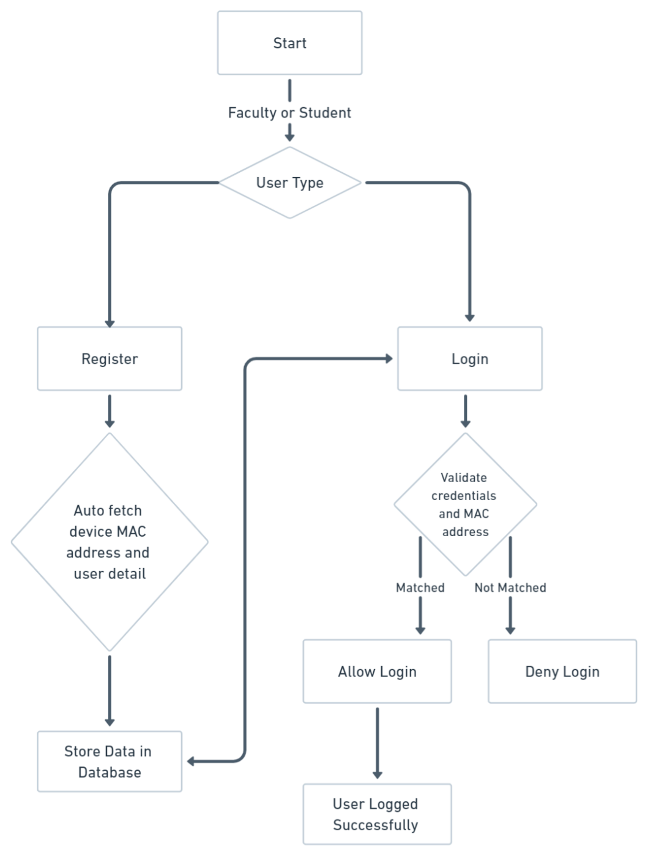
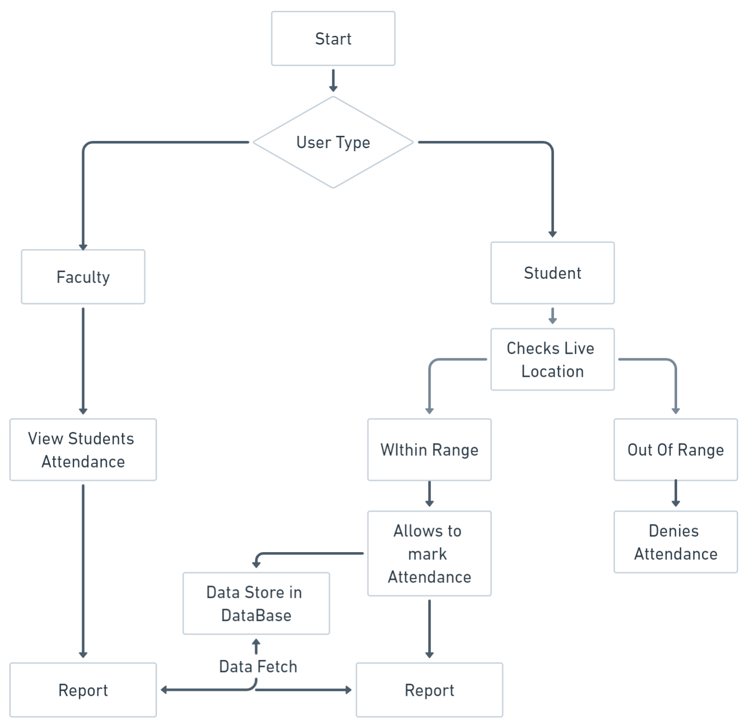
Project Flow Chart
After Login Flow Chart
Login & Registration Flow Chart

Slide 15
Tools & Technology
Our project, leveraging the MERN (MongoDB, Express.js, React, Node.js) technology stack to create a robust, scalable, and user-friendly solution that connects local service providers with individuals seeking services within their community. The MERN stack's strength lies in its ability to provide a full-stack JavaScript development environment, fostering code reuse and making it easier for developers to switch between the server and client sides. This stack is widely adopted for its flexibility, scalability, and efficiency in developing modern, single-page applications (SPAs) and other web-based projects.
Here's a brief description of each technology within the MERN stack:
React:
React is a powerful JavaScript library for building user interfaces. Developed and maintained by Facebook, React enables developers to create interactive and dynamic front-end applications with a component-based architecture. Its virtual DOM (Document Object Model) enhances performance by efficiently updating only the necessary parts of a web page, resulting in a smoother and more responsive user experience.
Express.js:
Express.js is a lightweight and flexible Node.js web application framework that simplifies the development of server-side applications. It provides a set of robust features for building web and mobile applications, including routing, middleware support, and the ability to create RESTful APIs. Express.js facilitates the rapid development of scalable and maintainable server-side components.
MongoDB:
MongoDB is a NoSQL, document-oriented database that stores data in a flexible, JSON-like format. It allows developers to handle large volumes of data and complex structures with ease. MongoDB's scalability and versatility make it an ideal choice for applications with evolving and dynamic data requirements.
Node.js:
Node.js is a server-side JavaScript runtime that enables the execution of JavaScript code outside of a web browser. It uses an event-driven, non-blocking I/O model, making it efficient for building scalable and real-time applications. Node.js is particularly well-suited for creating server-side components in MERN applications, ensuring a unified JavaScript stack from front to back.

Slide 16
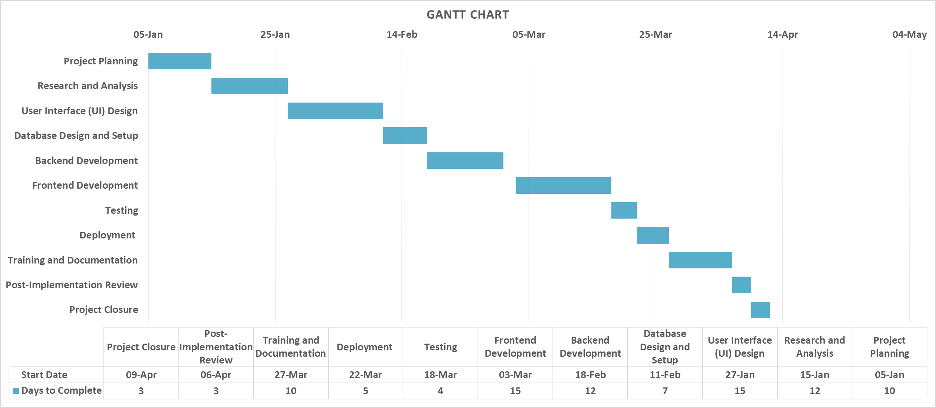
Gantt Chart

Slide 17
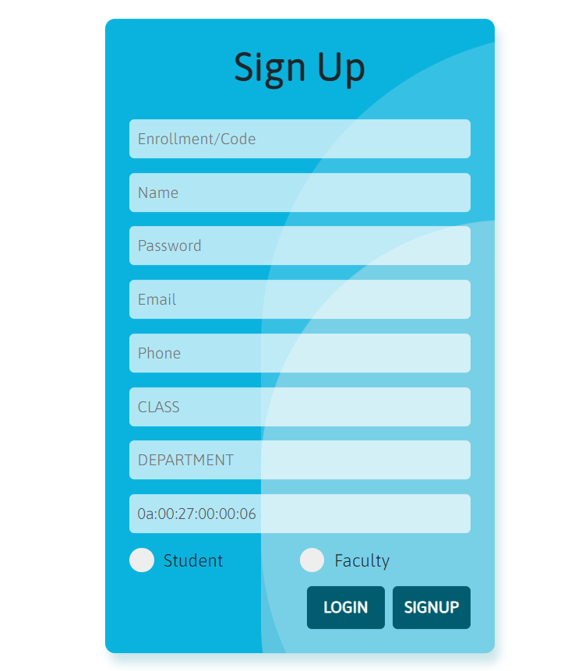
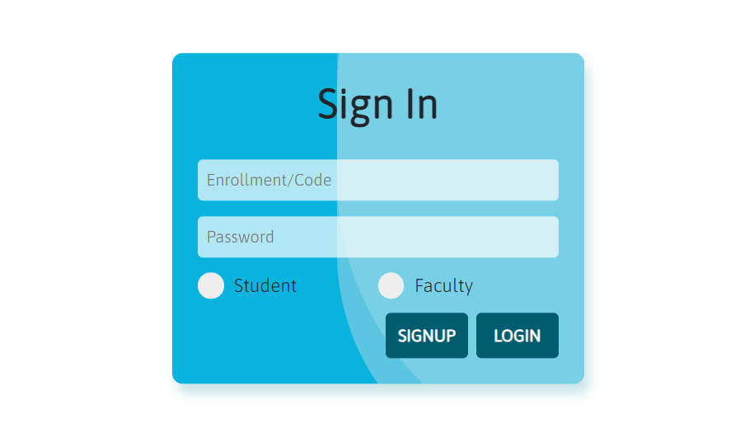
Expected Outcomes

Slide 18
References
WIFI BASED ATTENDANCE SYSTEM (Using QRCode)
https://ece.anits.edu.in/2019-20%20BE%20Project%20REPORTS/BCM_1920_PROJECT_2.pdf
Attendance Tracking System Using Wi-Fi (IP Based)
https://www.erpublication.org/published_paper/IJETR031995.pdf
Smart attendance system using RFID and Wi-Fi module
https://zenodo.org/records/6554182

Slide 19
Mini Project (01CE0609)
Review 2
WIFI BASED ATTENDANCE SYSTEM
Team ID: 102
Team Member 1: TEJ DEKIWADIYA (92100103011) (6TC2)
Team Member 2: UTSAV KHUNT (92100103007) (6TC2)
Team Member 3: SOHAM NAGPARA (92100103034) (6TC2)
Guided By
Internal Guide Name: Prof. Samir Kariya
Department of Computer Engineering, Faculty of Technology

Slide 20
Expected Outcomes

Slide 21
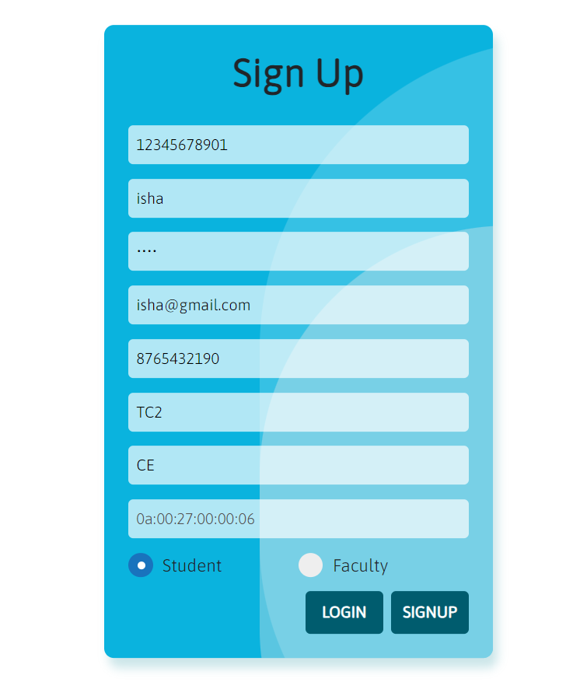
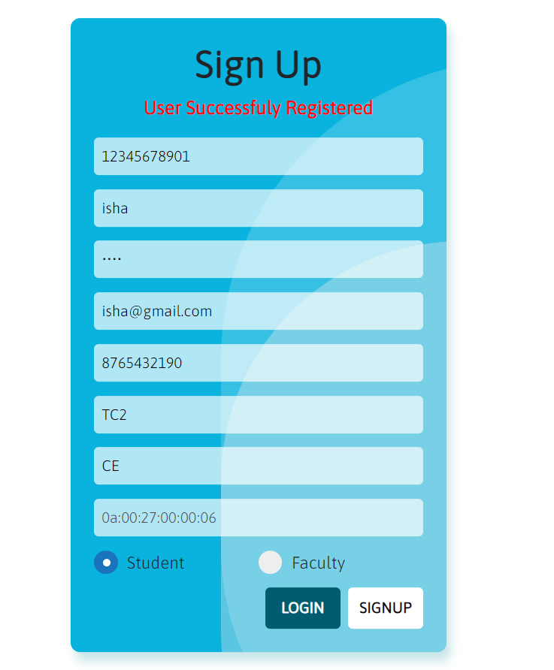
Expected Outcomes

Slide 22
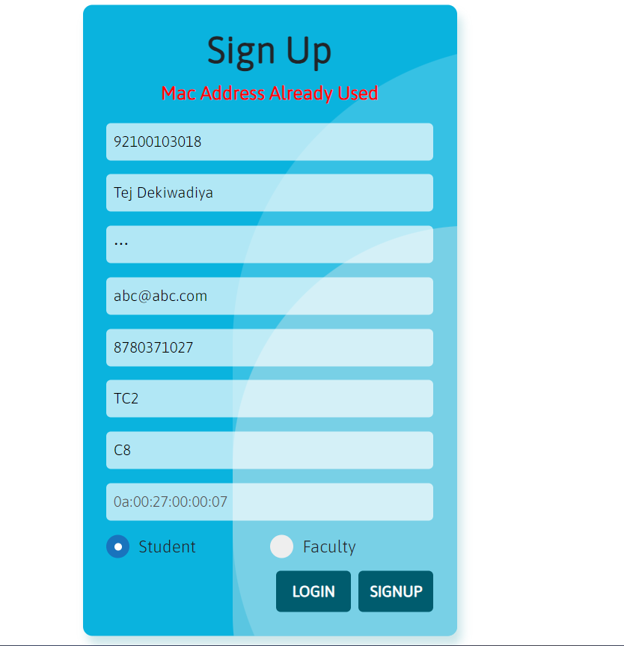
Expected Outcomes

Slide 23
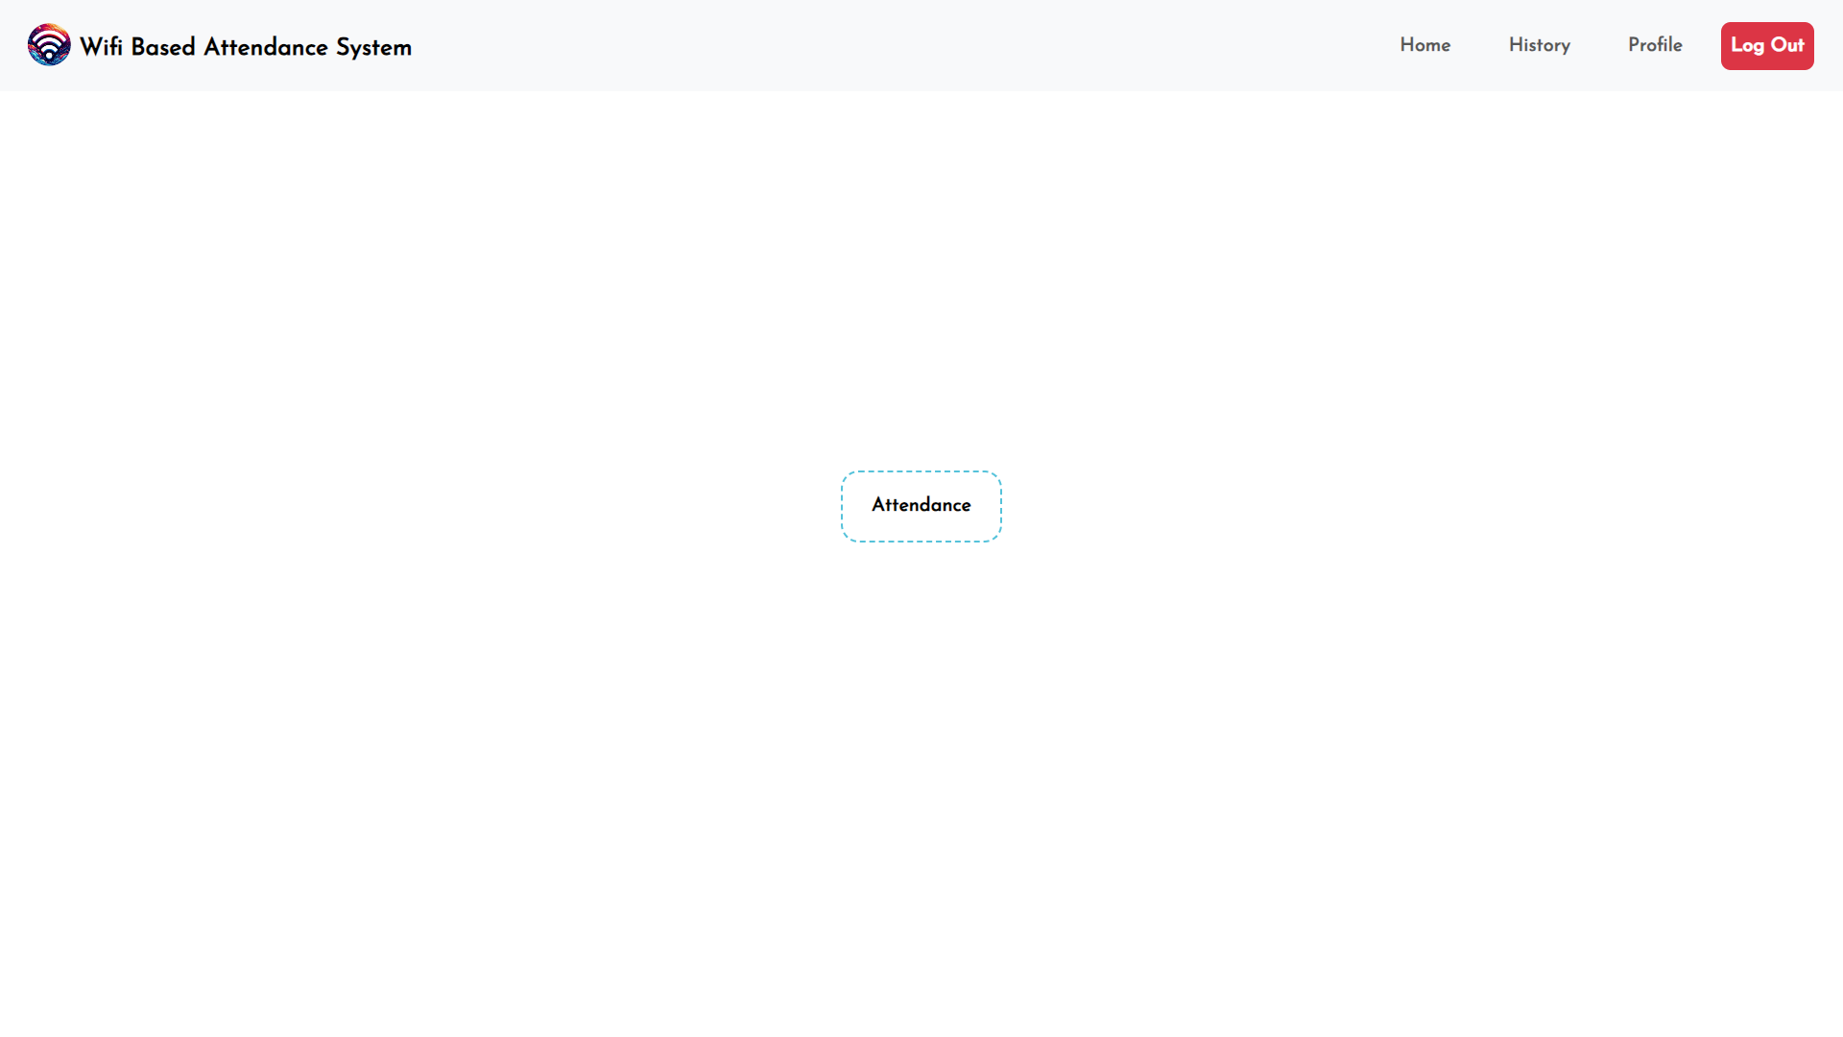
Expected Outcomes

Slide 24
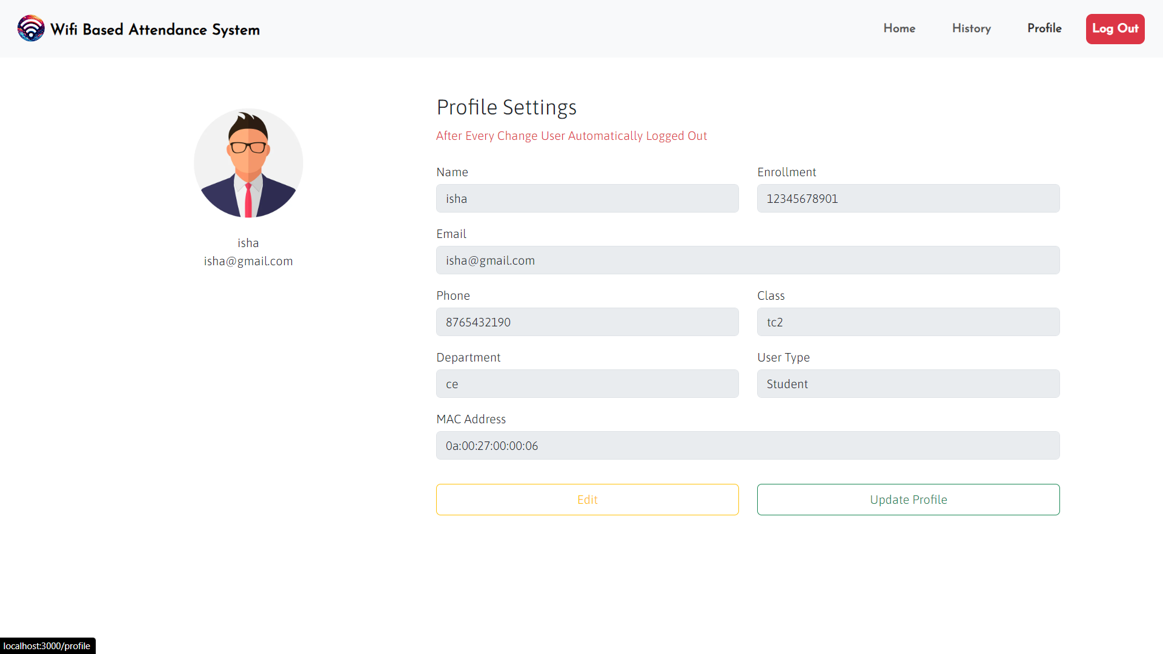
Expected Outcomes

Slide 25
Mini Project (01CE0609)
Final Review
WIFI BASED ATTENDANCE SYSTEM
Team ID: 102
Team Member 1: TEJ DEKIWADIYA (92100103011) (6TC2)
Team Member 2: UTSAV KHUNT (92100103007) (6TC2)
Team Member 3: SOHAM NAGPARA (92100103034) (6TC2)
Guided By
Internal Guide Name: Prof. Samir Kariya
Department of Computer Engineering, Faculty of Technology

Slide 26
Project Summary
The WIFI-Based Attendance System represents a significant advancement in attendance management, promising to transform traditional processes into streamlined, automated procedures. By harnessing the power of WIFI technology, this system eliminates the manual burden of attendance tracking, enabling organizations to achieve newfound efficiency and accuracy in record-keeping. Real-time data synchronization ensures that attendance records are always up-to-date, providing administrators with timely insights into attendance trends and patterns. The system's customizable reporting feature empowers decision-makers to derive actionable insights from attendance data. With robust authentication mechanisms in place, the system ensures the security and integrity of attendance records, bolstering trust and accountability within the organization. Its scalability and integration capabilities make it adaptable to organizations of varying sizes and seamlessly compatible with existing management systems. Overall, the WIFI-Based Attendance System offers a comprehensive solution that not only saves time and resources but also enhances transparency and operational effectiveness in attendance management.

Slide 27
Purpose
The purpose of the WIFI-Based Attendance System is to modernize and optimize attendance tracking processes within organizations. By leveraging WIFI technology and GPS technology, the system aims to automate the tedious task of attendance management, thereby reducing administrative burden and potential errors associated with manual data entry. The system's primary objective is to streamline attendance tracking, improve accuracy, enhance efficiency, and increase transparency in organizations of all sizes. Ultimately, the purpose of this system is to provide a reliable, real-time solution for managing attendance that aligns with the evolving needs and demands of modern workplaces and educational institutions.

Slide 28
Objective
Automate attendance tracking processes
Improve accuracy of attendance records
Enhance efficiency in attendance management
Increase transparency with real-time access to data
Ensure seamless integration with existing systems
Enhance security measures for data protection
Align with organizational needs and requirements

Slide 29
Scope
The scope of the WIFI-Based Attendance System involves developing software for automated attendance tracking, ensuring seamless integration with existing WIFI infrastructure and GPS. It encompasses real-time data synchronization, customizable reporting features, and robust security measures for data protection. Additionally, the project includes training sessions, support services, and scalability considerations to meet organizational needs efficiently.

Slide 30
Requirements Of New System
Hardware Requirements:
Server: To host our MERN stack application.
Networking Equipment: Reliable WIFI routers/access points to ensure stable connectivity for users.
Client Devices: Devices capable of connecting to WIFI, running a web browser and providing precise location for accessing the system.
Software Requirements:
Operating System: Windows or Ubuntu.
Database: MongoDB for storing user data including MAC addresses and attendance records.
Backend: Node.js for server-side scripting and Express.js for building RESTful APIs.
Frontend: React.js for the user interface.
Geolocation Services: Geolocation APIs to verify the user's live location and compare it with the predefined range for attendance marking.

Slide 31
Summary Of Project Work
Our project is a modern solution to streamline attendance tracking using WiFi technology. When users sign up for the system, their device's unique MAC address is securely stored in our database. Upon subsequent logins, the system verifies this MAC address to ensure authorized access. To prevent abuse, users can only mark their attendance if they are within a predefined range, verified through live location tracking. The system is built using the MERN stack, comprising MongoDB, Express.js, React.js, and Node.js, which ensures efficiency and flexibility. By leveraging WiFi and MAC address verification, we eliminate the need for traditional methods like ID cards or manual sign-ins, simplifying the process for both users and administrators. Overall, our WiFi-Based Attendance system offers a user-friendly and secure solution for organizations seeking a modern approach to attendance management, enhancing efficiency and accuracy while reducing administrative burden.

Slide 32
Limitations And Future Enhancement
Preventing Multiple Attendance Marking: Currently, users can mark attendance multiple times, causing inaccuracies. To tackle this, we plan to ensure users can only mark attendance once, enhancing data integrity. By implementing this solution, we'll promote fairness and accuracy in attendance records, ensuring each entry reflects a single instance of attendance
Enhancing Location Precision: Presently, our system lacks precise location data, limiting its accuracy. To overcome this, we aim to integrate GPS data, enabling pinpoint location accuracy. With this enhancement, we'll ensure that attendance tracking reflects users' actual presence in specified areas, enhancing reliability and trust in the system.

Slide 33
Project Outcomes
Streamlined Attendance Tracking: Our project aims to simplify attendance management by leveraging WiFi technology, reducing manual effort and paperwork. With our system, users can effortlessly mark their attendance using their devices, eliminating the need for traditional methods like paper sign-ins.
Enhanced Data Accuracy: By implementing measures to prevent multiple attendance marking and integrating precise location data, we ensure that attendance records are accurate and reliable. This enhances transparency and trust in the system, providing administrators with dependable data for payroll and performance evaluation.
Improved Efficiency and Productivity: With streamlined processes and accurate data, organizations can allocate resources more efficiently, optimize scheduling, and identify attendance patterns. This leads to improved productivity and better decision-making, ultimately benefiting the organization as a whole.

Slide 34

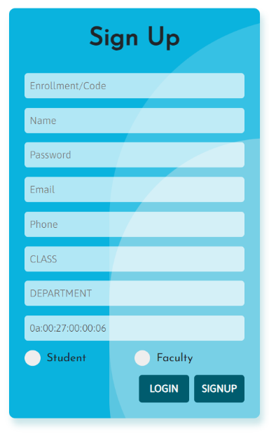
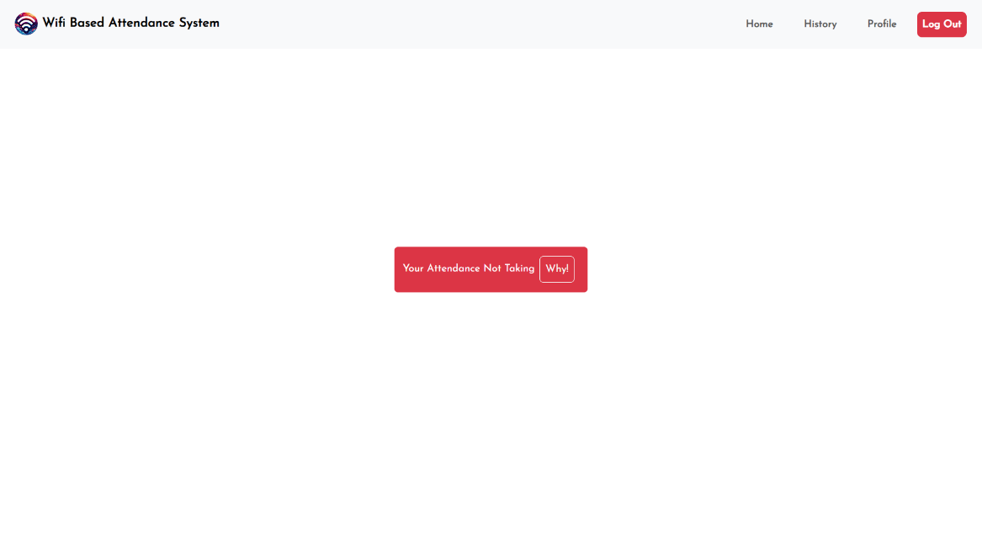
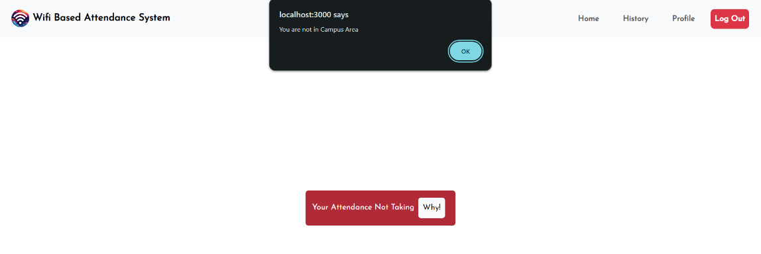
Outputs

Slide 35

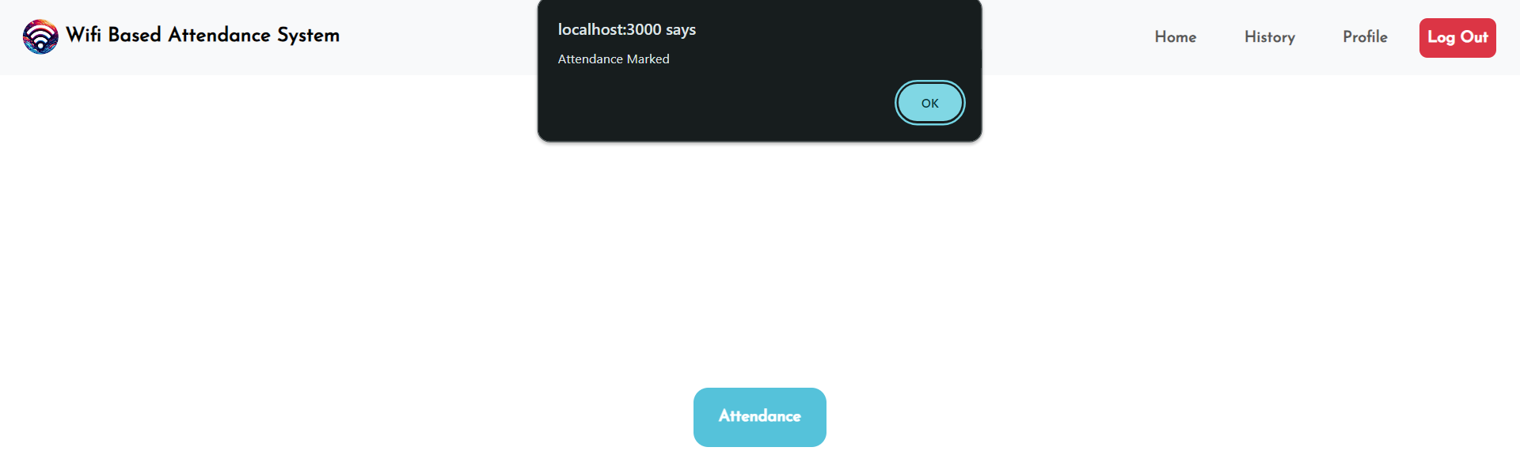
Outputs

Slide 36
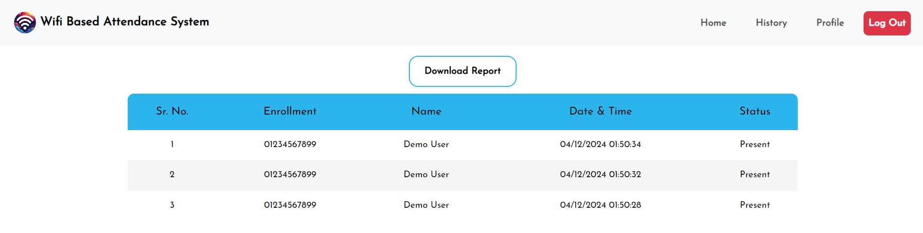
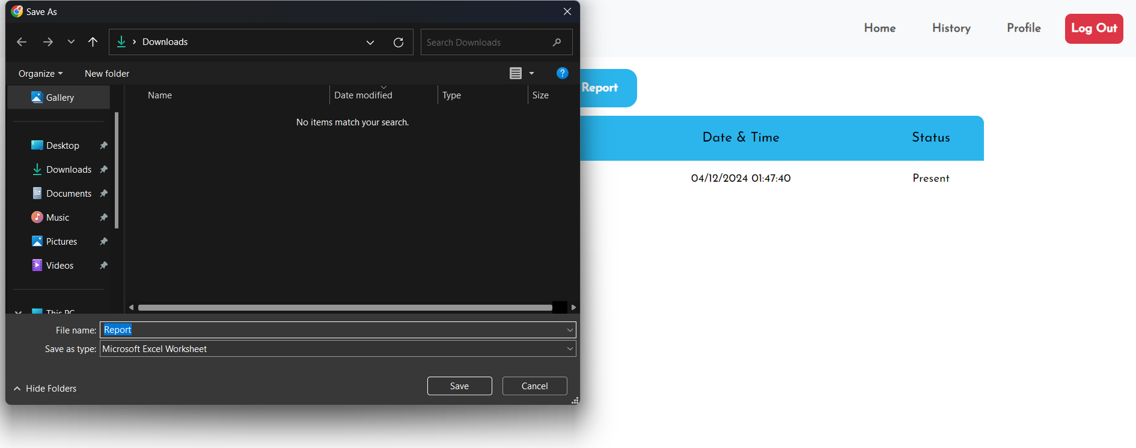
Outputs

Slide 37
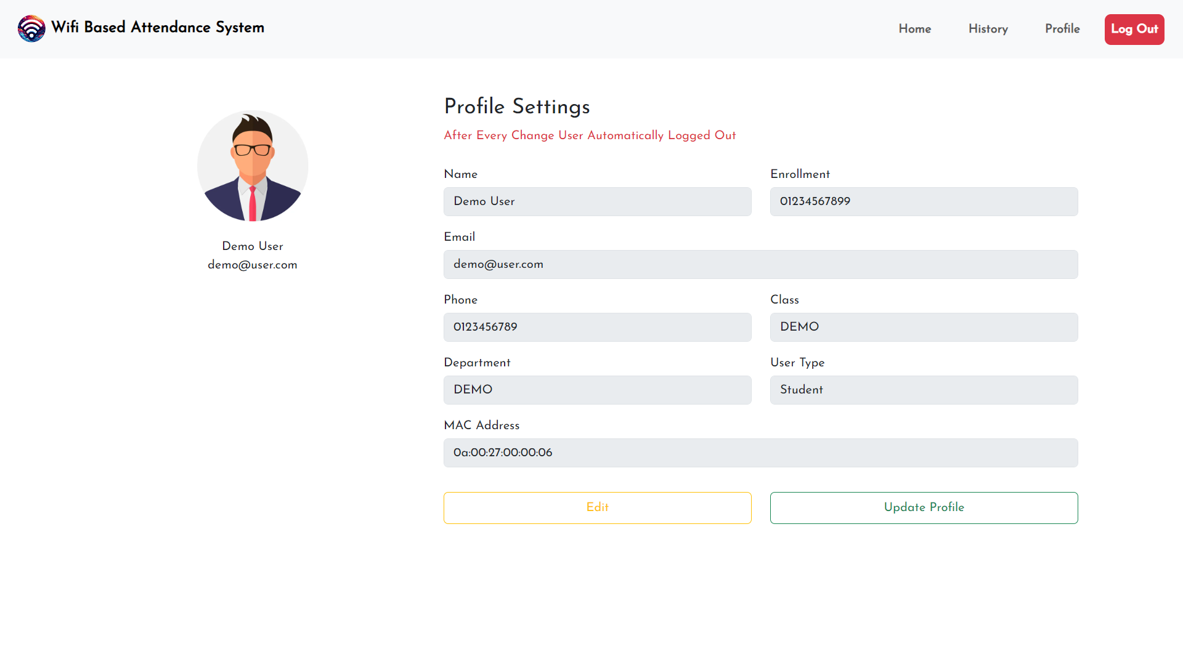
Outputs

Slide 38
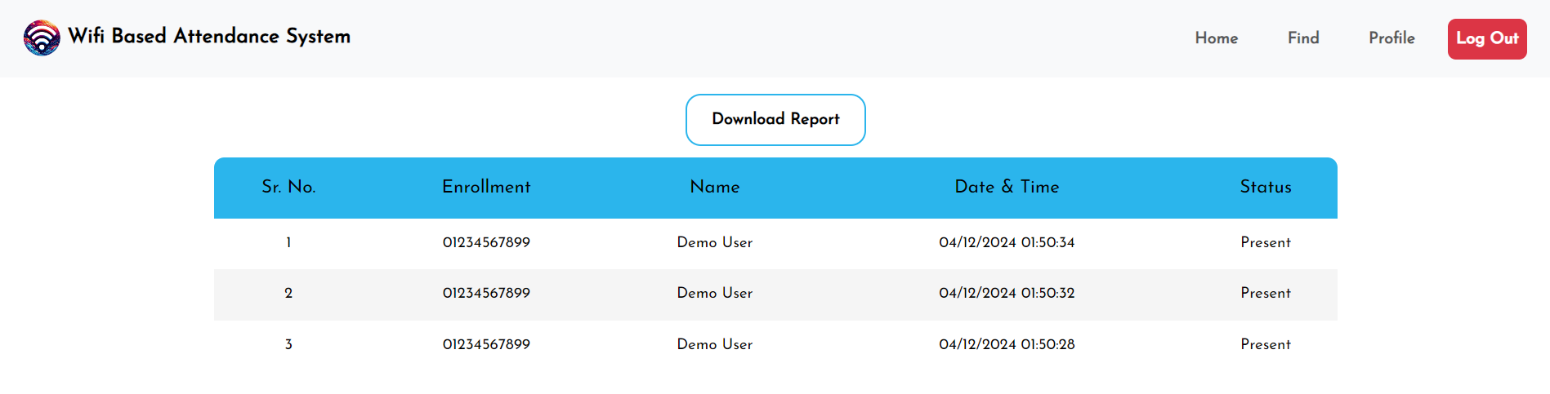
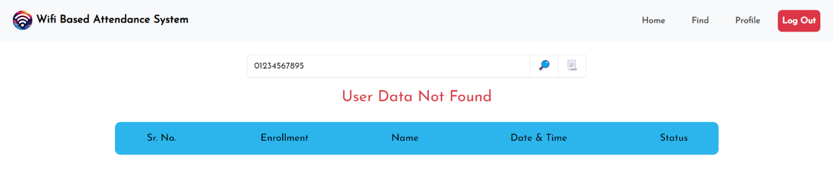
Outputs

Slide 39

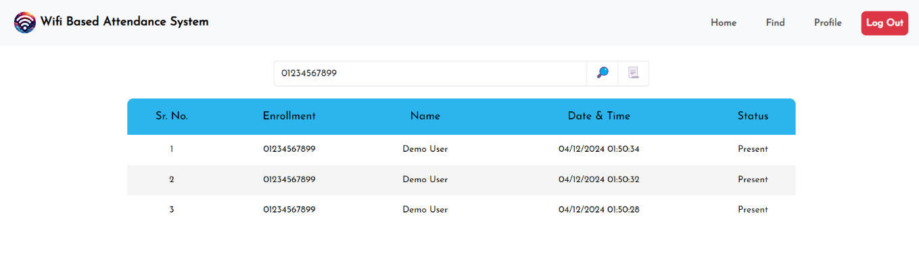
Outputs

Slide 40
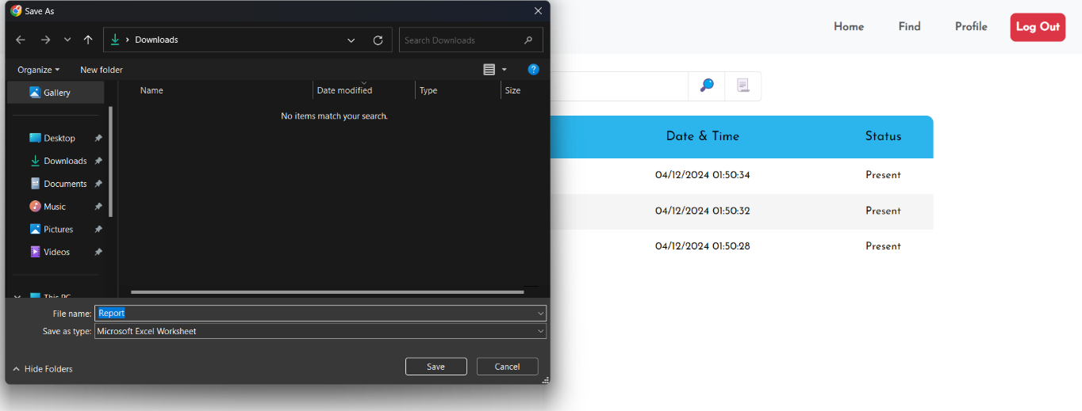

Outputs

Slide 41


