Slide 1
Inferential statistics
Statistical significance and statistical power
What are they?

Slide 2
The logic behind the meaning of p and power
Statistical significance (p): Assuming the null hypothesis is correct, what is the probability of getting a given result (or stronger) by chance? i.e., Prob(Data|H0)
Statistical power: Assuming a particular alternative hypothesis is correct, what is the probability of getting a result that allows you to reject the null hypothesis (at, say, p<.05) by chance? i.e., Prob(Data|H1)
Notes:
Prob(Data|H0) = Probability of data, given the null hypothesis
Prob(Data|H1) = Probability of data, given the alternative hypothesis
Alpha and power are monotonically related in opposite directions.
Increasing alpha means that your criteria are less stringent, but it means you’re more likely to find a false positive.
However, the tradeoff is that your study has greater power and you are more likely to say yes when the alternative hypothesis is true
Decreasing alpha means that finding significance will be harder, however the likelihood that you find a false positive is significantly lower.
Conversely, the smaller alpha means that you have also decreased your power. In English, this just means that the chance you are more likely to accept the null when it isn’t true.

Slide 3
Monte Carlo simulations
Set up the population for which the null (or alternative) hypothesis is true.
Simulate a study by randomly sampling from the population; record the result.
Keep doing the above (i.e., replicating) many, many times.
See how many of the studies resulted in a result that is at a certain level (or stronger)

Slide 4
Importance of statistical power
The main insight is:
No matter what your statistical power, when the null hypothesis is true, 5% of the time, you'll get a significant result.
Even when the null hypothesis is false (i.e., when your alternative hypothesis is correct), if you statistical power is low, you don't get a lot of significant results.
So, when statistical power is low, a large portion of the significant results reflect false alarms. (On the other hand, when statistical power is high, only a small portion of the significant results reflect false alarms).
The claim that "the results support one's hypothesis because p<.05" is more meaningful (more likely to be correct) if the statistical power of the study is high.
With assumptions about p(H0), you can compute p(H0|D) if you assume that when H0 is false, H1 is correct, and if know statistical power (i.e., p (D|H1)).

Slide 5
A thought experiment on the last point on the previous slide
Suppose, in your lifetime as a scientist, you've done 1000 studies, testing 1000 different hypotheses. Suppose, unbeknownst to you, 10% of the time your hypothesis [H1s] was correct.
Of the 900 times you were wrong (i.e., H0 is true), you still said “significant result!” 5% of the times = 45 times, by chance, if you used the p<.05 significance criterion.
Of the 100 times you were right (i.e., H1 is true), you said “significant result!” power*100, or 80 times. So:
If power = 0.8, you end up saying "significant!" 45 + 0.8*100 or 125 times. 45 of these happened (by chance) even though you were wrong. But the remaining 80 of the times, you were right. So: p(H1| you say “significant!”) = 0.8*100/(45+0.8*100)= 80/125 = .64
If power = 0.1, , you end up saying "significant" 45 + 0.1*100 or 55 times. 45 of these happened (by chance) even though you were wrong. But the remaining 10 of the times, you were right. So: p(H1| you say “significant!”) = 0.1*100/(45+0.1*100)=10/55= .18
Observation: When power is low, the majority of the time we find a significant result it's a false alarm. But when power is high, when we find significant results, they're more likely to be significant because the alternative hypothesis is correct.

Slide 6
To be sure, this happens when the probability of H1 is low. Below is what happens if P(H1) is high (e.g., when we're testing the hypothesis it's more likely to rain when there are clouds in the sky).
If P(H1) = 0.9:
Of the 100 times you were wrong (i.e., H0 is true), you still said “significant result!” 5% of the times = 5 times, by chance, if you used the p<.05 significance criterion.
Of the 900 times you were right (i.e., H1 is true), you said “significant result!” power*200 times [stat. power = p(data|H1)] So:
If power = 0.8, you end up saying "significant!" 5 + 0.8*900 or 725 times. 5 of these happened (by chance) even though you were wrong. But the remaining 720 of the times, you were right. So: p(H1| you say “significant!”) = 0.8*900/(5+0.8*900) = 720/725 = 0.99
If power = 0.1, , you end up saying "significant" 5 + 0.1*900 or 95 times. 5 of these happened (by chance) even though you were wrong. But the remaining 90 of the times, you were right. So: p(H1| you say “significant!”) = 0.1*900/(5+0.1*900)=90/95 = 0.95

Slide 7
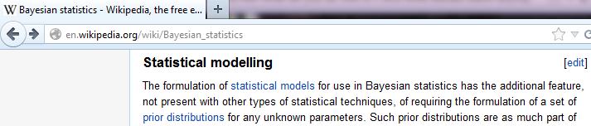
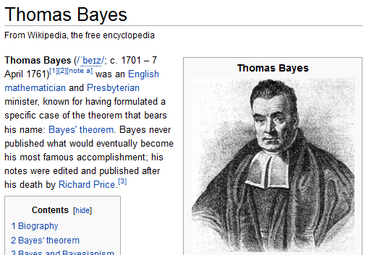
In what sense is it Bayesian?

Slide 8
My (YS’s) take:
Strive for large statistical power/don’t try to explain everything (esp. when power is low)

Slide 9
Confidence Intervals

Slide 10
Suppose that a 90% confidence interval goes from a low of100 to a high of 200. How would you interpret this statement?
http://stattrek.com/estimation/confidence-interval.aspx

Slide 11
Suppose that a 90% confidence interval goes from a low of100 to a high of 200. How would you interpret this statement?
Some people think this means there is a 90% chance that the population mean falls between 100 and 200. But what does it mean exactly?
http://stattrek.com/estimation/confidence-interval.aspx

Slide 12
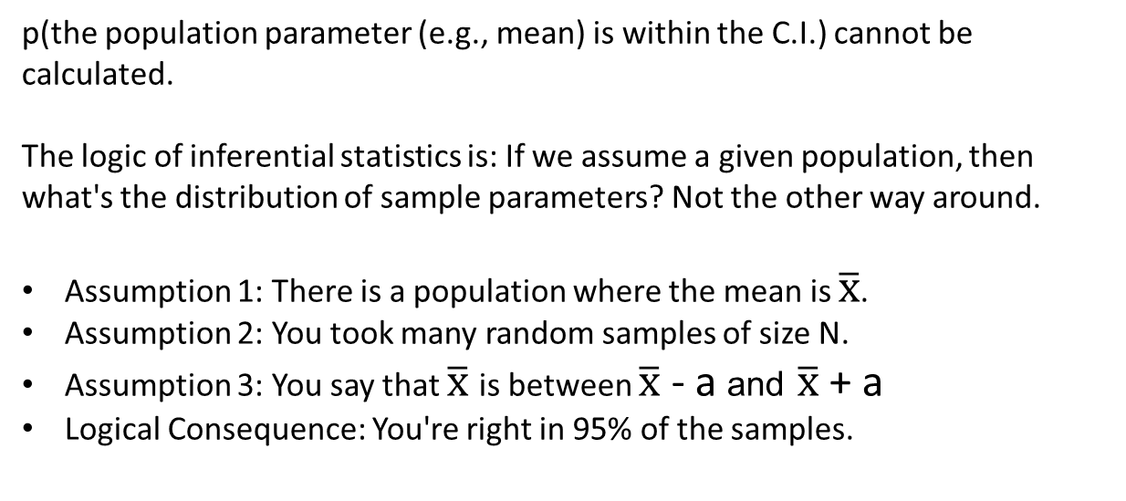
p(the population parameter (e.g., mean) is within the C.I.) cannot be calculated.
The logic of inferential statistics is: If we assume a given population, then what's the distribution of sample parameters? Not the other way around.
Assumption 1: There is a population where the mean is $\overline{x}$.
Assumption 2: You took many random samples of size N.
Assumption 3: You say that $\overline{x}$ is between $\overline{x}$ - a and $\overline{x}$ + a
Logical Consequence: You're right in 95% of the samples.

Slide 13

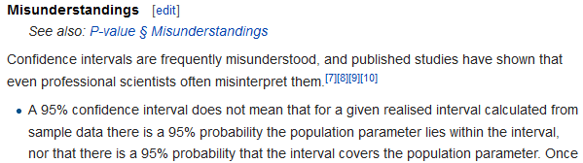

... if confidence intervals are constructed across many separate data analyses of repeated (and possibly different) experiments, the proportion of such intervals that contain the true value of the parameter

Slide 14
The confidence level describes the uncertainty associated with a sampling method. Suppose we used the same sampling method to select different samples and to compute a different interval estimate for each sample. Some interval estimates would include the true population parameter and some would not. A 90% confidence level means that we would expect 90% of the interval estimates to include the population parameter; A 95% confidence level means that 95% of the intervals would include the parameter; and so on.
http://stattrek.com/estimation/confidence-interval.aspx

Slide 15
Confidence intervals correspond to a chosen rule for determining the confidence bounds, where this rule is essentially determined before any data are obtained, or before an experiment is done. The rule is defined such that over all possible datasets that might be obtained, there is a high probability ("high" is specifically quantified) that the interval determined by the rule will include the true value of the quantity under consideration.

