Slide 1
Introduction to Multiple Regression
Why do we need multiple regression?

Slide 2
Let's set up a demo data set:
library(psych)
# setting up a population in which gre.q is positively related to gpa
population.N <- 10000 #smallish so my laptop can do this
sample.size.in.each.simulated.study <- 20
r.AC.gre.v <- 0.8
r.AC.gre.q <- 0.5
# true.slope <- 0
# AC below stands for "academic competence"
AC <- rnorm(n=population.N,mean=0,sd=1)
# creating gre.v such that cor(gre.v,AC) = intercorrelation
# In case you're interested, here's the rationale behind the formula I used below:
# First, in general, cor(X,Y) = cov(X,Y)/(sd(X),sd(Y)).
# So to make things simple, let's set up X and Y such that sd(X) = sd(Y) = 1,
# Then cor(X,Y) = cov(X,Y).
#
# Let's say we created Y such that Y = b*X + noise
# then cor(X,Y) = cov(X, b*X + noise) = cov(X,b*X) + cov(X,noise)
# ~ b*cov(X,X) + 0 # let "~" mean "equals in the long run"
# = b*var(X,X)
# = b # because sd(X) = 1.
#
# Q: How large should var(noise) be, so that var(Y) = 1?
# A: 1 - b^2.
#
# So, what we shold do is create Y such that Y = b*X + rnorm(sd=sqrt(1-b^2))
#
population.gre.v <- r.AC.gre.v*AC + sqrt(1 - r.AC.gre.v^2)*rnorm(n=population.N)
# Let's confirm:
cor(AC, population.gre.v)
population.gre.q <- r.AC.gre.q*AC + sqrt(1 - r.AC.gre.q^2)*rnorm(n=population.N)
cor(AC, population.gre.q)
#
# What's the correlation between gre.v and gre.q?
cor(population.gre.v, population.gre.q)#
# Let's linearly transform gre.v and gre.q so that the variables
# have a mean of 150 and sd of 20. Note cor(gre.v,gre.q) will remain
# the same. (Why?)
population.gre.v <- 150 + 20*population.gre.v
population.gre.q <- 150 + 20*population.gre.q
describe(population.gre.v)
describe(population.gre.q)
cor(population.gre.v, population.gre.q)
#
# Now, let's create the DV, Npubs, let's say it's the N of pre-tenure pubs.
population.Npubs <- 20 + 3*scale(population.gre.v) + 2*scale(population.gre.q) + rnorm(n=population.N)
describe(population.Npubs)
hist(population.Npubs)

Slide 3
Let's do one study:
# Let's do a study:
participantIDs <- sample(1:length(population.Npubs), size=50)
sample.gre.v <- population.gre.v[participantIDs]
sample.gre.q <- population.gre.q[participantIDs]
sample.Npubs <- population.Npubs[participantIDs]
describe(sample.gre.v)
describe(sample.gre.q)
describe(sample.Npubs)
plot(x=sample.gre.v, y=sample.Npubs)
plot(x=sample.gre.q, y=sample.Npubs)

Slide 4
Our challenge: come up with the best linear predictor of Npubs based on V and Q.
You can combine V and Q in any linear combination:
PREDICTED = a + b*sample.gre.v + c*sample.gre.q
For example:
PREDICTED = 0.2 + 0.5*sample.gre.v + 0.5*sample.gre.q
Such that PREDICTED fits Npubs best.
Notes:
Determining the values of a, b, and c follows the same principles as determining the variables in a one predictor line of best fit.

Slide 5
Graphically, we want to pick the best a, b, and c, to define
PRED=a + b*V + c*Q, such that PRED is the best predictor of Npubs
V
b * V
+ a
best fit
PRED
Npubs
Q
c * Q
Notes:
Main goal of multiple regression is to find the formula that is the best fit for making predictions.

Slide 6
You may use the results of the following regression analyses to find the best a, b, and c.
lm(sample.Npubs ~ sample.gre.v)
lm(sample.Npubs ~ sample.gre.q)
By "best" we mean sum(residuals) = 0, and sum(residuals^2)= 0:
# Let's say your prediction equation was:
Pred <- 20 + 3*(scale(sample.gre.v)) + 3*(scale(sample.gre.q))
# Let's compute the residuals:
Resid <- sample.Npubs - Pred
Resid2 <- Resid^2
# Let's see how our prediction fits the actual Npubs:
plot(sample.Npubs, Pred)
sum(Resid)
sum(Resid2)
plot(Pred,Resid) # if this goes down, you're over-predicting.

Slide 7
Exercise: Come up with a better way to combine V and Q (don't use multiple regression, yet:)

Slide 9
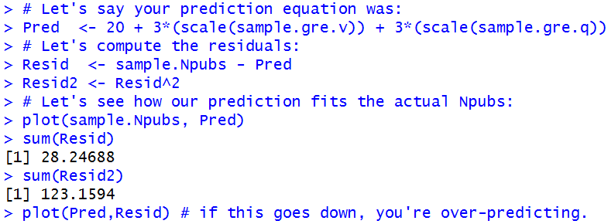
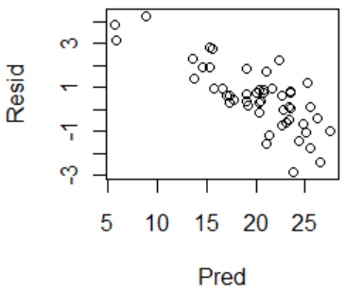
The following are produced by one possible (less than perfect) way of combining V and Q.

Slide 10
Is there a better way to combine V and Q to predict Npubs?

Slide 11
Is there a better way to combine V and Q to predict Npubs?
Yes.

Slide 12
Is there a better way to combine V and Q to predict Npubs?
Yes.
lm(sample.Npubs ~ sample.gre.v + sample.gre.q)

Slide 13
Is there a better way to combine V and Q to predict Npubs?
Yes.
lm(sample.Npubs ~ sample.gre.v + sample.gre.q)
Multiple regression!

Slide 14
lm.result <- lm(sample.Npubs ~ sample.gre.v + sample.gre.q)
lm.result$coefficients

Slide 15
lm.result <- lm(sample.Npubs ~ sample.gre.v + sample.gre.q)
lm.result$coefficients
Pred <- (lm.result$coefficients[1]
+ lm.result$coefficients[2]*sample.gre.v
+ lm.result$coefficients[3]*sample.gre.q)
Resid <- sample.Npubs - Pred
Resid2 <- Resid^2
# Let's see how our prediction fits the actual Npubs:
plot(Pred, sample.Npubs)
sum(Resid)
sum(Resid2)
plot(Pred,Resid) # if this goes down, you're over-predicting.

Slide 16
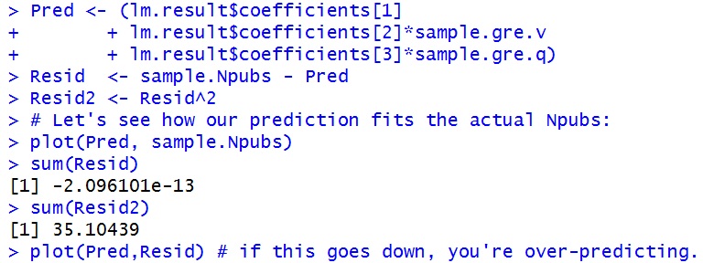
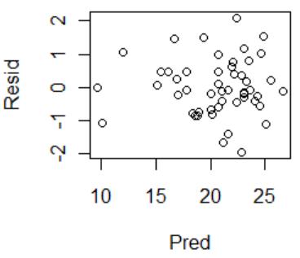

Slide 17



The new sum of the squared residuals is smaller than before (and should be the smallest possible)

Slide 18
What's the correlation between the residuals and the predictors?

Slide 19
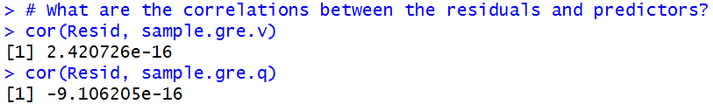
What are the correlations between the residuals and the predictors?

Slide 20


Slide 21
How good was the MR-based predictor of Npubs as a single variable predictor of Npubs?

Slide 22
How good was the MR-based predictor of Npubs as a single variable predictor of Npubs?

Slide 23
Compare the results with the results from the MR with V and Q?

Slide 24
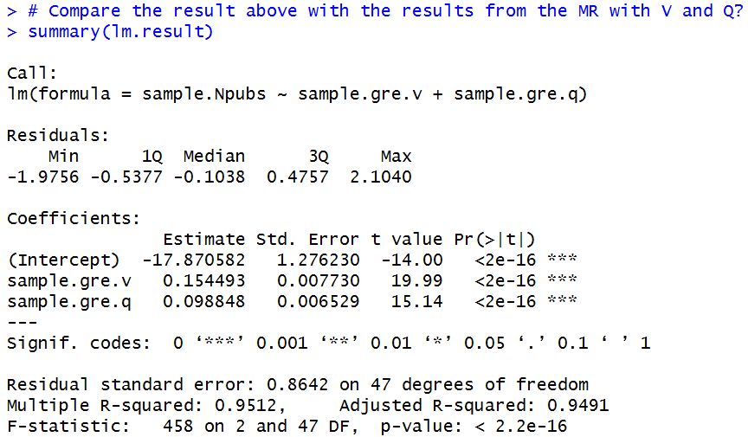
Compare the results with the results from the MR with V and Q?

Slide 25

Compare the results with the results from the MR with V and Q?

Slide 26
MR Take Home Points (so far)
MR gives you the best linear combination of IVs to predict the DV: predicted DV = a + b1*IV1 + b2*IV2, ...
var(DV) = var(predicted) + var(residual)
r(DV, predicted) = sqrt("Multiple R-squared") = Multiple R
R^2 = var(predicted)/var(DV)

Slide 27
Ideas for some insight-generating exercise
Go back to slide 2, generate a data set in which Q, rather than V, plays a greater impact on Performance; analyze with MR, and see if the results reflect that. What if V and Q are uncorrelated?
What if V and Q are highly correlated?

Slide 28
Extra Slides

Slide 29
Why? (an attempt at an intuitive explanation)
MR does its job by optimally weighting the IVs, thus forming a predictor in the form of: Predictor = B0 + B1*IV1 + B2*IV2 + ... Bn*IVn
The weights are adjusted so that this predictor does the best job at predicting the DV.
It does the prediction linearly (i.e., no further trickery). That is, through a bivariate regression predicting DV from Predictor.
The variance of the DV accounted for by Predictor is determinied by the correlation between Predictor and the DV. Call this "R".
The square of "R" is the variance of the DV accounted for by Predictor, which is the variance of the DV accounted for by this bunch of IVs optimally weighted.

Slide 30
What happens if your IVs are measured imperfectly?

Slide 31
Conclusion: MR's ability to "uncover the truth" depends on our ability to measure variables of interest reliably.
Implications: (1) try to measure as reliably as you can; while being aware of the consequences of unreliable measures (esp., IVs), and having measures with highly varying reliability.
(2) do SEM (http://en.wikipedia.org/wiki/Structural_equation_modeling)

Slide 32
Why "Adjusted R"?

Slide 34
Extra slides

Slide 35
Slope predicting PERFORMANCE from PRED.mr is 1.0, because it's already what we should predict (if PRED.mr = 1000, then we're predicting PERFORMANCE of 1000)

Slide 36
Different story when predicting from zPredicted
zV
.212* V
+0.0
zPredictedPERFORMANCE
0.86 * zPredictedPERFORMANCE
zPERFORMANCE
zQ
.733* Q

Slide 37
V
Why?
0.291 * V
+ 1.316
PredictedPERFORMANCE
1.0 * Predicted PERFORMANCE
PERFORMANCE
Q
100.753 * Q
Why? "It's already optimized, so that the sum of (PERFORMANCE - PredictedPERFORMANCE)^2 is minimum.
A more verbose way of saying the above:
1. MR produces PredictedPERFORMANCE that minimizes the sum of (PredictedPERFORMANCE - PERFORMANCE)^2.
2. If you regress PERFORMANCE on PredictedPERFORMANCE, you're asking SPSS to choose a and b that minimize the sum of:
((a + b*PredictedPERFORMANCE) - PERFORMANCE)^2
3. But we know PredictedPERFORMANCE is created such that the sum of (PredictedPERFORMANCE - PERFORMANCE)^2 is smallest
4. So (a + b*PredictedPERFORMANCE) = PredictedPERFORMANCE. That is, a = 0, b = 1.

Slide 38
Why?
zV
0.008 * V
+0.0
zPredictedPERFORMANCE
0.86 * zPredicted PERFORMANCE
zPERFORMANCE
zQ
0.813 * Q
Why? "It's already optimized, so that the sum of (zPERFORMANCE - zPredictedPERFORMANCE)^2 is minimum.
And the "slope of the regression line predicting zY from zX" is the correlation.
Remember: slope = r * SD(x)/SD(y) by stretching and shrinking X and Y. For every 1 unit increase in zX, r unit increase in zY

Slide 40
As noise increases, what remains constant?
Do the following twice, changing the amount of noise (sd=100, vs. 500)

Slide 41
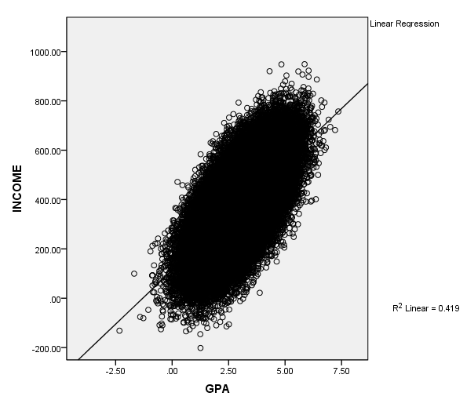
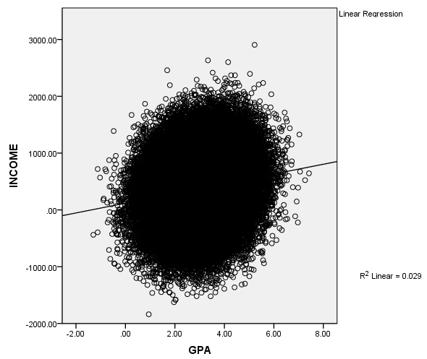

Slide 44
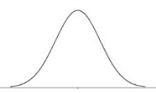
The "noise free" DV increased as a function of Q

Slide 45
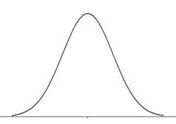
The "noise free" DV increased as a function of Q
Adding noise does not change the best fitting slope -- it still goes through the original "noise free" part, except now the distribution reaches up, and down, quite a lot, in an equal extent.

Slide 46
The same result if the noise is not normally distributed (e.g., uniform), as long as you add the same "noise" independent of the IV.

Slide 47
Let's see if MR can "reverse engineer".

