Slide 1
Summary: Hierarchical Multiple Regression
Introduce predictors in sequence (i.e., not all at the same time). For example:
Step 1: predict DV from IV1
Step 2: predict DV from an optimal combo of IV1, IV2
Step 3: predict DV from an optimal combo of IV1, IV2, IV3, ...
IVs in earlier steps are always a subset of later steps.
Examine the R (and hence R²) at each step.
R² always increases at each step (why?).
Results of interest: (1) What is the increase in R² as a result of adding new IV(s)? (2) Is the increase too large to happen by chance associations alone? If it is, the results suggest that the new IVs added account for the DV variance “over and above” the IVs entered in earlier steps.
Notes:
The earlier steps contain variables that are nested. Doing it this way makes significance testing possible.
Adding any new variable will increase multiple r2. Even if the variable is random. There is no variable completely unrelated to another. However, theoretically if there was a perfect correlation of 0 then the result would be AT LEAST the same as the initial IV/DV pairing.

Slide 2
These are the two meanings of semi-partial correlations:
If you square it, it is the additional variance of DV accounted for by the IV in question, over and above all other IVs in the model
Correlation of DV with the residuals of the IV in question controlling for all other IVs in the model

Slide 3
Inferential statistics with Hierarchical MR

Slide 4
Testing if the increase in R^2 is "significant"
set.seed(1)
N <- 100
SES <- rnorm(n=N) # I'm using upper case variables names for unobserved ones
education <- SES + rnorm(n=N)
occupation <- SES + rnorm(n=N)
income <- SES + rnorm(n=N)
DV <- 0.3*education + 0.4*occupation + 0.5*income + rnorm(n=N,sd=2)
lm.DV.edu <- lm(DV ~ education)
lm.DV.edu.occ <- lm(DV ~ education + occupation)
lm.DV.edu.occ.inc <- lm(DV ~ education + occupation + income)
summary(lm.DV.edu)$r.squared
summary(lm.DV.edu.occ)$r.squared
summary(lm.DV.edu.occ.inc)$r.squared
anova(lm.DV.edu, lm.DV.edu.occ, lm.DV.edu.occ.inc)

Slide 5
http://data.library.virginia.edu/hierarchical-linear-regression/

Slide 6
(1) Make a data set roughly like the example here (http://data.library.virginia.edu/hierarchical-linear-regression/)
n <- 100
age <- runif(n=N,min=18,max=35)
genderMale <- round(rnorm(n=N))
friends <- runif(n=N,min=5,max=20)
pets <- runif(n=N,min=0,max=10)
happiness <- (6 - 0.11*age - 0.14*genderMale + 0.17*friends + 0.36*pets
+ rnorm(n=N,sd=10))
(2) Following the examples shown on the web page above, analyze the data using lm(), report the results, and interpret them. In particular, answer the question "what proportion of the variance in happiness does the number of pets explain above and beyond age, gender, and the number of (human) friends? Is that increase statistically significant? And what exactly does your answer to the significance question mean? In your report (a Word document), be sure to include the R output, a table like the one from Lankau and Scandura (2002) included in the web page, and write a short paragraph interpreting the results.
Notes:
What is the probability of getting that increase in R squared given the null hypothesis.

Slide 8
The “Ballantine” “parts of the DV that overlaps with the IVs" metaphor
Y
X1
X2

Slide 9


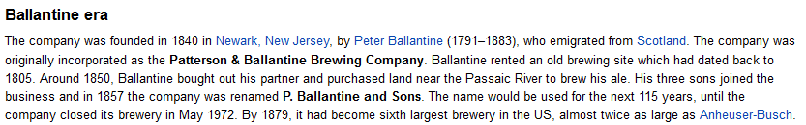
Digression: What’s “Ballantine”?

Slide 10
The “Ballantine” “parts of the DV that overlaps with the IVs" metaphor
Y
X1
X2

Slide 11
The “ballantine” visual interpretation of sr as the part of the DV variance “overlapping” with the IVs
X2
Y
X1

Slide 12
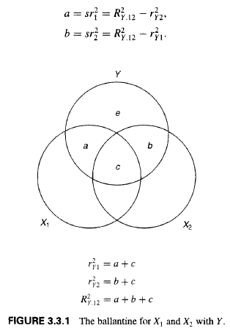
The “ballantine” visual interpretation of sr as the part of the DV variance “overlapping” with the IVs
sr^2 is the additional variance accounted for
X2
Y
X1
sr^2(Y,X1 controlling for X2) = a/(a+b+c+e)

Slide 13



The “ballantine” visual interpretation of sr as the part of the DV variance “overlapping” with the IVs
sr^2 is the additional variance accounted for
X2
Y
X1
Extension to partial correlation

Slide 14
The “ballantine” visual interpretation of sr as the part of the DV variance “overlapping” with the IVs
sr^2 is the additional variance accounted for
d
Extension to partial correlation

Slide 15
The “ballantine” visual interpretation of sr as the part of the DV variance “overlapping” with the IVs
sr^2 is the additional variance accounted for
N <- 1000
common <- rnorm(n=N)
x1 <- common + rnorm(n=N)
x2 <- common + rnorm(n=N)
y <- x1 + x2 + rnorm(n=N)
summary(lm(y~x1))$r.squared
summary(lm(y~x2))$r.squared
summary(lm(y~x1 + x2))$r.squared
summary(lm(x1~x2))$r.squared
d
Extension to partial correlation

Slide 16
The “ballantine” visual interpretation of sr as the part of the DV variance “overlapping” with the IVs
> N <- 1000
> common <- rnorm(n=N)
> x1 <- common + rnorm(n=N)
> x2 <- common + rnorm(n=N)
> y <- x1 + x2 + rnorm(n=N)
>
> summary(lm(y~x1))$r.squared
[1] 0.6241638
> summary(lm(y~x2))$r.squared
[1] 0.6703429
> summary(lm(y~x1 + x2))$r.squared
[1] 0.8588598
> summary(lm(x1~x2))$r.squared
[1] 0.2582979
sr^2 is the additional variance accounted for
d
Extension to partial correlation

Slide 17
The “ballantine” visual interpretation of sr as the part of the DV variance “overlapping” with the IVs
> N <- 1000
> common <- rnorm(n=N)
> x1 <- common + rnorm(n=N)
> x2 <- common + rnorm(n=N)
> y <- x1 + x2 + rnorm(n=N)
>
> summary(lm(y~x1))$r.squared
[1] 0.6241638
> summary(lm(y~x2))$r.squared
[1] 0.6703429
> summary(lm(y~x1 + x2))$r.squared
[1] 0.8588598
> summary(lm(x1~x2))$r.squared
[1] 0.2582979
sr^2 is the additional variance accounted for
d
a + b + c = .86
a = .86 - .67 = .19
b = .86 - .62 = .24
c = (.62 + .67) - .66 = .63
d = .26 - .63 = -.37 ???!
Extension to partial correlation

Slide 18
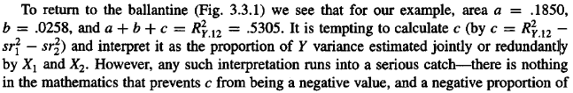
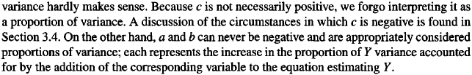
Limits of the "ballantine" analogy: Interpreting "area C" as a proportion of variance can also be a problem (see pages 73 and 170 of CCWA).
CCWA, page 73

Slide 19
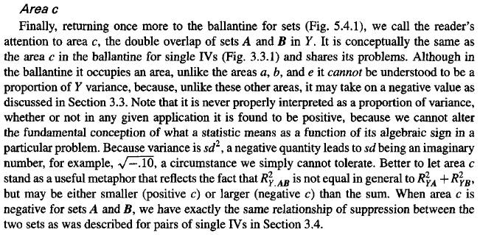
CCWA, page 170

