Slide 1
The impact of the number of IVs
Why does CCWA caution against having lots of IVs?
What's the purpose of an "adjusted R"?

Slide 2
Demo/exploration using N_of_IVs.R
Create a universe in which there are a number of predictor (IV) variables, and a DV that is, in the long run, not correlated at all to any of the predictor variables.
First, create (i.e., sample) a data set with 30 cases, and 10 predictor variables none of which are (in the long run) correlated with the DV. What’s the multiple-R? And what's the r between any given pair of variables?
Explore the effect of increasing the number of IVs. Try 20 IVs. How do the results compare against what you found above?
How did "adjusted R“ change as you changed N (sample size) and K (N of predictor variables)?
Set K = 3. Reduce N to 10, and then to 5, and finally to 3. What happens to the R?

Slide 3
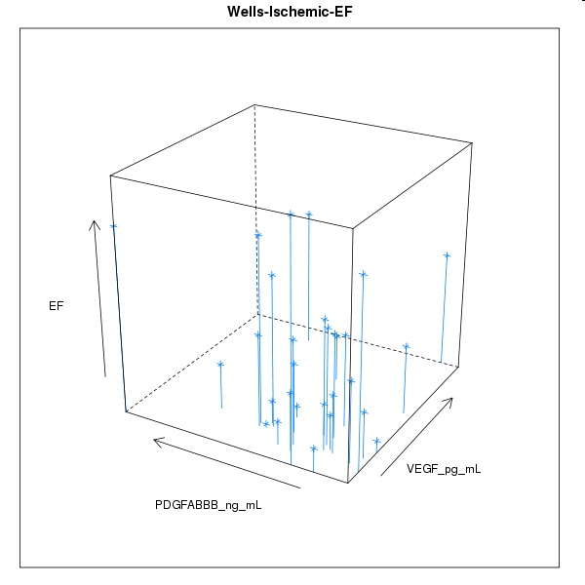
Regression analysis when N > 3, K = 2: finding a plane that minimizes the sum of squared errors (on the Y dimension) from the plane.
Y
X2
X1

Slide 4
You can fit a plane through any three points in a 3D space. Hence when N=3, K=2 (i.e., X1 and X2 predicting Y), R = 1.0.
Y
X2
X1

Slide 5
* Why?
* 3 data points in a 3D space forms a triangle.
* You can always find a plane that goes through 3 data points in a 3D space.
* Y = b0 + b1*X1 + b2*X2 defines a plane in a 3D space.

Slide 6
Imagine, if you can (I can’t), 4 points in a 4D space. We can find a 3D “plane” that fits these 4 points. Hence R=1.0 when N=4, K=3.

Slide 7
Why adjusted R?
“Because R is a ‘biased estimate’ of the population value”

Slide 8
"Adjusted R is to R, as (sum of squared deviations)/(N-1) is to (sum of squared deviations)/N."
But there are different approaches to exactly how to make that adjustment: e.g., https://stat.ethz.ch/pipermail/r-help/2013-January/346273.html
Also, it doesn't lend itself to the "partitioning of variance" framework.

Slide 9
A nice Wikipedia entry about biased vs. unbiased estimator: http://en.wikipedia.org/wiki/Bias_of_an_estimator. The first paragraph, and the sections on Median-unbiased estimators, Bias with respect to other loss functions, and Effects of transformations, are worth reading (but don't worry about the math part, unless of course you're interested in that part, then by all means delve into it!). This Wikipedia article also says something thought-provoking: there are situations "for which it may be good to use an estimator with a small, but nonzero, bias." I suggest thinking about what this means.

Slide 10

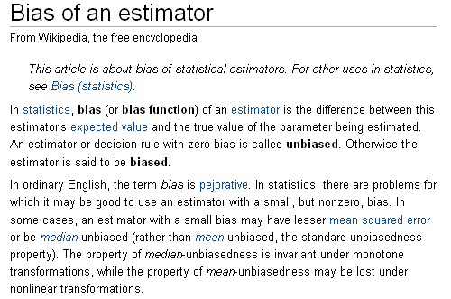

Slide 11
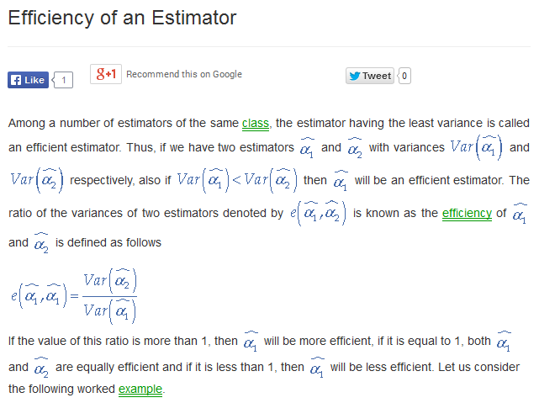
http://www.emathzone.com/tutorials/basic-statistics/efficiency-of-an-estimator.html

