Slide 1
Suppression

Slide 2
Suppose we are interested in predicting people's real-life performance, and we have available two predictor variables: one is their scores on a test that measures abilities relevant for the performance we're interested in, and the other is a measure that simply reflects people's ability to do well on any test (independent of their actual ability or knowledge the test seeks to measure).
To illustrate, the R code below creates a data set with a number of variables including: performance, aptitude.measure, and tt.skills.measure.
set.seed(1)
N <- 1000
TRUE.APTITUDE <- rnorm(n=N)
TEST.TAKING.SKILLS <- rnorm(n=N)
aptitude.measure <- TRUE.APTITUDE + TEST.TAKING.SKILLS + rnorm(n=N)
tt.skills.measure <- TEST.TAKING.SKILLS + rnorm(n=N)
performance <- TRUE.APTITUDE + rnorm(n=N)

Slide 3
Let's first examine how the two tests are related to Performance.
round(cor(performance,cbind(aptitude.measure, tt.skills.measure)),2)
lm.perf.apt <- lm(performance ~ aptitude.measure)
summary(lm.perf.apt)$r.squared
lm.perf.tts <- lm(performance ~ tt.skills.measure)
summary(lm.perf.tts)$r.squared

Slide 4
Let's first examine how the two tests are related to Performance.
What happens if you use both as a predictor in an MR?
round(cor(performance,cbind(aptitude.measure, tt.skills.measure)),2)
lm.perf.apt <- lm(performance ~ aptitude.measure)
summary(lm.perf.apt)$r.squared
lm.perf.tts <- lm(performance ~ tt.skills.measure)
summary(lm.perf.tts)$r.squared

Slide 5
Let's first examine how the two tests are related to Performance.
What happens if you use both as a predictor in an MR?
Does adding tt.skills.measure significantly improve aptitude.measure's ability to predict performance?
round(cor(performance,cbind(aptitude.measure, tt.skills.measure)),2)
lm.perf.apt <- lm(performance ~ aptitude.measure)
summary(lm.perf.apt)$r.squared
lm.perf.tts <- lm(performance ~ tt.skills.measure)
summary(lm.perf.tts)$r.squared

Slide 6
Let's first examine how the two tests are related to Performance.
What happens if you use both as a predictor in an MR?
Does adding tt.skills.measure significantly improve aptitude.measure's ability to predict performance?
round(cor(performance,cbind(aptitude.measure, tt.skills.measure)),2)
lm.perf.apt <- lm(performance ~ aptitude.measure)
summary(lm.perf.apt)$r.squared
lm.perf.tts <- lm(performance ~ tt.skills.measure)
summary(lm.perf.tts)$r.squared
lm.perf.tts.apt <- lm(performance ~ tt.skills.measure + aptitude.measure)
summary(lm.perf.tts.apt)$r.squared
anova(lm.perf.apt, lm.perf.tts.apt)

Slide 7
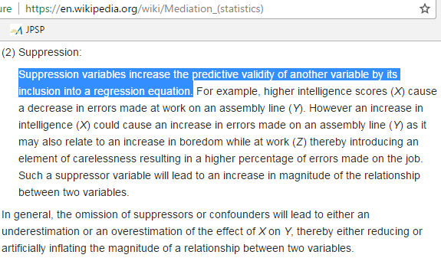
What we have here is an instance of "suppression"
https://www.youtube.com/watch?v=Ysg6-puIR1s

Slide 8
A "inside look" into a suppression situation
Test taking skills
True ability

Slide 9
A "inside look" into a suppression situation
Test taking skills
True ability
Real-life performance

Slide 10
A "inside look" into a suppression situation
Test taking skills
Performance on a paper-and-pencil measure of the ability
True ability
Real-life performance

Slide 11
A "inside look" into a suppression situation
Performance on a measure of test-taking skills
Test taking skills
Performance on a paper-and-pencil measure of the ability
True ability
Real-life performance

Slide 12
Using Christensen & Smith (2016) as an example, write up the analysis and results from the previous slides.
In addition, compute the residuals of aptitude.measure controlling for test.taking.skills.measure, and then how much of the variance of performance the residuals account for. Use this to illustrate your interpretation of the results above.

Slide 14
A limitation of the "ballantine" analogy (again)
and a better (I think) visual representation

Slide 15
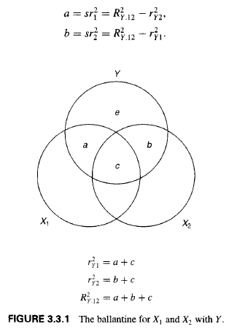



The “ballantine” visual interpretation of sr as the part of the DV variance “overlapping” with the IVs
sr^2 is the additional variance accounted for
> lm.perf.apt <- lm(performance ~ aptitude.measure)
> lm.perf.tts <- lm(performance ~ tt.skills.measure)
> lm.perf.tts.apt <- lm(performance ~ tt.skills.measure
+ aptitude.measure)
> summary(lm.perf.apt)$r.squared
[1] 0.07069052
> summary(lm.perf.tts)$r.squared
[1] 0.003765638
> summary(lm.perf.tts.apt)$r.squared
[1] 0.201663
a + b + c = .201
a = .201 - .004 = .197
b = .201 - .071 = .130
c = (.071 + .004) - .201 = -.126 ???!
aptitude.measure
test.taking.skills.measure
Extension to partial correlation

Slide 16

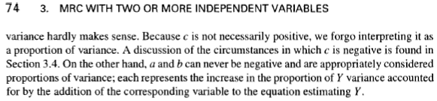
A problem with (or the limit of) the "ballantine" visual analogy
page 74

Slide 17
A “better” interpretation, which avoids running into the problem of interpreting area c as variance:
Correlation between partial “components” of IVs and DV.

Slide 18
In contrast to the “Ballantine” “parts of the DV that overlaps with the IVs:
Y
“Info contained in x1”
“Info contained in x2”
sr1

Slide 19
A better metaphor
Y
Let’s visualize sr as correlations between partial “components” of IVs and the whole DV
sr.1
“Info contained in x1”
“Info contained in x2”
X2.1
sr.1 = cor(Y, X2.1)

Slide 20
Y
This makes it easier to visualize sr when controlling for more than one variable
sr.13
“Info contained in x1”
“Info contained in x2”
X2.13
“Info. contained in X3”
sr.13 = cor(Y, X2.13)

Slide 21
What about partial (i.e., NOT semi partial) correlations?

Slide 22
“Info contained in x1”
Y
Let’s visualize pr as correlations between partial “components” of IVs and partial components of the DV
pr.1
“Info contained in x1”
“Info contained in x2”
X2.1
pr.1 = cor(Y.1, X2.1)

Slide 23
“Info contained in x1”
Y
This makes it easier to visualize pr when controlling for more than one variable
“Info. contained in X3”
pr.13
“Info contained in x2”
“Info contained in x1”
X2.13
“Info. contained in X3”
pr1.13 = cor(Y.13, X2.13)

Slide 24
The meaning of partial (rather than "part" aka "semi-partial") correlations
It’s the correlation between the residual of DV and the residual of the IV in question, both controlling for all other IVs in the model; the parts predicted by the other IVs are taken out from both the DV and the IV of interest.
But it's not "nice" in the context of hierarchical MR because for semi-partial correlations:
Variance of Y accounted for X and Z =
+ (semi-partial correlation for predicting Y from Z)^2
+ (semi-partial correlation for predicting Y from X controlling for Z)^2
Squared partial correlations don't add up nicely because it's a proportion of different parts of the DV variance.

