Slide 1
Basic concepts in ML
15CSE401
Machine Learning and Data Mining
Radhakrihnan / Priyanka Vivek
Department of CSE

Slide 2
Parametric vs non-parametric models
Does the model have a fixed number of parameters
Fixed: parametric
Pros: Faster to use
Cons: makes stronger assumptions about the nature of the data distributions
Parameters may grow with data: non-parametric
Pros: More Flexible
Cons: Computationally more complex

Slide 3
Example of a non-parametric classifier
K-nearest neighbors
“looks at” the K points in the training set that are nearest to the test input x, counts how many members of each class are in this set, and returns that empirical fraction as the estimate
where, where N_{K}(x,D) are the (indices of the) K nearest points to x in D and

Slide 4
K-nearest neighbors

Slide 5
ML Concepts contd...
Linear regression
Response is a linear function of the inputs
Logistic regression
Generalization of linear regression to the (binary) classification

Slide 6
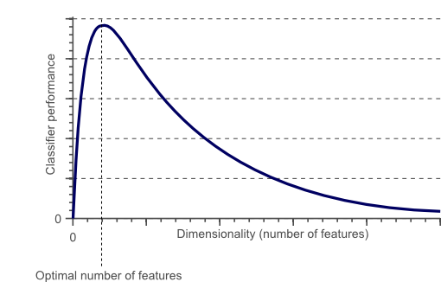
Curse of dimensionality
After a certain point, increasing the dimensionality of the problem by adding new features would actually degrade the performance of our classifier
As the dimensionality increases, the classifier’s performance increases until the optimal number of features is reached. Further increasing the dimensionality without increasing the number of training samples results in a decrease in classifier performance.

Slide 7
ML Concepts contd...
Overfitting
A model is said to be overfitted, when we train it with a lot of data. When a model gets trained with so much of data, it starts learning from the noise and inaccurate data entries in our data set. Then the model does not categorize the data correctly, because of too much of details and noise.
No free lunch theorem
There is no universally best model. The reason for this is that a set of assumptions that works well in one domain may work poorly in another.

Slide 8
How to avoid Overfitting:
The commonly used methodologies are:
Cross- Validation: A standard way to find out-of-sample prediction error is to use 5-fold cross validation.
Early Stopping: Its rules provide us the guidance as to how many iterations can be run before learner begins to over-fit.
Pruning: Pruning is extensively used while building related models. It simply removes the nodes which add little predictive power for the problem in hand.
Regularization: It introduces a cost term for bringing in more features with the objective function. Hence it tries to push the coefficients for many variables to zero and hence reduce cost term.

Slide 9
Reinforcement Learning
It is an important type of ML where an agent learn how to behave in an environment by performing actions and seeing the results.
Idea:
An agent will learn from the environment by interacting with it and receiving rewards for performing actions

Slide 10
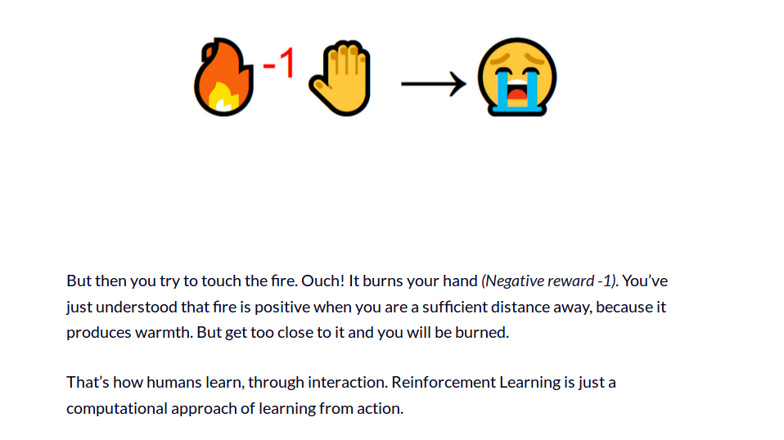
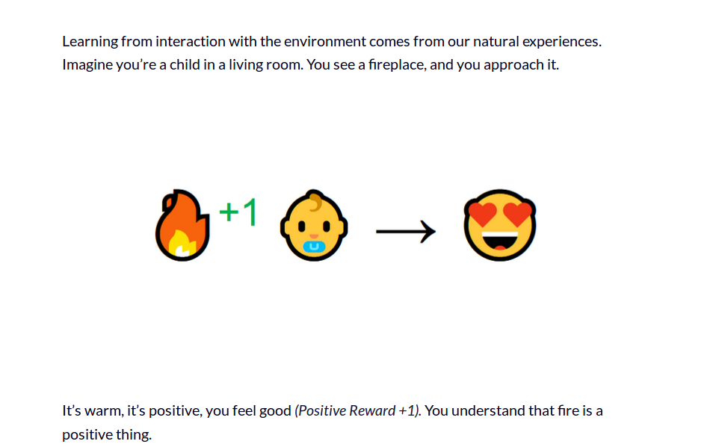
Example

Slide 11
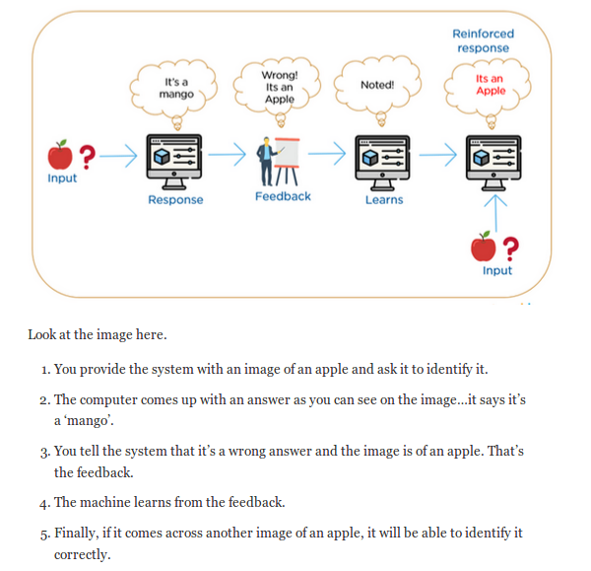

Slide 12

problem statement: To reach the Omega and kill it, where Cage is an agent who interacts with the environment (which is the whole surrounding where Cage is) through his actions (Cage’s activities) and receives a reward (finding a lead to get closer to Omega’s location) in return.
He learns from the outcomes of his actions (by trial and error) further select his actions that maximizes his reward accumulated over time

