Slide 1
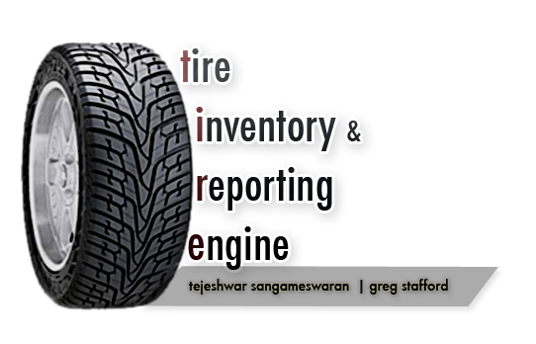

Slide 2

PROBLEMS FACED
currently there exist no way to uniquely identify tires.
tire theft.
cost associated with tire warranties.
detecting pressure in 18 wheels on a semi is a strenuous task.
ill-judged pressure in tires result in decreased fuel efficiency.
also poses a safety hazard.

Slide 3
OBJECTIVES
to embed a customized RFID based tag within the tires.
these tags will be used for identification and diagnosis.
will facilitate in uniquely identifying tires.
will aggregate information about tire (eg. tire pressure, etc)
collect data from tags, and broadcast to repository.
this data will be used by the core data processing engine to analyze and efficiently manage thousands of tires.

Slide 4
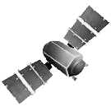



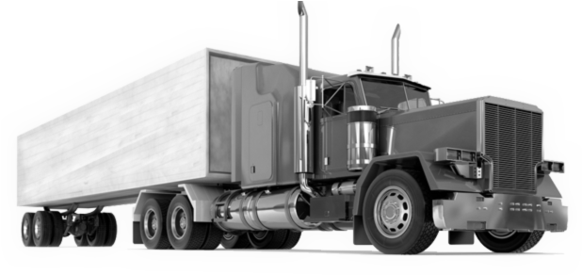
Design flow
Received data from thousands of trucks and beams it back to base.
RFID tag aggregates data.
this data is beamed through via a satellite link.
[-] Server continuously tracks:
- status of tires
- position of truck
- fuel in truck
[-] Gives holistic viewing and
querying of all data
[-] Allows optimum efficiency in fuel
and safety.

Slide 5
Technology
Satellite
- Data processing engine
- Inventory Management
- Reporting Services
- RFID Tags
- Pressure Sensors
- On-board RFID Readers
- Satellite transmitter / GPS

Slide 6
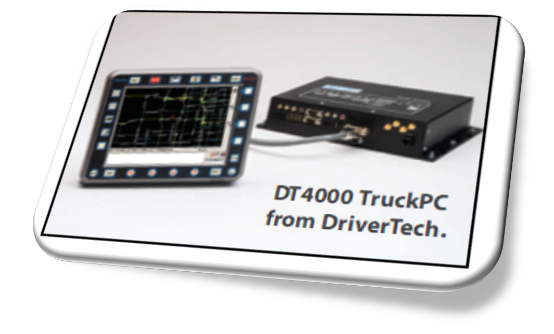
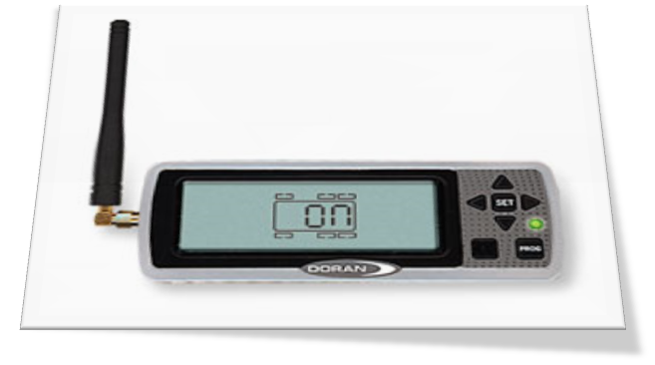
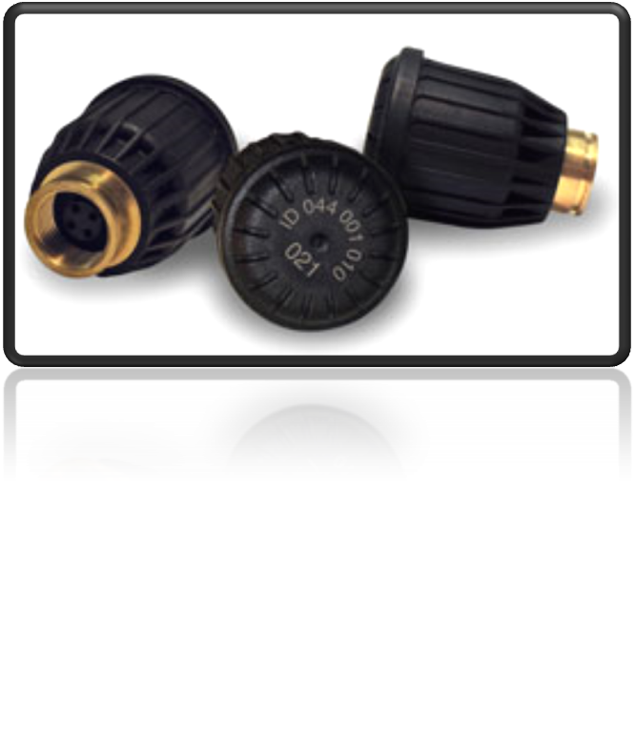
Technology in Use

Slide 7
APPROACH
research current solutions and modern technology.
devise design patterns to store and process large amounts of data.
devise algorithms for optimum maintenance and inventory of tires.
develop software first under simulated hardware.
analyze cost and benefits.
build hardware based on simulated hardware prototype. (RFID, Pressure Sensors)

Slide 8
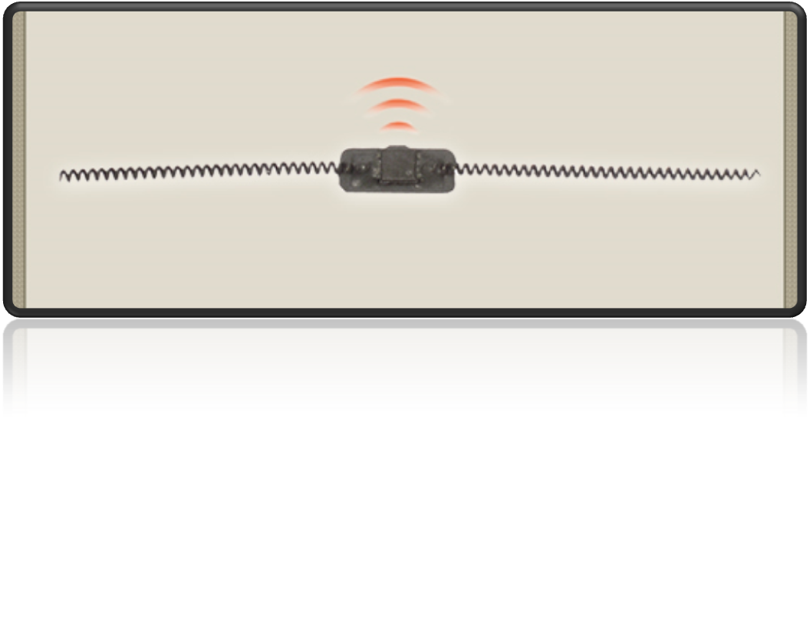
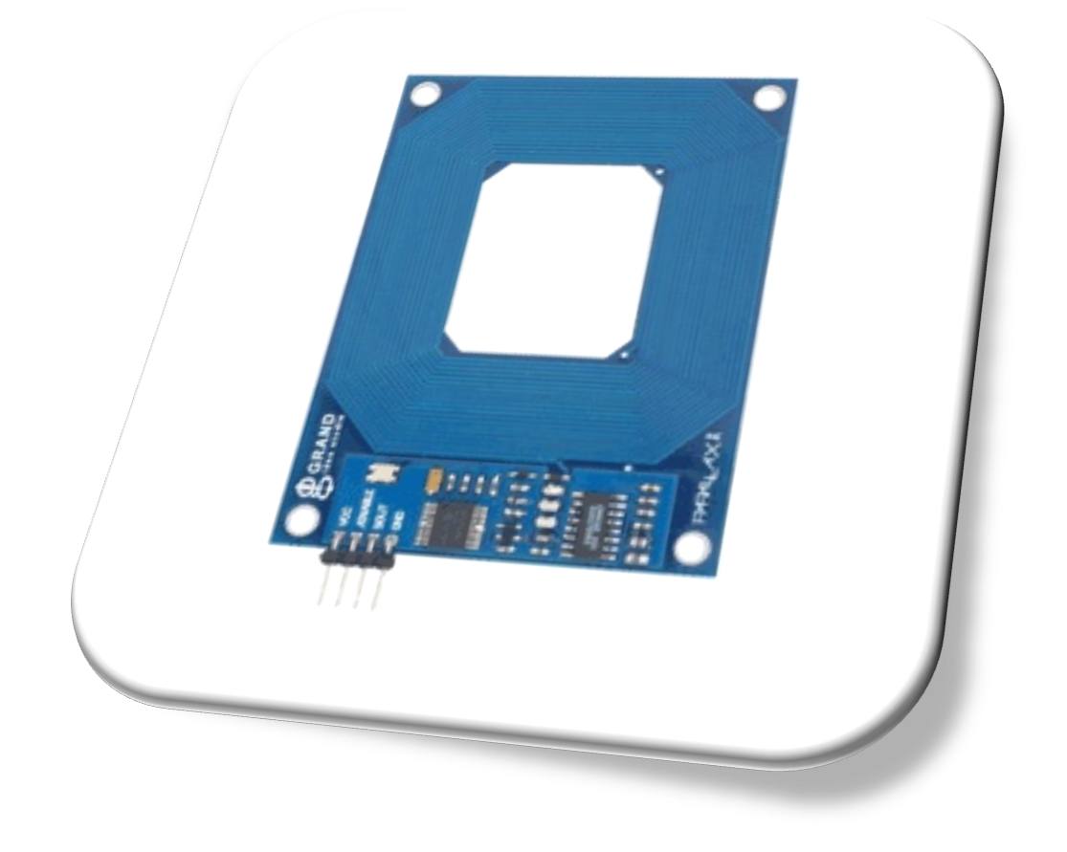

IMPLEMENTATION

Slide 9
RISKS
information received from hardware is not reliable enough for practical use
cost for hardware may be too excessive
may be too time consuming to retrofit into the current industry

