Slide 1

Common Linux Ubuntu Commands Overview
Prepared by: Ameer Sameer Hamood
University of Babylon - Iraq
Information Technology - Information Networks

Slide 2
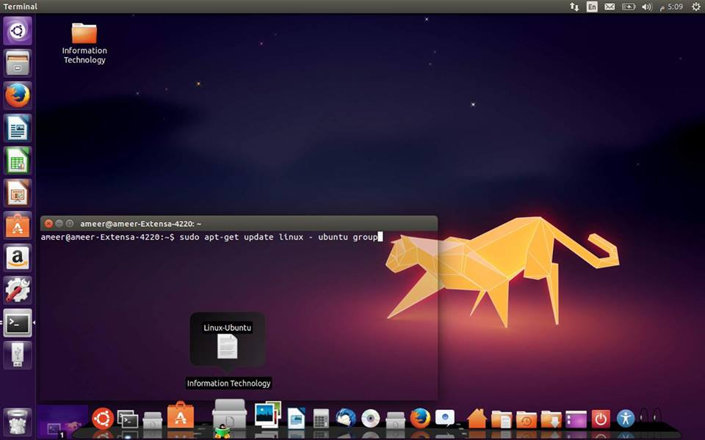


Slide 3
System Information
pwd
Print working directory, i.e., display the name of my current directory on the screen.
hostname
Print the name of the local host (the machine on which you are working). Use netconf (as root) to change the name of the machine.
id username
Print user id (uid) and his/her group id (gid), effective id (if different than the real id) and the supplementary groups.
date
Print or change the operating system date and time. E.g., I could change the date and time to 2000-12-31 23:57 using this command:
date 123123572000
To set the hardware (BIOS) clock from the system (Linux) clock, use the command (as root) setclock

Slide 4
System Information
who
Determine the users logged on the machine.
finger user_name
System info about a user. Try: finger root . displays the user's login name, real name, terminal name and write status (as a ``*'' after the terminal name if write permission is denied), idle time, login time, office location .
history | more
Show the last (1000 or so) commands executed from the command line on the current account. The "| more" causes the display to stop after each screenful.

Slide 5
Basic operations
any_command --help |more
Display a brief help on a command (works with most commands). "--help" works similar to DOS "/h" switch. The "more" pipe is needed if the output is longer than one screen.
man topic
Display the contents of the system manual pages (help) on the topic.
Info topic
information pages, which are generally more in-depth than man pages.

Slide 6
List Command
ls - Short listing of directory contents
-a list hidden files
-d list the name of the current directory
-F show directories with a trailing '/'
executable files with a trailing '*'
-g show group ownership of file in long listing
-i print the inode number of each file
-l long listing giving details about files and directories
-R list all subdirectories encountered
-t sort by time modified instead of name

Slide 7
Copy files
cp file1 file2
or
cp myfile yourfile
Copy the files "myfile" to the file "yourfile" in the current working directory. This command will create the file "yourfile" if it doesn't exist. It will normally overwrite it without warning if it exists.
cp -i myfile yourfile
With the "-i" option, if the file "yourfile" exists, you will be prompted before it is overwritten.
mv source destination
Move or rename files. The same command is used for moving and renaming files and directories. Ex: mv testdir newnamedir

Slide 8
Copy files
rm files
Remove (delete) files. You must own the file in order to be able to remove it. On many systems, you will be asked or confirmation of deleation, if you don't want this, use the "-f" (=force) option, e.g., rm -f * will remove all files in my current working directory, no questions asked.
mkdir directory
Make a new directory.
rmdir directory
Remove an empty directory.
rm -r files
(recursive remove) Remove files, directories, and their subdirectories. Careful with this command as root--you can easily remove all files on the system with such a command executed on the top of your directory tree, and there is no undelete in Linux (yet). But if you really wanted to do it (reconsider), here is how (as root): rm -rf /*

Slide 9
Copy files
cat filename
View the content of a text file called "filename"
find / -name filename
Find the file called "filename" on your file system starting the search from the root directory "/". The "filename" may contain wildcards (*,?).ex: find / -name "file.text"
locate filename
Find the file name of which contains the string "filename". Easier and faster than the previous command but depends on a database that normally rebuilds at night.

Slide 10
Basic Administration Commands
adduser user_name
Create a new account (you must be root). E.g., adduser barbara Don't forget to set up the password for the new user in the next step. The user home directory is /home/user_name.
useradd user_name
The same as the command " adduser user_name ".
userdel user_name
Remove an account (you must be a root). The user's home directory and the undelivered mail must be dealt with separately (manually because you have to decide what to do with the files).
groupadd group_name
Create a new group on your system. Non-essential but can be handy even on a home machine with a small number of users.
passwd user_name
Change the password on your current account. If you are root, you can change the password for any user using: passwd user_name

Slide 11
Permissions
File Permissions
chmod perm filename
chmod command sets the permission of a file or folder. chmod command uses three digit code as an argument and the file or folder location.
In the example,
7 – Owner(current user)
5 – Group(set by owner)
4 – anyone else
The fundamental concept:
Execute is 1, Write is 2 and Read is 4.

Slide 12
Permissions
Sum of these basic ones makes combination of permissions:
0 – no permission, this person cannot read, write or execute
1 – execute only
2 – write only
3 – execute and write only (1 + 2)
4 – read only
5 – execute and read only (1 + 4)
6 – write and read only (2 + 4)
7 – execute, write and read (1 + 2 + 4)

Slide 13
Account Permissions
examples:
sudo useradd -m -s /bin/bash user_Name
explain: -s User's login shell (default /bin/bash)
-m Create the home directory
-M Do not create the home directory
2- sudo passwd user_Name
3- unlock
sudo passwd -u user_Name
4- Add Full Name
sudo usermod -c "Full Name" user_Name

Slide 14
Account Permissions
5- add group
sudo groupadd group_Name
add user to group
sudo usermod -G group_Name user_Name
6- Delete a user
userdel -r user_Name
id Print user and group id's

Slide 15
Pipe
The pipe allows us to change this paradigm, whereby the output of one program becomes the input of another program.
Example1 :
I would do that by using the | character — which is called, appropriately enough, the pipe — as follows:
$ ls -l | less
This tells BASH to do the following:
1-Execute the ls command, with the parameter -l as input
2-Take the results of executing that command — the output — and pass them as input to the less command
3-Send the output of the less command to the monitor as usual

Slide 16
Pipe
Example2 :
$ ls -l | grep 'init' | less
List all of the files, using the -l option
Search the results of that file listing for the string init
Send the results of that search to less

Slide 17
Redirection
Redirection is similar to pipes except using files rather than another program. The standard output for a program is the screen. Using the > (greater than) symbol the output of a program can be sent to a file. Here is a directory listing of /dev again but this time redirected to a file called listing.txt
ls -la > listing.txt
There won’t be anything displayed on the terminal as everything was sent to the file. You can take a look at the file using the cat command (which can be piped into more) or for convenience you can just use the more command on its own:
more listing.txt
If listing.txt had already existed, it will be overwritten. But you can append to an existing file using >> like this:
ls -la /home > listing.txt
ls -la /dev >> listing.txt

Slide 18
Search Command
Grep command
How do I use grep with other commands?
The syntax is:
command | grep 'search-pattern'
command1 | command2 | grep 'search-pattern'
In this example, run ls command and search for the string/pattern called resume.pdf:
ls | grep resume.pdf
ls -l | grep resumd.pdf
ls -l *.mov | grep 'birthday'
ls -l *.mov | grep -i 'birthday'

Slide 19
Find Command
The Linux Find Command is one of the most important and much used command in Linux systems. Find command used to search and locate list of files and directories based on conditions you specify for files that match the arguments. Find can be used in variety of conditions like you can find files by permissions, users, groups, file type, date, size and other possible criteria
Example1
Find all the files whose name is tecmint.txt in a current working directory.
# find . -name tecmint.txt.
Find all php files in a directory.
Example 2:
# find . -type f -name "*.php"
./tecmint.php
./login.php
./index.php

Slide 20
Network
ping Test a network connection
ping user_Name
ets…..
Nmap ("Network Mapper") is an open source tool for network exploration and security auditing.
sudo apt-get install nmap
To quickly identify all available Ethernet interfaces, you can use the ifconfig command as shown below.
ifconfig -a | grep eth
eth0 Link encap:Ethernet HWaddr 00:15:c5:4a:16:5a
ethtool is a program that displays and changes Ethernet card settings such as auto-negotiation, port speed, duplex mode, and Wake-on-LAN. It is not installed by default, but is available for installation in the repositories.

Slide 21
Network
sudo apt-get install ethtool
The following is an example of how to view supported features and configured settings of an Ethernet interface.
sudo ethtool eth0
To temporarily configure an IP address, you can use the ifconfig command in the following manner. Just modify the IP address and subnet mask to match your network requirements.
sudo ifconfig eth0 10.0.0.100 netmask 255.255.255.0
To verify the IP address configuration of eth0, you can use the ifconfig command in the following manner.
ifconfig eth0
To verify your default gateway configuration, you can use the route command in the following manner.
route –n
Display Information of All Network Interfaces

Slide 22
Network
ifconfig eth0
To verify your default gateway configuration, you can use the route command in the following manner.
route –n
Display Information of All Network Interfaces
ifconfig –a
How to Disable an Network Interface
ifconfig eth0 down
OR
ifdown eth0
How to Assign a IP Address to Network Interface
ifconfig eth0 172.16.25.125

Slide 23
Tcpdump Commands – A Network Sniffer Tool
tcpdump is a most powerful and widely used command-line packets sniffer or package analyzer tool which is used to capture or filter TCP/IP packets that received or transferred over a network on a specific interface.
How to Install tcpdump in Linux
Many of Linux distributions already shipped with tcpdump tool, if in case you don’t have it on systems, you can install it using following Yum command.
# yum install tcpdump
1. Capture Packets from Specific Interface
tcpdump -i eth0

Slide 24
Tcpdump Commands – A Network Sniffer Tool
2. Capture Only N Number of Packets
tcpdump -c 5 -i eth0
3. Display Available Interfaces
tcpdump -D
4.Capture IP address Packets
tcpdump -n -i eth0
5. Capture only TCP Packets.
tcpdump -i eth0 tcp
6. Capture Packets from source IP
tcpdump -i eth0 src 192.168.0.2
7. Capture Packets from destination IP
tcpdump -i eth0 dst 50.116.66.139

Slide 25
install , remove App in linux
1- install :
sudo apt-get install Package_Name
2- remove :
apt-get remove package_Name
To remove any unused packages, use the “autoremove” command, as shown in the following command.
sudo apt-get autoremove
You can combine the two commands for removing a program and removing dependencies that are no longer being used into one, as shown below (again, two dashes before “auto-remove”).
sudo apt-get purge --auto-remove gimp
If you’re short on space, you can use the “clean” command to remove downloaded archive files, as shown below.
sudo apt-get clean

Slide 26
print
echo Display message on screen •

Slide 27
File Compression
gzip Compress files
(GNU Zip)
compress Compress files (Unix)
bzip2 Compress files (BZip2)
zip Compress files
(Windows Zip)

Slide 28
Disks and Filesystems
df Show free disk space
mount Make a disk accessible
fsck Check a disk for errors
sync Flush disk caches

Slide 29
Backups and Remote Storage
mt Control a tape drive
dump Back up a disk
restore Restore a dump
tar Read/write tape archives
cdrecord Burn a CD
rsync Mirror a set of files

Slide 30
File Properties
stat Display file attributes
wc Count bytes/words/lines
du Measure disk usage
file Identify file types
touch Change file timestamps
chown Change file owner
chgrp Change file group
chmod Change file protections
chattr Change advanced file
attributes
lsattr List advanced file
attributes

Slide 31
File Viewing
cat View files
less Page through files
head View file beginning
tail View file ending
nl Number lines
od View binary data
xxd View binary data
gv View Postscript/PDF files
xdvi View TeX DVI files

Slide 32
File Location
find Locate files
slocate Locate files via index
which Locate commands
whereis Locate standard files

Slide 33
File/Directory Basics
ls List files
cp Copy files
mv Rename files
rm Delete files
ln Link files
cd Change directory
pwd Print current directory
name
mkdir Create directory
rmdir Delete directory

Slide 34
Printing
lpr Print files
lpq View print queue
lprm Remove print jobs

Slide 35
Spelling Operations
look Look up spelling
aspell Check spelling
interactively
spell Check spelling in batch

Slide 36
Processes
ps List all processes
w List users’ processes
uptime View the system load
top Monitor processes
xload Monitor system load
free Display free memory
kill Terminate processes
nice Set process priorities
renice Change process priorities

Slide 37
Scheduling Jobs
sleep Wait for some time
watch Run programs at set
intervals
at Schedule a job
crontab Schedule repeated jobs

Slide 38
Hosts
uname Print system information
hostname Print the system’s
hostname
ifconfig Set/display network
information
host Look up DNS
whois Look up domain
registrants
ping Check if host is reachable
traceroute View network path to
a host

Slide 39
Audio and Video
grip Play CDs and rip MP3s
xmms Play audio files
cdparanoia Rip audio
audacity Edit audio
xcdroast Burn CDs

Slide 40

Thanks!
https://www.linkedin.com/in/ameer-sameer-452693107
https://www.facebook.com/ameer.Mee
http://www.slideshare.net/AmeerSameer
https://www.researchgate.net/profile/Ameer_Sameer

