Slide 1

Google Data Analytics Capstone Project I Topic :How Does a Bike-Share Navigate Speedy Success?
By – Tejeswar Reddy Chadivae
https://www.linkedin.com/in/tejeswar-reddy-328a19133/
https://github.com/tejeswarc333
https://www.kaggle.com/tejeswarc333

Slide 2
Background
In 2016, Cyclistic launched a successful bike-share offering. Since then, the program has grown to a fleet of 5,824 bicycles that are geo-tracked and locked into a network of 692 stations across Chicago. The bikes can be unlocked from one station and returned to any other station in the system anytime.
There are two types of cyclists, those who purchase causal tickets and those purchase annual memberships. The marketing team believes that maximizing the number of annual members will be key to future growth, rather than creating a marketing campaign that targets all-new customers, there is a very good chance to convert casual riders into members.

Slide 3
Scenario
What is the most effective marketing strategy of converting Cyclistic’s casual riders to annual memberships?
How do annual members and casual riders use Cyclistic bikes differently?

Slide 4
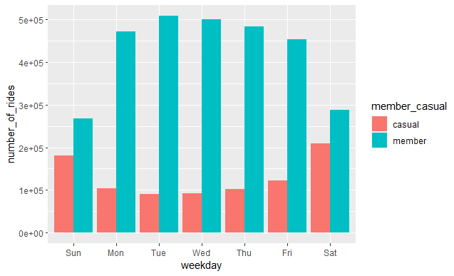
What did the data tell us : Ride per week

Slide 5
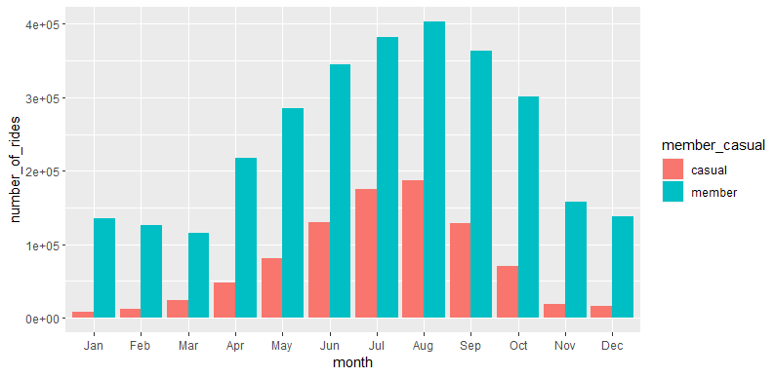
What did the data tell us : Ride per month

Slide 6
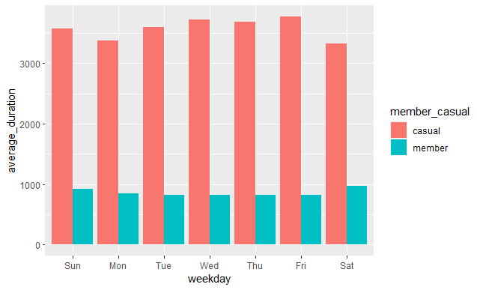
What did the data tell us : Average Duration

Slide 7
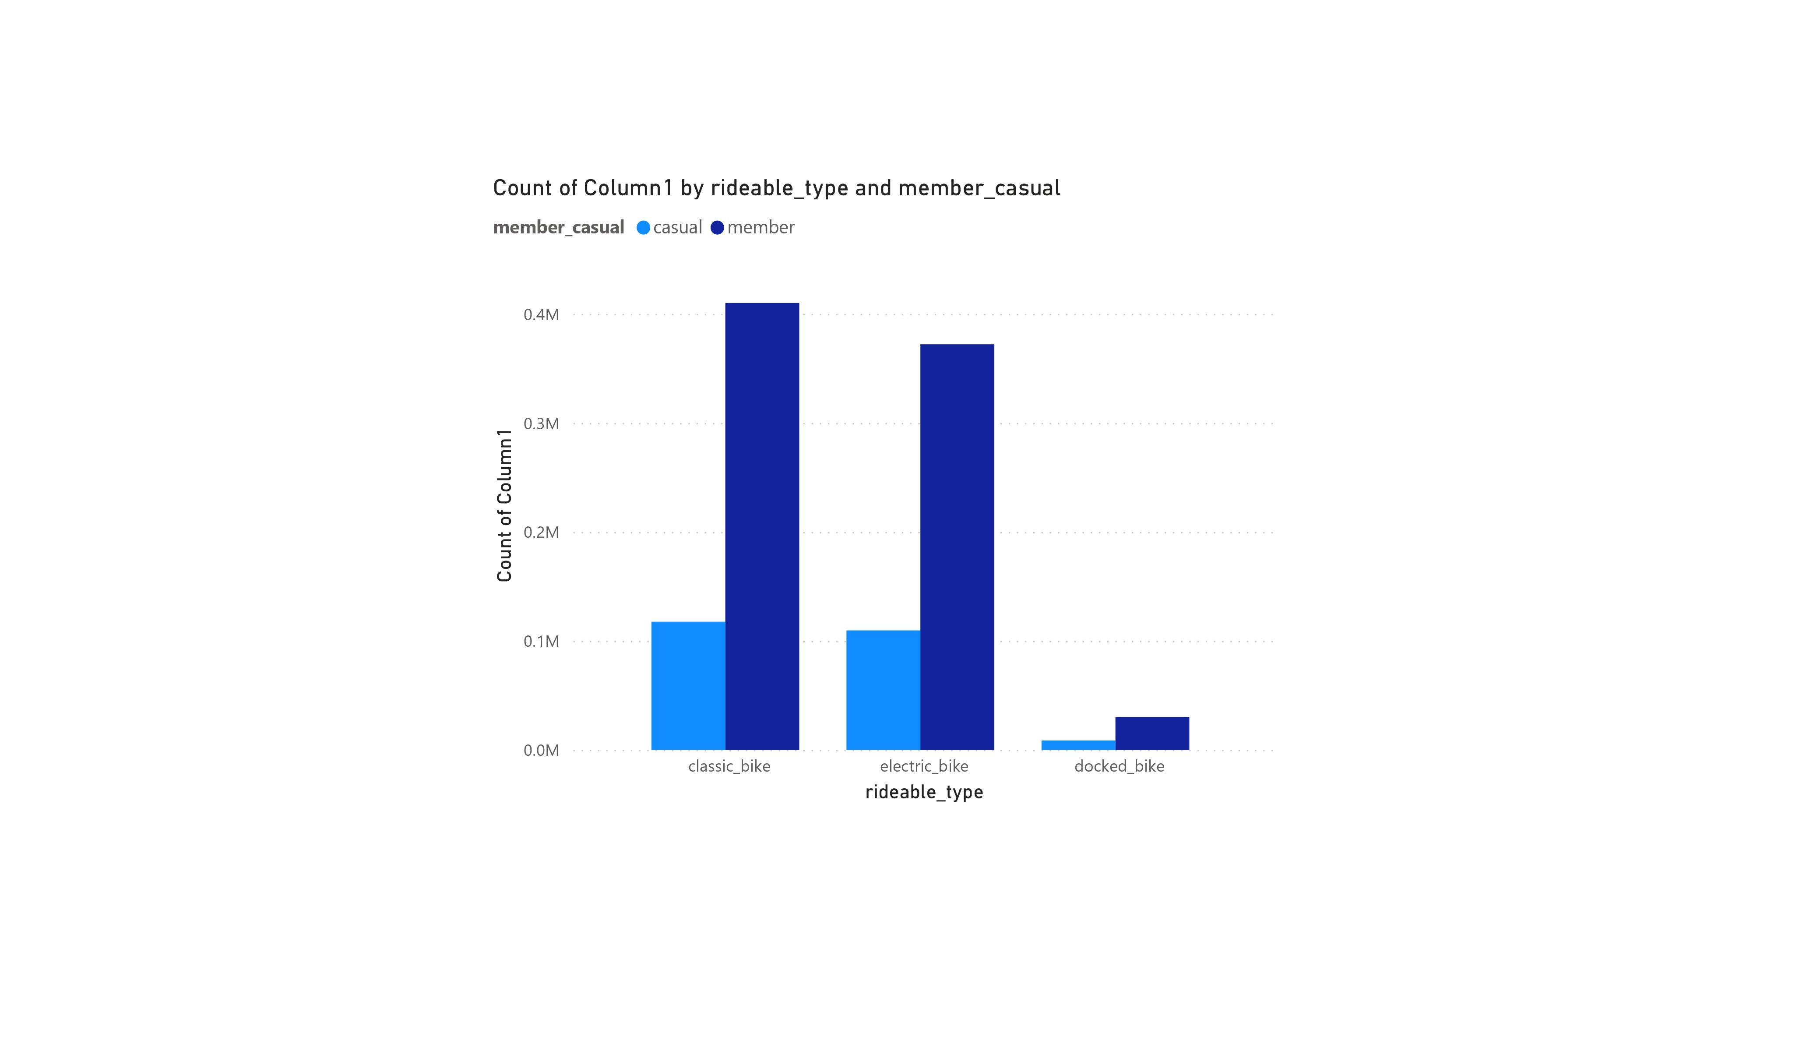
What did the data tell us : Which Bike is more popular

Slide 8
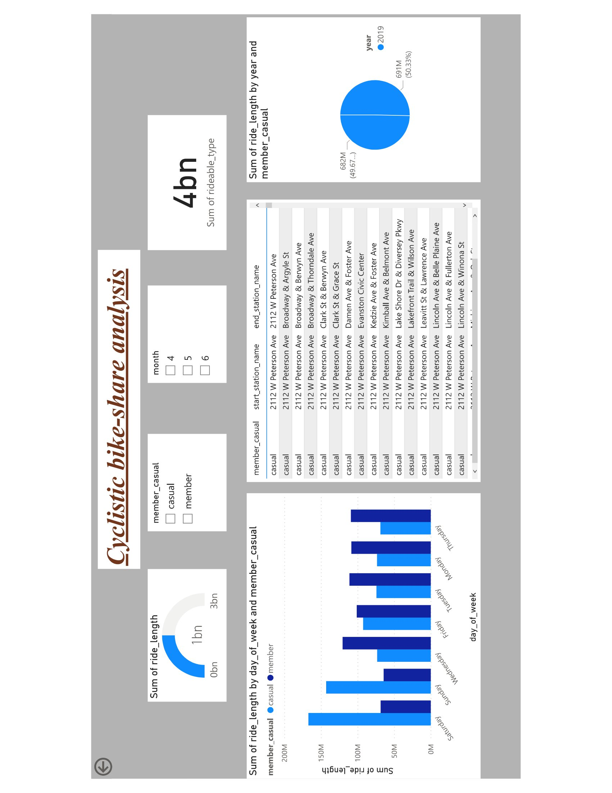
Report in PowerBI (2019)

Slide 9
Key findings: summary
Casual users tended to ride more so in the warmer months of Chicago, namely June-August. Their participation exceeded that of the long-term members.
To further that the Casual demographic spent on average a lot longer time per ride than their long-term counterparts.

Slide 10
Recommendations
Introducing plans that may be more appealing to casuals for the summer months. This marketing should be done during the winter months in preparation.
The casual users might be more interested in a membership option that allows for per-use balance card(puch card). Alternatively, the existing payment structure may be altered in order to make single-use more costly to the casual riders as well as lowering the long-term membership rate or offer a discounted promotional rate.
Membership rates specifically for the warmer months as well as for those who only ride on the weekends would assist in targeting the casual riders more specifically.

Slide 11
Things to consider
The report understands the scope of this analysis is extremely limited and because of that fact, additional data, as well as data points may have been able to contribute to this report offering an even more granular analysis.
The following are data points that could have enhanced the report:
Age and gender: This would add a dynamic to whether customer are being targeted across demographic lines. Is the existing market effective? Is there potential for more inclusive targeting?
Pricing structure: The actual pricing plans data was not provided and would give further insight to which plans are the most popular and by(how much) when comparing them. It would also be effective to understanding the spending behavior of casual users.
Their needs and demands what motivates them

Slide 12
Things to consider
Household income data: Pinpointing the average income of the long-term members as compared to the casual counter-parts. Further analysis of what is the typical economic standing of each type of member, as well as providing the ability to understand overall sensitivity between the two membership types.

Slide 13
Sources
Data Source
https://divvy-tripdata.s3.amazonaws.com/index.html

