Slide 1
Customer search platform

Slide 2
Executive Summary
Current Challenges
Proposed Solution
Not able to Save & Resume journey
Unavailability of Customer lookup
Less conversion rate
Seamless onboarding of Customer through customer lookup & reduced journey time
Decoupled architecture on modern technology Stack using AI capabilities.
Simplified & Integrated navigation

Slide 3
Architecture principles
The architecture of the internet banking application is built upon the following design principles:
Modularity and Scalability: The application is designed to be modular, with well-defined and loosely coupled components. This allows for easy scalability, enabling the app to handle increasing user demand and accommodate future growth without compromising performance.
User-Centric Approach: The application prioritizes the user experience, ensuring that the interface is intuitive, visually appealing, and easy to navigate.
Security and Privacy: Robust security measures are to be considered to protect user data, transactions, and personal information. Strong encryption, secure authentication.
Performance Optimization: The application should be optimized for performance, ensuring fast response times and smooth user interactions.
Reliability and Fault Tolerance: The application is designed with reliability in mind, employing redundant and fault-tolerant architectures.
Integration and Interoperability: The application is designed to seamlessly integrate with various external systems and services, such as core banking system and notification services.
Extensibility and Maintainability: The application’s architecture should allow for easy extensibility and maintenance.
Analytics and Insights: The application should incorporate analytics and reporting capabilities to gather meaningful insights about user behaviour, preferences, and appication performance.

Slide 4
Architecture goals and constraints
The following non-functional requirements that affect the architectural solution have been identified:
Non-functional requirement | Description
Performance | The application should be highly responsive and able to handle large concurrent users and transactions without significant performance degradation. It should provide fast response times for actions such as account creation, Funds Transfer.
Scalability | The application should be able to scale horizontally to handle increasing demands. It should have the ability to add more servers, database resources, or other infrastructure components to accommodate the growing user base and expanding to different geographics without impacting performance.
Reliability and Availability | The application should be reliable and available to users at all times. It should have minimal downtime to ensure uninterrupted service
Disaster Recovery | The application should have proper disaster recovery and backup mechanisms in place to ensure data integrity and the ability to recover from system failures or disasters.

Slide 5
Architecture style
The application will be constructed using a Microservices and Event-Based architecture, which provides several advantages, including enhanced scalability, flexibility, and maintainability. It emphasizes the concept of loose coupling and independence among the microservices, enabling their individual development, and scalability.
The architecture follows the microservices style, where the application is decomposed into a set of small, autonomous services that can be developed, deployed, and scaled independently. Microservices are designed based on functional domain and data boundaries to mitigate the single point of failure.
Microservices are designed based on functional domain and data boundaries to mitigate the single point of failure. Each subdomain corresponds to a bounded context and can be implemented as an individual micro service.
The communication mechanism between these services is event-driven, where events are used as the primary means of decoupled interaction, allowing services to react to changes or trigger actions asynchronously.
Microservices:
Search Platform Customer Indexing Pipeline
Search Platform Customer Search Service
Event bus architecture will be used for communication between services asynchronously wherever required through events and WebSocket's subscribing to events.
API Composition will be used from API Gateway an aggregator service that composes data from multiple microservices by making individual API calls to each service and aggregating the responses.

Slide 6
Proposed technology stack
Frontend Layer
Technology: React.js
Rationale: Library for building user interfaces, SPAs. component-based architecture.
Testing: Jest, React Testing Library
Backend Layer
Technology: Python with Sentence Transformers & REST-API
Rationale: Simplifies the development of AI/ML & RESTful web services and microservices architecture.
Microservices Framework: FAST API
Rationale: For building distributed systems and microservices, offering features like, circuit breakers
Database Layer
Distributed Search platform like Open Search or Elastic Search
Rationale: NOSQL with strong support for horizontal scaling & high performance
Integration & Messaging Layer
Message Broker: Apache Kafka
Rationale: For EDA, high-throughput, fault-tolerant, and distributed messaging.
API Gateway: APIGEE
Rationale: For routing, rate limiting, and securing microservices.
DevOps and CI/CD
Version Control: Git, GitHub/GitLab
Rationale: For source code management and collaboration.
CI/CD: ADO, Jenkins, GitLab CI/CD, or GitHub Actions
Rationale: For automating builds, tests, and deployments.
Containerization: Docker
Monitoring & Logging
Logging: Dyna Trace, Splunk
Monitoring: Prometheus and Grafana
Notes:
Coordination Model:
EAO Governance Board: Includes CTO, Director of Engineering, Executive leadership and CoP leaders.
Project proposals: Business units submits project RFP’s/proposals to EAO, EAO checks the alignment, review and approves & monitor.
Project Alignment: Architects assigned to projects based on CoP expertise.
Communication Channels:
Regular Updates: Weekly status reports and monthly governance meetings.
Tools: Use of project management and collaboration tools (Jira, Confluence).
Feedback Loop:
Continuous Improvement: Regular feedback from projects and CoPs for refinement.

Slide 7
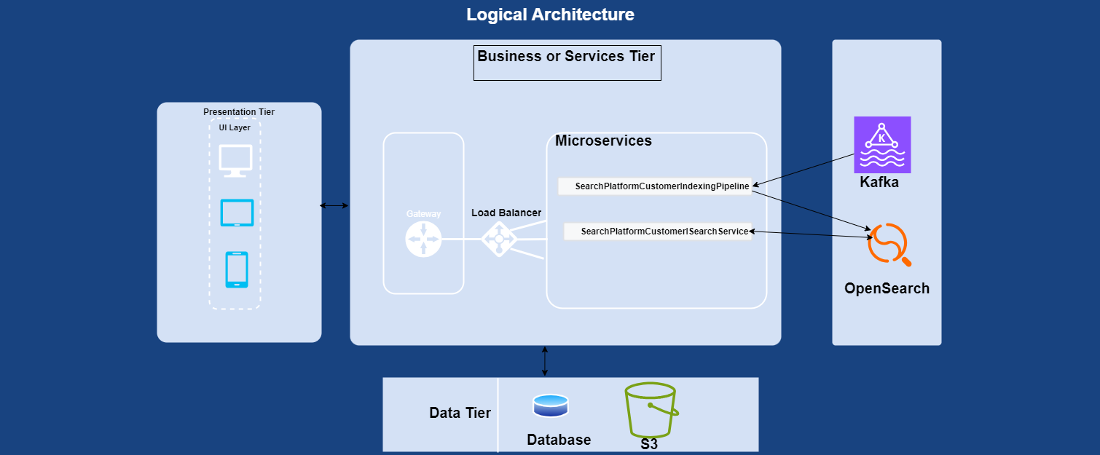
Logical view
Logical view captures the essential components, modules, and their relationships, illustrating how they work together to fulfil the system's requirements and provide the desired functionality.
The below logical architecture depicts the Components, Relationships, Interfaces, Functional Decomposition, Control Flow, Layering and Abstraction for Internet Banking Platform and how they are integrated with the Front end. All the network calls between UI and backend systems is based on HTTPS and data encryption will be enabled across the layers

Slide 8
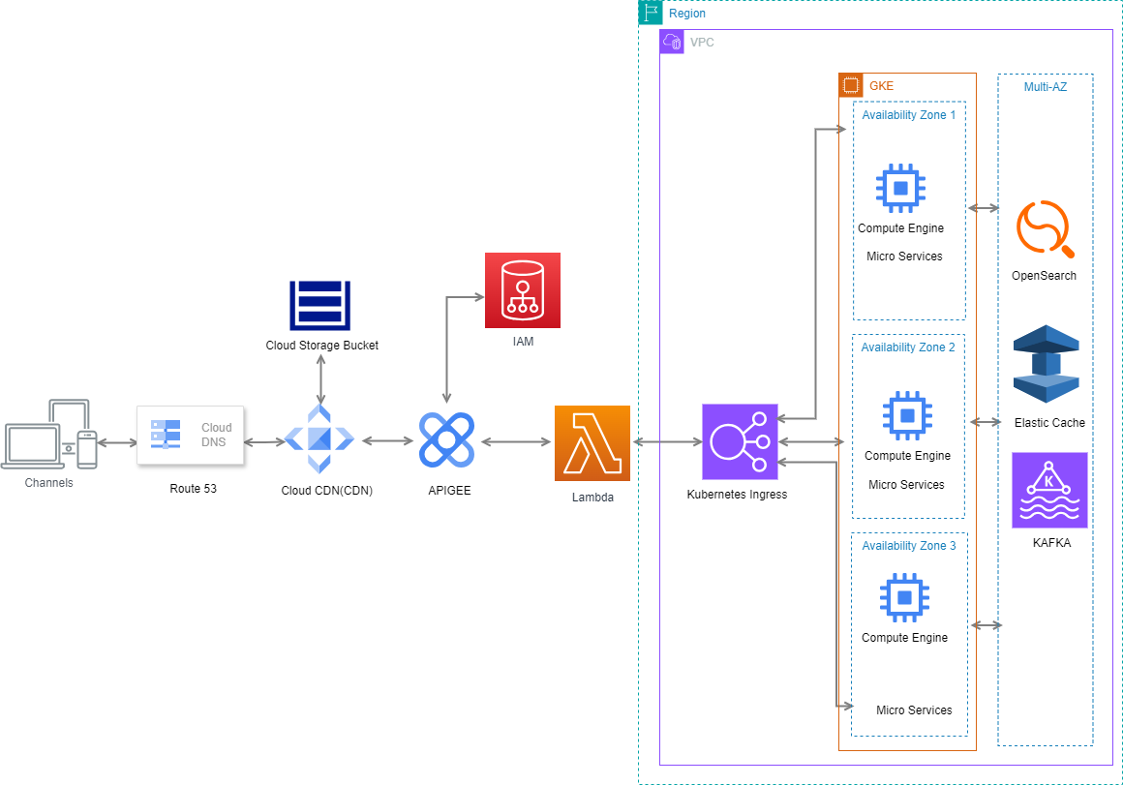
Application/Deployment Target architecture

Slide 9
Solution Architecture
Presentation Layer
API Gateway Layer
Components:
Cloud DNS: DNS service that routes user requests to CloudFront, ensuring global reach and reliability.
Amazon S3: Stores the static files of the React application (HTML, CSS, JavaScript, images, etc.).
Configured for static website hosting.
Cloud CDN CDN: CloudFront uses S3 bucket as origin for the CloudFront Distribution, retrieves and caches the content from S3 bucket.
Content Delivery Network that caches content closer to users, reducing latency and improving load times.
Responsibilities:
Route and distribute incoming requests efficiently.
All the static content , front end assets, Java script will be deployed to CDN.
Serve static content with low latency.
Components:
API Gateway: Manages API requests, performs request validation, authorization, and throttling. Acts as a unified entry point for all API calls.
Responsibilities:
Handle API request routing, rate limiting, and security.
Handles authentication and provides single sign on by calling a Lambda service which internally authenticates the user through IAM and generates Access Token & Refresh token on successful authentication
Abstract backend services and provide a unified API interface.

Slide 10
Solution Architecture
Load Balancer Layer
Service Mesh Layer
Components:
Kubernetes Ingress(ALB): Distributes incoming application traffic across multiple targets (EKS cluster) in different Availability Zones (AZs).
Responsibilities:
Ensure high availability and fault tolerance by distributing traffic across multiple AZs.
manages external access to services within a Kubernetes cluster(HTTP/HTTPS traffic)
Perform health checks and route traffic to healthy targets.
Components:
Service Mesh Control Plane: Manages configuration, policies, and observability of the service mesh.
Service Mesh Data Plane (Sidecar Proxies): Proxies deployed alongside each microservice(User Service, Account Service, Transaction Service, Notification Service) to handle service-to-service communication, traffic management, and security.
Responsibilities:
Provide traffic management, including routing, retries, and circuit breaking.
Enhance security with mutual TLS and access control policies.
Improve observability with metrics, logging, and tracing.

Slide 11
Solution Architecture
Application Layer (Microservices)
Database Layer
Components:
Search Platform Customer Indexing Pipeline: Manages Indexing of data sets in OpenSearch Cluster.
Search Platform Customer Search Service: Handles Semantic search requests from the Front end
Components:
OpenSearch: Distrubuted search platform capable of holding multiple KNN indexes and enable KNN search on the index.

Slide 12
Solution Architecture
Caching Layer
Monitoring and Logging Layer
Components:
Elastic Cache (Multi-AZ): In-memory data store used for caching frequently accessed data to reduce database load and improve response times.
Responsibilities:
Cache frequently accessed data to improve performance.
Provide fast data retrieval for read-heavy operations.
Components:
DynaTrace: Collects and tracks metrics, monitors log files, and sets alarms.
ELK Stack (Elasticsearch, Logstash, Kibana): Aggregates logs, provides search capabilities, and visualizes log data for monitoring and troubleshooting.
Responsibilities:
Monitor system performance and health.
Collect, aggregate, and analyse logs for debugging and operational insights.
Set up alarms to notify administrators of potential issues.

Slide 13
Solution Architecture
Messaging Layer
Components:
KAFKA: For delivering messages to subscribed topics for event driven communication.
Responsibilities:
Decouple microservices by providing a messaging layer for event-driven communication.
Ensure reliable delivery of messages and notifications.

Slide 14
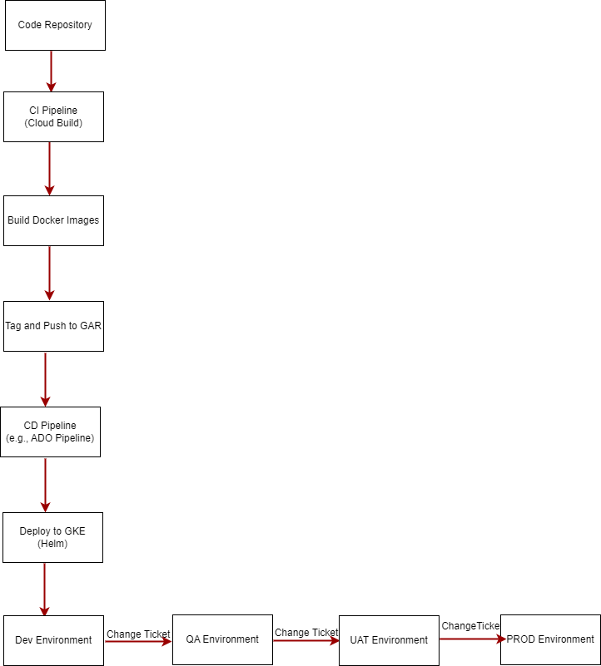
Ci/cd process
The CI/CD process automates the building, testing, and
deployment of microservices, ensuring fast and reliable
delivery of changes.
Source Code Management: GitHub or BitBucket
CI/CD Pipeline: Jenkins, Azure Dev Ops
Containerization: Docker
Infrastructure as Code: AWS CloudFormation, Terraform
Deployment: GCP GKE, Helm (for Kubernetes)
Monitoring: DynaTrace, Prometheus, Grafana
Steps:
Code Commit:Developers commit code changes to the source code repository
(e.g., GitHub).

Slide 15
Ci/cd process
Continuous Integration (CI):
Trigger Build: The CI pipeline is triggered by a code commit.
Build Docker Images: Build Docker images for the microservices.
Run Unit Tests: Execute unit tests to ensure code quality.
Static Code Analysis: Perform code analysis using tools like SonarQube .
Static Code Analysis(Security): Perform Security code analysis using tools like Fortify
White source Scan: Perform White source scan for security vulnerabilities.
Push to Container Registry:
Tag and Push: Tag the Docker images with the commit ID or version number and push them to GAR.
Continuous Deployment (CD):
Deploy to GKE: Use Helm charts to deploy or update the microservices in the GKE cluster.
Run Integration Tests: Execute integration tests to validate the deployment.
Run End-to-End Tests: Perform end-to-end tests to ensure the entire application works as expected.
Alerting:
Set Up Alerts: Configure alerts in DynaTrace or Prometheus to notify the DevOps team of any issue
Monitoring and Logging:
Monitor Deployments: Use DynaTrace and Prometheus to monitor the health and performance of the deployed microservices.
Log Aggregation: Collect and analyze logs using ELK Stack (Elasticsearch, Logstash, Kibana).
Alerting:
Set Up Alerts: Configure alerts in DynaTrace or Prometheus to notify the DevOps team of any issues.
Rollback:
Automated Rollback: In case of deployment failures, the pipeline should support automated rollback to the previous stable version using Helm.

Slide 16
Q&A

