Slide 1
Design and Characterization of Standard Cells for DSM Process
By
Ranjana.S(1AM07EC054)
Suraksha.N.Kasal(1AM07EC070)
Tara.K.K(1AM07EC072)
Tejeswini.J(1AM07EC073)

Slide 2
About this project
This project involves designing and characterizing the standard cells INVERTER1X2,NAND2X32 and D Flip-Flop2X for a 90nm CMOS process over a wide range of load, supply voltage variation and various process corners..

Slide 3
overview
Basics
Fabrication
Design flow
Project stages
Standard cells
Inverter 1x2
Simulation stages
Reasons for Characterization
Characterization Flow
Characterization Parameters
Measurement & Verification
applications
Sources & Acknowledgments

Slide 4
What is VLSI?
VLSI stands for "Very Large Scale Integration".
This is the field which involves packing more and more logic devices into smaller and smaller areas.
The advances in the world of computers has been a dramatic proliferation of tools that can be used to design VLSI circuits.
By obeying Moore's law, the capability of an IC has increased exponentially over the years, in terms of computation power, utilization of available area, yield.
The combined effect of these two advances is that people can now put diverse functionality into the IC's,

Slide 5
Continued…
The factors influencing VLSI circuits are:
Circuit Delays
Power
Layout

Slide 6
CMOS
CMOS stands for “Complementary Metal Oxide Semiconductor”.
CMOS fabrication process: In simplest terms, this refers to the sequence of steps that we use to take a bare “wafer” of silicon to the finished form of an electronic integrated circuit.
CMOS circuits are designed by creating nFETs and pFETs in silicon and then wiring them together using interconnect lines formed on the conducting layers.

Slide 7
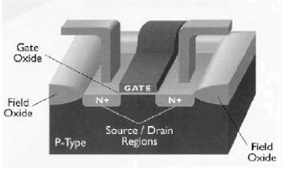

Slide 8
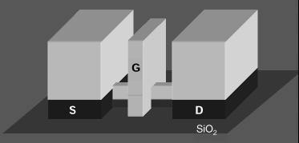
90 nm mos transistor

Slide 9
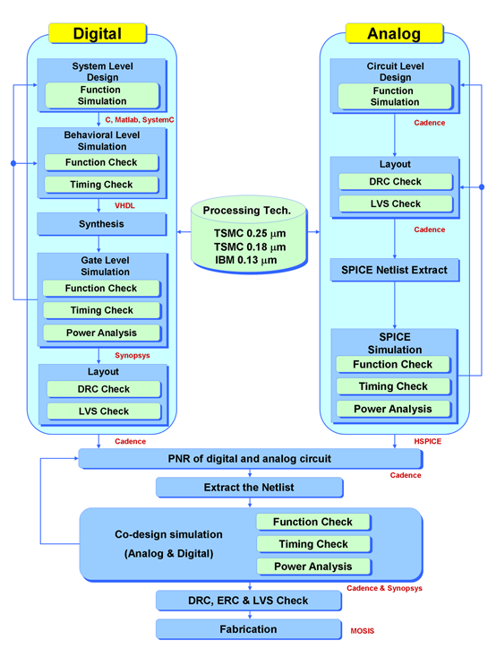

Slide 10
Project Stages
Std-Cells
INVERTER1x2
Pre-layout sim
Post-layout sim
NAND2X32
Pre-layout sim
Post-layout sim
D Flip-Flop2X
Pre-layout sim
Post-layout sim

Slide 11
What are Standard Cells?
Logic units used in Semi-custom design flow.
Pre-designed cells that have successfully completed all the checks for functionality and performance.
Example: AND,NAND,NOR,FLIP-FLOP,LATCH etc.
Come in libraries for a specific technology. Logic units of similar geometry
(same height)
– Implement basic logic (NAND,
NOR, INV, FF, LATCH,
complex gates, …)
– Usually come in libraries for a
specific technology

Slide 12
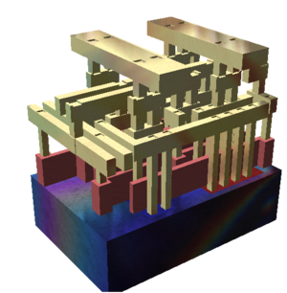
An overview of a std cell.
A rendering of a small standard cell with three metal layers (dielectric has been removed). The sand-colored structures are metal interconnect, with the vertical pillars being contacts, typically plugs of tungsten. The reddish structures are polysilicon gates, and the solid at the bottom is the crystalline silicon bulk.

Slide 13
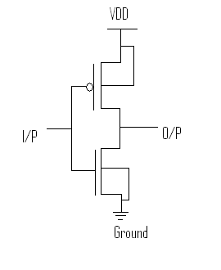
INVERTER1X2
Inv P/N ratio = µ = 2.29
nMos = l/w*2 = 0.1/0.49*2 =0.1/0.98
pMOS = l/w*µ*2 = 0.1/0.49*2.29*2 = 0.1/2.24

Slide 14
Simulation stages
Pre layout simulation
Schematic
Dumped netlist
Running the testbench
Obtain the log files.
Post layout simulation
Layout
LVS check
DRC check
Extracted netlist

Slide 15
Reasons for characterization
• is described in higher
level language (e.g. RTL)
– Description is translated in
Boolean logic and sequential
elementsUse (Flow)
– Hardware
– The logic is mapped on standard
cells
– Standard cells are placed in
rows
– Cells are properly connected by
routing channels and/or
additional metal layers Prof. P. Fischer: “Digitale Schaltungstechnik

Slide 16
Need of characterization
Problems of Standard Cells in polygon level
format (GDSII)
– Extraction of functionality is complicated and unnecessary as it
is known
– Functional/Delay simulation takes way too long
– Power extraction for a whole chip takes too long
– Automatic detection of timing constraints (e.g. Setup time) is
difficult
• Solution
– A simple model for delay, function, constraints and power on
cell/gate level => cell characterization

Slide 17
Flow of characterization
Netlist Extraction
– Transistors, resistances and capacitances are extracted with
special tools and saved as SPICE netlist (or similar)
• Specification of parameters
– Library-wide parameters have to be specified:
e.g. max Transition time, PVT-corners
• Model selection and specification
– The used models determine the required data

Slide 18
Flow of characterization
Measurement
– The cells are simulated with a SPICE-like tool to obtain the
required data
• Model Generation
– The obtained data is fed into the models
– Completes characterization itself
• Verification
– Different checks are performed to ensure the correctness of the
characterization

Slide 19
Characterization parameters
Global Parameters
– PVT Corner Selection (Process, Voltage, Temperature)
– Unit Definition (e.g. Standard Load)
– Default Definition
– Threshold values (Transition Thresholds, …)
– Limits (max. Output Load, max. Transition time, …)
– Wireload Models
Measured Transition
Time
Transition Time: Characterized
and Measured
Y
70% Vdd
30% Vdd
Y
Reported Transition
Transition Time: Time
Standardized Reporting 90% Vdd

Slide 20
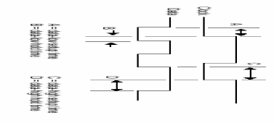
For mapping, functional simulation
– Functionality
• For optimization, delay simulation
– Area
– Power
– Timing constraints (Setup/Hold time, Recovery/Removal time)
– Propagation Delay time
– Requires:
• Input Capacitance
• Transition time
(Output Slew)

Slide 21
For Power extraction, IR-Drop analysis, EM analysis
– Dynamic Power (switching power)
– Static Power (leakage power)
– Passive power (internal power)
(power used by sequential cells (e.g. flip-flops) when inputs (clock too) change
without output change)
– Same Requirements as Delay
• For Place & Route
– Geometry (cell width)
– Pin locations
– Routing channels (metal areas not used by a cell)
and Routing obstructions (additional metal areas used by cell)

Slide 22
Measurement and verification
Simulation
– Extracted netlist is simulated with a SPICE-like tool
– Every required data point is processed (pass mill method)
– Temperature sweeps and simulations with varying element parameters
(Monte Carlo simulation) give information about result reliability
– Constraints are found by binary search
• Physical
– Creation of chip with all cells and special testing logic (see next page)
– Measurement of cells with probing tool
– E.g. INV-chain is used to measure typical delay

Slide 23
Measurement and verification
Trend Checks
– Checks if values like capacitances are in expected range
– Checks if models behave like expected
• Higher load => higher delay
• Higher input slew => higher transition time
• Higher driving strength => lower delay
• Higher temperature => higher delay
• …
• Test Designs
– Typical design is created with standard tools
– Checked for functionality and technology rule violations

Slide 24
Applications
Std cell libraries are widely an integral part of any ASIC and SOC based design.
Std cell parameters are required to analyze the timing behavior of the design.
Decides fanout complexity.
Std cell library is what enables automatic place rout in ASIC physical design.

Slide 25
Sources and acknowledgements
Pucknell and Eshraghian pages 62 - 92
Fabricius pages76 – 82

